Slide 1
Painting EF Figures
In “The 71 Vibe” Style – Part II

Slide 2
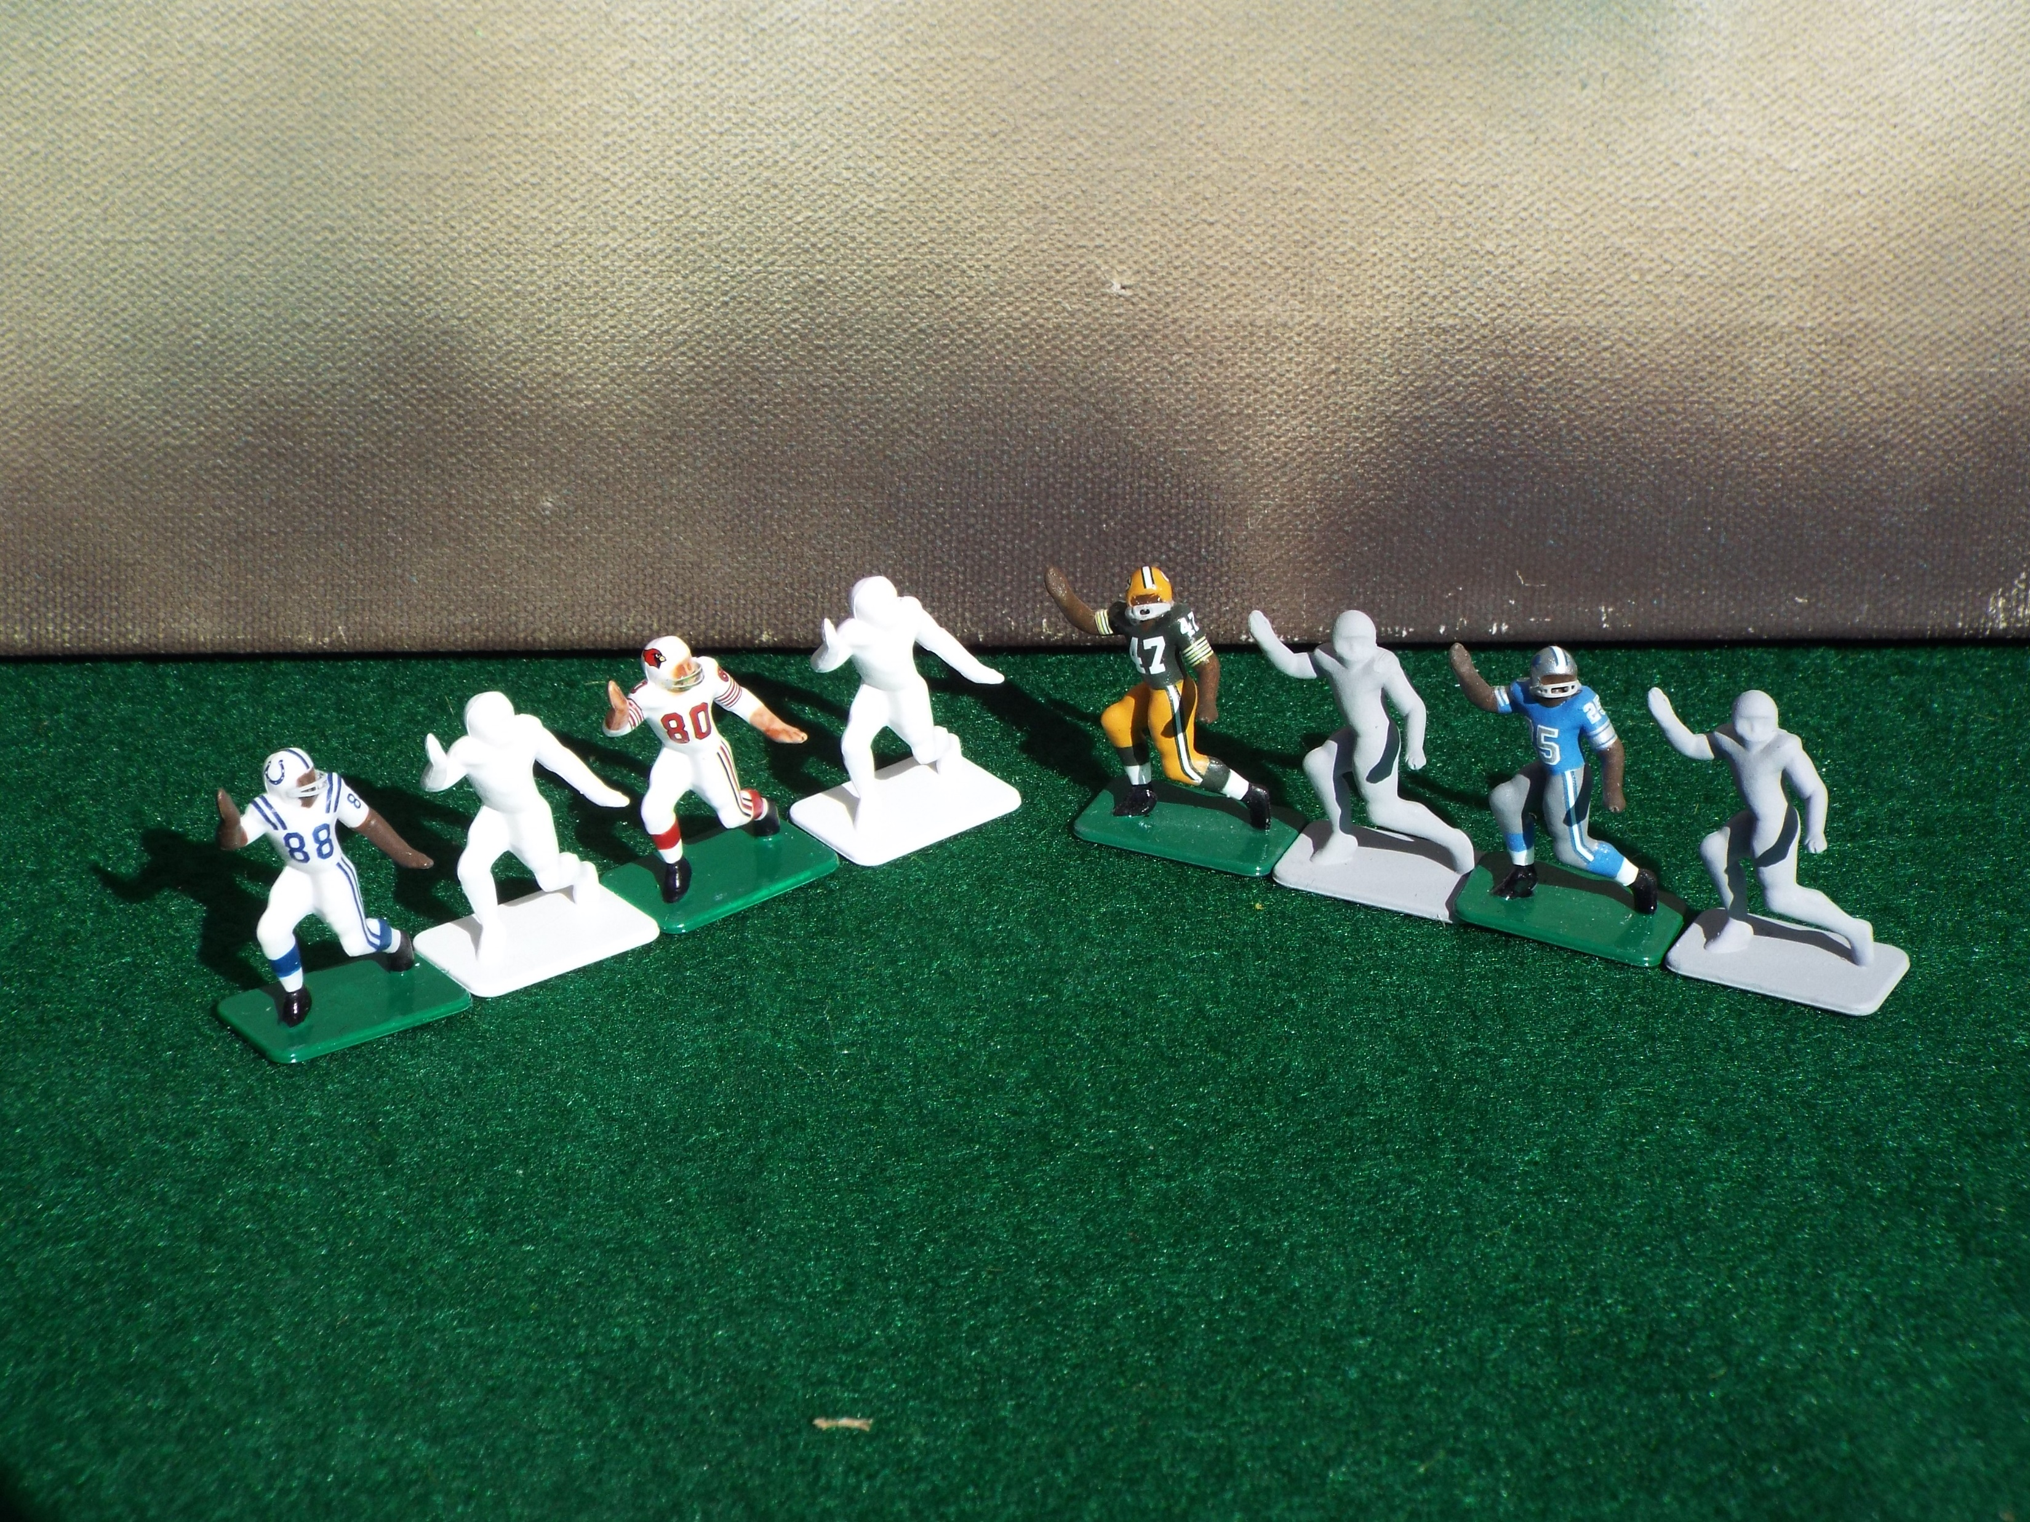
The first step in painting your figures is often the most critical when it comes to ease in painting. Using
the correct primer facilitates painting a figure properly and makes the bright colors of NFL uniforms easier
to see at this scale. Remember the three-foot rule. Most people, including you, the person running the game,
see the figure from a considerable distance. Therefore the colors must “jump from” the figure. The darker the
primer, the more difficult that is to achieve. Gray primer is the darkest I employ.

Slide 3
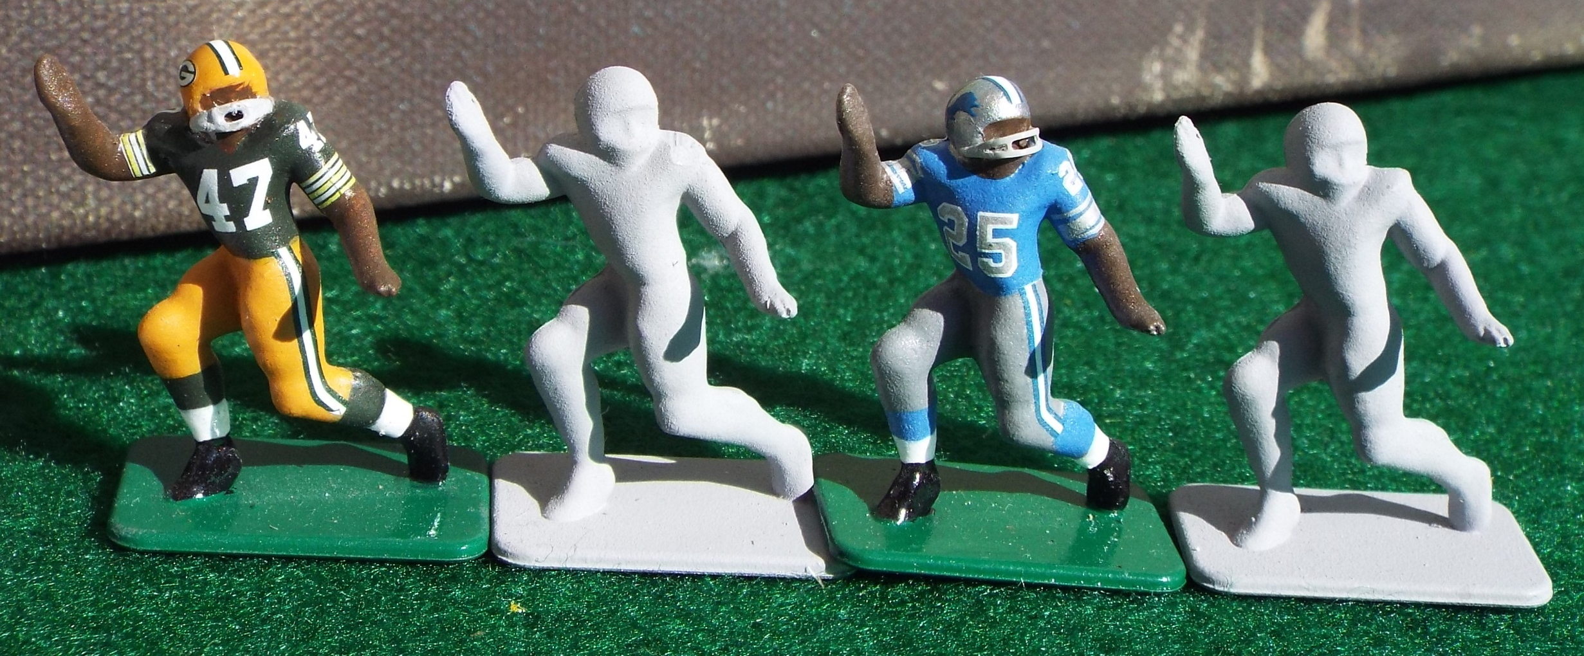
Here I have chosen eight of the mean 13 figures by Tudor. Looking at the uniforms of the Detroit Lions and Green
Bay Packers, one can see white only on the socks. Everything else is full color. I chose to use gray primer here as
it covers so easily, often requiring only two coats. The Lions uniform pants are so close to the primer color, that I
only needed a single coat there. Do yourself a favor, use high quality brushes, always remembering to use the largest
possible to do the job neatly.

Slide 4
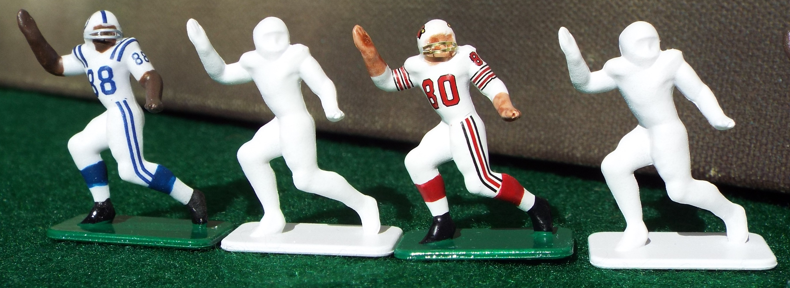
These figures received a white primer for obvious reasons. Covering white primer requires more coats of paint.
The figure base or platform required three coats. A tip here, hit any figures primed white with a light coat of matte
varnish after the primer dries. This will make covering the primer much easier. White primer also makes these figures
really pop as the colors appear much brighter.

Slide 5
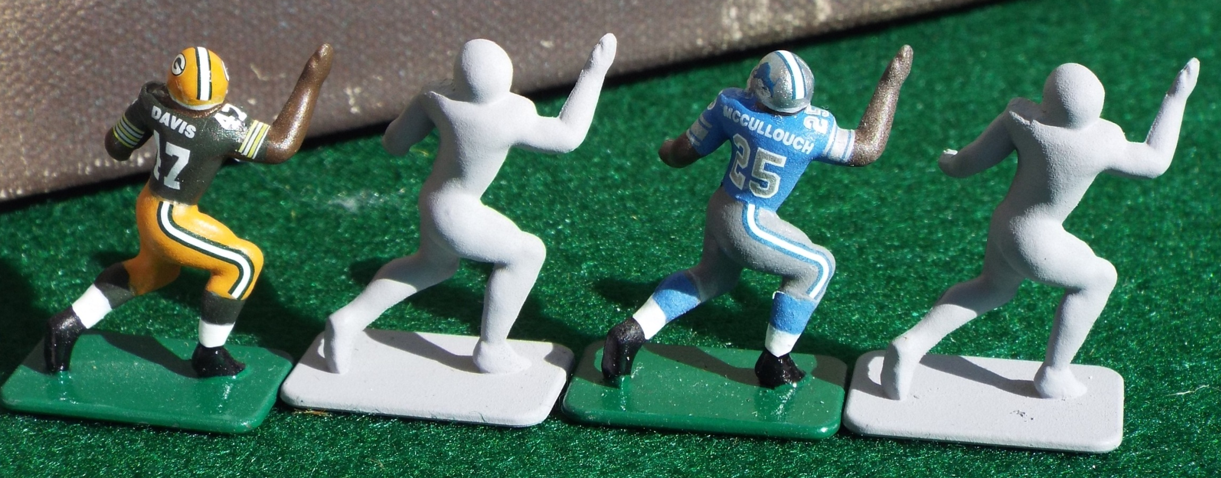
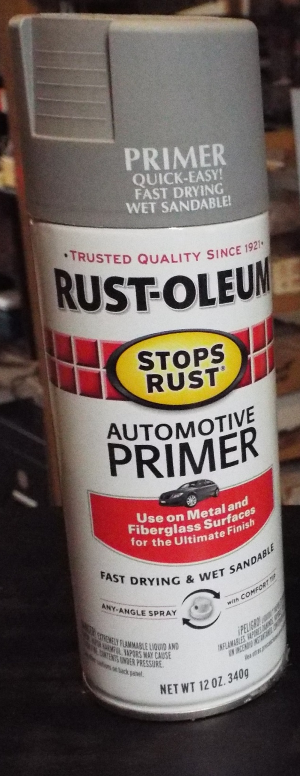
I have experimented with many gray primers. This is the best for the job. It is also among
the cheapest, which is a good thing. It is gray, but on the light side, and dries to a dead
flat finish. You can literally buy it almost anywhere. I have found it at Lowes, Home Depot and
even Wal-Mart.

Slide 6
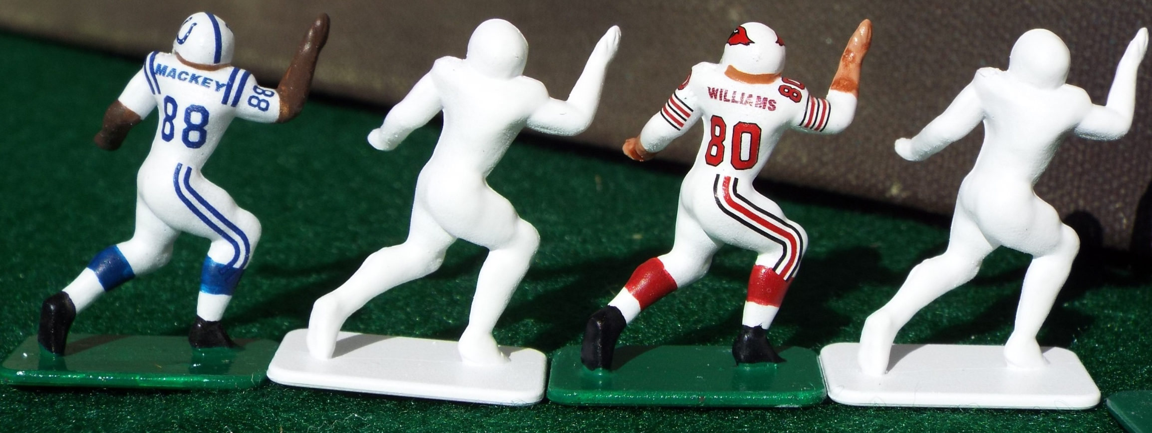

This primer is the best white primer I have found. It covers well and is a very bright white. The
downside is that it dries more of a semi-matte still having a sheen when you have covered the
entire figure. Resolve this by covering with a spray matte varnish. Army painter makes one and
it is the best I have used. Below is a link to an online hobby store where the Army Painter
brand may be found.
https://www.miniaturemarket.com/accessories/model-paints.html#/?_=1&filter.category_hierarchy=Accessories%2FModel%20Paints%2FArmy%20Painter%20Warpaints&page=1

Slide 7
In part three I will take you through my process of applying base colors to the figures, including flesh tones. I
will also show you how I prep the figures for decal application. Thanks for reading Part II.

