Slide 1
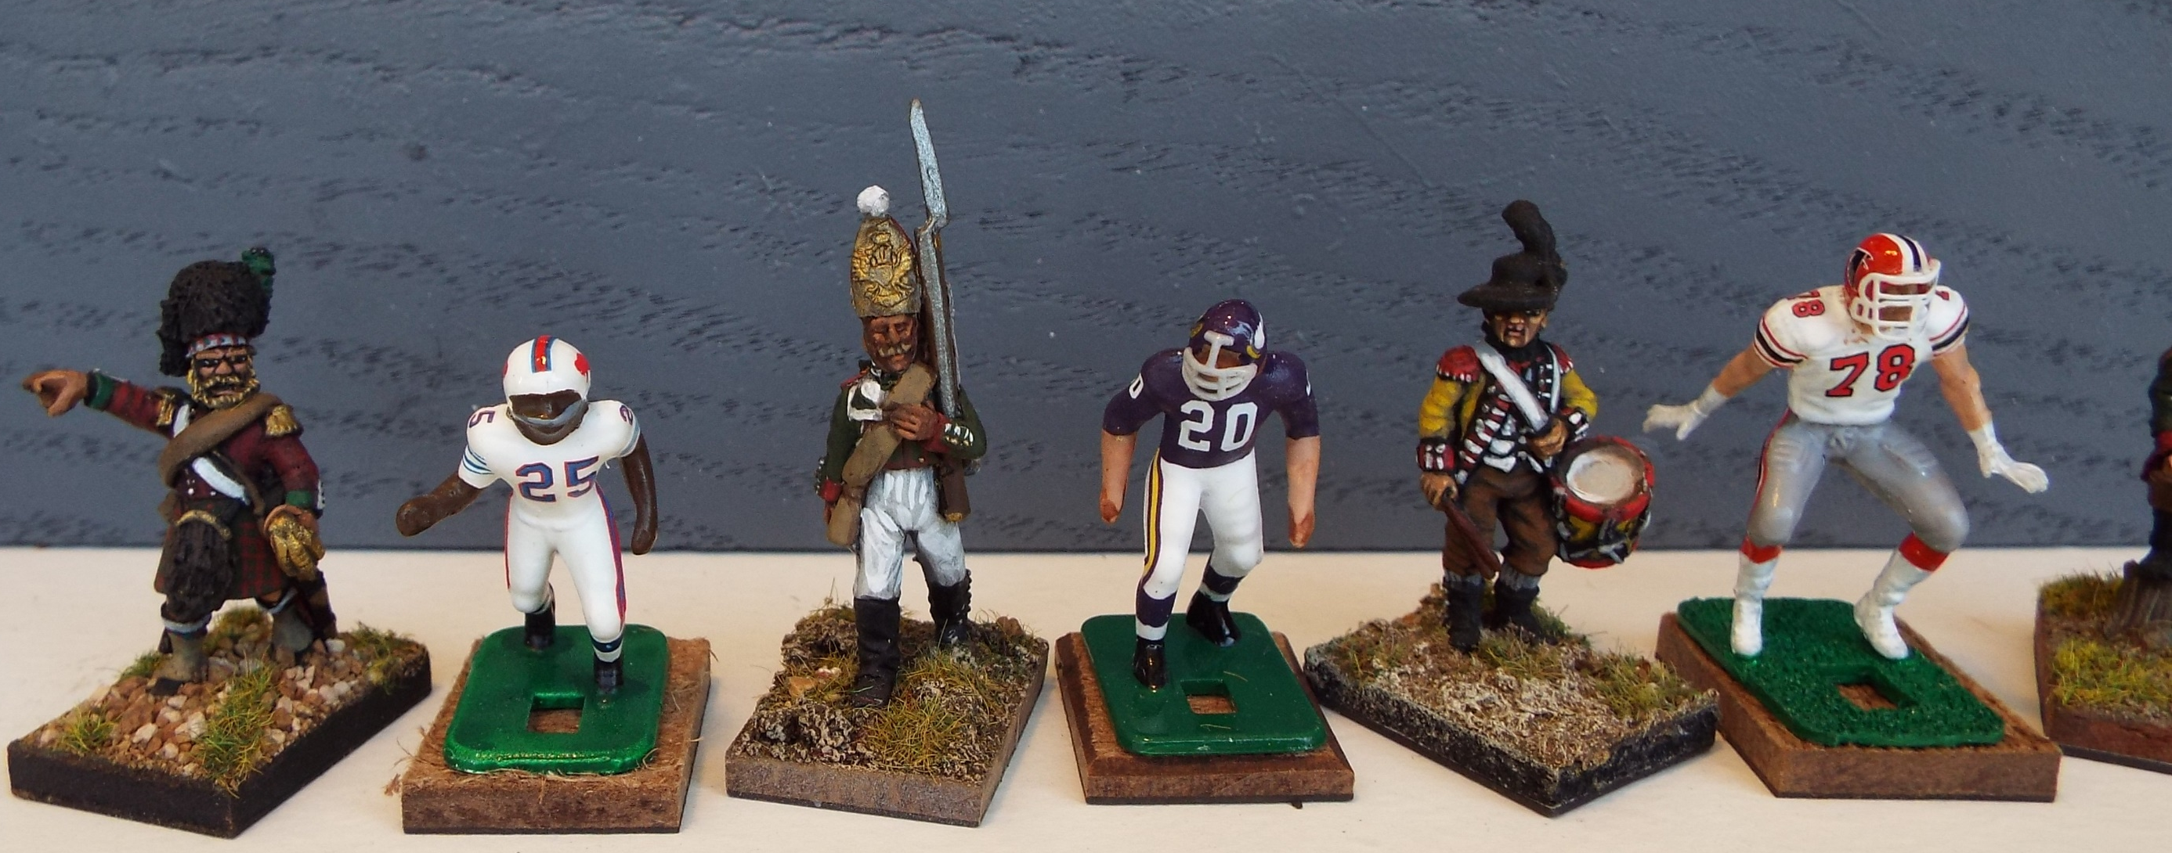
PAINTING EF FIGURES IN THE 71 VIBE STYLE: PART I
Russian Pavlov’s Grenadier
Private 1812 Russian Campaign
British Drummer
38th Regiment of Foot
North America 1781
Crimean War
British Highlander
Officer - 1853
1971 Buffalo Bills
Haven Moses
Tudor Hogleg 1972
1971 Minnesota
Vikings Bobby Bryant
Tudor Mean 13 - 2019
1983 Atlanta Falcons
Mike Kenn
Electronic Gridiron

Slide 2
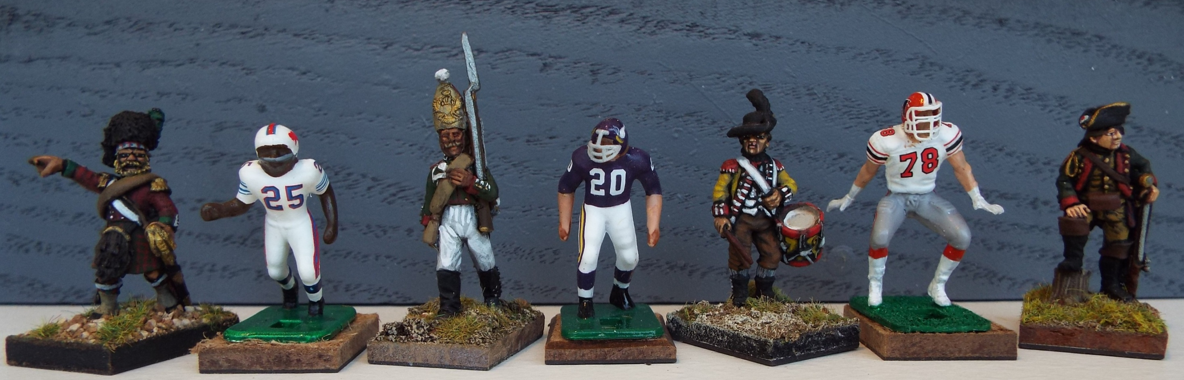
I have been asked to show a “how to” somewhere on this page by a few folks. I will do this in several parts. I want to start
by showing where my painting methods have their origins. While I first started collecting Tudor figures in the early 1970s,
my painting skills arose from my experience with painting Historical Miniatures. These are my true love, but the skills can apply
to EF figures as well. Both are of the same size range 28mm historical figures. Here are some samples below.
Captain Ewald
Hessian Jaeger
North America
1781

Slide 3
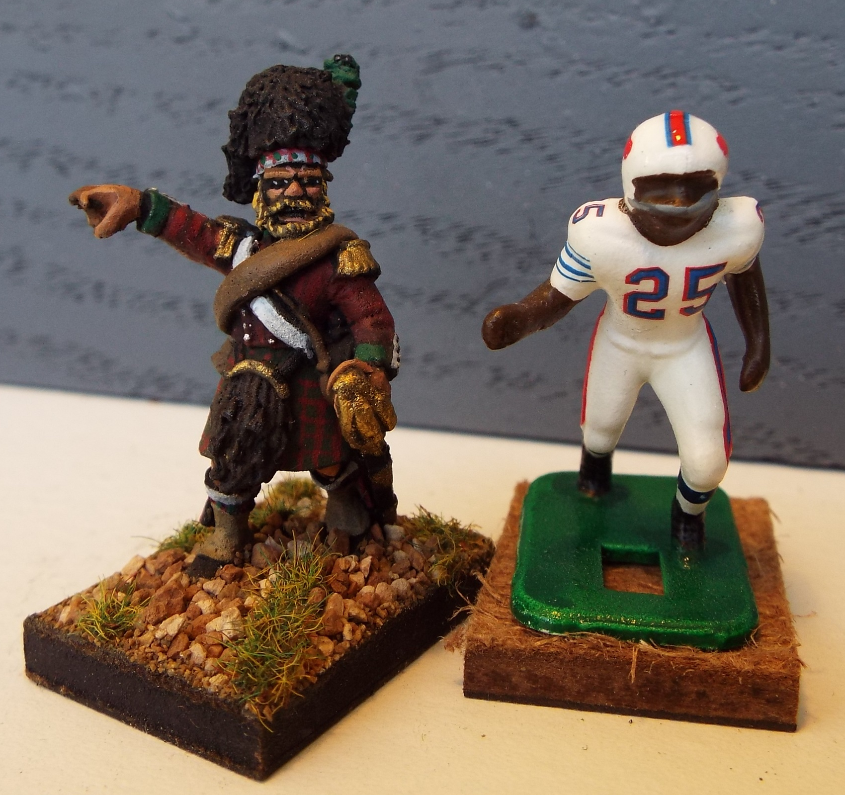
While the same size, the pewter historical figures hold much deeper detail and are much more
challenging to paint. However, the skills required to paint such a detailed figure as this highlander
Officer from the Crimean War (1853-56) benefit my painting EF Figures. You can see how much less
detail the EF figures have to paint.

Slide 4
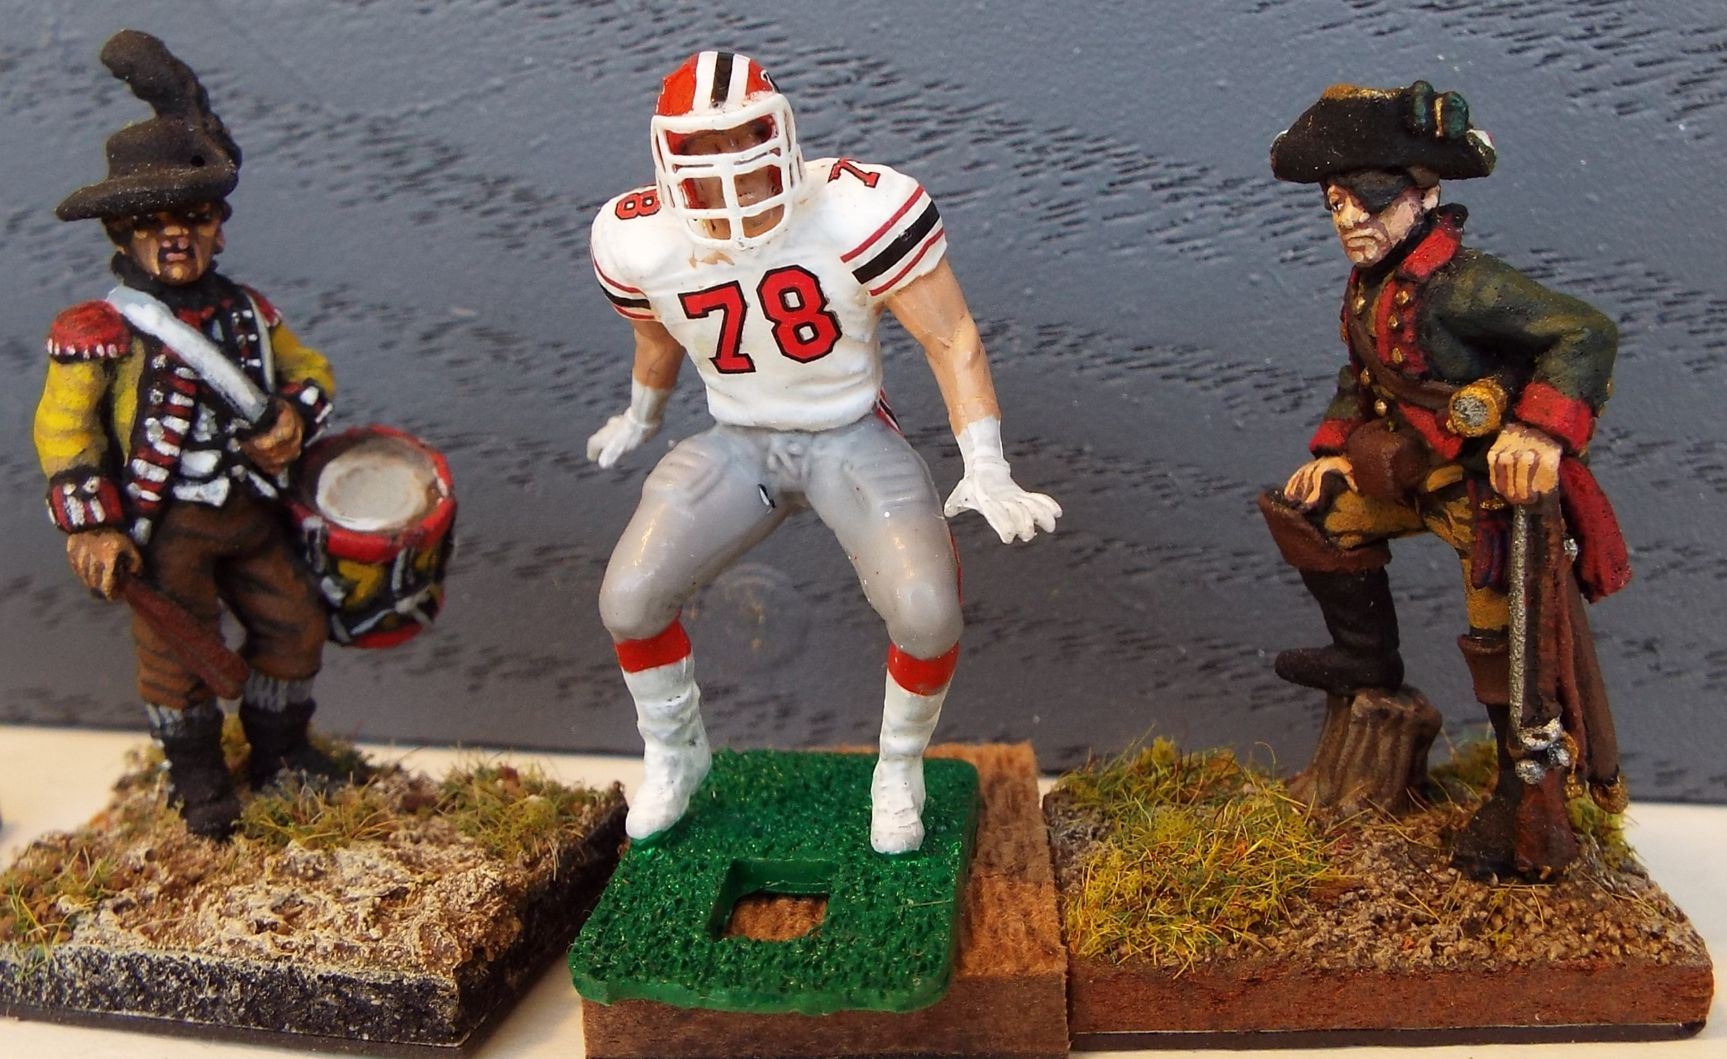
While some of the newer figures are more detailed, there is simply no comparison to the metal historical figures
Seen in this photo. The basics, however, still apply.

Slide 5
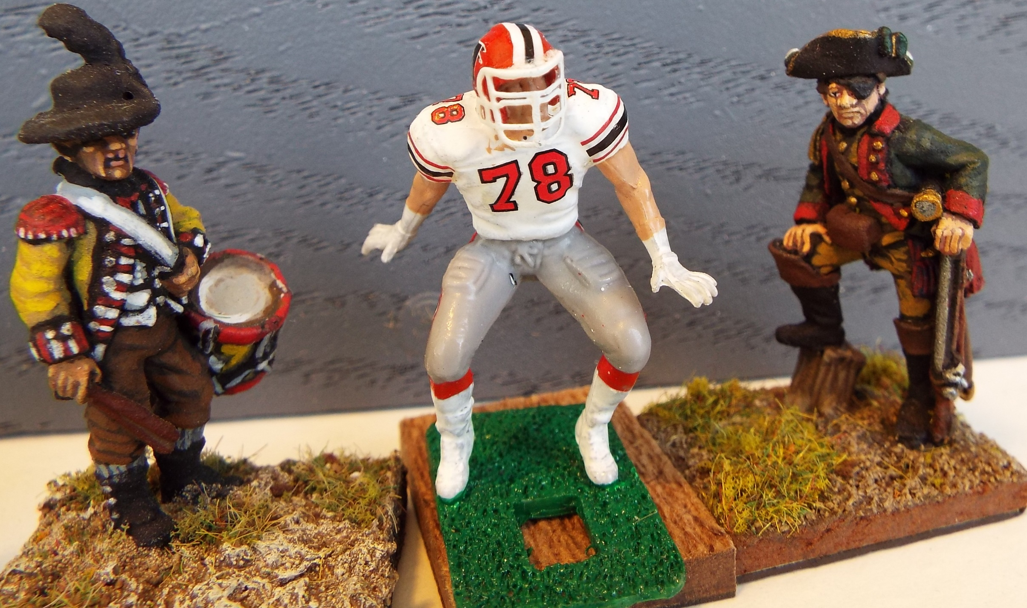
Always use primer, always use the largest brush possible to accomplish the detail you are painting and always know the uniform
details of your figure before you start painting.

Slide 6
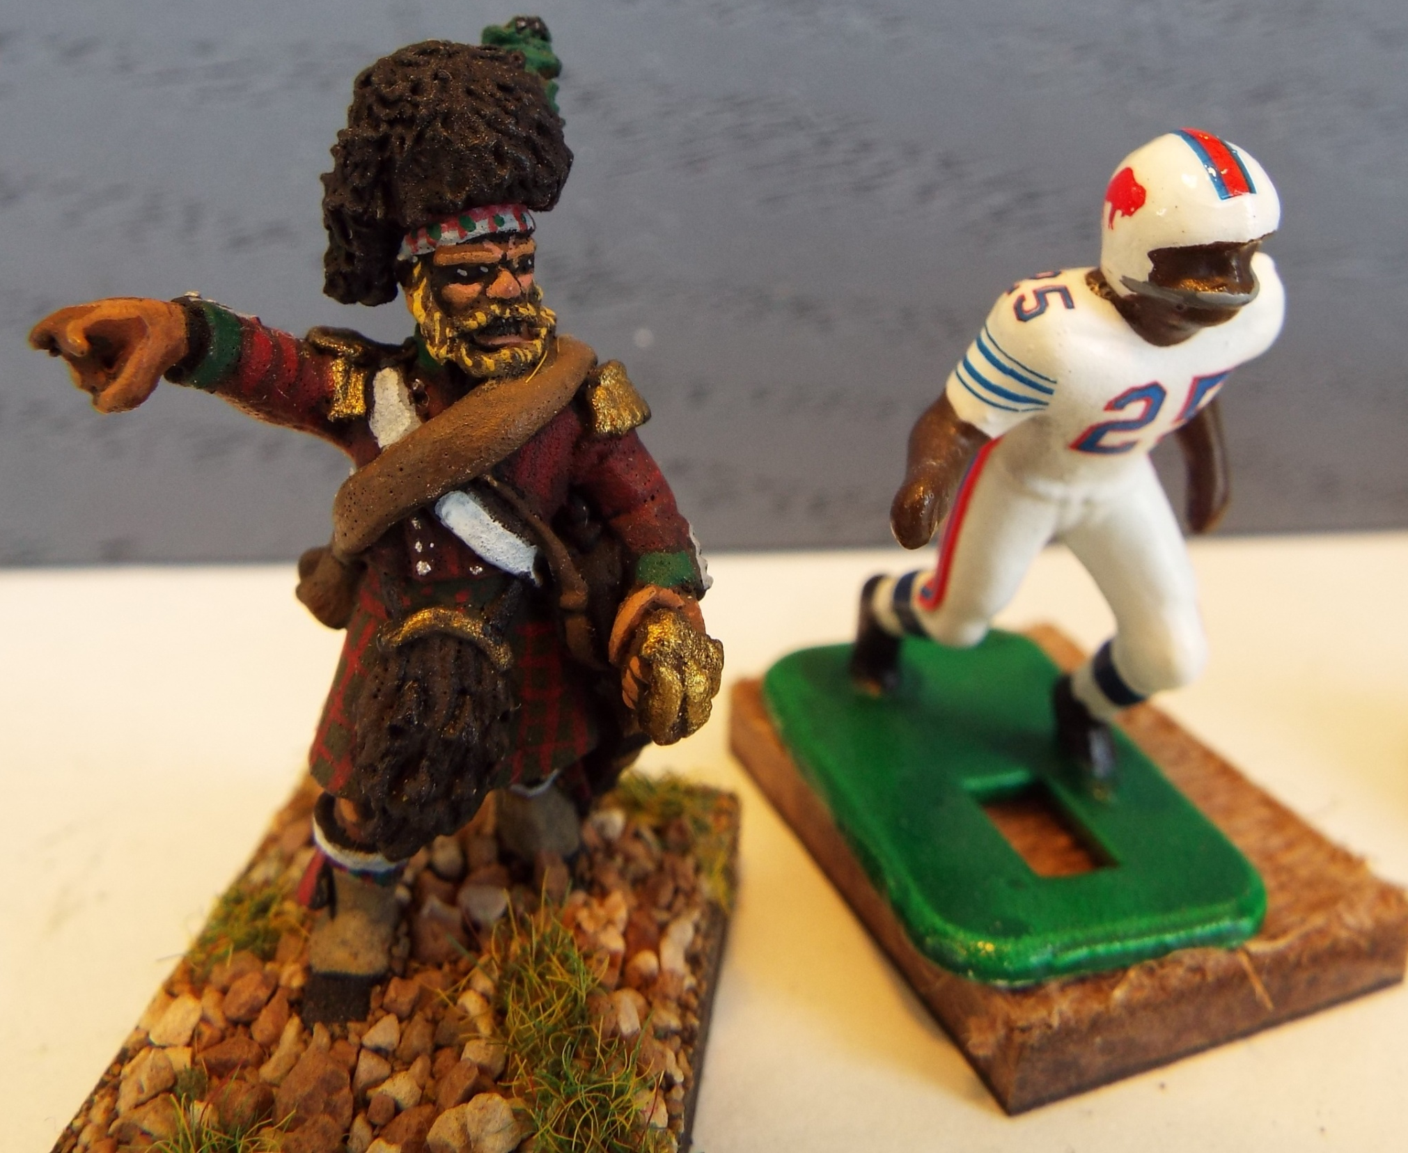
Finally, there is no substitute for careful painting. The sloppier you are with something as simple as the
base coat for the uniform, the more difficult and time-consuming it is to clean it up later.

Slide 7
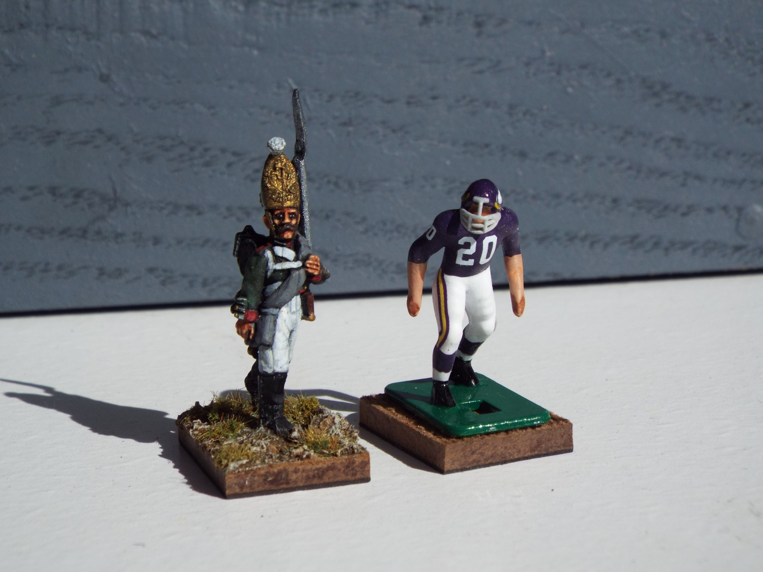
Know your desired result as well. For my historical figures, I want as mush detail as possible. I paint full
regiments or battalions doing the same step and color on each figure before proceeding to the next uniform
element. This method works well for EF figures as well. For those figures, I wanted a look similar to what the old
Tudor figures had, but with crisp uniform colors and neatly painted helmets, jerseys and careful decaling.

Slide 8
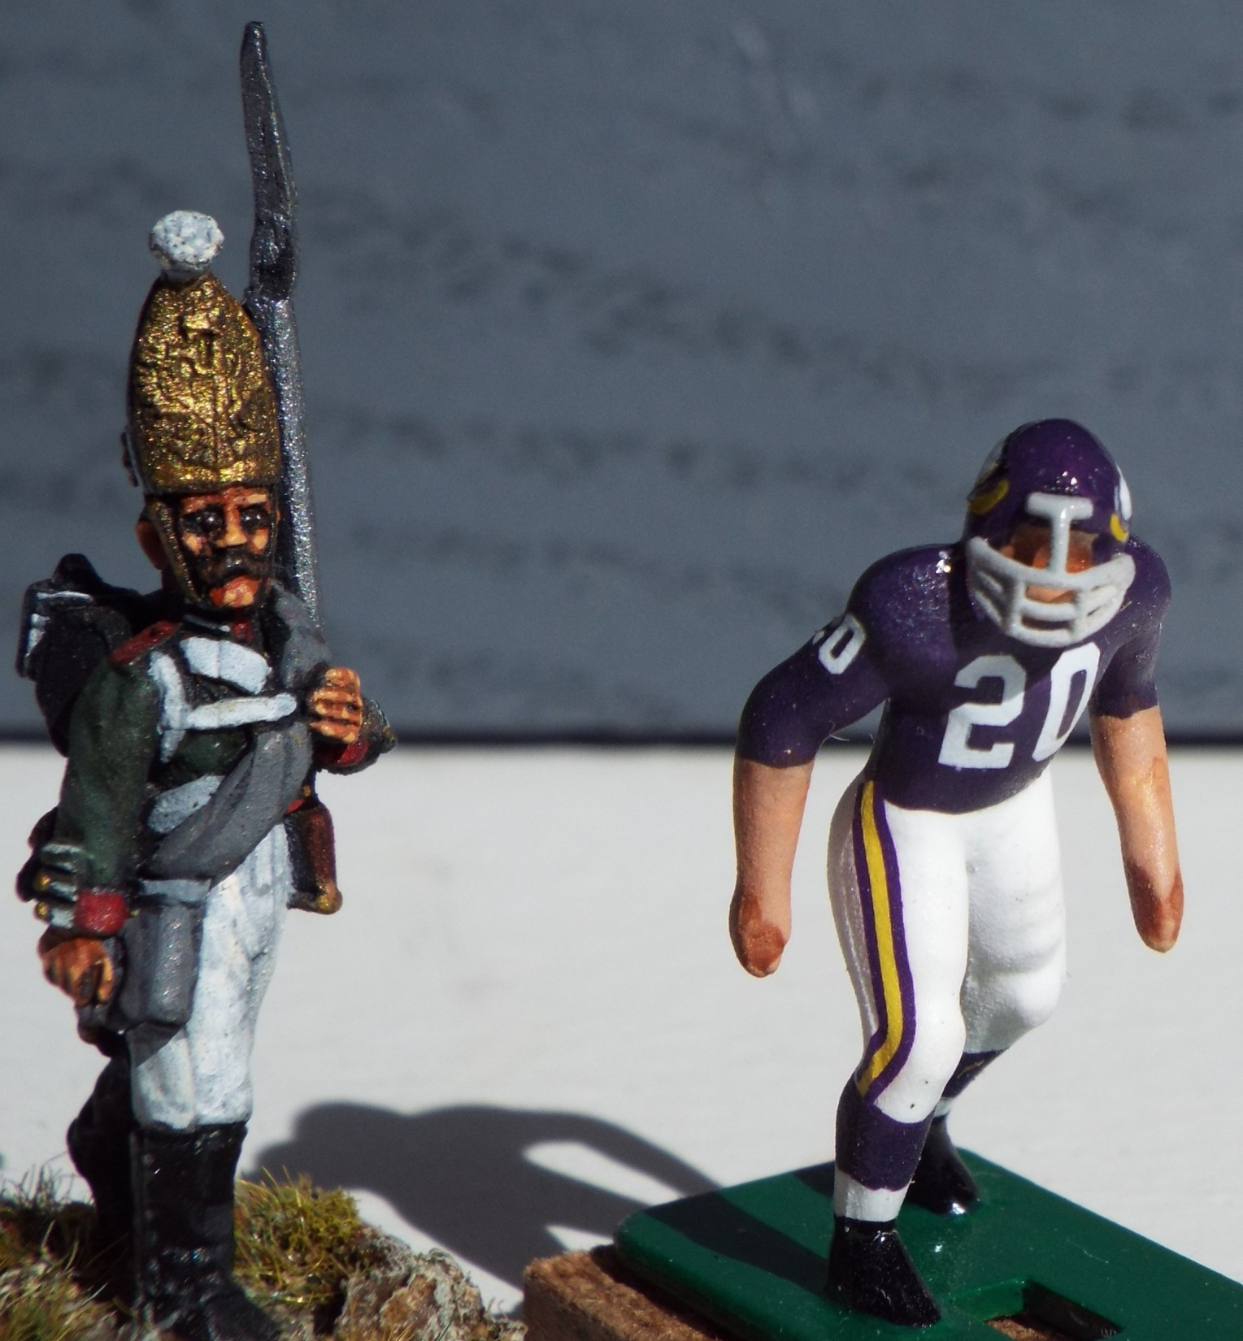
While hands and faces
Show the most difference
in detail, the other parts of
the figure are less detailed
as well. This means one
doses not need the multi-
stepped layering of the
Progressively lighter shade
Variants of the same color.
I use this method with my
historical models, but a
good double or triple coat
of the same color purple
is all I used for Bobby
Bryant. I have seen EF
players painted this way by
experts such as Gene Sanny.
They are indeed beauftiful.
Just remember your objective,
if you want a few highly
detailed figures, it is perfect.
Hands
If you want the throwback
1970’s look and feel, you
may want to use the
simpler methods I will
begin to cover in part II.
Faces

Slide 9
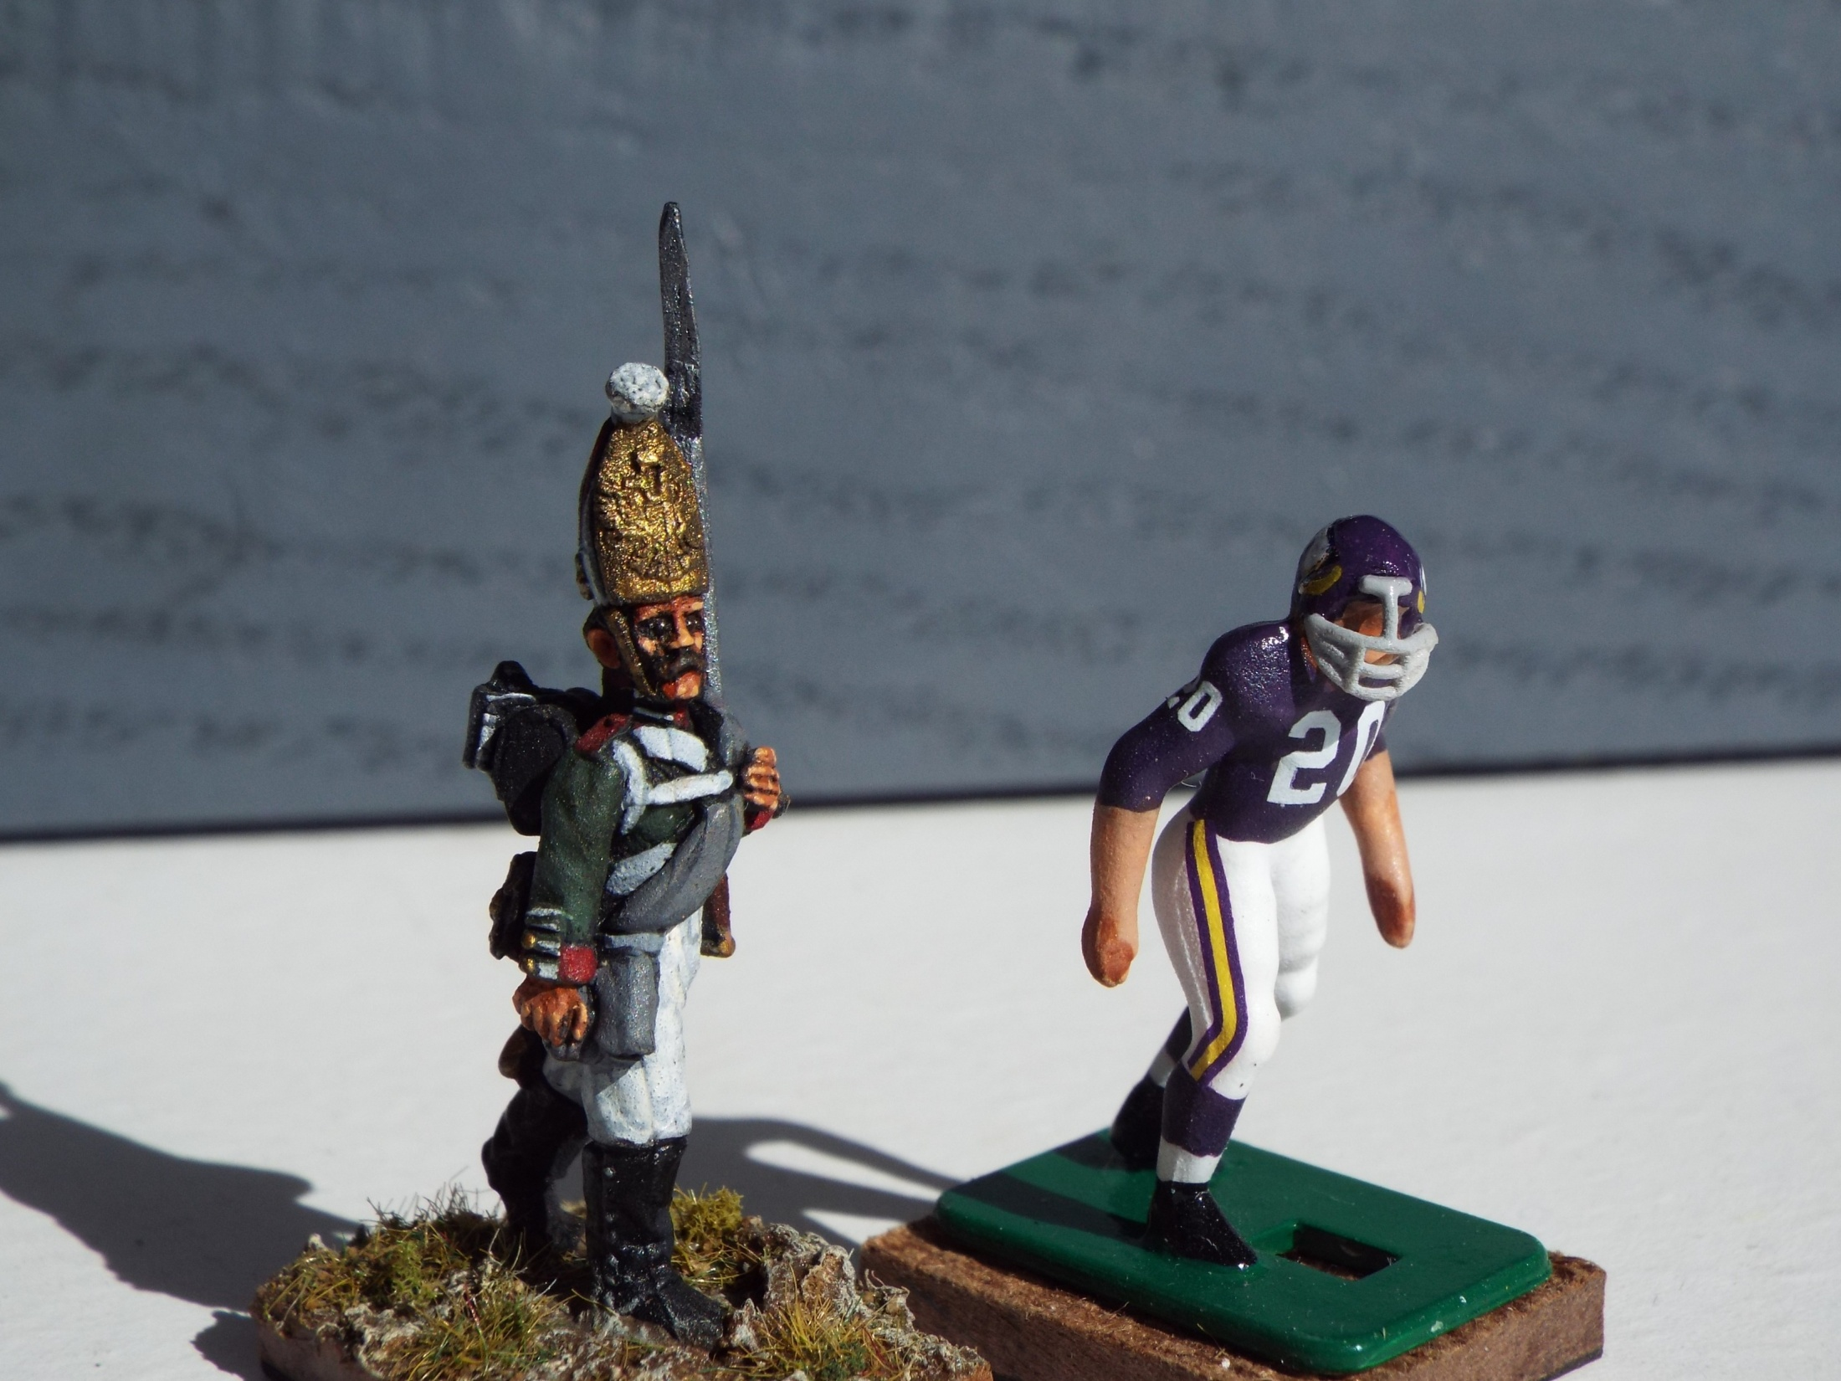

Slide 10
