Slide 1
Painting The 71 Vibe
Part III Section A – Painting the Figure

Slide 2
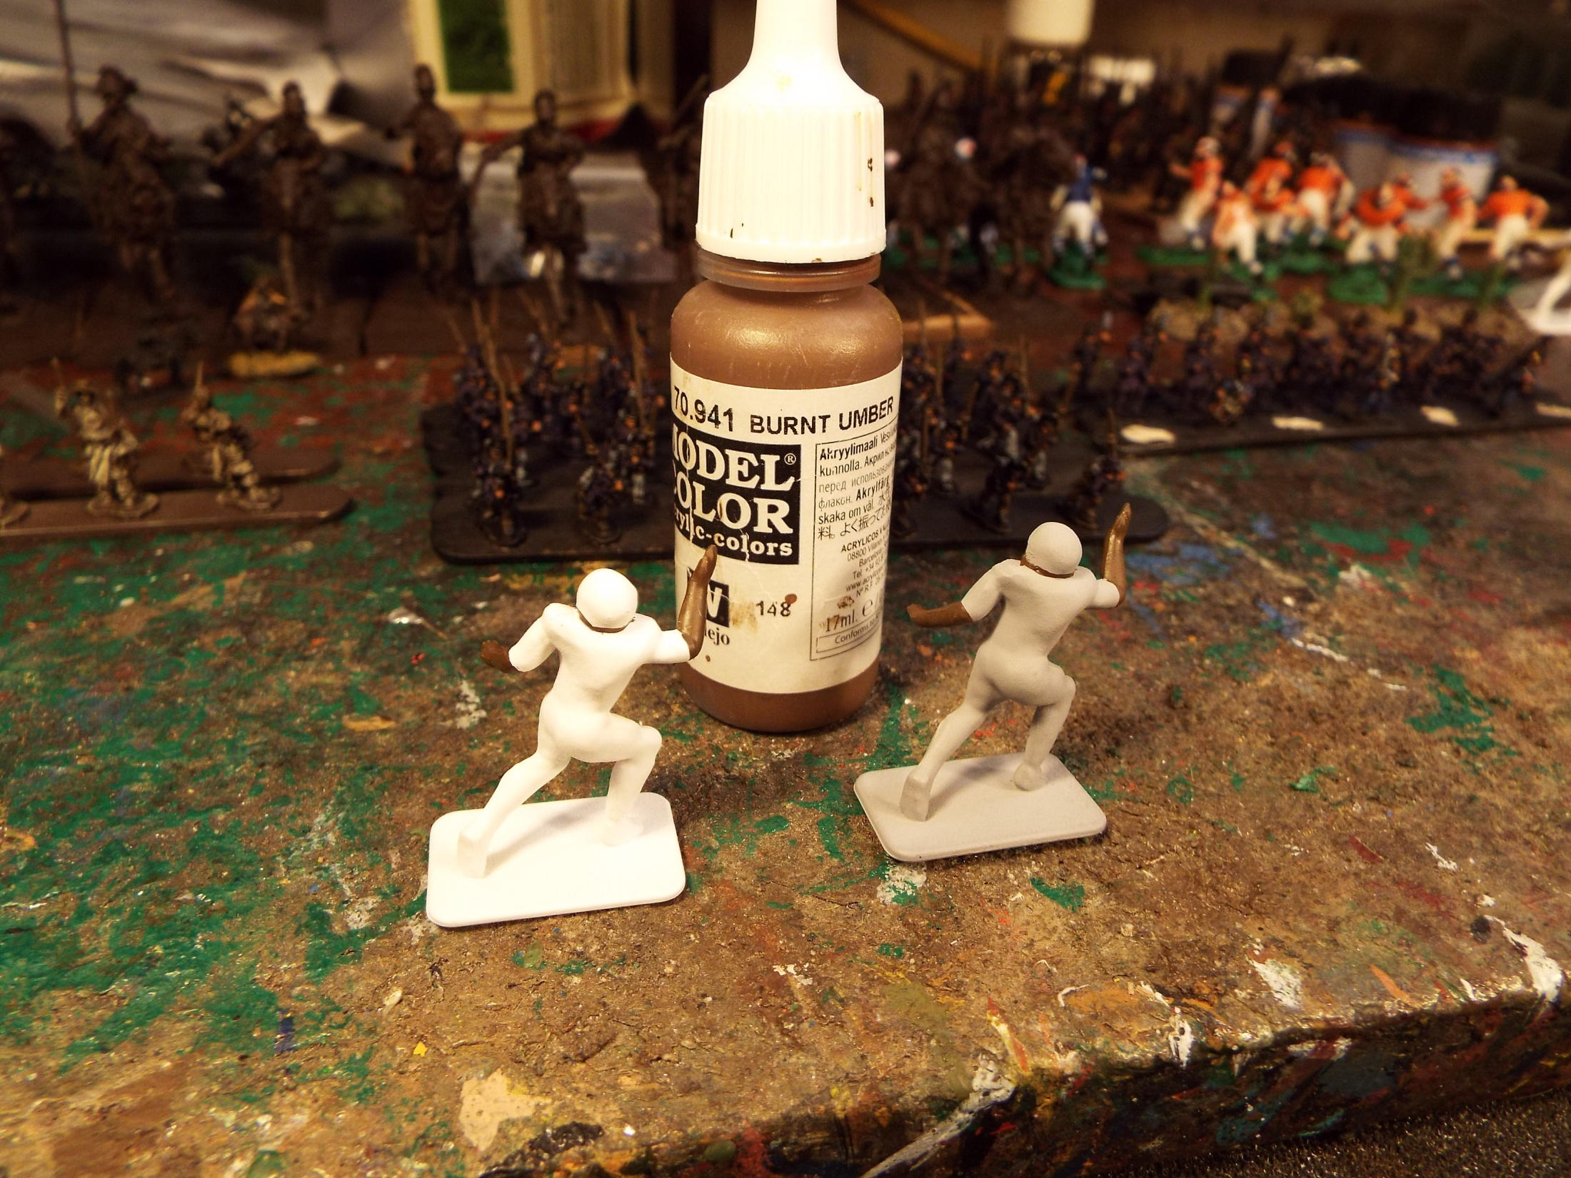
I always try to paint the figure from the inside out, as if a were dressing the figure. Therefore
I usually paint the flesh tones first. For African flesh, I find burnt umber from Vallejo is often
the best choice. I use a number 1 size brush for this activity. This is a nice big brush but has a
nice sharpened tip. It holds a good amount of paint and makes for fewer brush strokes.

Slide 3
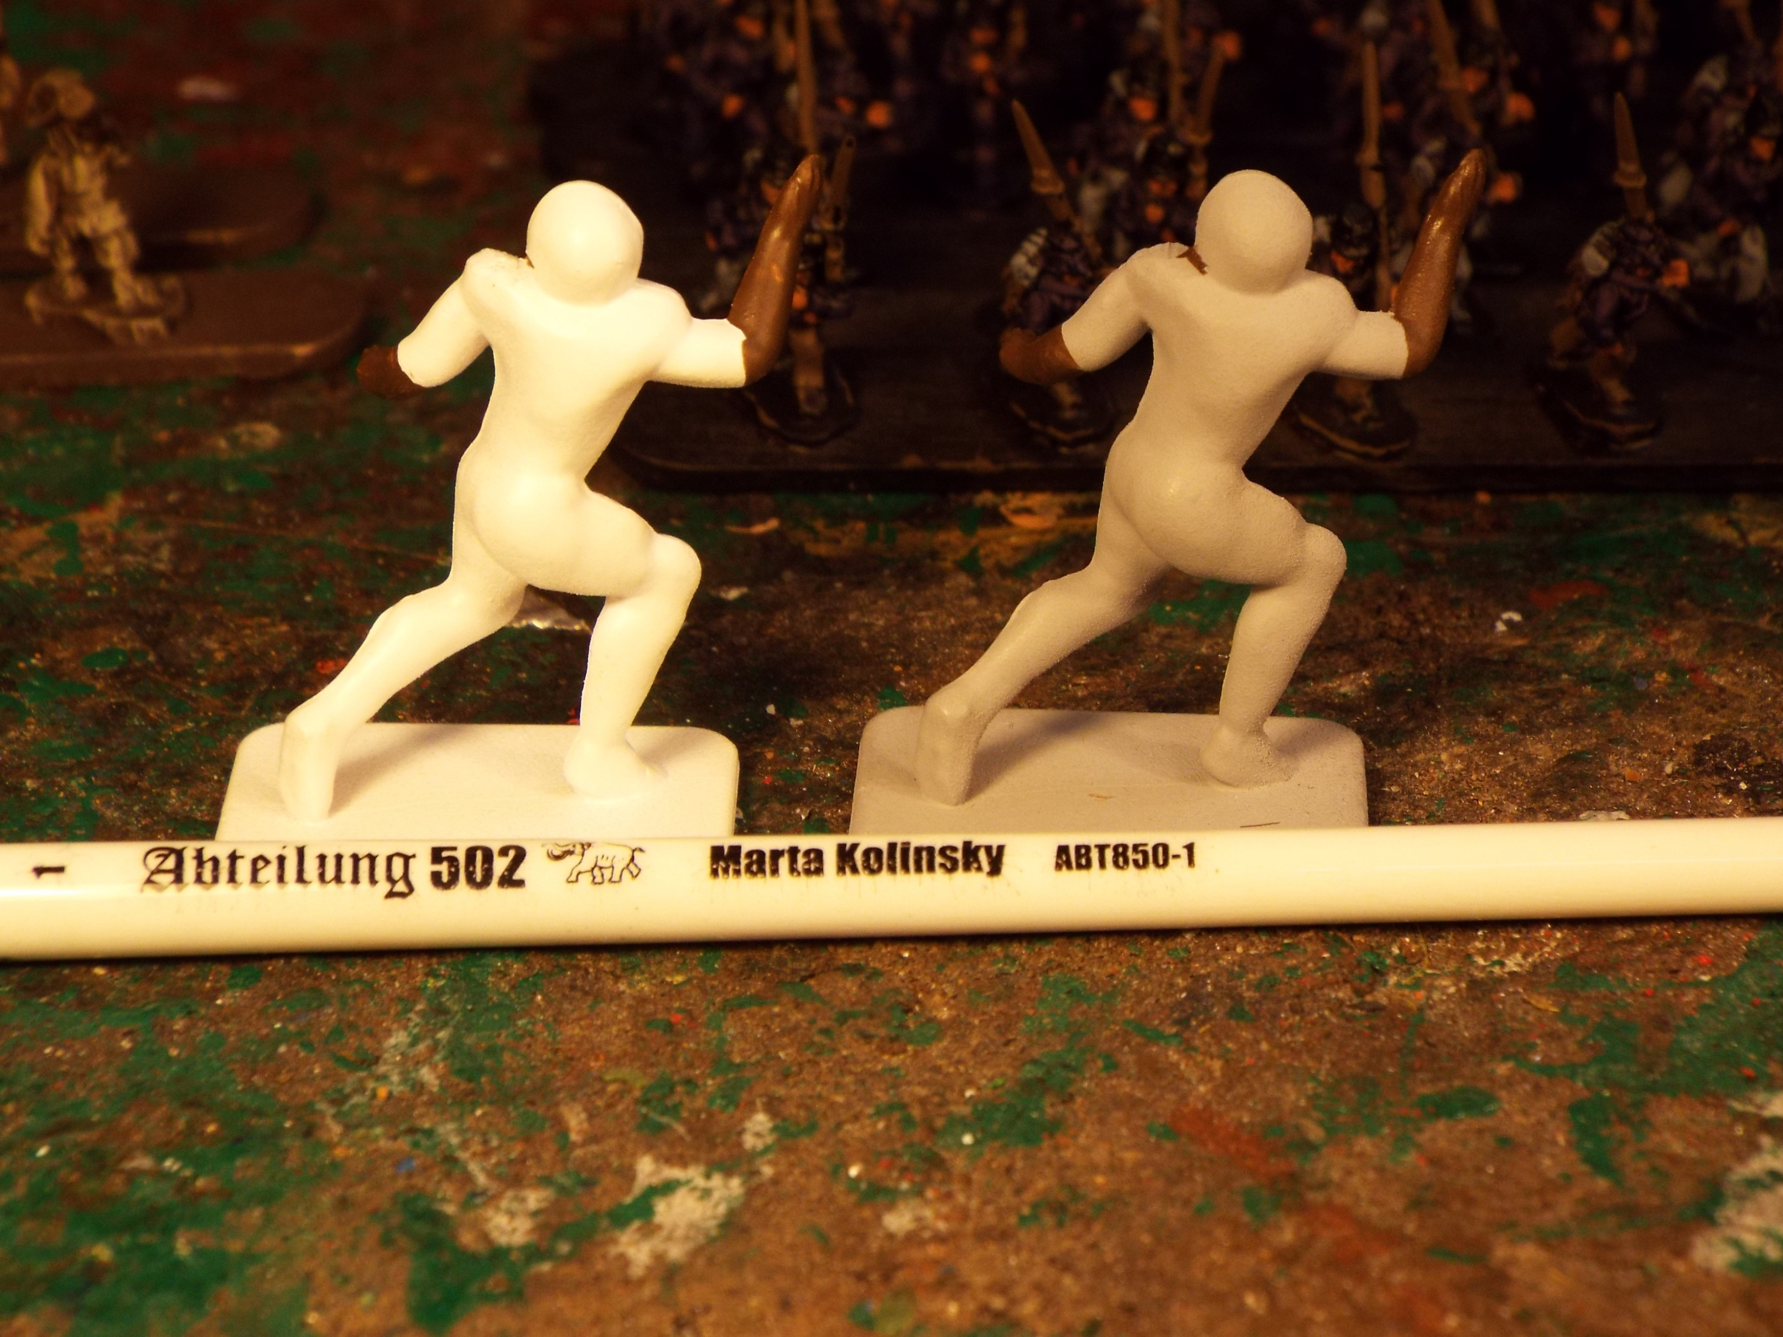

Slide 4
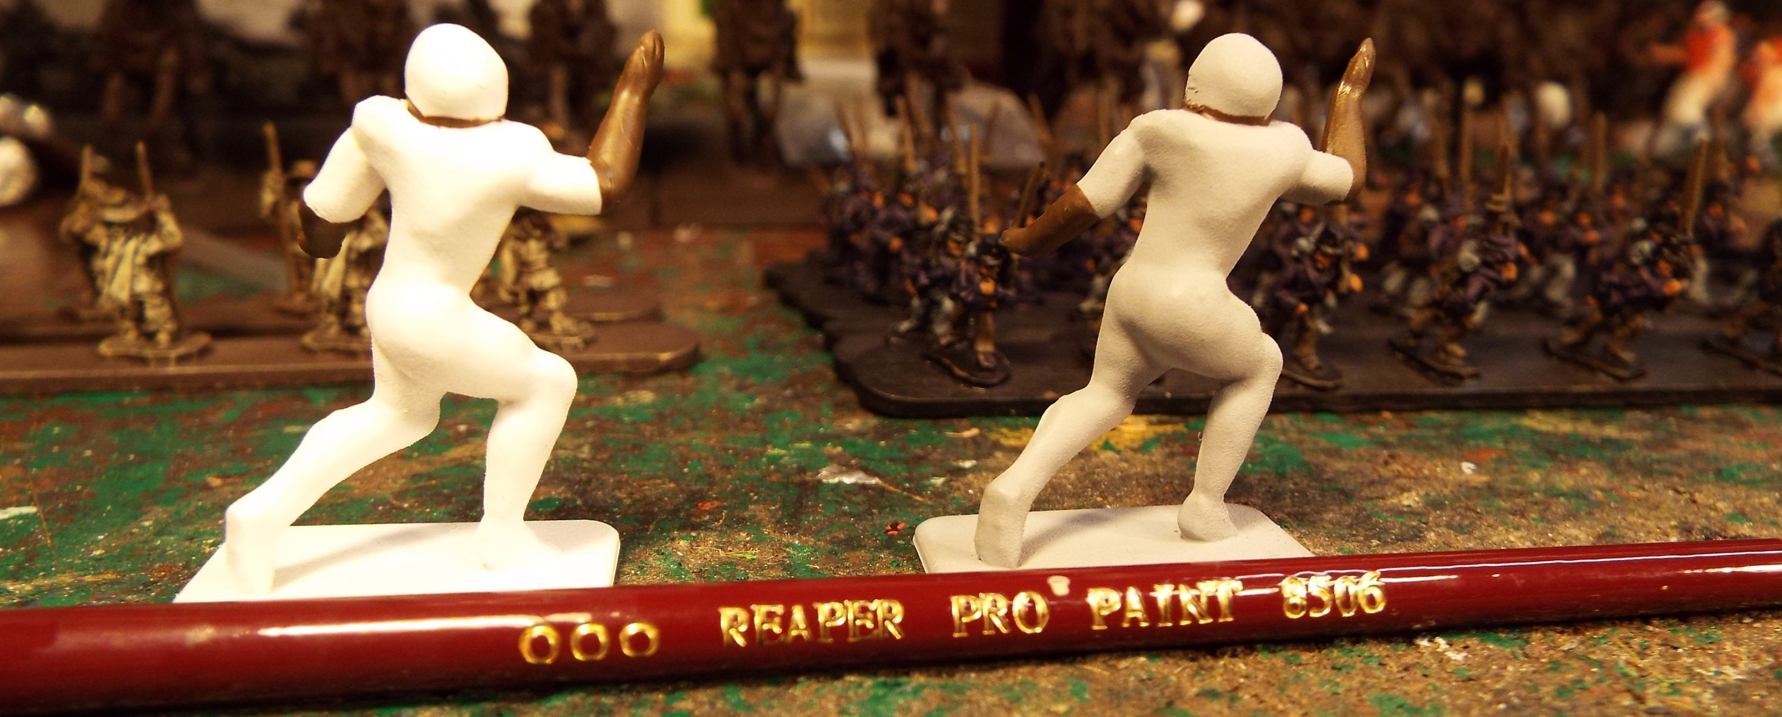
The underside of the helmet gets a much smaller brush but the same color for
African flesh.

Slide 5
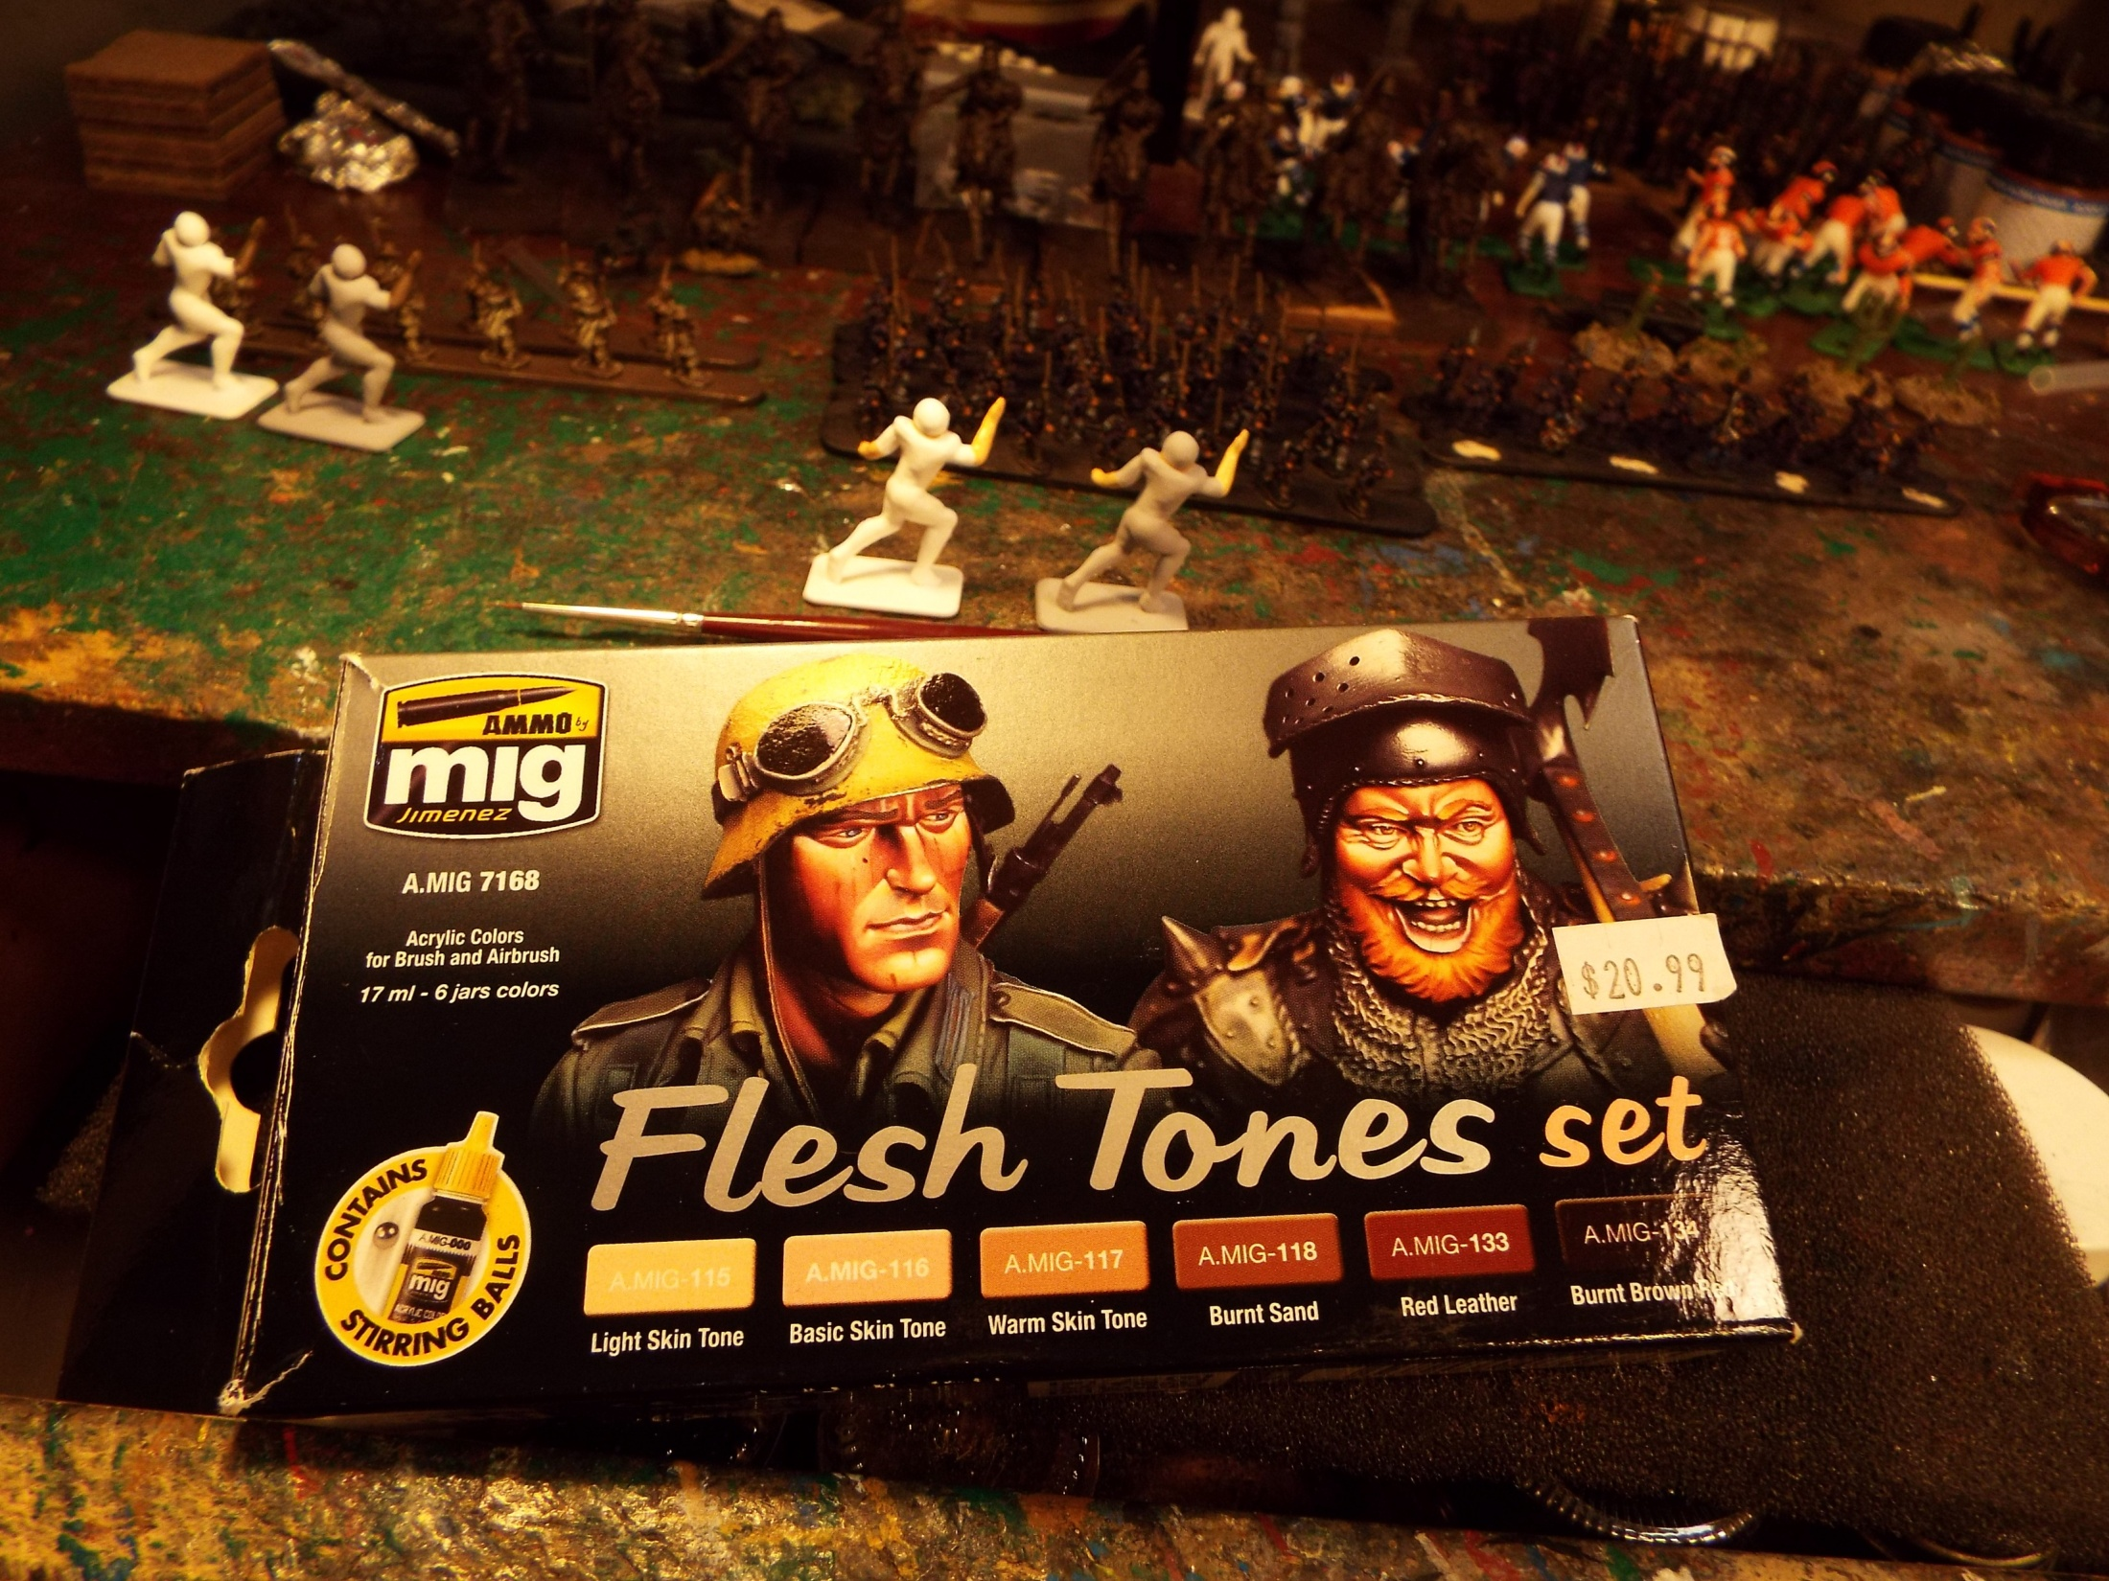
For Caucasian flesh I will start with Mig A-118 Basic skin tone. There are a few steps to painting
Caucasian flesh due to its lighter tone. Tudor did Caucasian flesh very poorly back in the day. The reason
for this was the tone was unrealistically pale and even. Hogleg players had the skin tone of the walking dead.

Slide 6
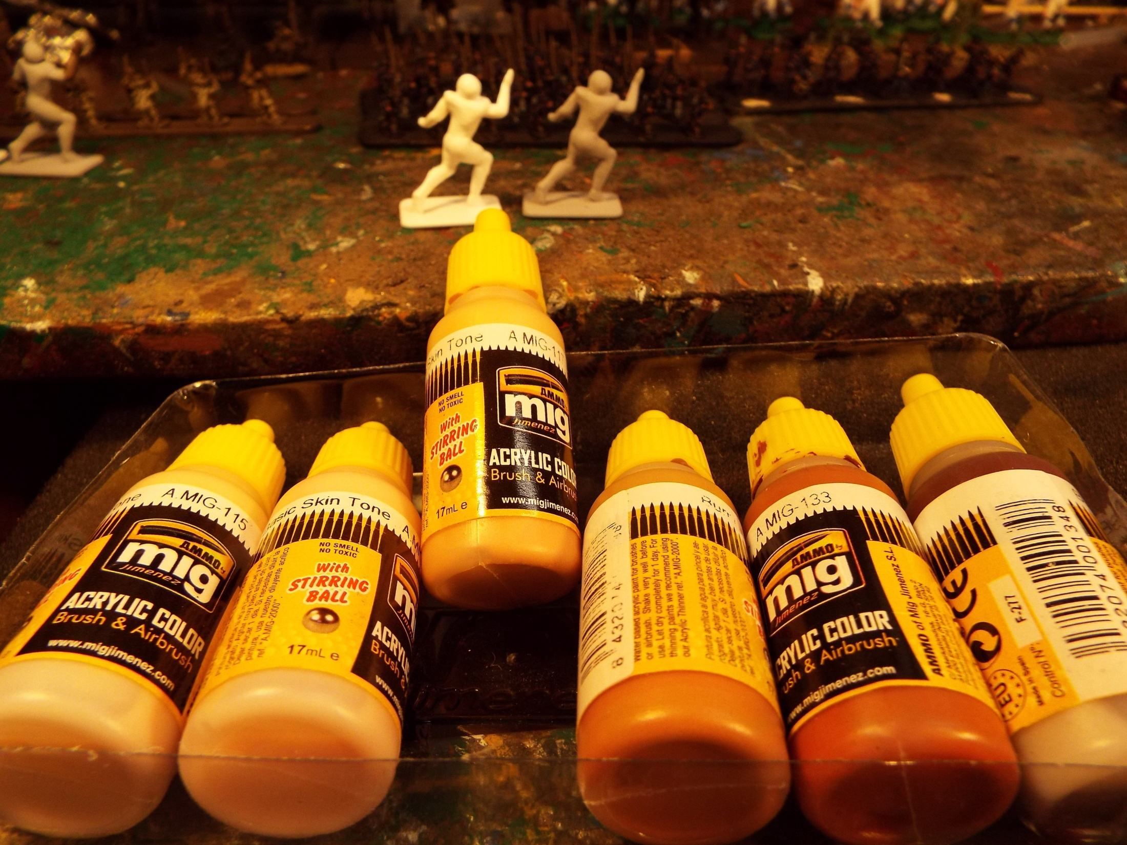
A-118
I again
used a
number
1 Brush

Slide 7
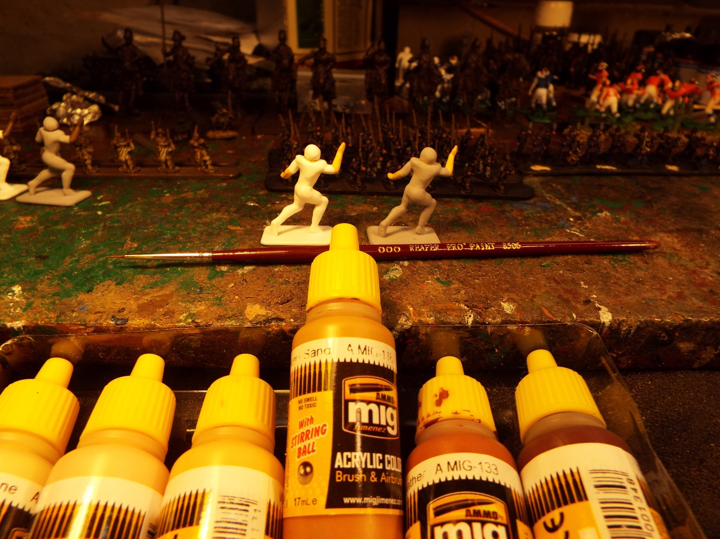
A-119
The necks under the helmet line is
done using the next darkest color
in the fleshtone set. I used the 000
Brush once again for this job.

Slide 8
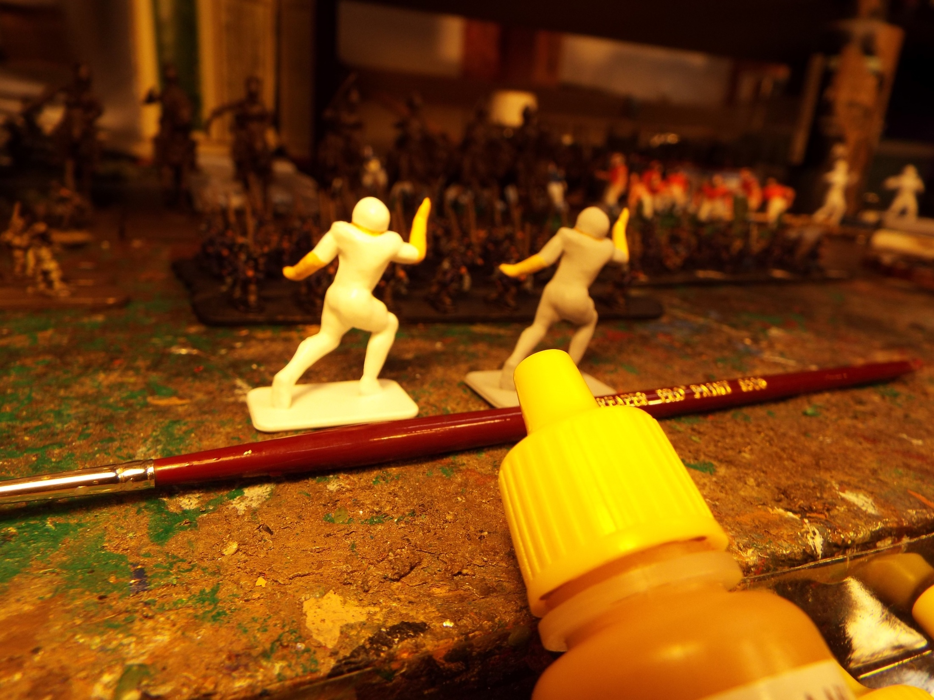
The reason for using the darker color on the next is explained later.

Slide 9
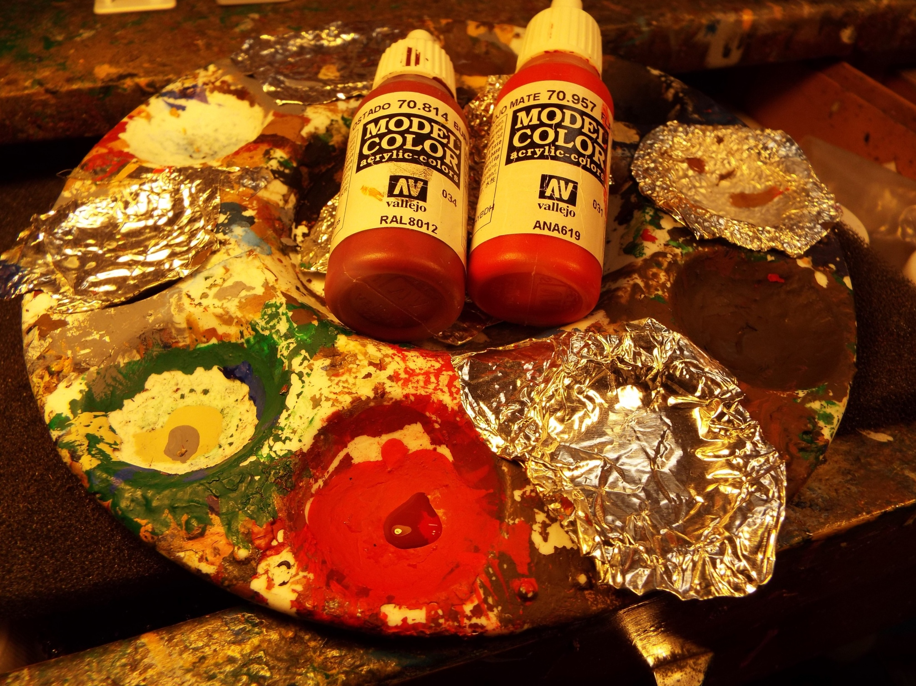
When possible, I avoid mixing colors for painting military units of entire football teams. Getting the blend
100% correct when adding items to the units or teams later becomes problematic. For the Skins and Cowboys
of the early 70s, no one makes the proper colors. So, I blend and simply write down the mix in a record book. For
the Skins, the uniform color I made was about 80% Burnt Red and 20% Flat Red, both from Vallejo.

Slide 10
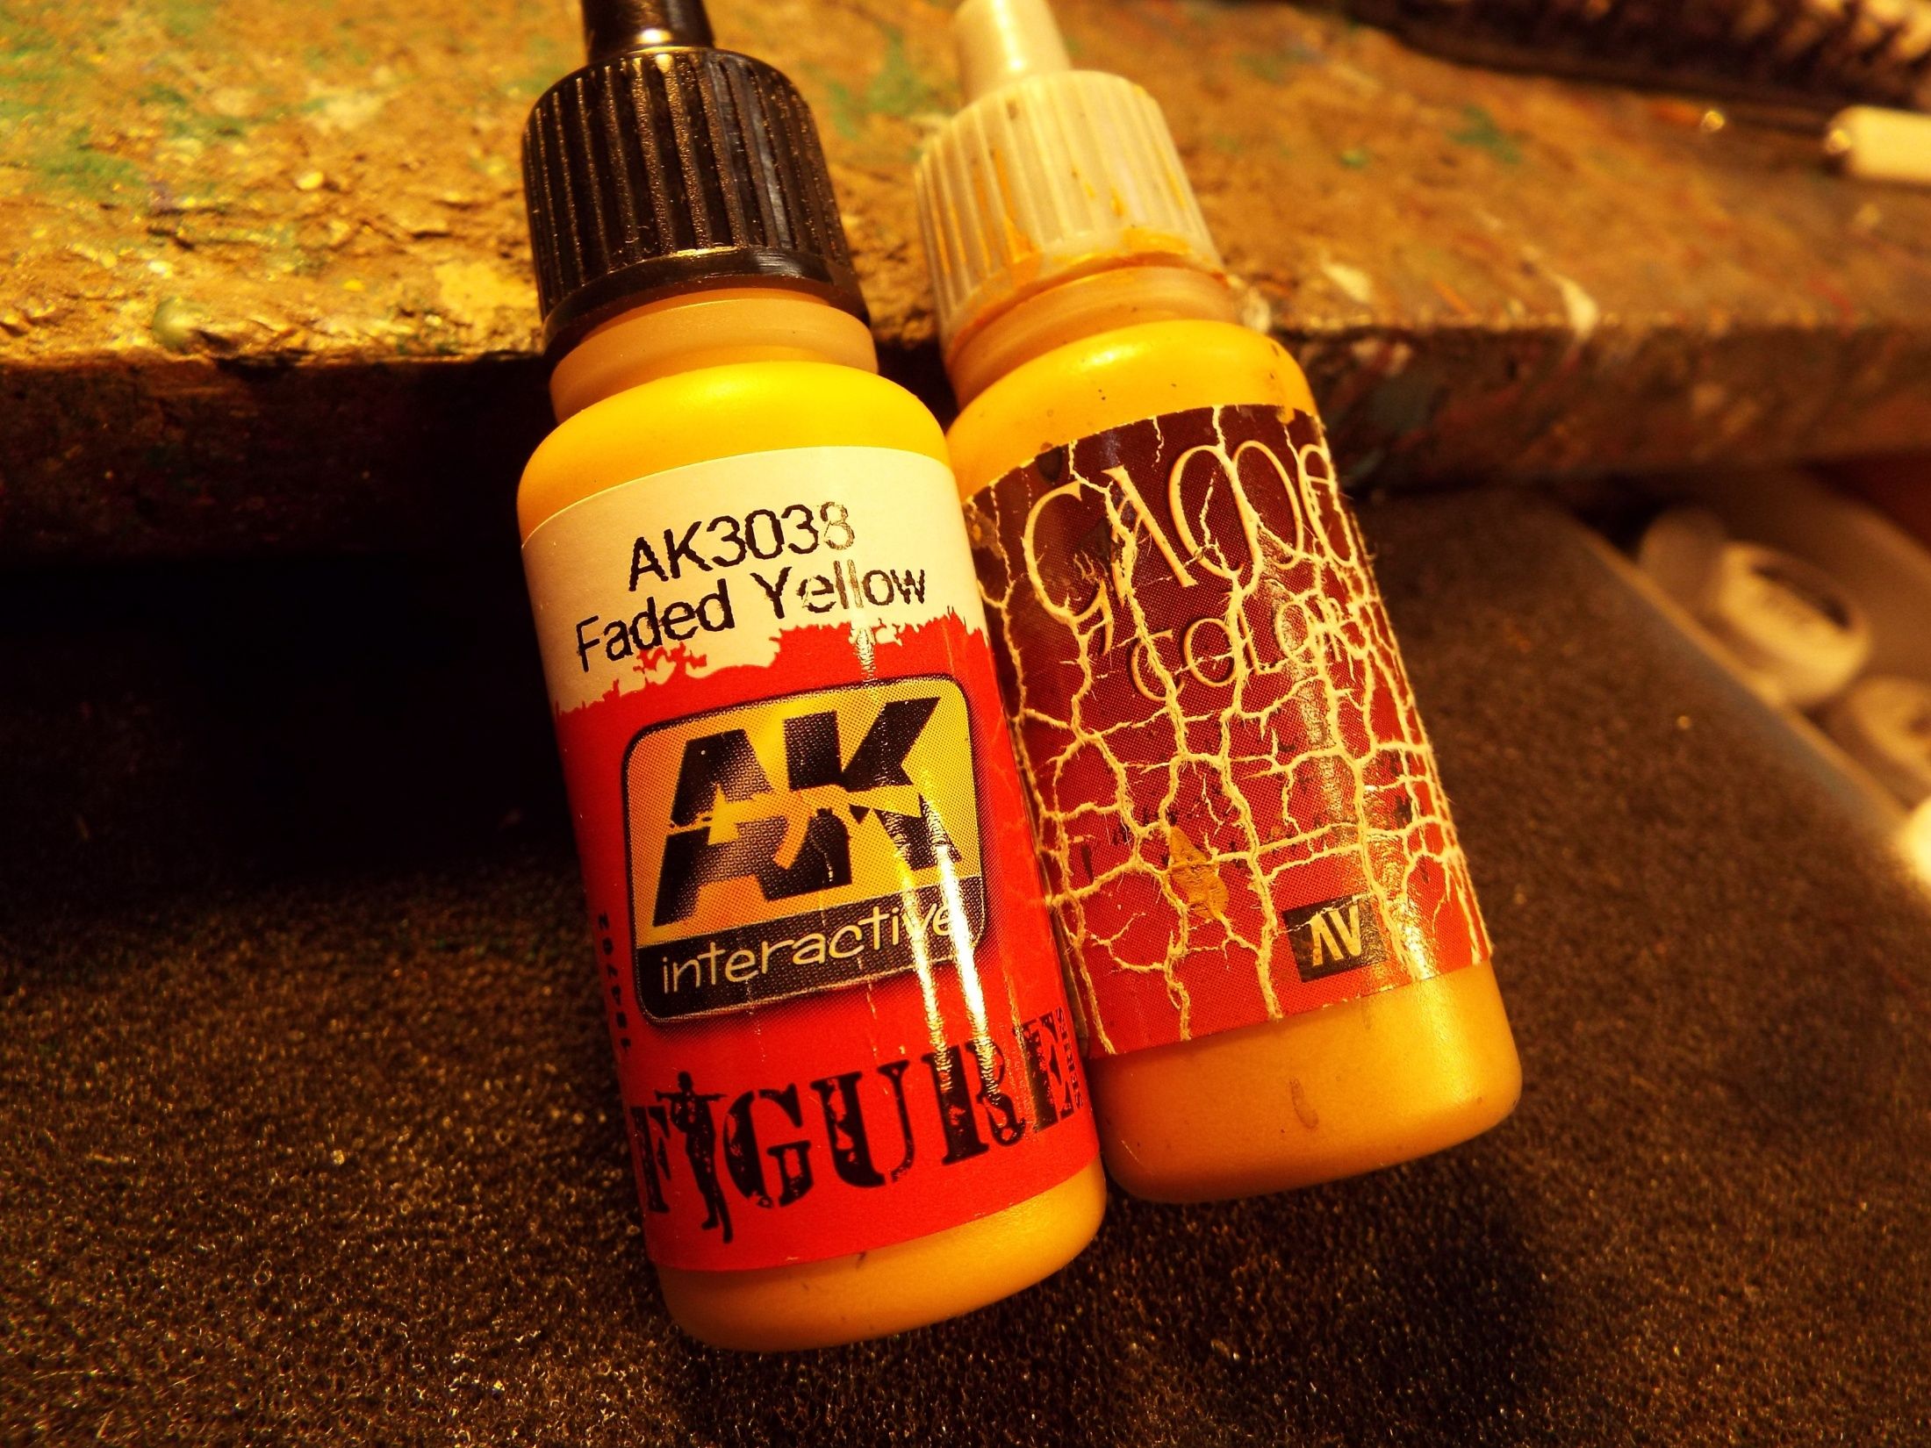
For the pants I used AK Interactive Faded Yellow and Vallejo Game Colors Gold Brown in a
50/50% mix.

Slide 11
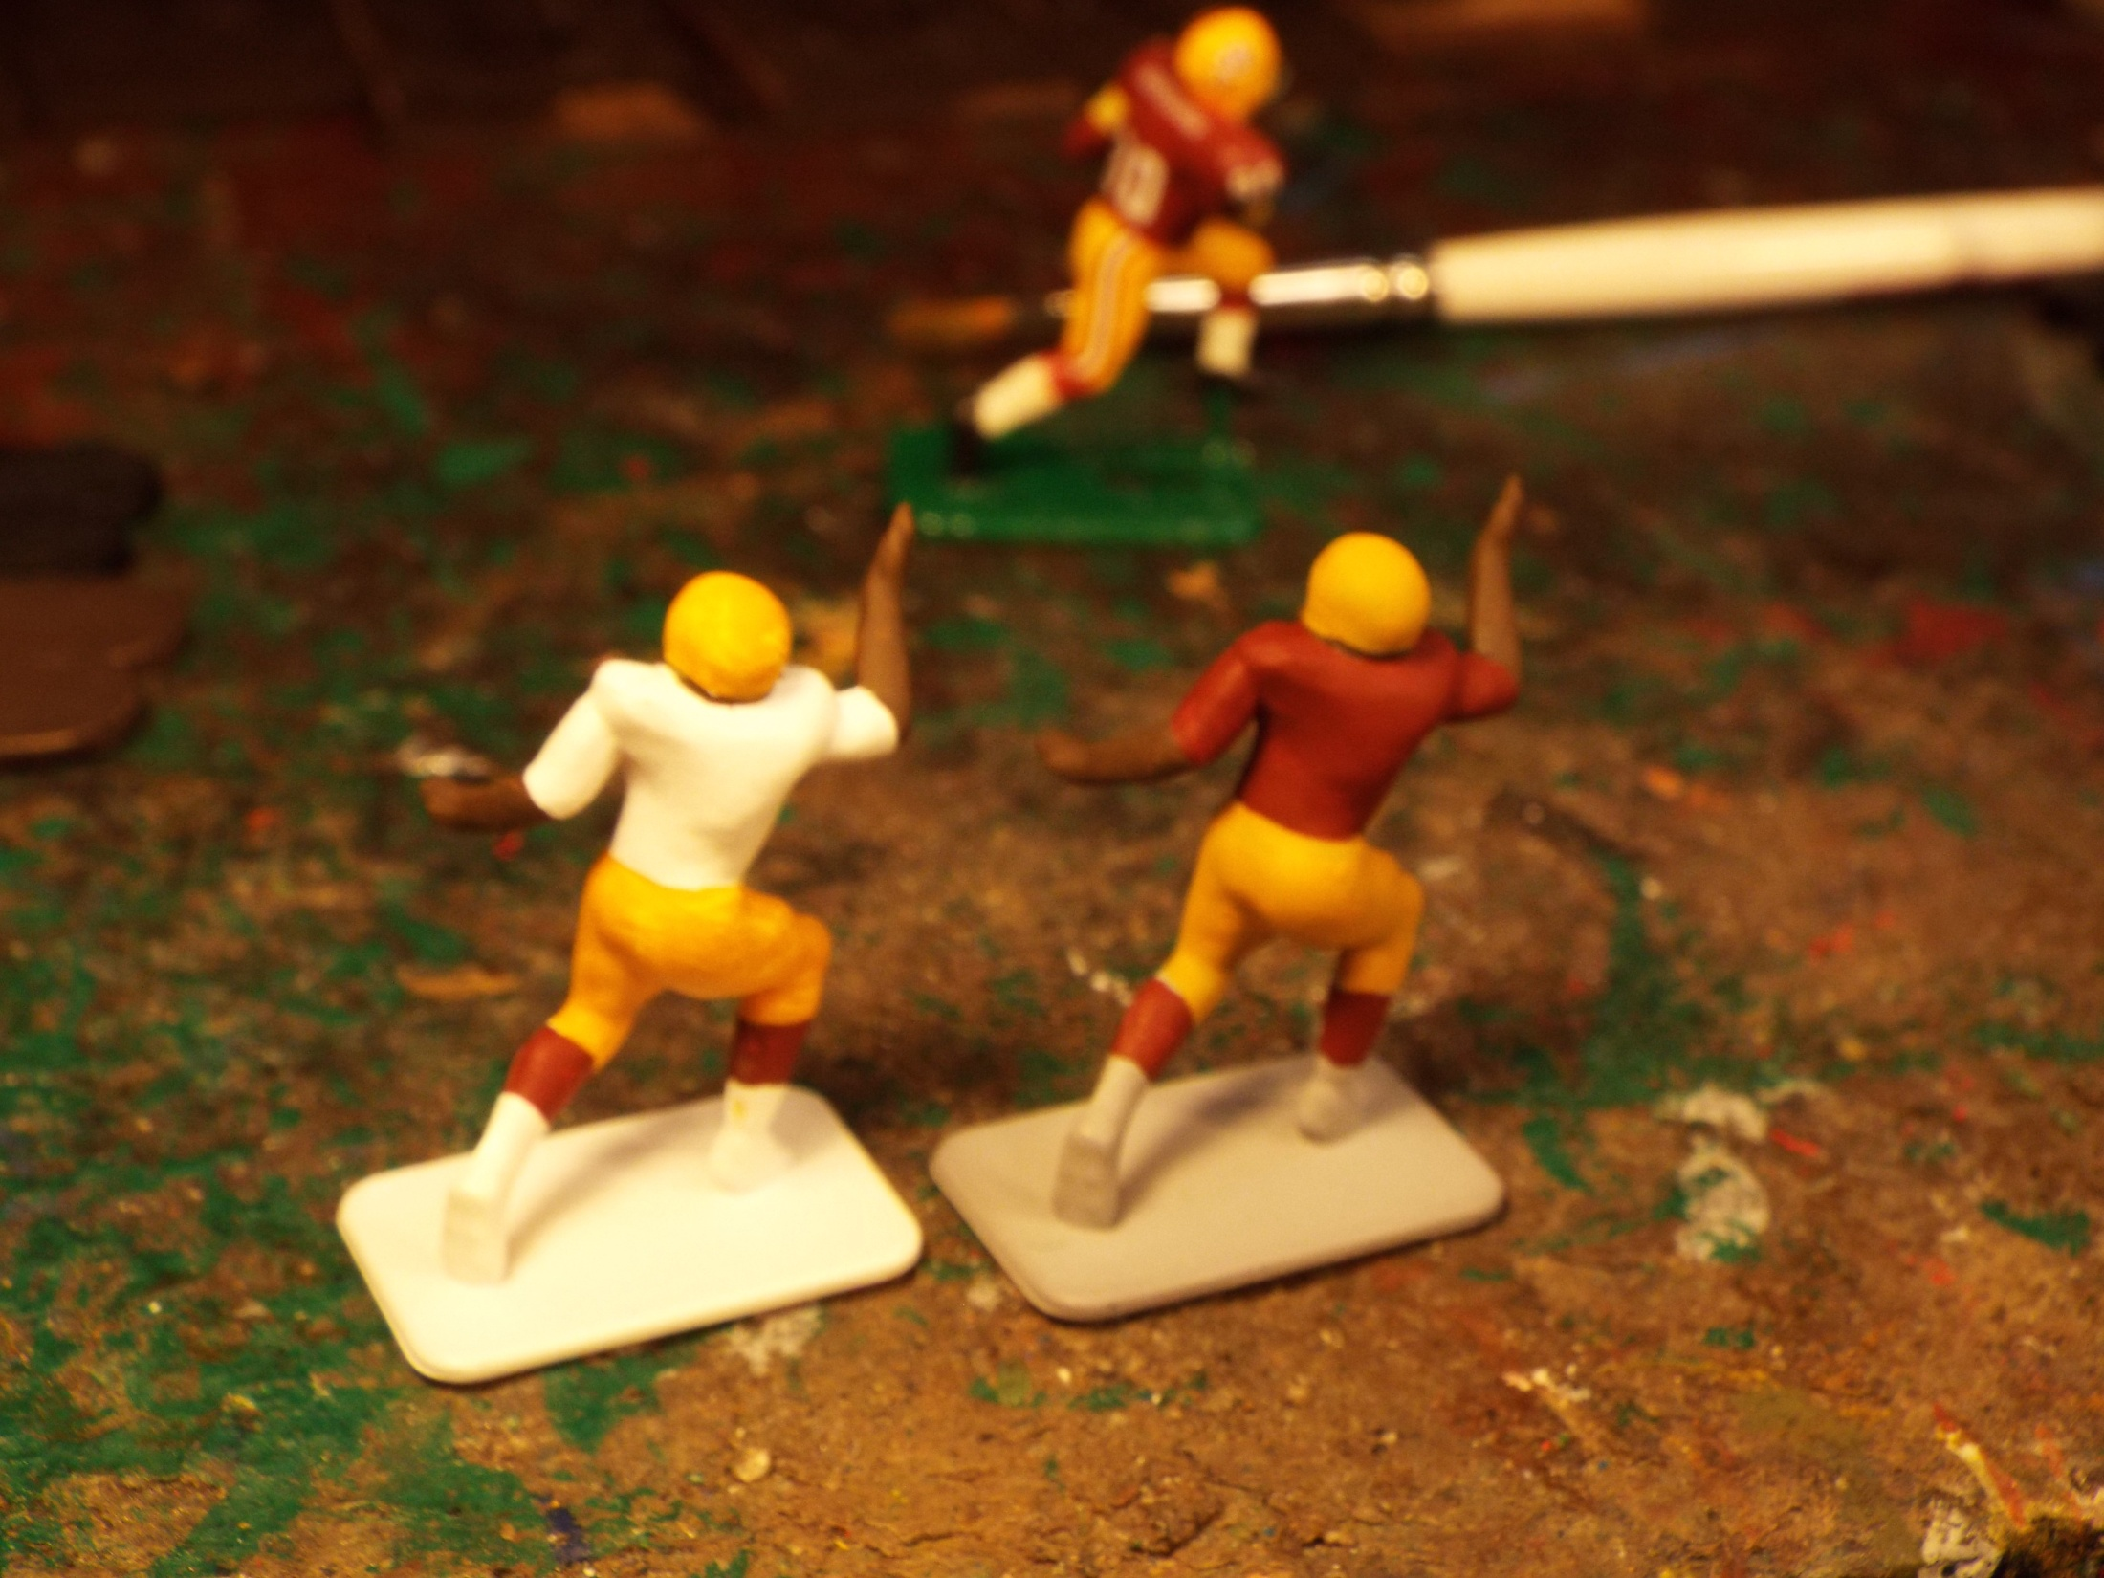

Slide 12
The figure in back is my control figure. As I noted in the previous part, white primed figures
take many layers of paint to cover. The pants and helmets took four coats on the white primed figure.
The gray primed figure only took two for each color.

