Slide 1
Painting the 71 Vibe
Part IV – Decal Application

Slide 2
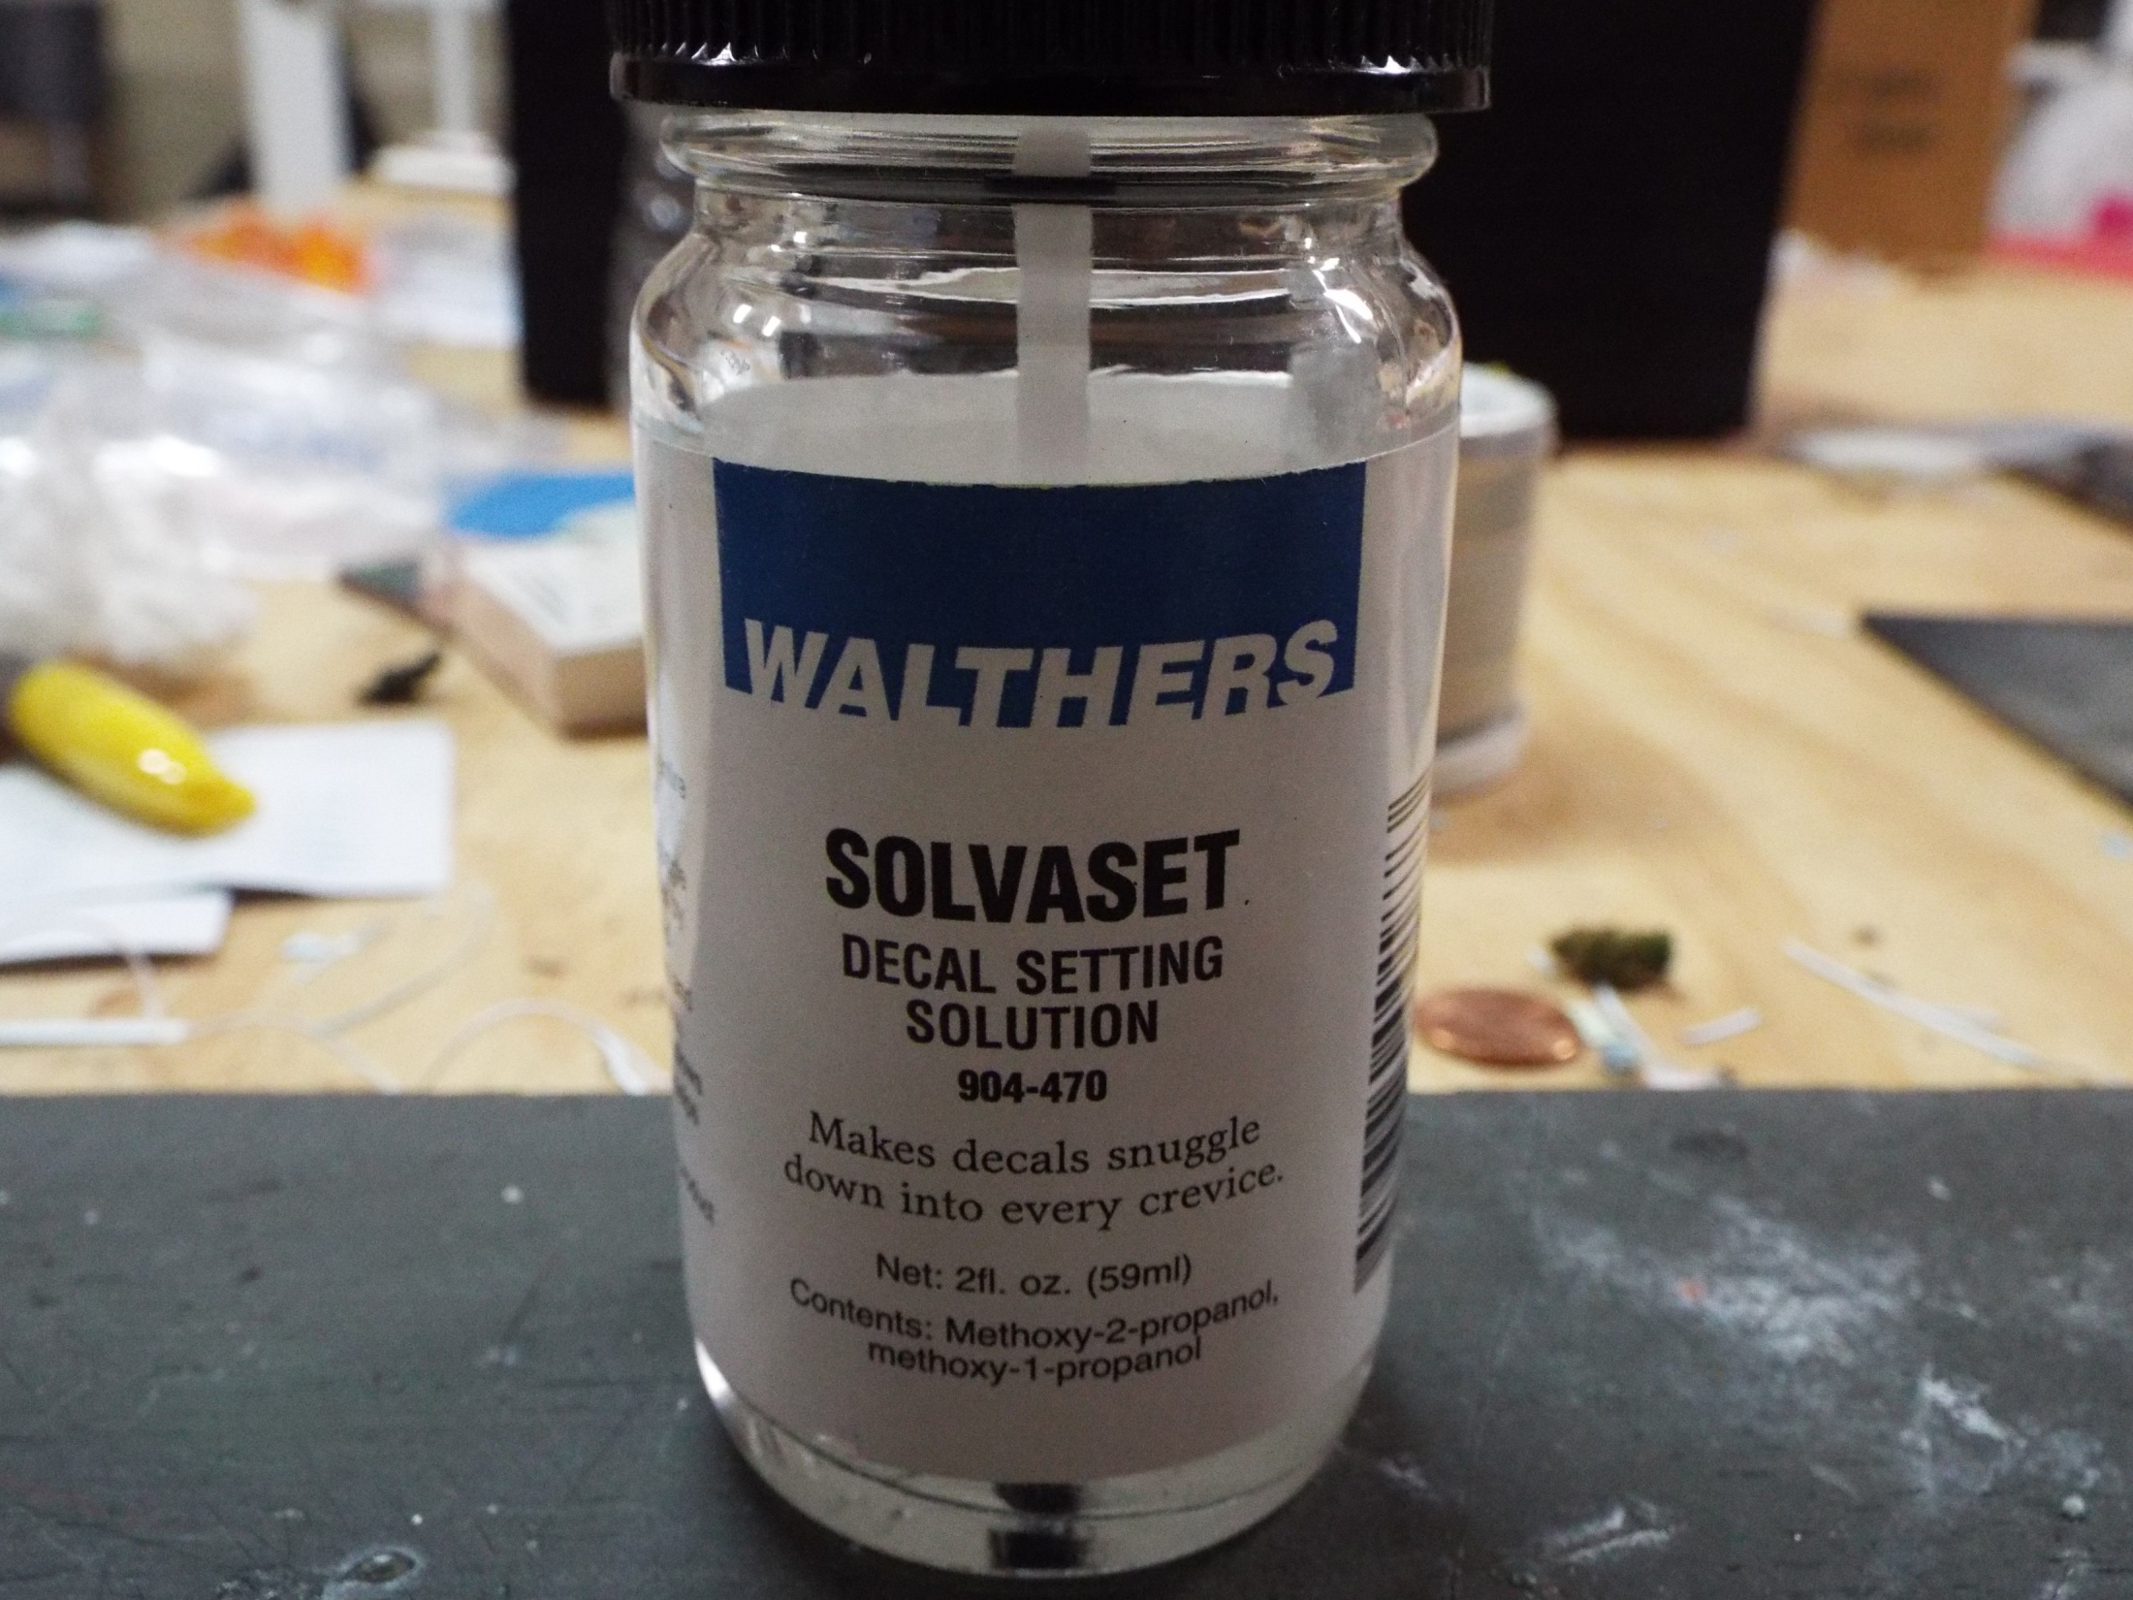
I always keep multiple bottles of this on hand. I used it for decals of all kinds. It is the best available.

Slide 3
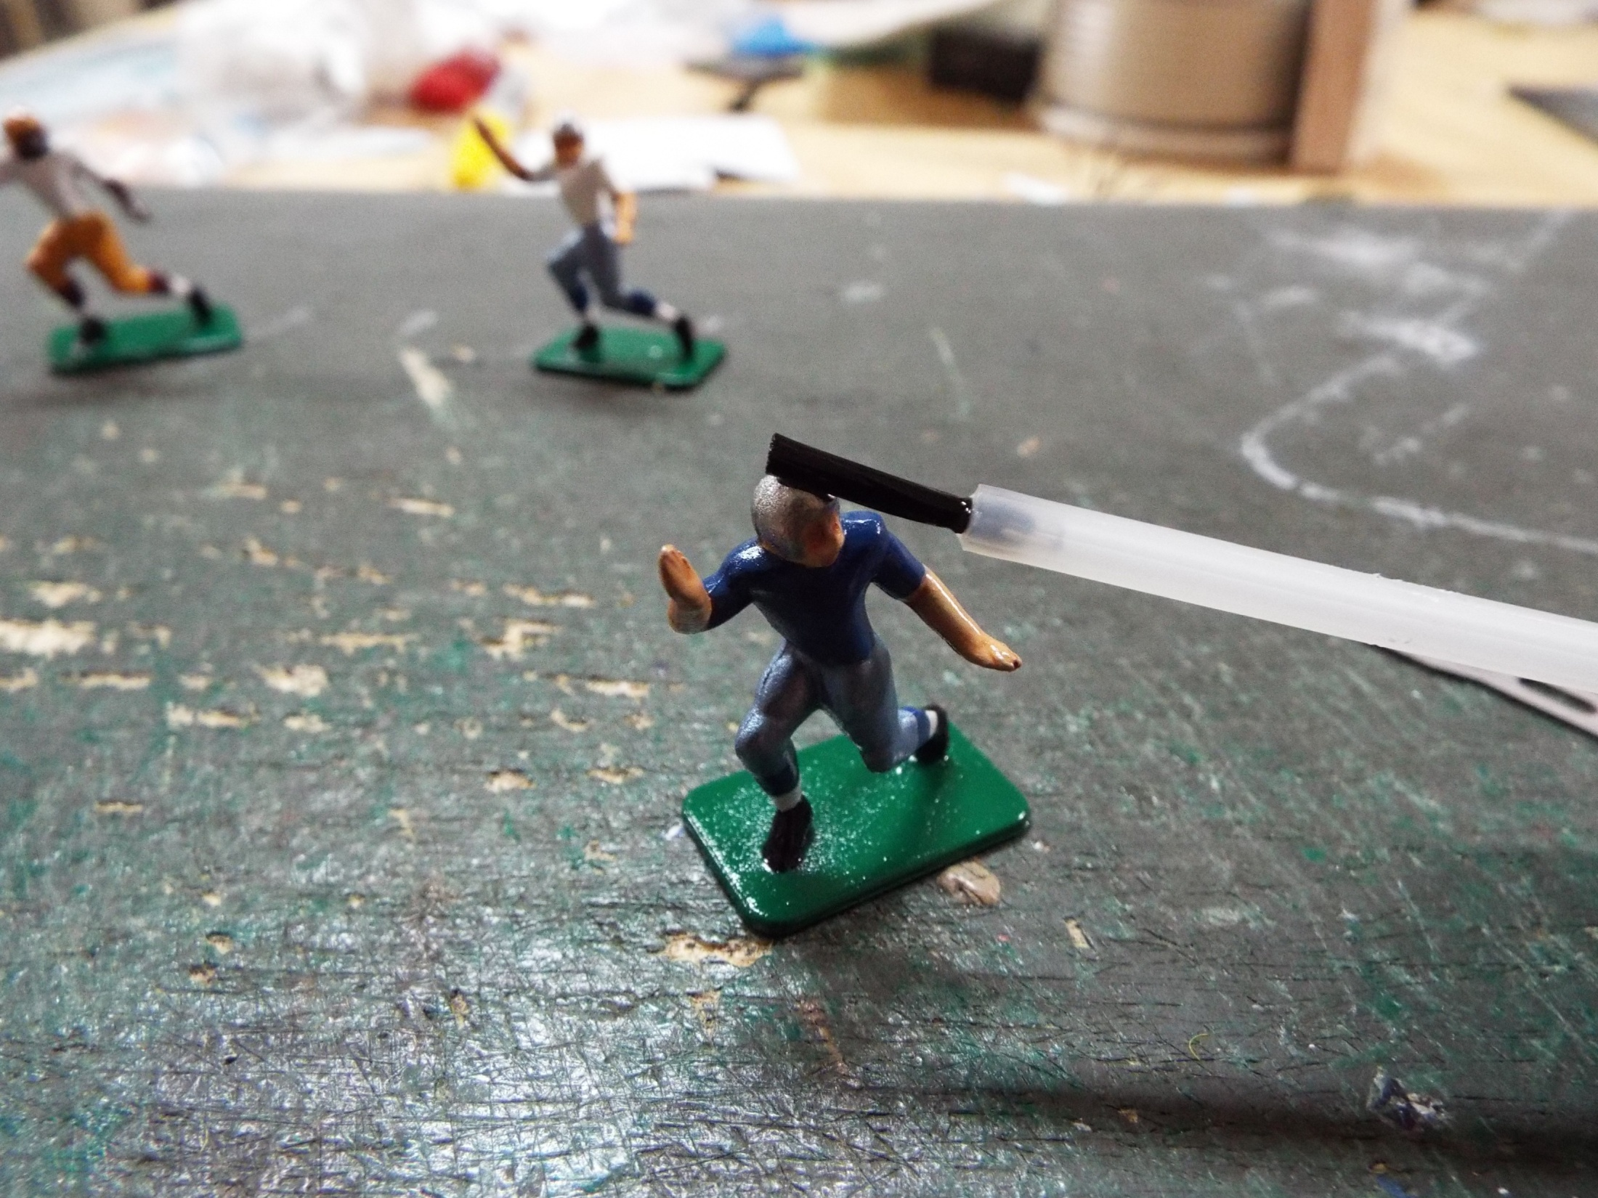
Solvaset goes on, just a drop is required.

Slide 4
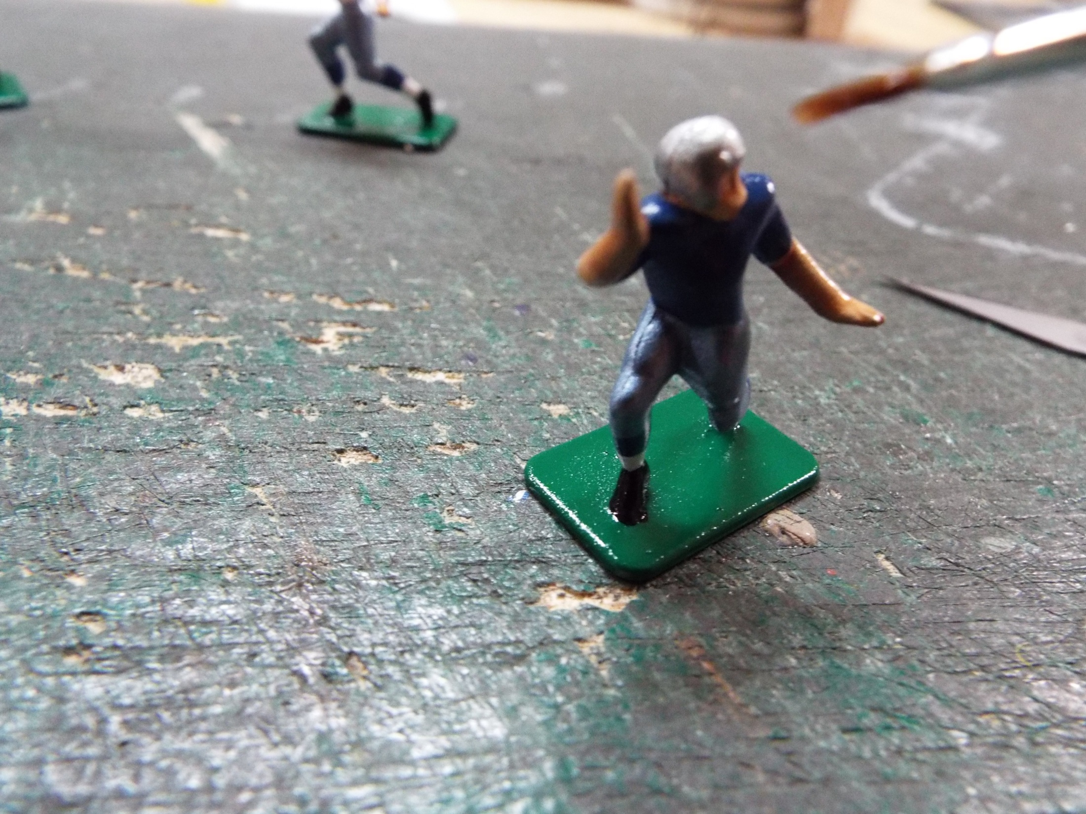
I used a small paintbrush to add a drop of water.

Slide 5
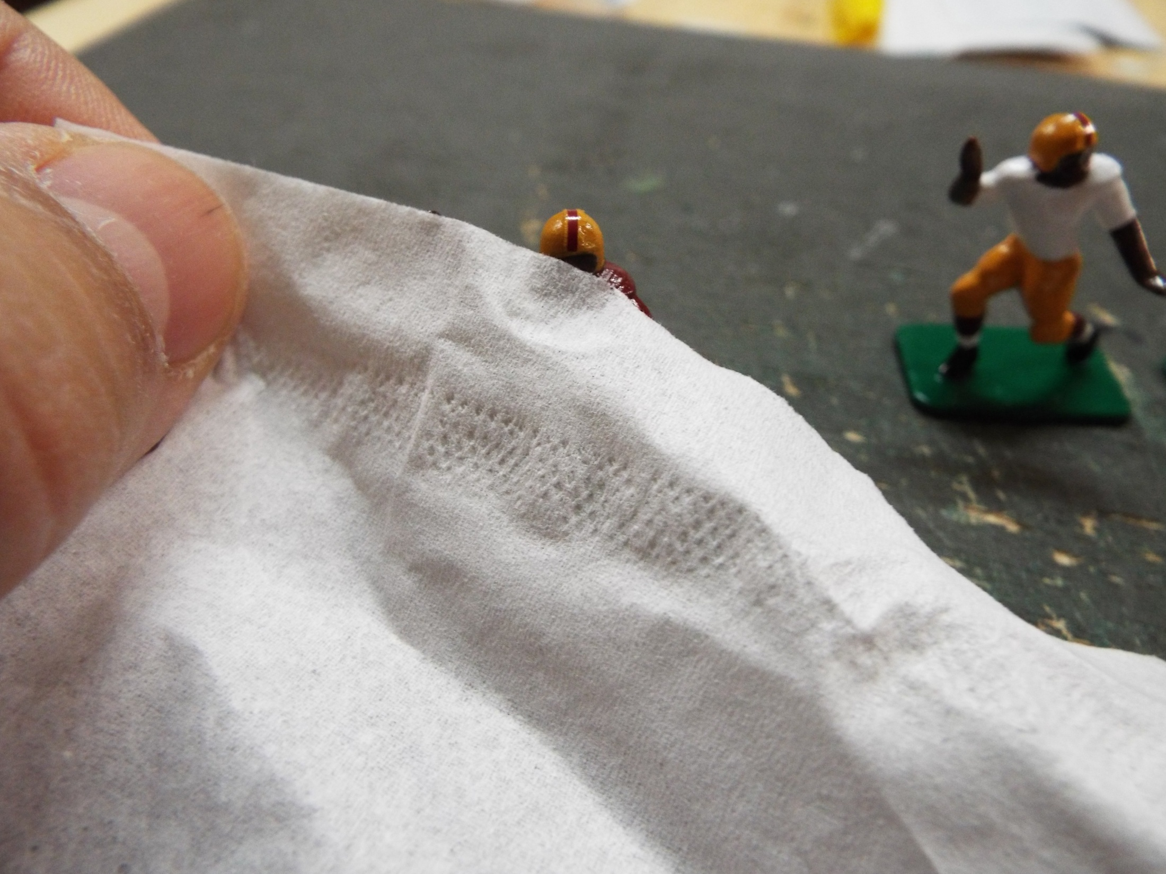
I first apply a bit of Solvaset and then a bit of water. The water enables you to adjust the position
0f the decals. If you fail to do this, you will not be able to move the decal once it makes contact with
the Solvaset and it will be stuck in place. I always do the helmet stripes, if required, first. I adjust the
position and then drain the excess fluid off of the head. You can still adjust at this point. But only for
A few minutes. The Solvaset works fairly quickly and begins turn the decal into an almost gel-like
substance. If conforms with the contours of the figure and grabs the surface extremely well.

Slide 6
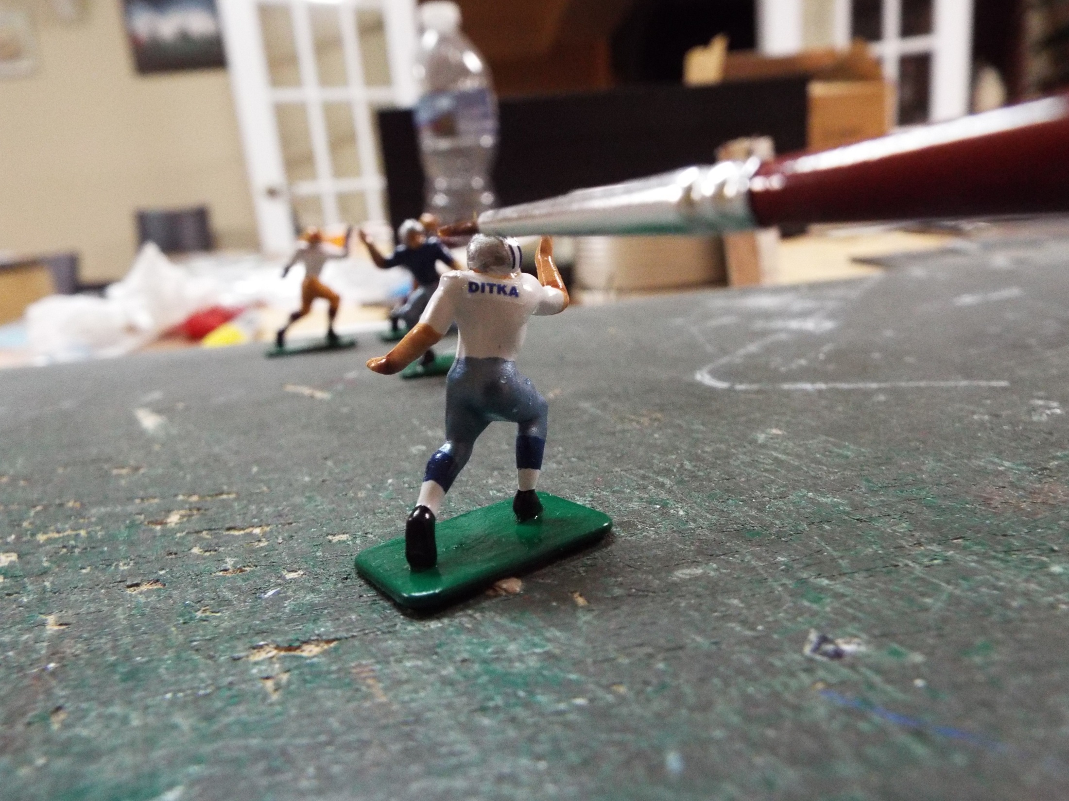
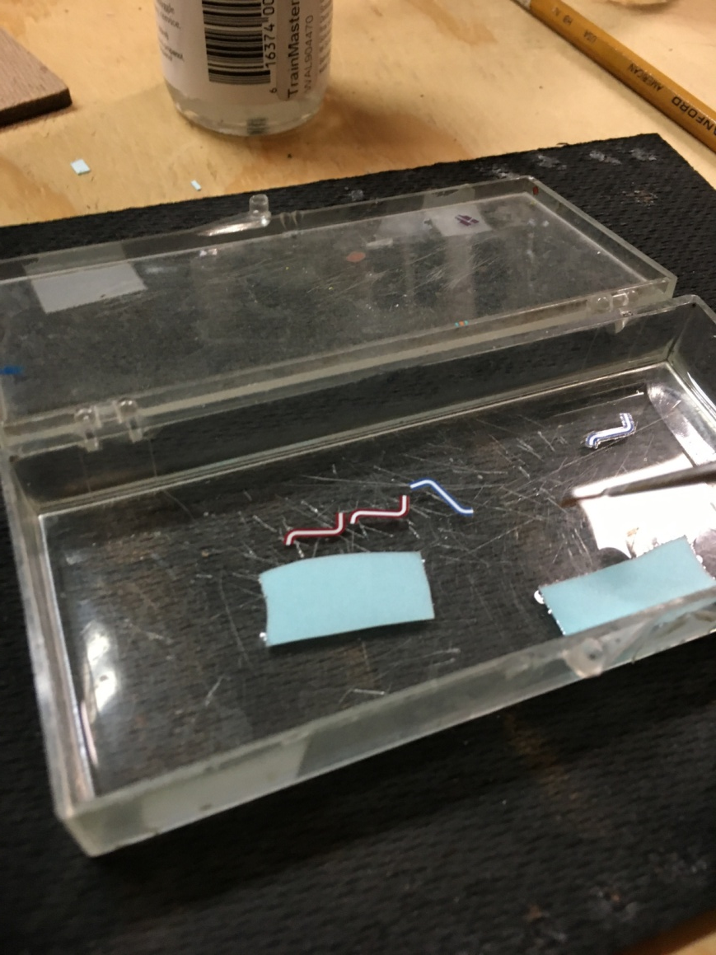
I place my decals in a small plastic box (insert) and after a few moments, I use a paintbrush
to move the paper, allowing the decals to slide off upside down. I then apply them to the figure,
afterward draining the fluid as described above. Important note, let the decal on the helmet dry
and move next to the jersey names. Helmet logos come later and one side at a time.

Slide 7
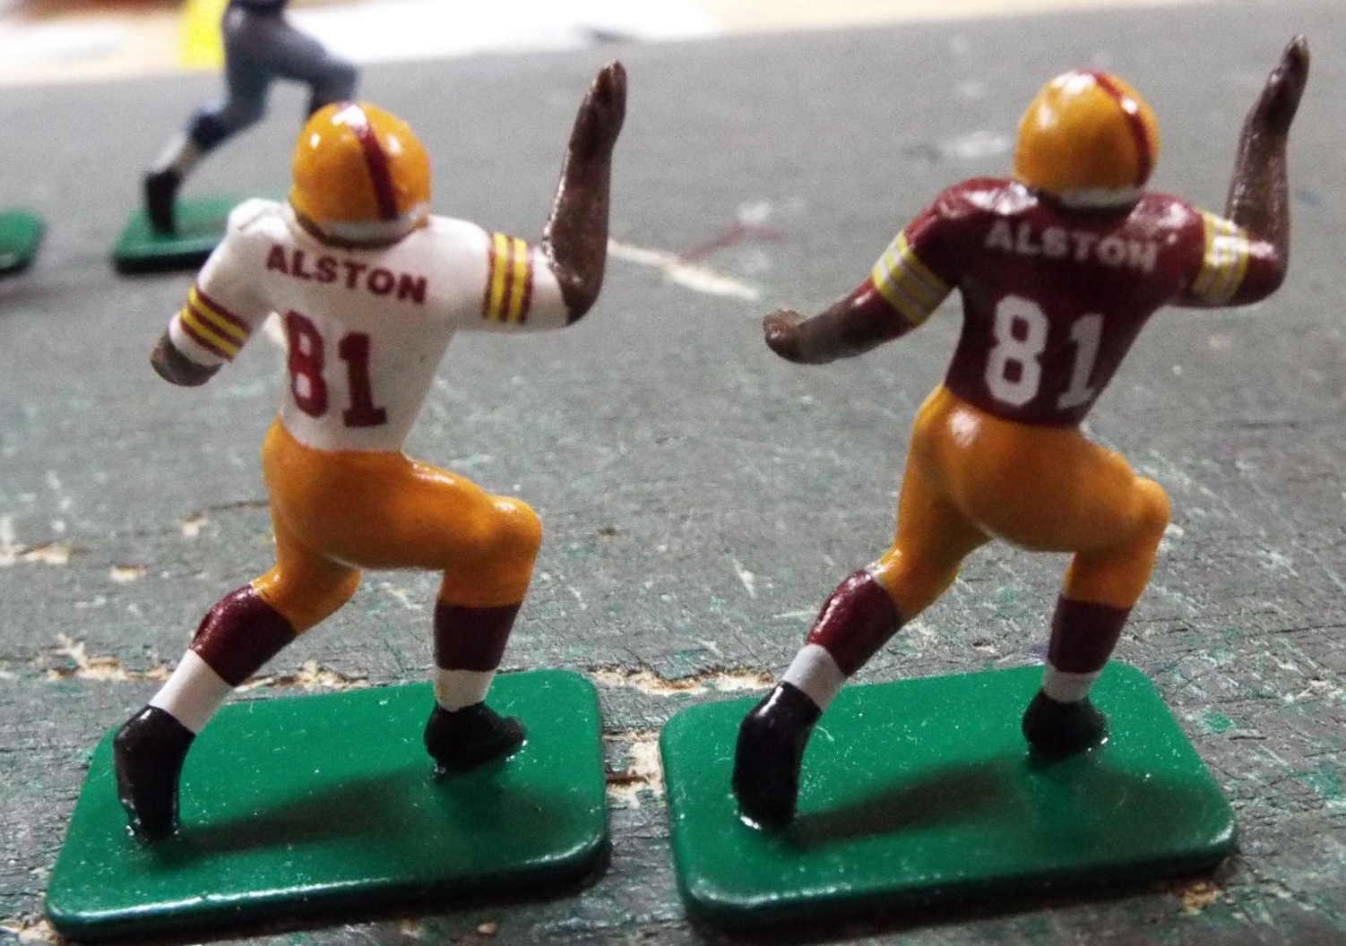
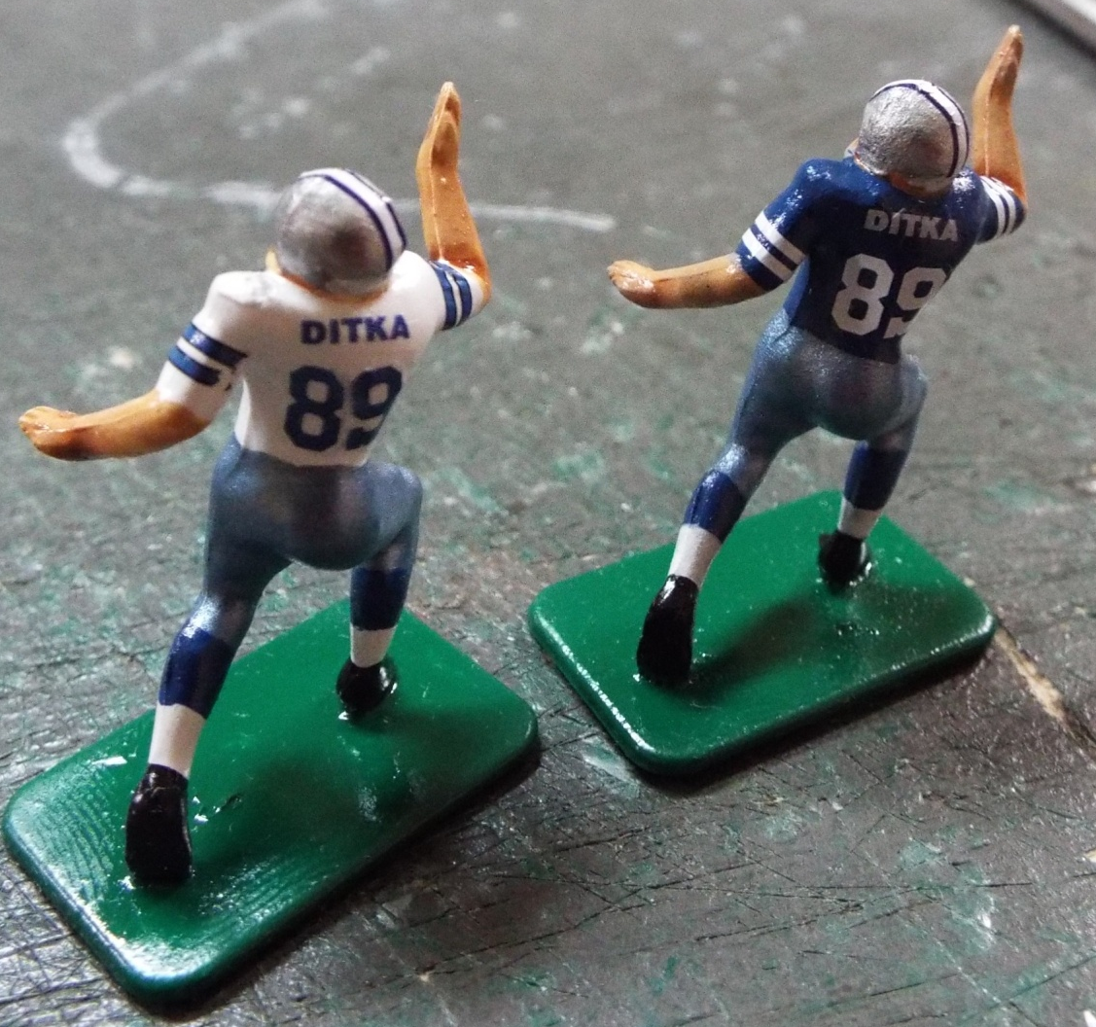
Do the sleeve stripes next, which are a pain in the….sleeve to adjust. Follow this with the large jersey numbers,
Going front to back. The order here is important.

Slide 8
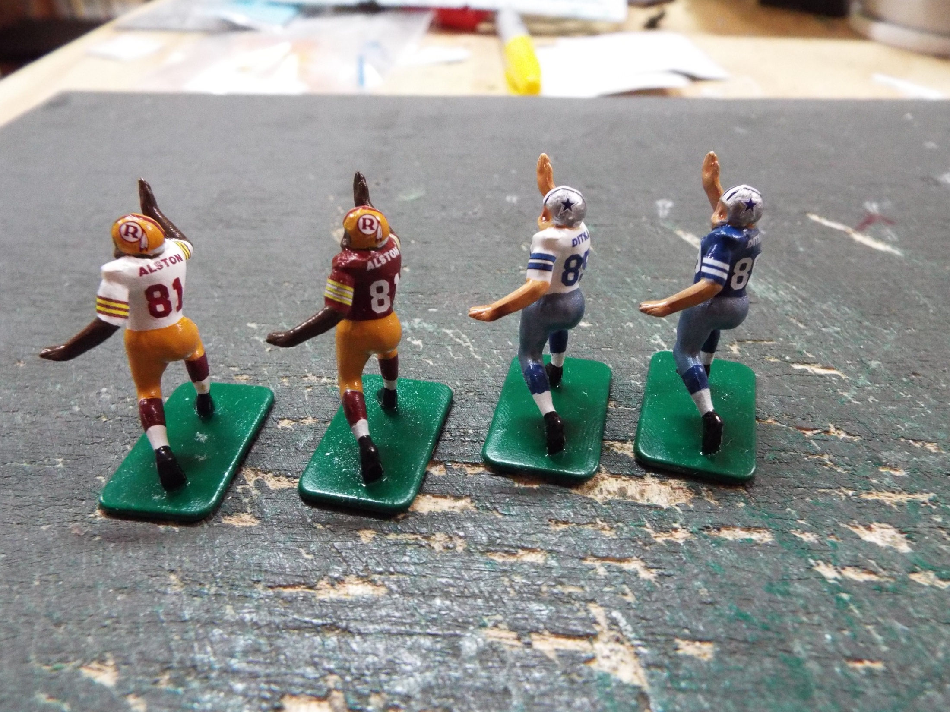
Do one side of the helmet logos next. Either side will do, but be consistent. Move in the same figure order with each step, allowing drying time for each.

Slide 9
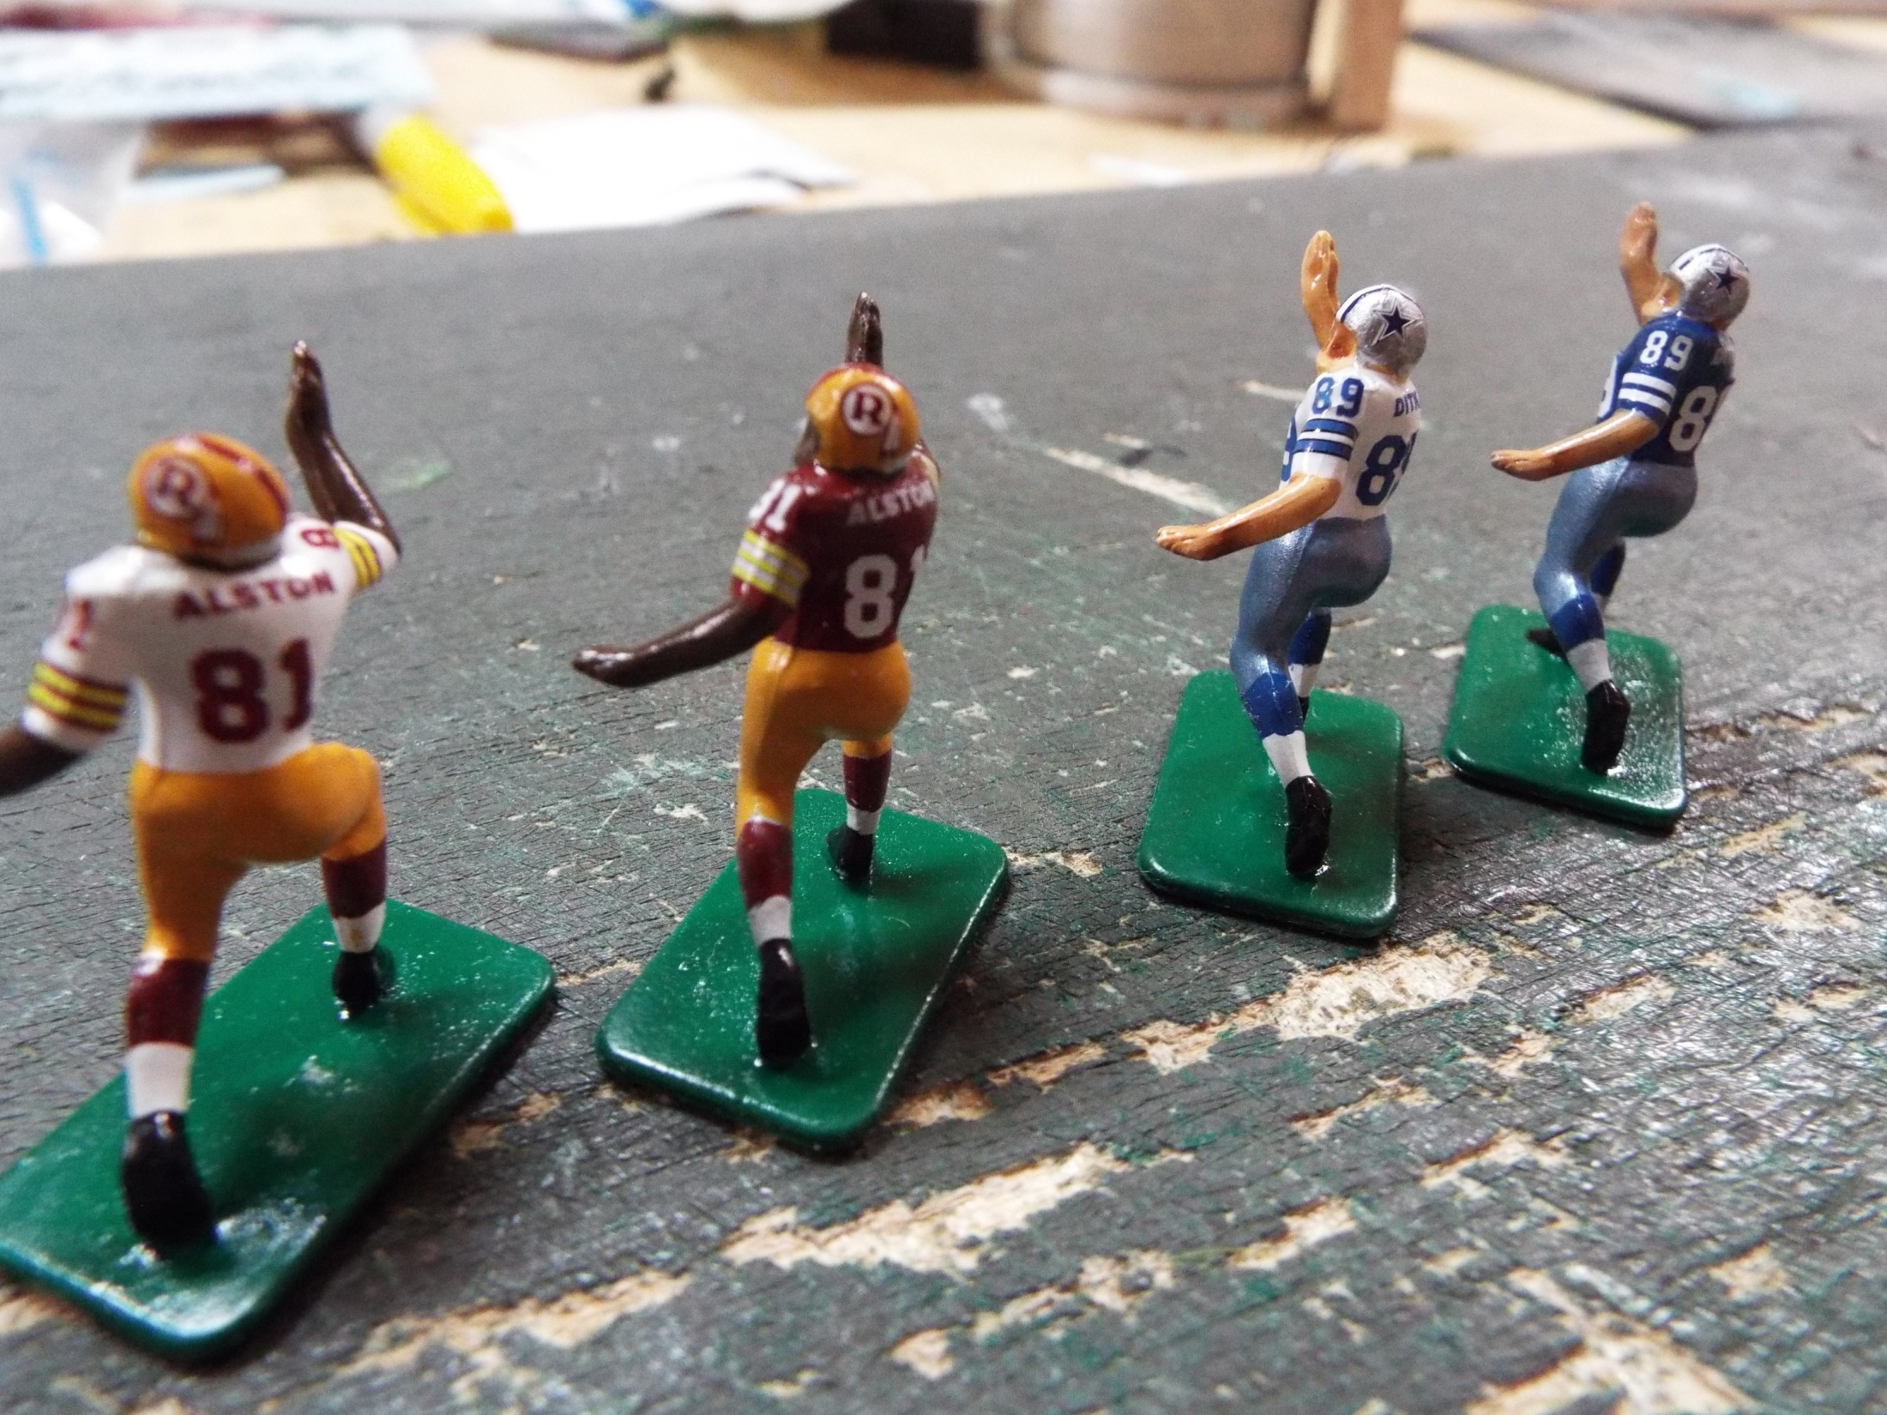
Do the small shoulder numbers next if appropriate.

Slide 10
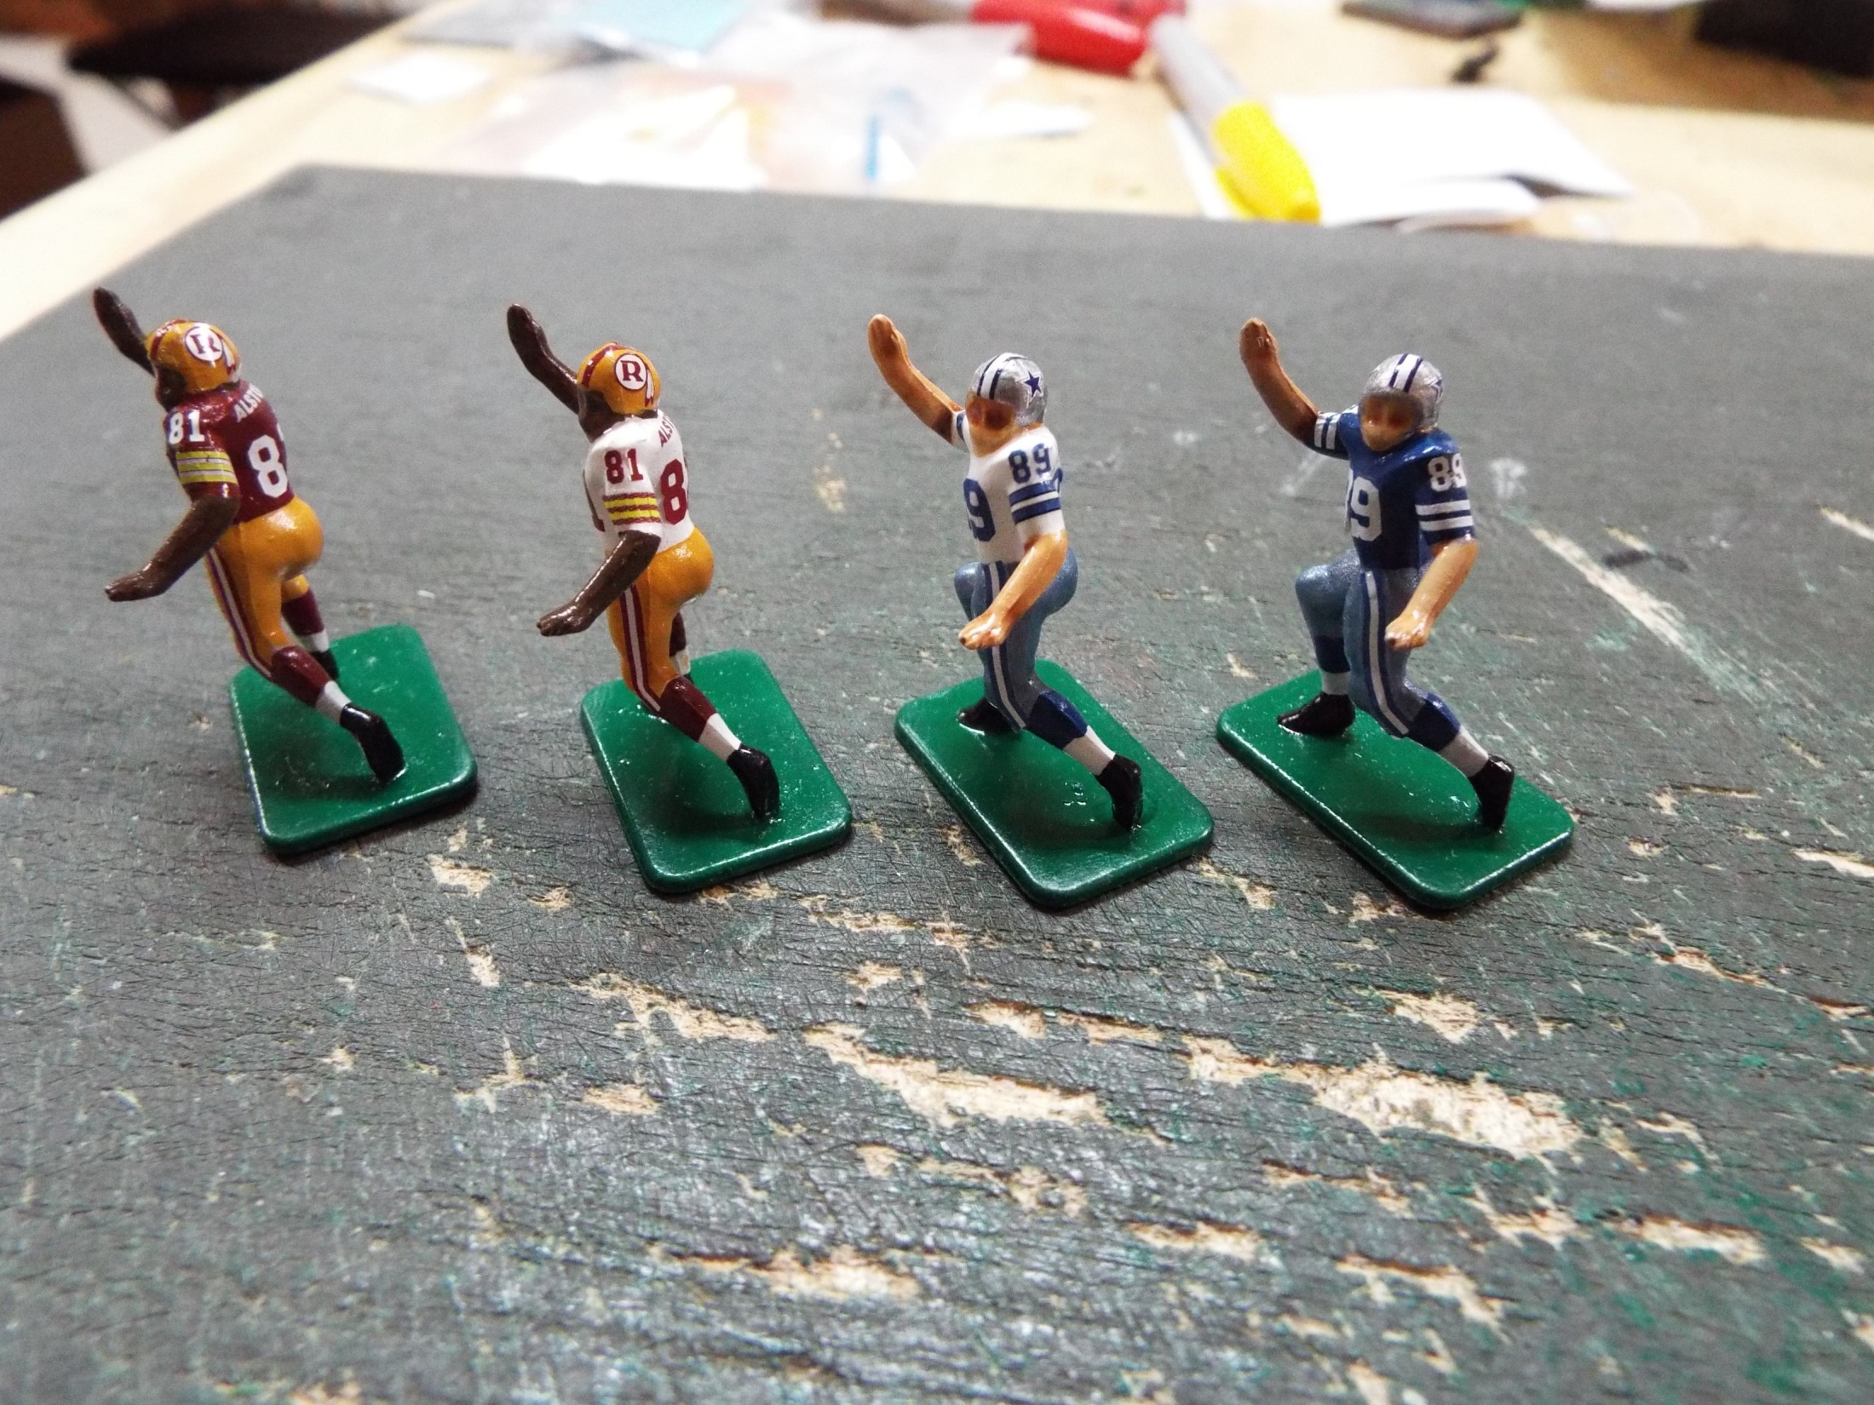
Now you can apply the other side of the helmet logo decals. The leg stripes
come next.

Slide 11
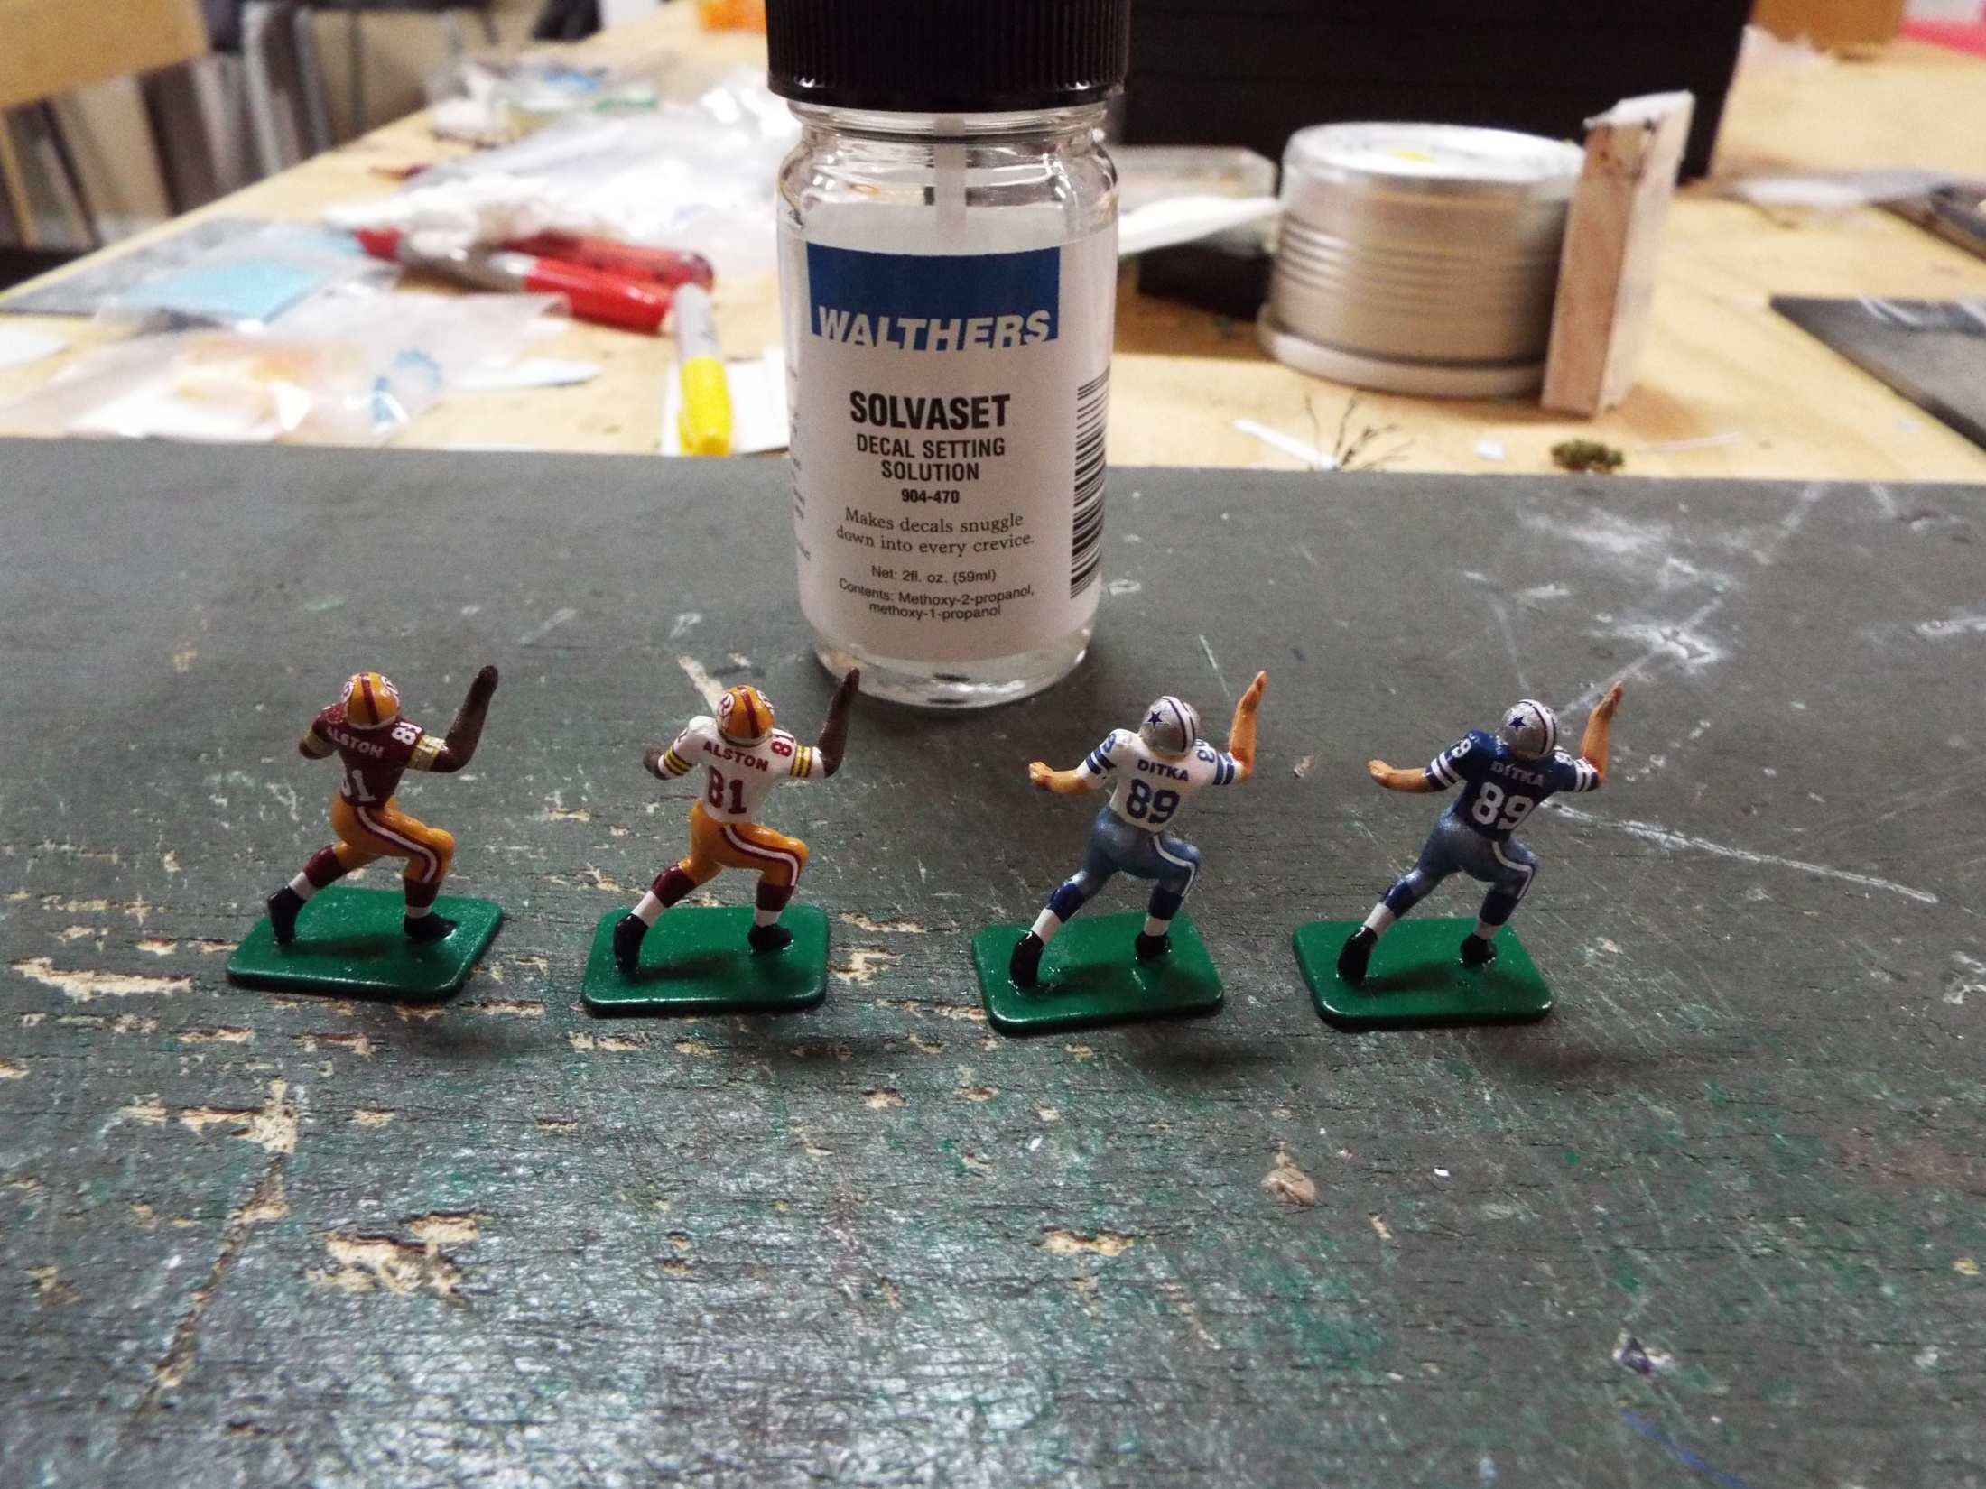
Finally, do the leg stripes. Again one side per figure, then the other. Drain the fluid as you go.

Slide 12
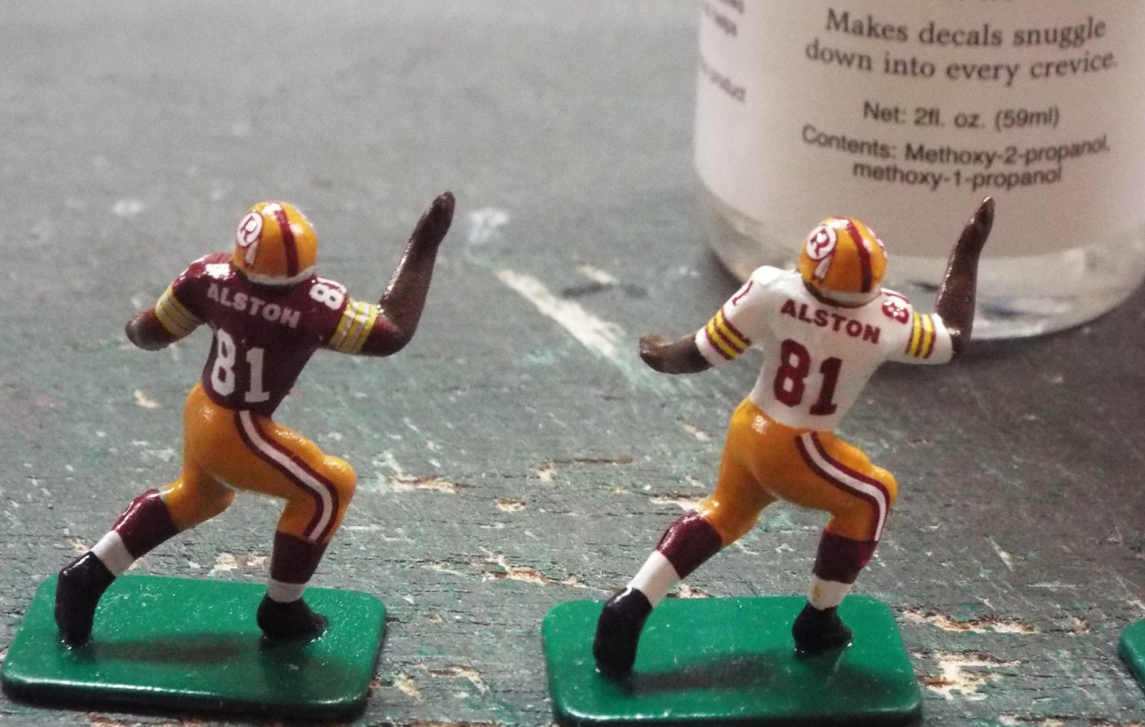
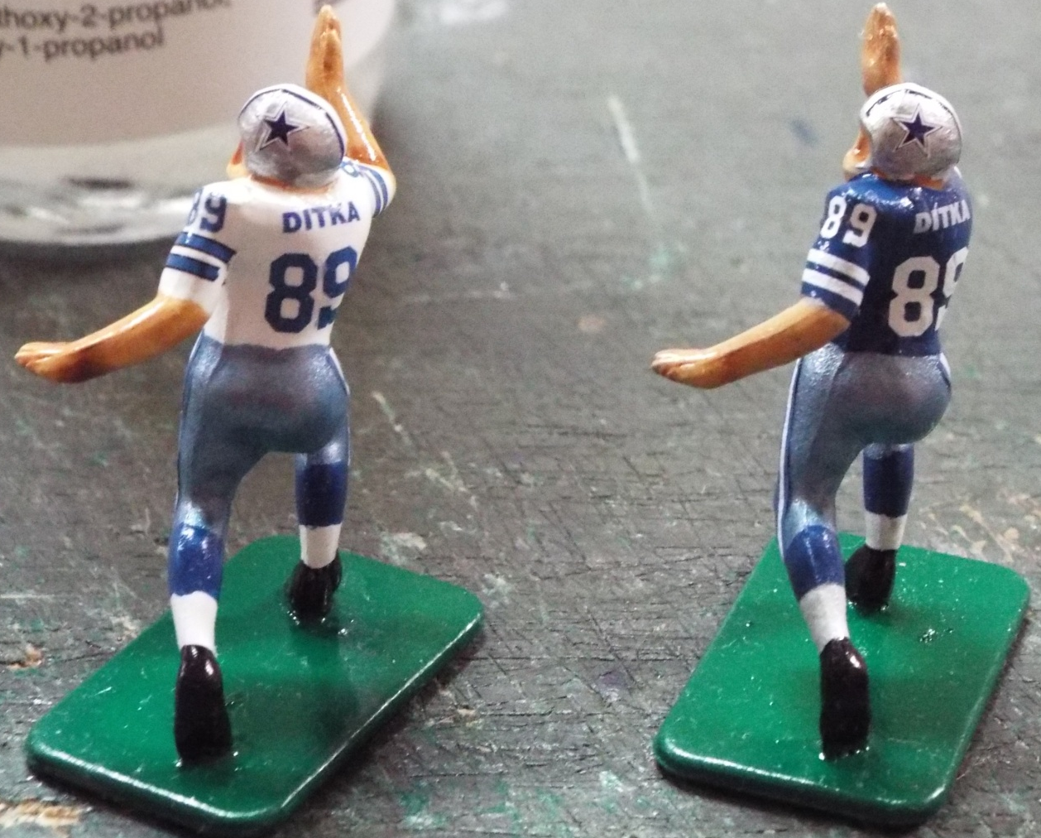
Now, walk away. No matter how tempted you are to finish. Your patience will be rewarded. - Alton Brown on Good Eats

Slide 13

After at least an hour passes, go back and coat every decal with another
fairly generous application of Solvaset. Let this dry thoroughly. This will
ensure complete adherence to the contours of the figure.

Slide 14
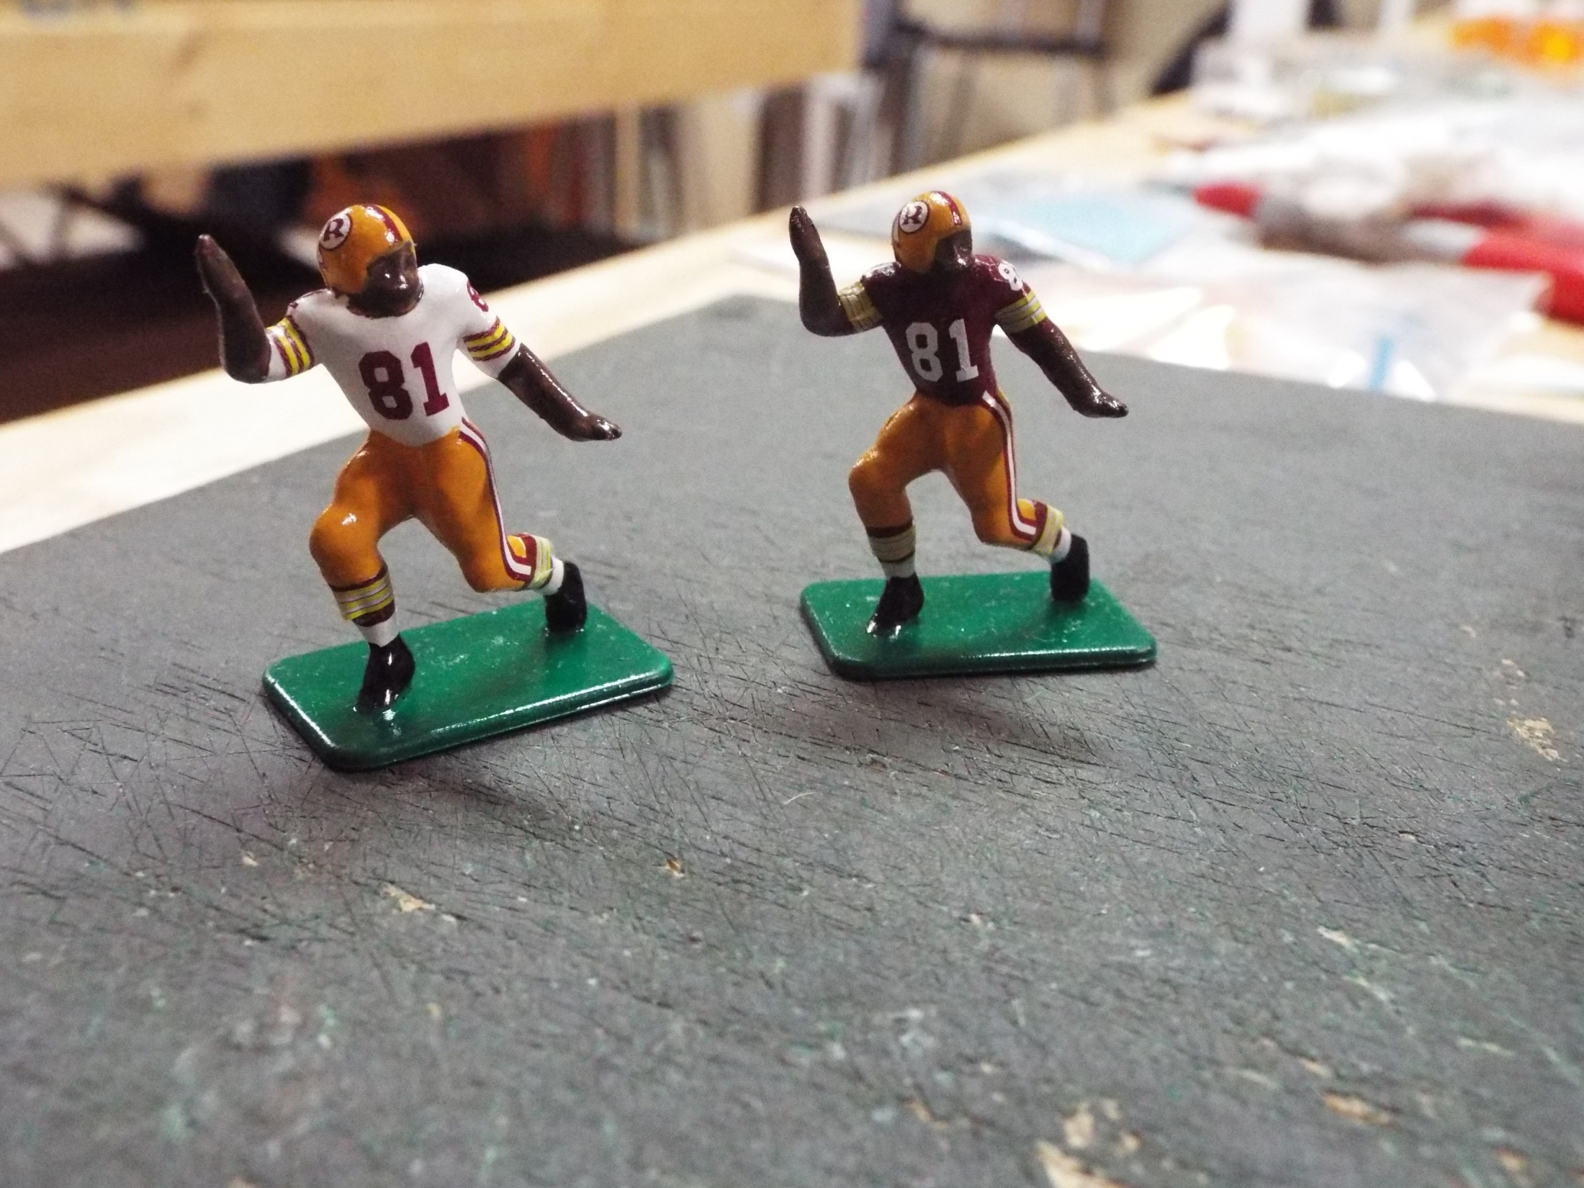
If you want to do socks, that is the final step. I always cut them a bit long so the will fold
over each other. The socks are the most difficult part of this process. It is really not necessary
for most teams, and takes multiple adjustments and three applications of Solvaset. I have
done this for the Redskins, Pats and Dolphins, all of which had distinctive socks.

Slide 15
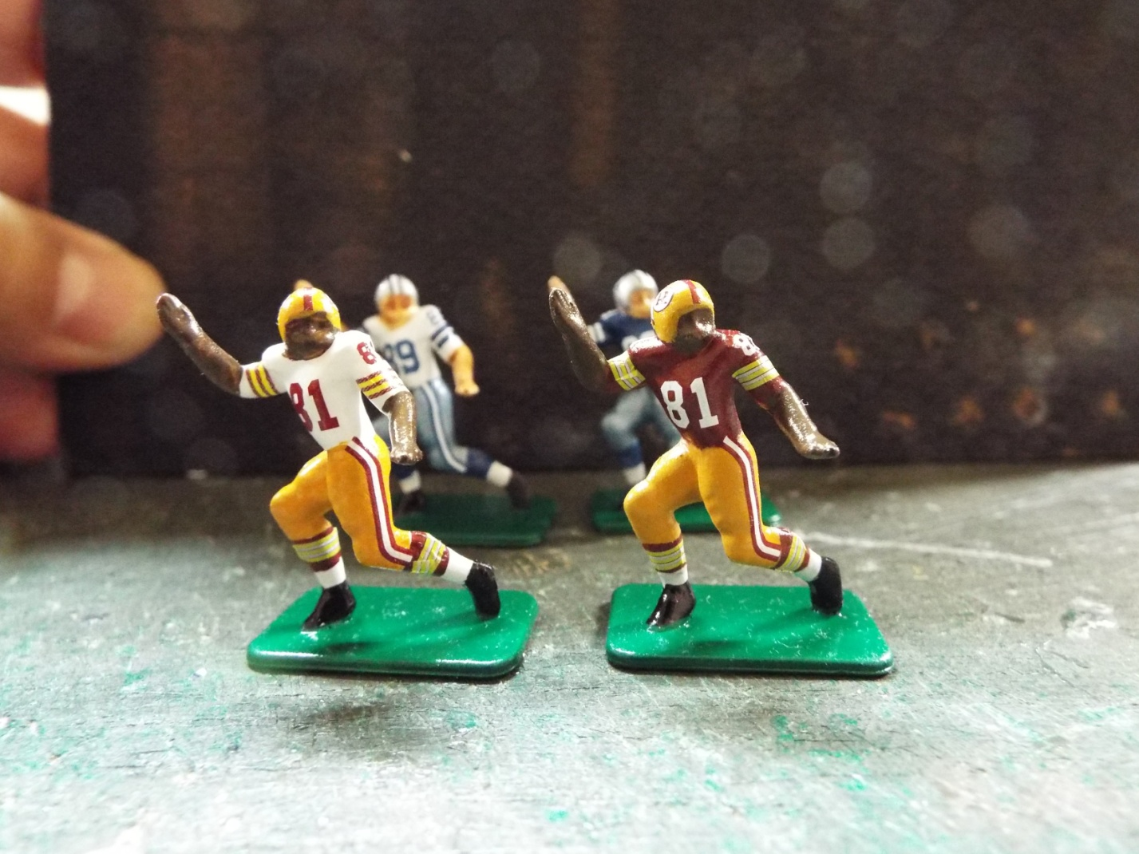
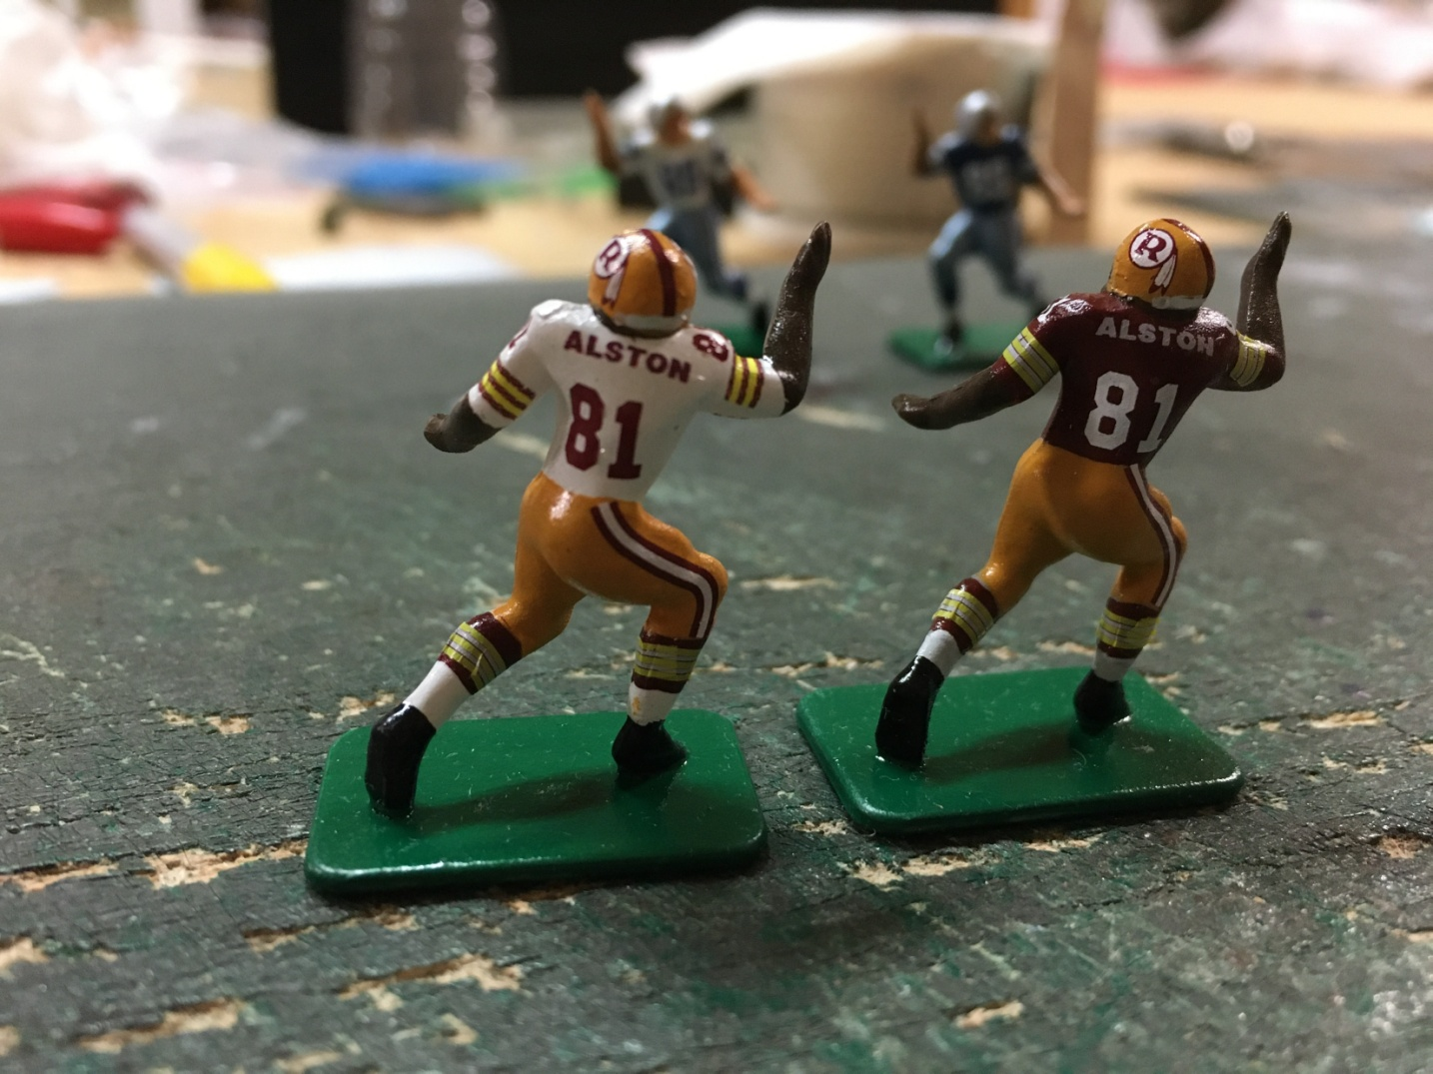
The next few steps will help with the socks, but this will be in part V.

