Slide 1
Painting The 71 Vibe
Final Part V – Face Masks and Finishing

Slide 2
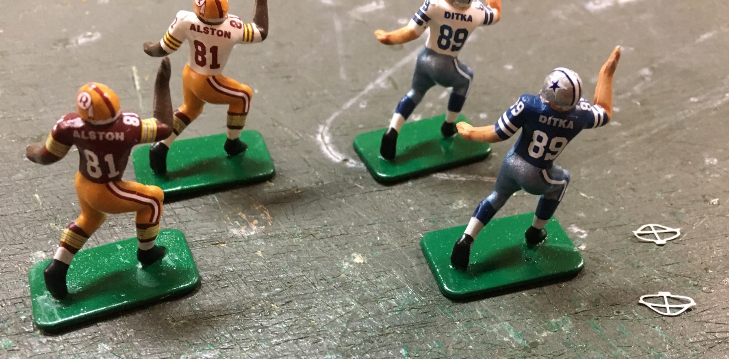
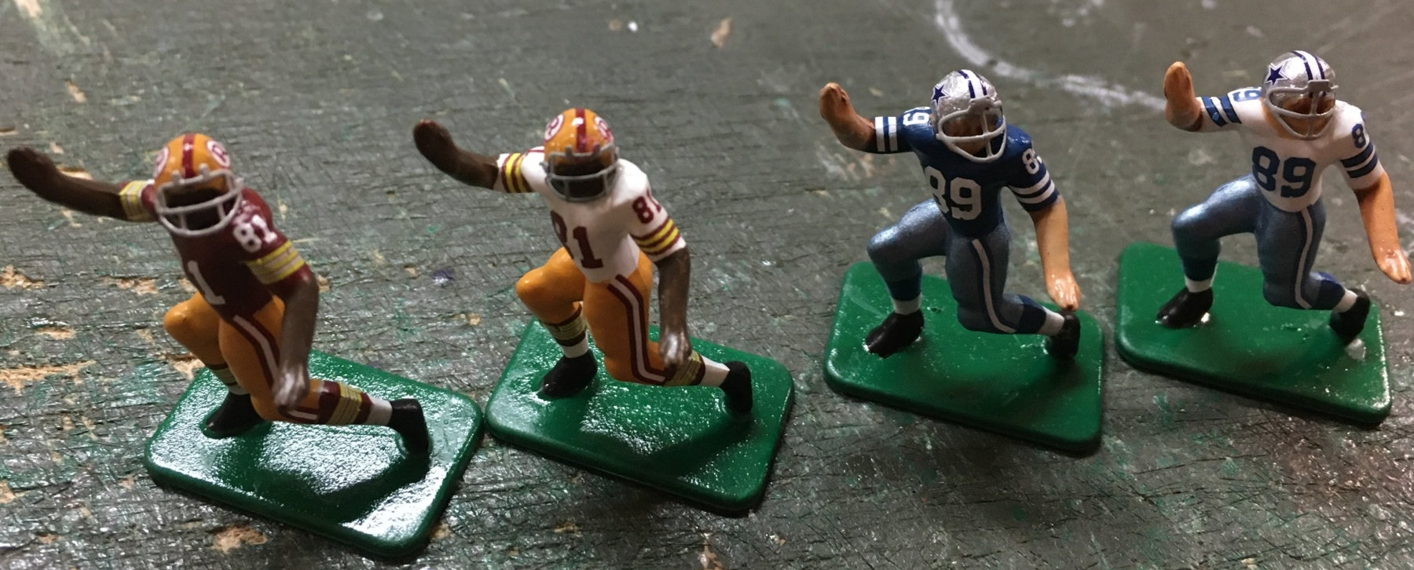
I won’t spend a great deal of time on
face mask application. I use Gridiron
Buzz throwback face masks which I
Usually order from Bryan Nutt when
I order decals. I keep them on hand, and
I try to match the style I use on both home
and away jerseys. Use a quality super
glue and then leave these to dry for at
least an hour. This will prevent the
glue from clouding the varnish layers
I put on the figures for protection.

Slide 3
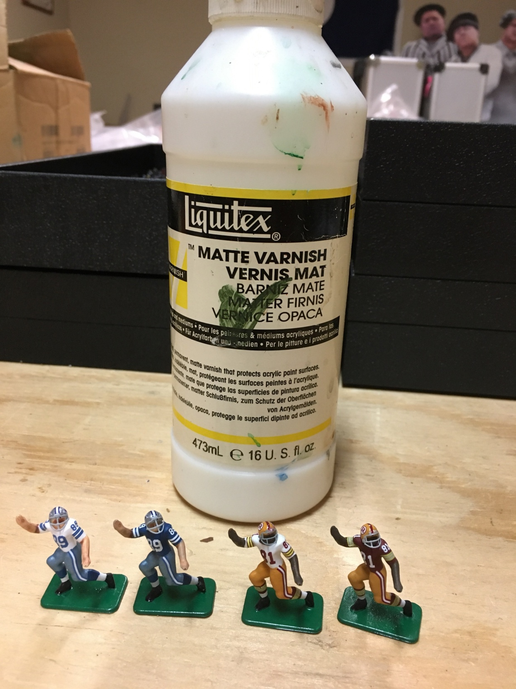
I use a non-yellowing Liquitex brush-on varnish to protect the decals. This is an important step as you will handle these figures frequently. If you skip this, I guarantee the decals will come off eventually. This step also prevents fading and yellowing. Let this dry thoroughly. If you are rough on your figures, apply a second coat and let that dry completely before moving on.

Slide 4
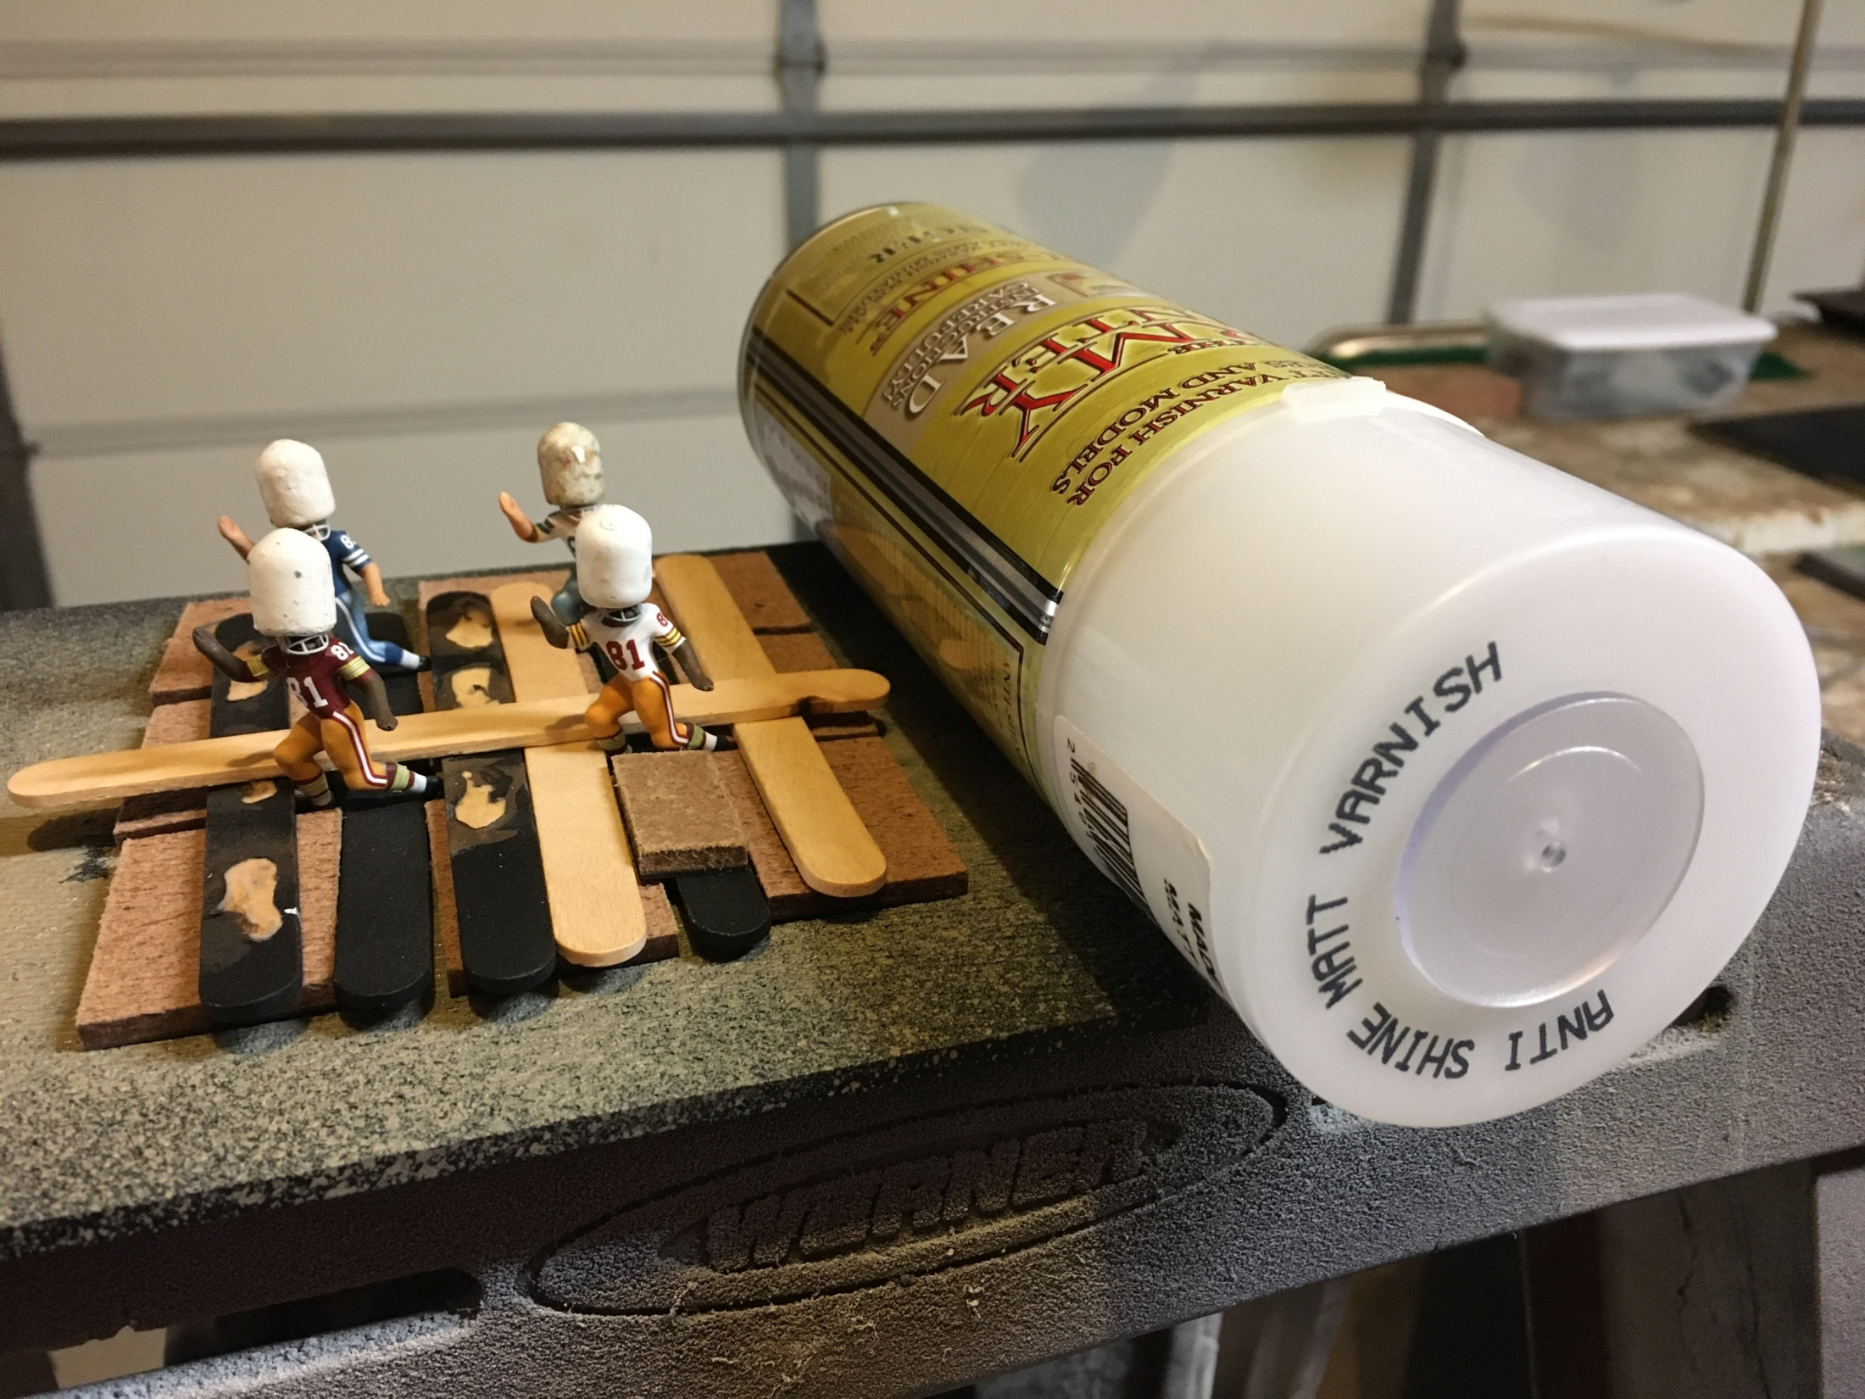
I then cover up the bases and helmets and use a spray matte varnish from Army Painter.
This will bring your figures to a dead-flat. This is not a required step, but the flat finish
allows all your hard work to be more realistic and more easily seen. The glare from gloss
finishes covers up details and makes photography very difficult. This is a important aspect of
the hobby for me. Take care to use short burst from around 6-8 inches in distance. Don’t over spray!

Slide 5
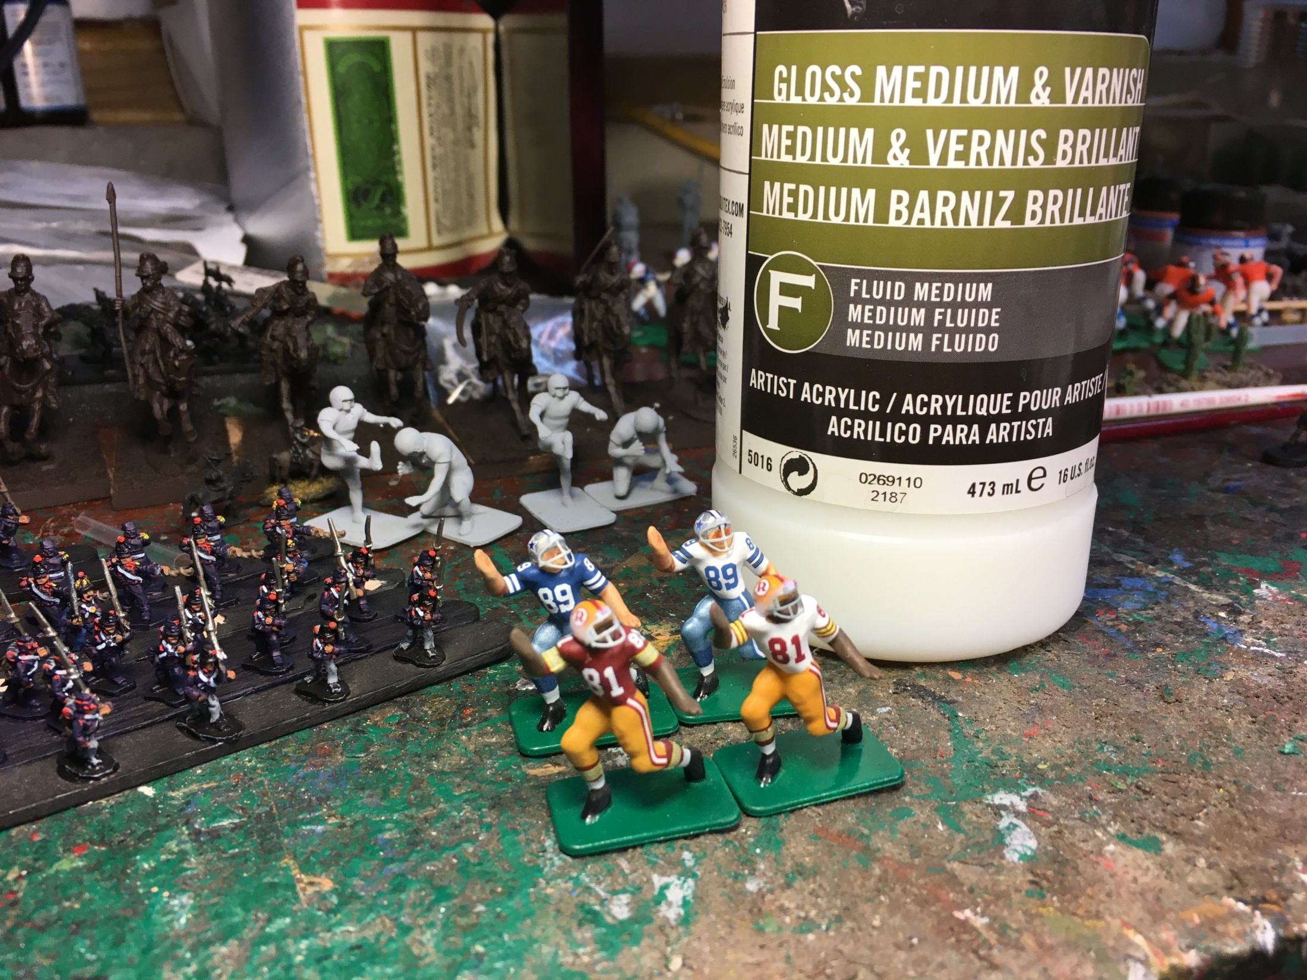
The final step is a double, or even triple coat of Liquitex Gloss varnish on the helmets.
This makes the helmets look great and also helps to hold the face masks securely in place.

Slide 6
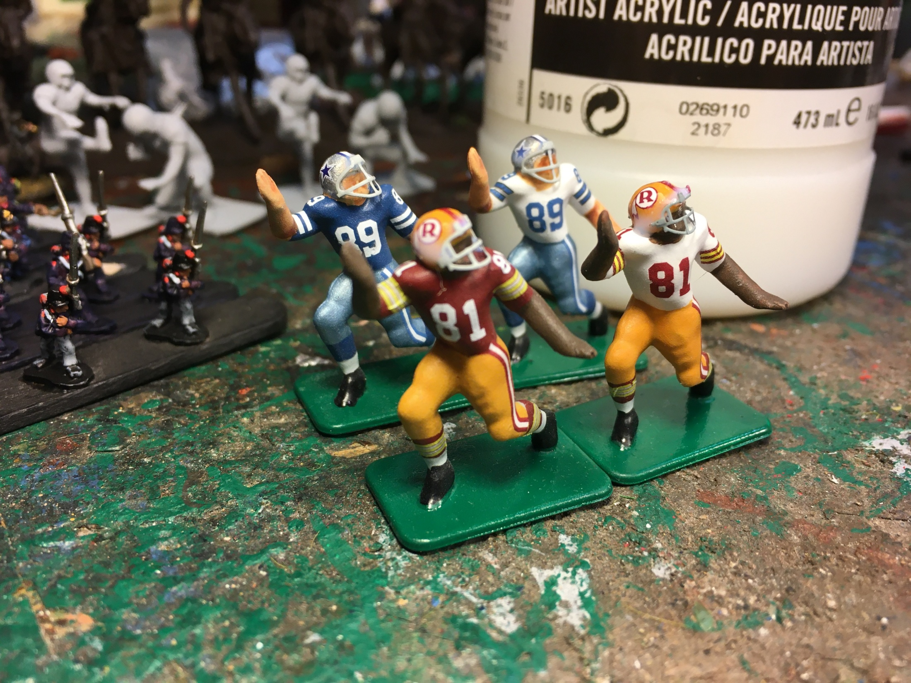
The first coat should be fairly thin. I clean up anything dripping on to the jersey with an old brush.

Slide 7
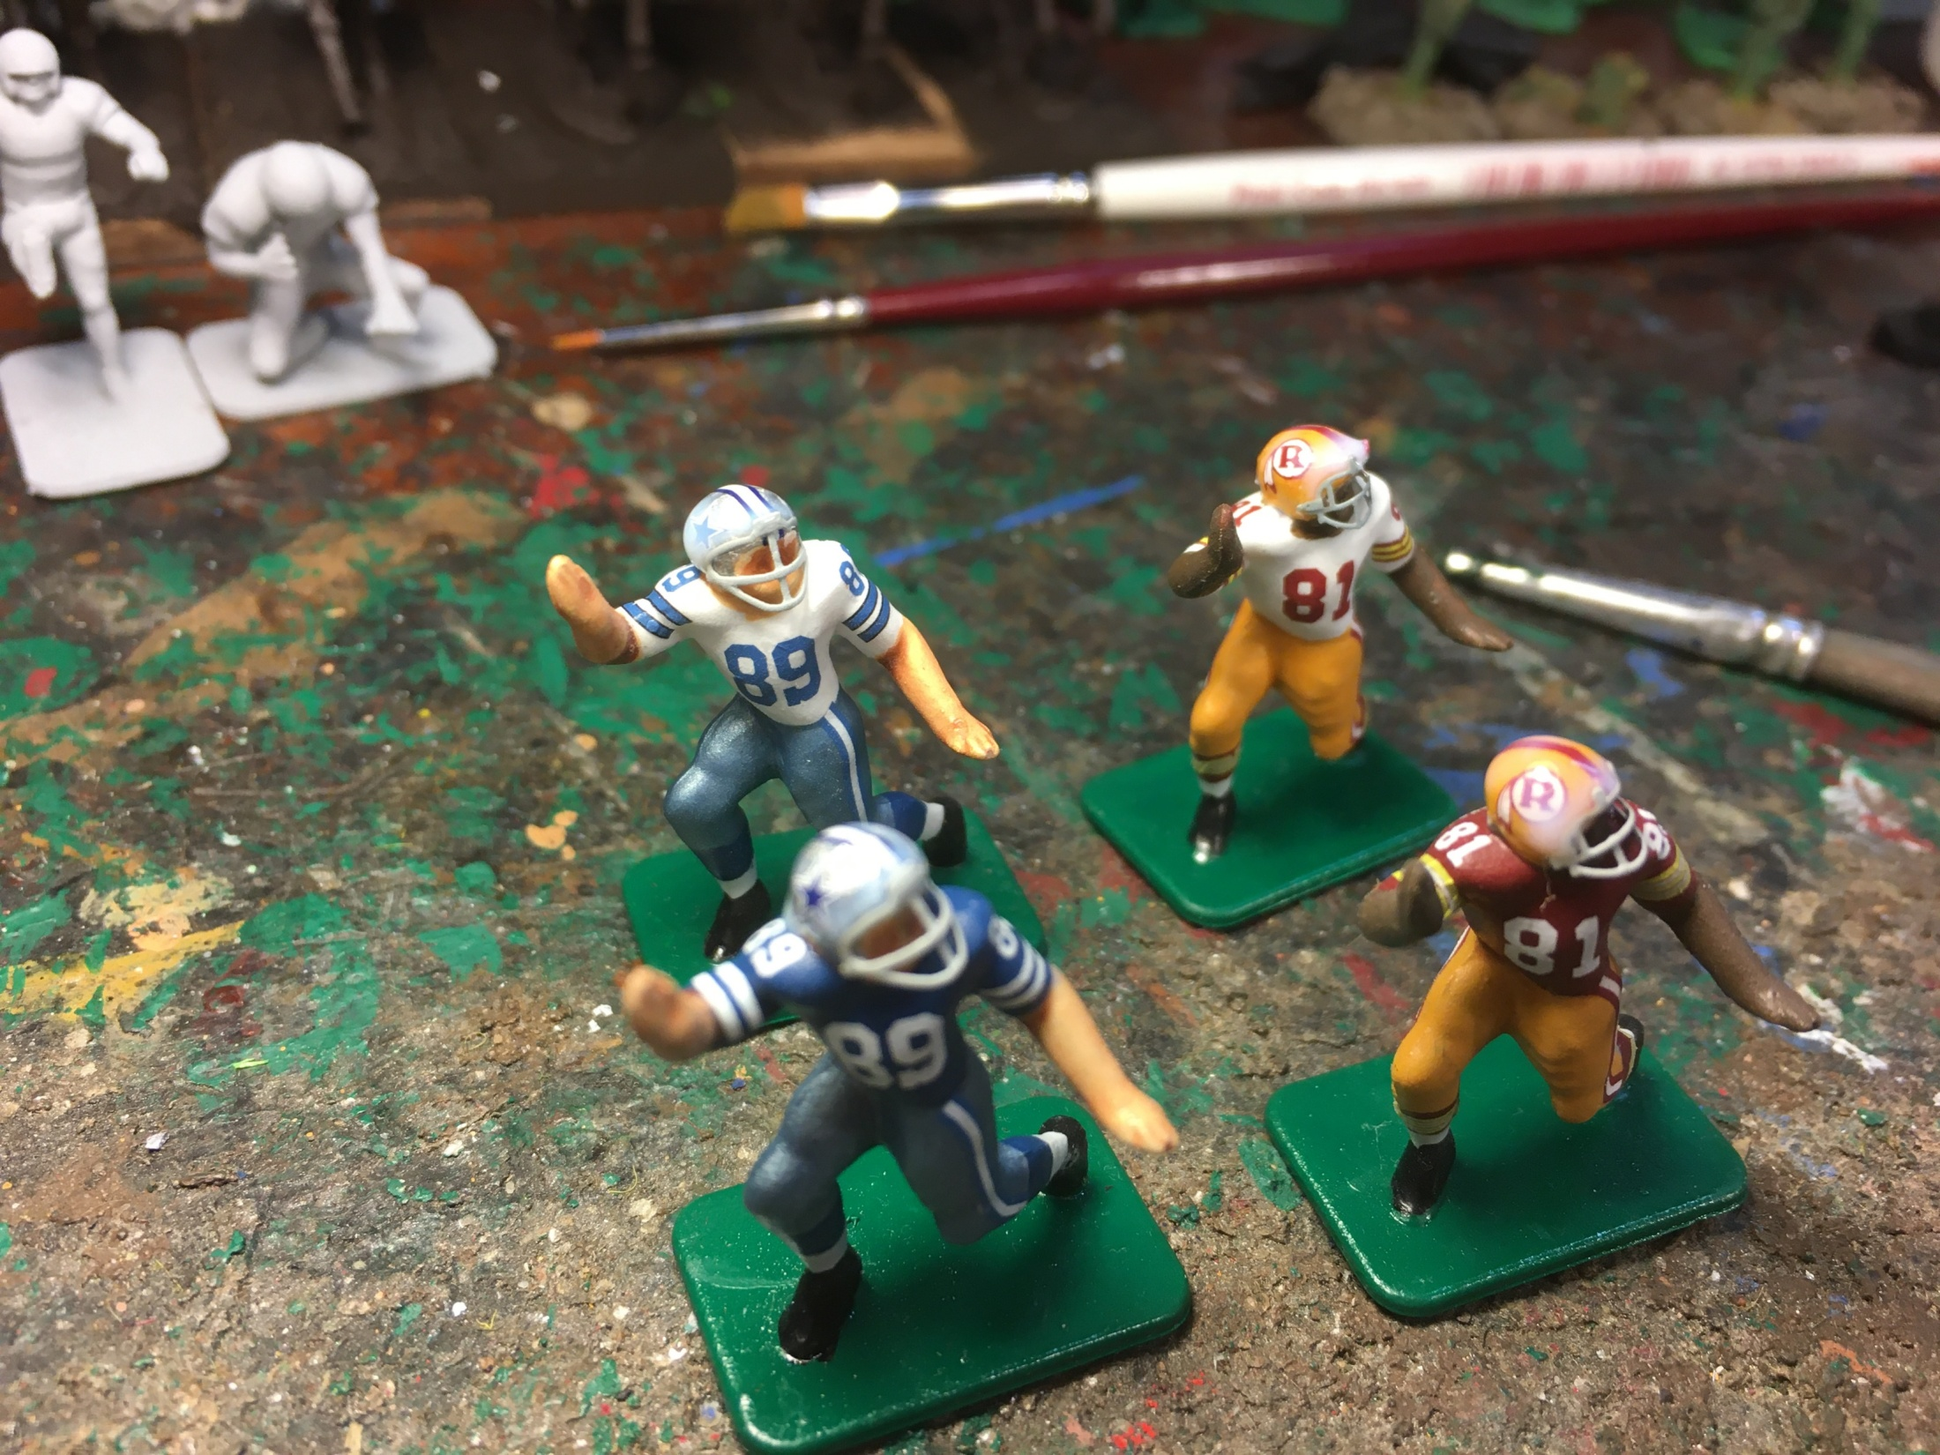
Second Coat can be a little thicker.

Slide 8
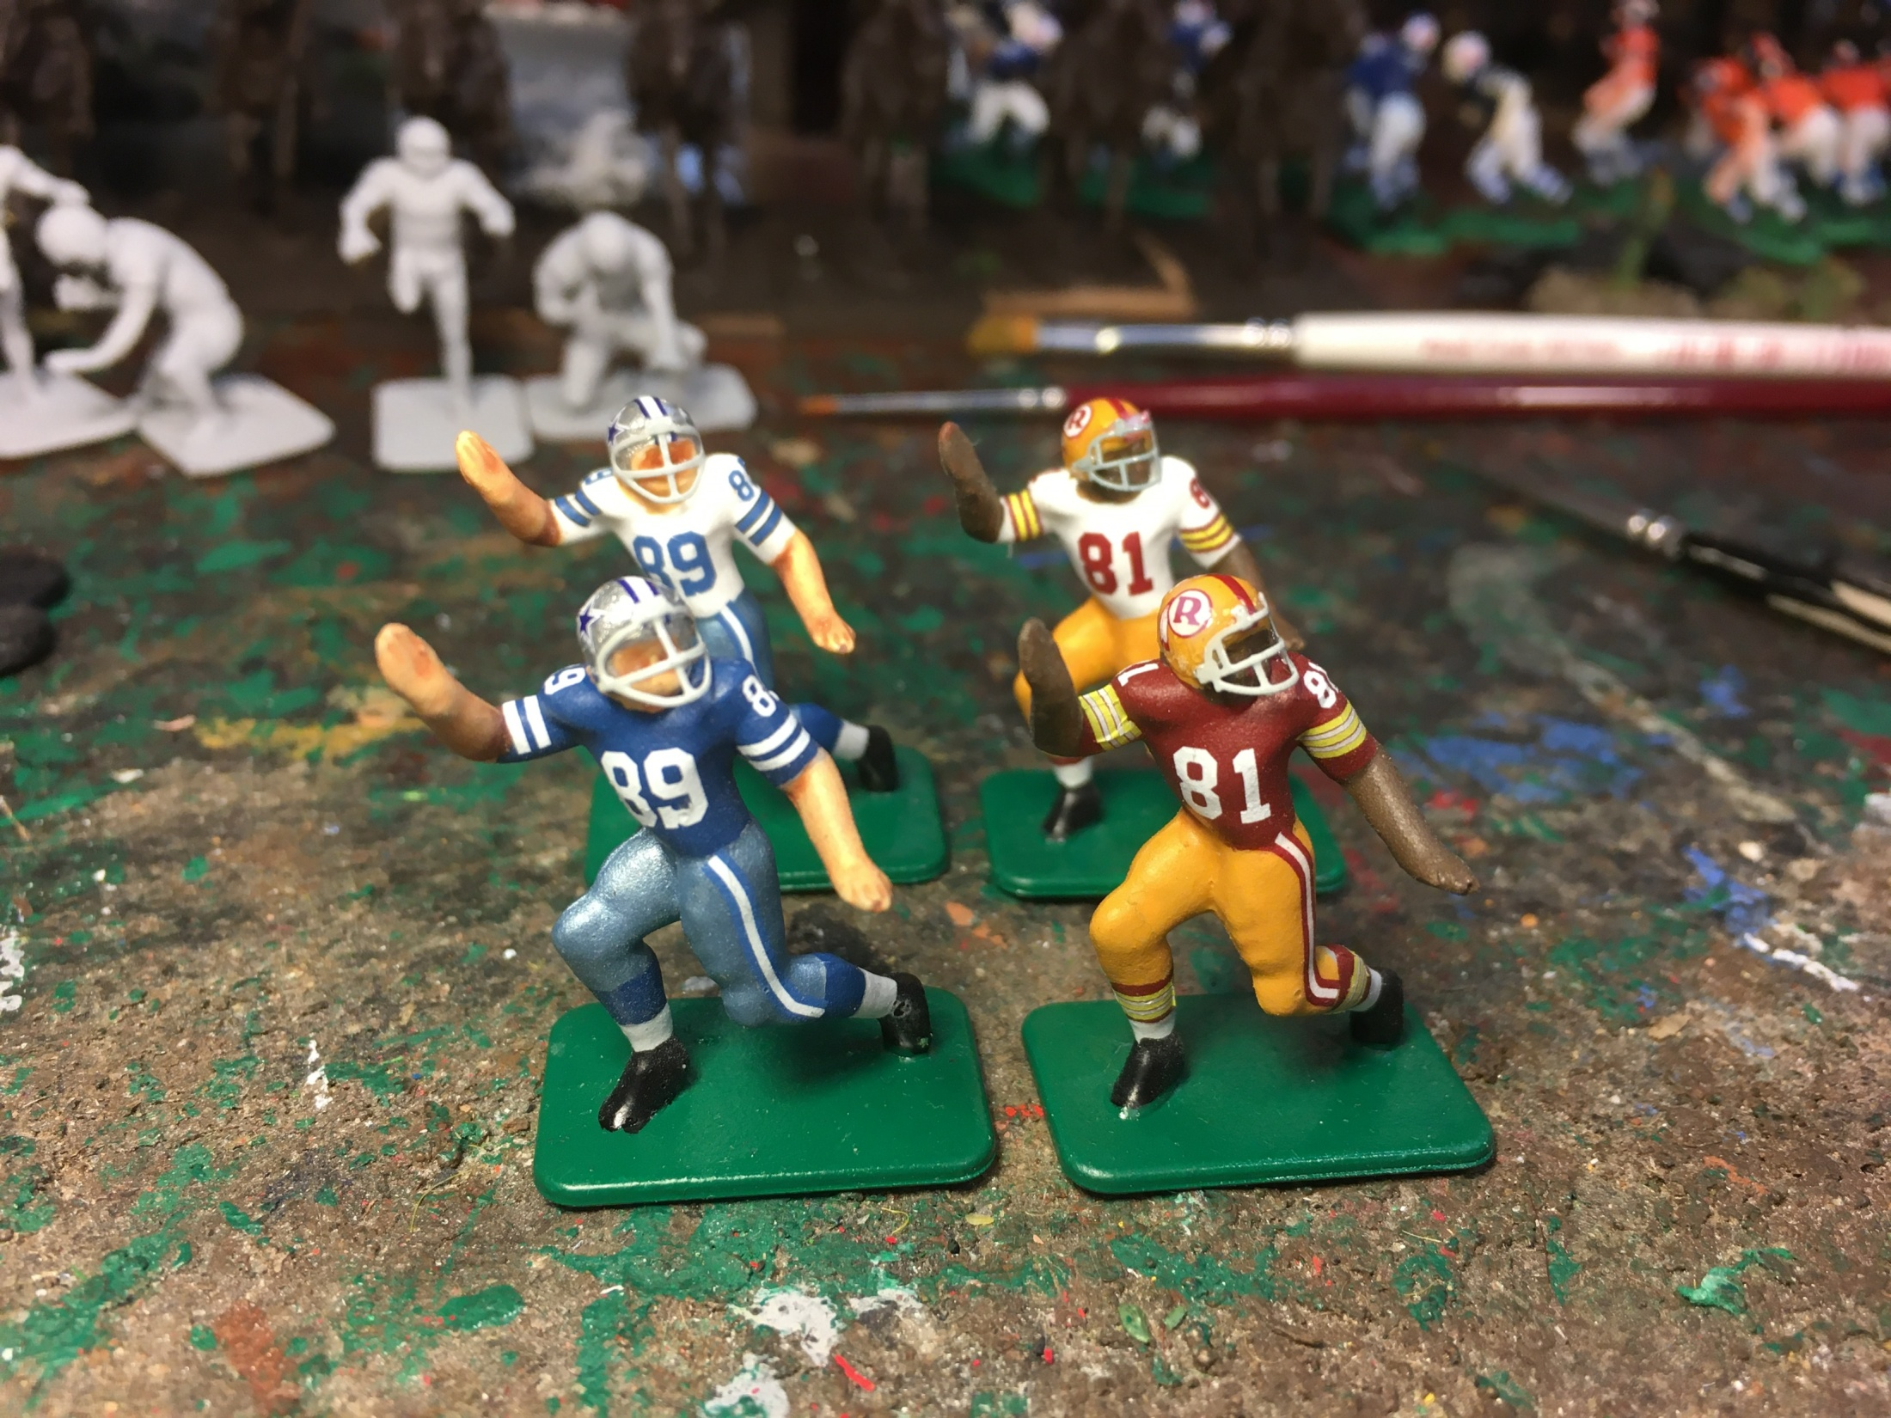
After the third and final coat, I let the figures sit under a lamp and dry thoroughly. When I store
my figures, I keep them in plastic boxes standing upright and stored out of the light. This will act
as another factor of protection against fading and yellowing. These fellas are ready for The 71 Vibe!

Slide 9
Thanks for joining The 71 Vibe!
Thanks for reading the documents.
I sincerely hope they are helpful to you.

