Slide 1


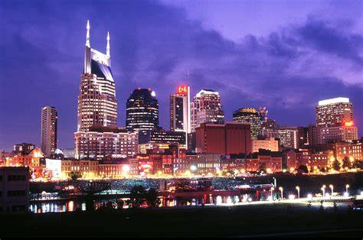











TENNESSEE
Professional Electric Football League
8 Teams, 4 Cities,
3 Very Distinct and Diverse Geographical Regions
MEMPHIS
NASHVILLE
KNOXVILLE
CHATTANOOGA
a Solitaire ELECTRIC FOOTBALL League
presented by

Slide 2

TENNESSEE
Season 2
Professional Electric Football League
East Division
West Division
Tennessee Titans
Tennessee Oilers
Knoxville Bears
Chattanooga Cherokees
Memphis Showboats
Memphis Southmen
Memphis Mad Dogs
Memphis Maniax
The Tennessee Professional Electric Football League is a solitaire league made up of professional football franchises that have played in the state of Tennessee.
Tennessee Titans / Tennessee Oilers - One of the 8 original franchises of the 1960 - 69 American Football League (AFL) as the Houston Oilers. Moved to Tennessee in 1997 and played as the Tennessee Oilers for 2 seasons before becoming the Tennessee Titans in 1999.
Memphis Showboats - Played in the United States Football League (USFL) for 2 seasons, 1984 - 85.
Memphis Southmen - Played in the 1974 - 75 World Football League (WFL).
Knoxville Bears - 1965 played in the minor league Southern Football League.
Chattanooga Cherokees - 1963 - 1965 played in the minor league Southern Football League.
Memphis Mad Dogs - 1995 Canadian Football League (CFL) - American Expansion Team. Played one season.
Memphis Maniax - One of the eight original 2001 XFL teams

Slide 3
TnPEFL Season 2 Official Rules
For this season of the TnPEFL, we are going to combine several rules implemented by the various professional football leagues of the past along with some of the rules now being used by some of the newer leagues.
KICKOFFS
Kickoffs will take place form the kicking team’s 25-yard line with the teams lined up 10 yards apart. The kicking team players must remain one yard behind the restraining line and the receiving team must have 8 players in the set-up zone between the 35 and 45 yad lines. After a kickoff travels 20 yards, the first touch must be by the receiving team. If untouched, the kick becomes dead, and the ball belongs to the receiving team at that spot.
SCORING
A touchdown counts 7 points. After a touchdown has been scored an Action Point attempt will take place. it may be either a 1-point, 2-point or 3-point attempt. A 1-point attempt will take place from the 2-yard line, a 2-point attempt from the 5-yard line and a 3-point attempt from the 10-yard line.
PUNTING
All punts must be returned. Gunners on the punting team may not line up outside the numbers.
FORWARD PASSES
Teams are allowed to throw two forward passes from behind the line of scrimmage.
GAME TIMING
The game clock stops for first downs inside the final two minutes of the second and fourth quarters.
Other than the above-mentioned rule changes listed above , traditional NFL Rules will be used.

Slide 4
“The Kicking Game” Kick Placement Cards will be used for all Kickoffs, Punts, and Field Goal attempts. Using the deck of “Kickoff” cards, field goals are successful if the distance indicated is the same or more than the distance from the spot of the kick to the goal posts.
The TTQB will be used for all passing that is more than 5 yards from the QB to the intended receiver. 5 yads or less is an automatic completion.
A ball will be used to place on the hand or in the arms of the ball carrier to indicate possession and a fumble will occur anytime the ball carrier loses possession of the ball.
Various game boards may be used through out the season regardless of size and manufacturer, so long as it is fully operational.
Teams are 11-player “iron man” teams with the same players playing both offense and defense. Figure used are the “Fab 5” Haiti Repro figures manufactured by Tudor Games, Inc. mounted to bases manufactured by Tudor.
At a minimum bases are tweaked to run straight .
We will also use a multi-stop style of game play action which allows for the stoppage of play progress to allow for the offense to adjust direction of the ball carrier and blockers and for the defense to make “read and react” adjustments.
A ball carrier is not “down” or “tackled” until his forward progress has been stopped.

Slide 5
Chattanooga Cherokees
11 Haushalter QB / LB
30 Vandergriff FB / DB
22 Henley HB / DB
25 Hogan FL / DB
86 Bradley OE / DB
80 Brown OE / LB
50 Kunka C / DT
60 Snyder G/ DT
65 Fuller G / DE
70 Locke T / DE
74 Phillips T/ LB
Knoxville Bears
12 Troutman QB / LB
31 Nichols FB / DB
23 Faircloth HB / DB
20 Frazier FL / DB
82 Baskette SE / DB
84 McCauley TE / LB
52 Shafer C / DT
64 Warwick G / DT
61 Cole G /DE
74 White T / DE
75 Daniels T / LB
Memphis Southmen
7 Haurte QB / LB
39 Csonka FB / DB
21 Kiick HB / DB
42 Warfield FL / DB
89 Marshall WR / DB
87 Shirk TE / LB
53 Hill C / DT
64 Kruyer G / DT
62 Mikolajczyk G / DT
73 Canale T / DE
77 Cotton T / LB
Memphis Showboats
10 Lewis QB / LB
40 Quarles FB / DB
34 Reid HB / DB
83 Carney SE / DB
9 Crawford FL / DB
87 Shirk TE / LB
50 Kuehn C / DT
61 Smith G/ DT
66 Gunn G / DE
92 White T / DE
74 Clark T/ LB
Tennessee Oilers
9 McNair QB / LB
27 George FB / DB
20 Thomas HB / DB
81 Sanders FL / DB
84 Davis SE / DB
89 Wycheck TE / LB
53 Stepnoski C / DT
66 Layman G / DT
69 Runyon G /DE
74 Matthews T / DE
72 Hopkins T / LB
Tennessee Titans
17 Tannehill QB / LB
22 Henry FB / DB
33 Lewis HB / DB
11 Brown FL / DB
84 Davis WR / DB
82 Walker TE / LB
60 Johns C / DT
64 N. Davis G / DT
54 Evans G / DT
77 Lewan T / DE
78 Conklin T / LB
Memphis Maniax
16 Druckenmiller QB / LB
31 Salaam FB / DB
22 Moss HB / DB
88 Jordan WR / DB
80 Hobbs WR / DB
85 Thomas TE / LB
62 Seymour C / DT
70 James G/ DT
75 Rountree G / DE
79 Boatswain T / DE
77 Sheldon T/ LB
Memphis Mad Dogs
9 Allen QB / LB
34 Anderson FB / DB
20 Shipman HB / DB
17 Horn FL / DB
89 Collins SE / DB
86 Walczak TE / LB
64 Bradley C / DT
63 Jones G / DT
67 Earle G /DE
62 Perez T / DE
61 Hammond T / LB

Slide 6
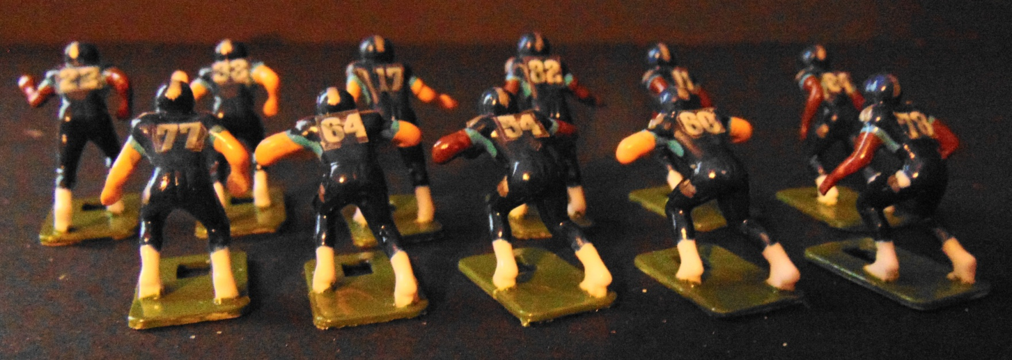
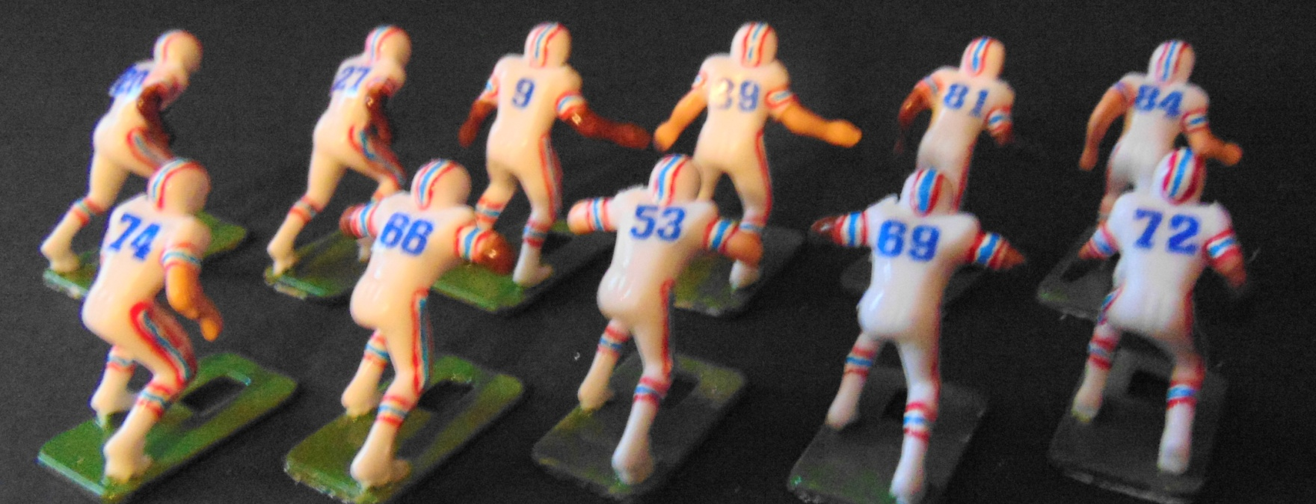
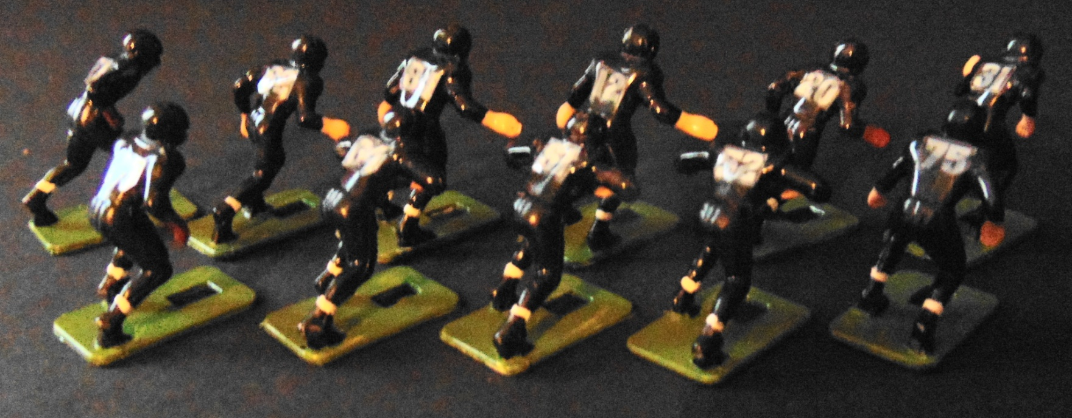

Team Photos
East Division
Tennessee Titans
Tennessee Oilers
Knoxville Bears

Slide 7
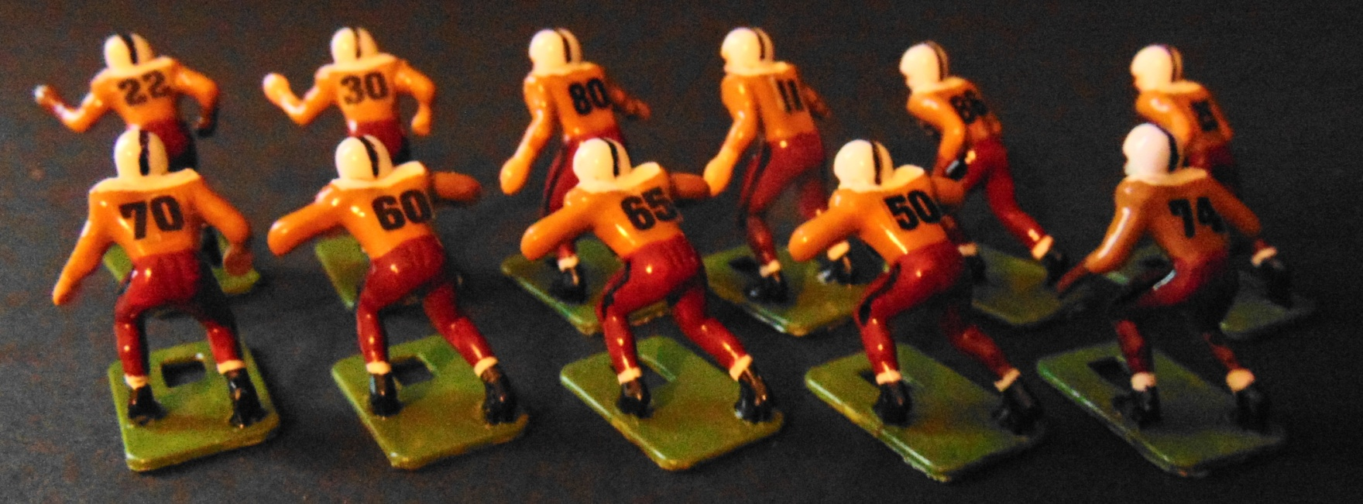
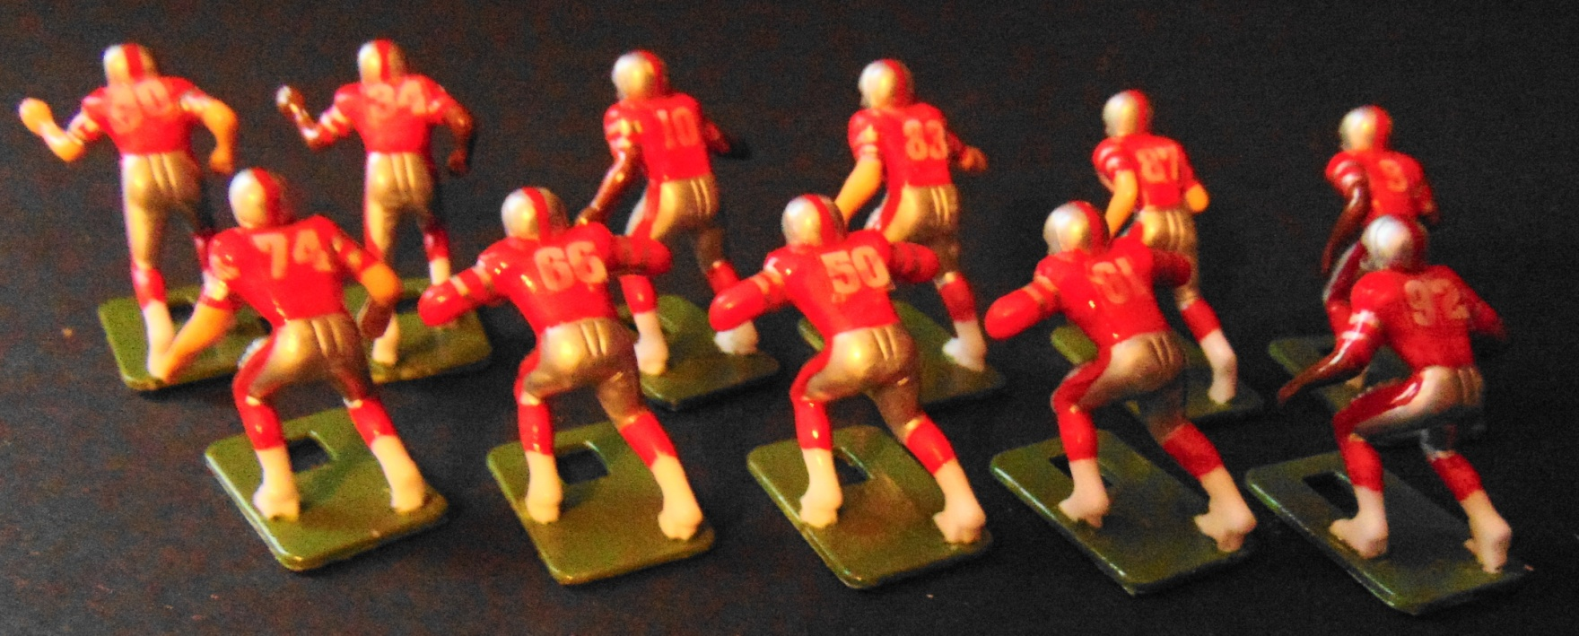
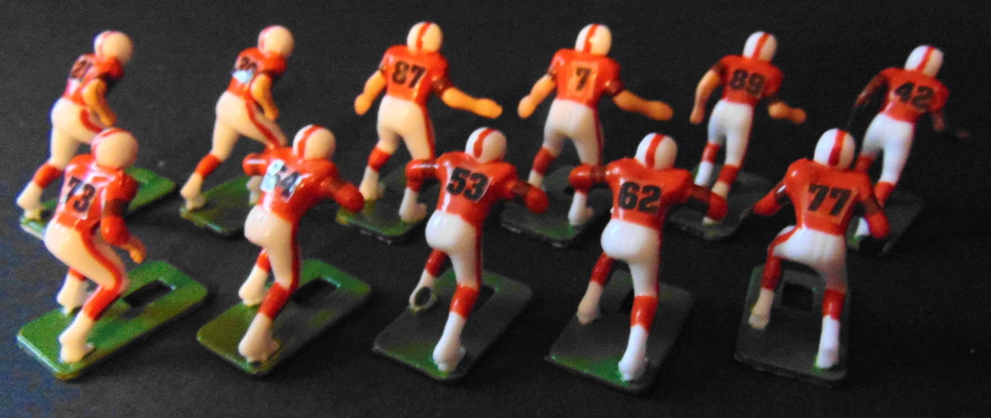
Team Photos
Chattanooga Cherokees
West Division
Memphis Showboats
Memphis Southmen

Slide 8
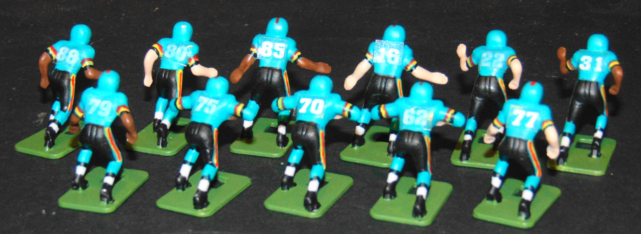
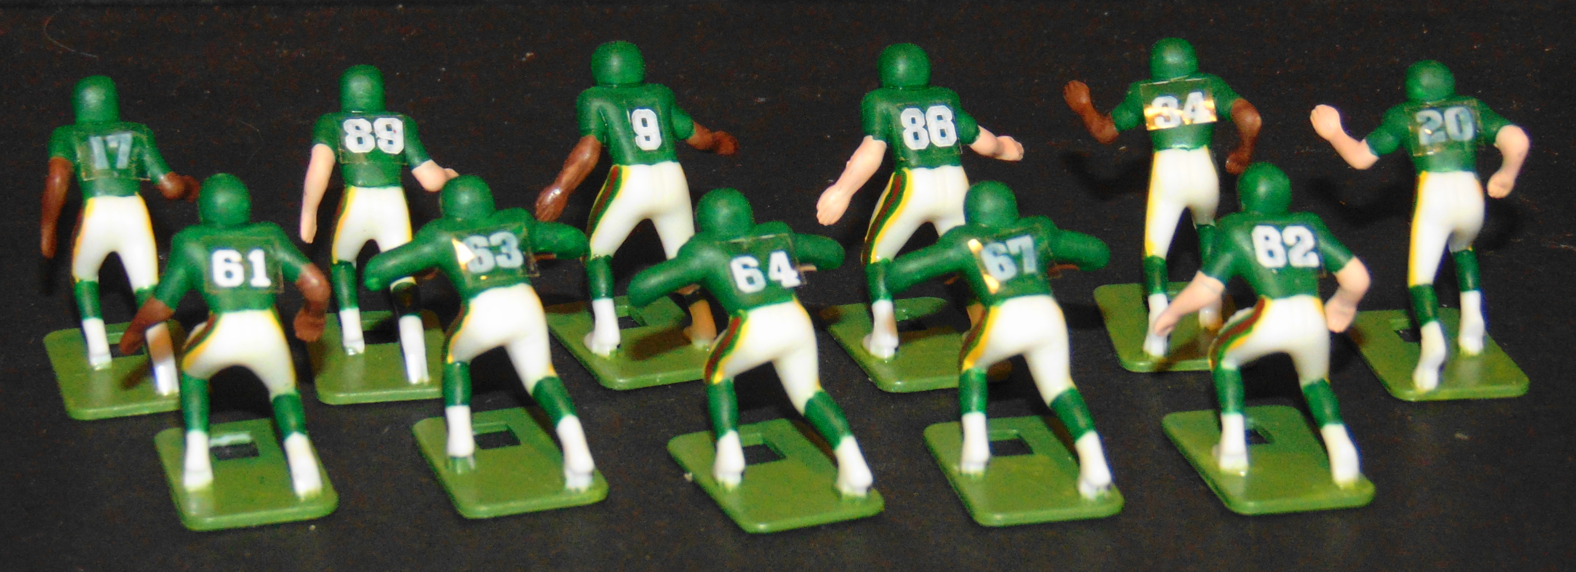
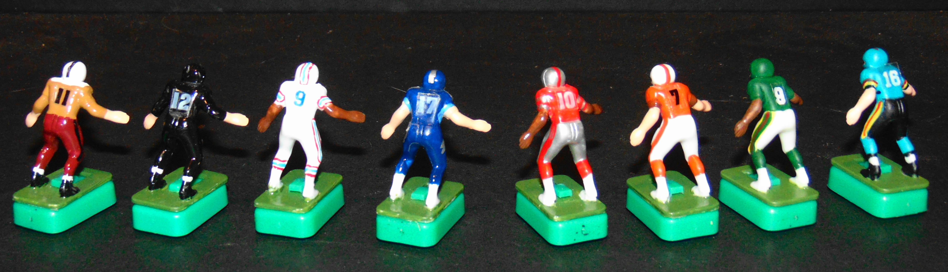
Team Photos
Memphis Maniax
Memphis Mad Dogs
QB’s of the TnPEFL
#11 Hausualter #12 Troutman #10 Lewis #7 Haurte
#9 McNair #17 Tannehill #9 Allen #16 Druckenmiller

Slide 9
Regular Season Schedules
Titans
Showboats
Oilers
Southmen
Bears
Mad Dogs
Cherokees
Maniax
WK 1 Game 1 Game 2 Game 3 ___ Game 4 _
Mad Dogs Titans Southmen Bears
Maniax Oilers Showboats Cherokees
WK 2 Game 1 Game 2 Game 3 ___ Game 4 _
Showboats Southmen Cherokees Bears
Mad Dogs Maniax Titans Oilers
WK 3 Game 1 Game 2 Game 3 ___ Game 4 _
Southmen Oilers Showboats Titans
Mad Dogs Cherokees Maniax Bears

