Slide 1


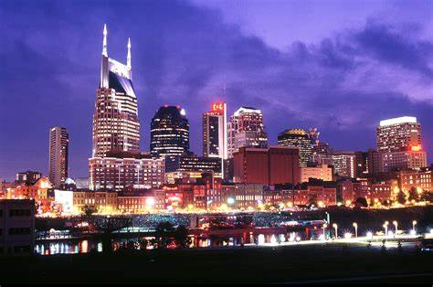
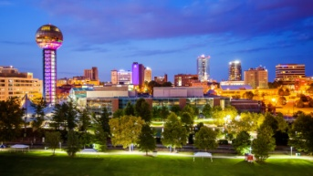

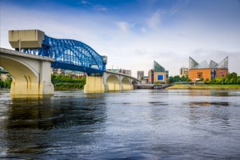






TENNESSEE
Professional Electric Football League
6 Teams, 4 Cities,
3 Very Distinct and Diverse Geographical Regions
MEMPHIS
NASHVILLE
KNOXVILLE
CHATTANOOGA
a Solitaire ELECTRIC FOOTBALL League
presented by

Slide 2

TENNESSEE
Professional Electric Football League
Blue Division
Grey Division
Tennessee Titans
Memphis Showboats
Knoxville Bears
Tennessee Oilers
Memphis Southmen
Chattanooga Cherokees
The Tennessee Professional Electric Football League is a solitaire league made up of professional football franchises that have played in the state of Tennessee.
Tennessee Titans / Tennessee Oilers - One of the 8 original franchises of the 1960 - 69 American Football League (AFL) as the Houston Oilers. Moved to Tennessee in 1997 and played as the Tennessee Oilers for 2 seasons before becoming the Tennessee Titans in 1999.
Memphis Showboats - Played in the United States Football League (USFL) for 2 seasons, 1984 - 85.
Memphis Southmen - Played in the 1974 - 75 World Football League (WFL).
Knoxville Bears - 1965 played in the minor league Southern Football League.
Chattanooga Cherokees - 1963 - 1965 played in the minor league Southern Football League .
Teams will play a 7-game regular season schedule: 2 games each vs. Division opponents and 1 game each vs. non division opponents. Post season schedule will consist of 1 Championship Game: Blue Division Champion vs. Grey Division Champion.

Slide 3
Regular Season Schedules
Titans
Showboats
Bears
WK 1 Showboats A
WK 2 Bears H
WK 3 Oilers N
WK 4 Southmen A
WK 5 Cherokees H
WK 6 Bears A
WK 7 Showboats H
WK 1 Titans H
WK 2 Oilers H
WK 3 Southmen N
WK 4 Bears A
WK 5 Bears H
WK 6 Cherokees A
WK 7 Titans A
WK 1 Oilers A
WK 2 Titans A
WK 3 Cherokees H
WK 4 Showboats H
WK 5 Showboats A
WK 6 Titans H
WK 7 Southmen A
Oilers
Southmen
Cherokees
WK 1 Bears H
WK 2 Showboats A
WK 3 Titans N
WK 4 Cherokees A
WK 5 Southmen H
WK 6 Southmen A
WK 7 Cherokees H
WK 1 Cherokees A
WK 2 Cherokees H
WK 3 Showboats N
WK 4 Titans H
WK 5 Oilers A
WK 6 Oilers H
WK 7 Bears H
WK 1 Southmen H
WK 2 Southmen A
WK 3 Bears A
WK 4 Oilers H
WK 5 Titans A
WK 6 Showboats H
WK 7 Oilers A
WK 1 Game 1 Game 2 Game 3 ____
Titans 33 Bears 37 Southmen 49
Showboats 35 Oilers 37 Cherokees 20
WK 2 Game 1 Game 2 Game 3___________
Bears (0-0-1) 37 Oilers (0-0-1) 14 Cherokees (0-1) 24
Titans (0-1) 35 Showboats (1-0) 38 Southmen (1-0) 27
WK 3 Game 1 Game 2 Game 3___________
Oilers (0-1-1) 14 Showboats (2-0) 33 Cherokees (0-2) 14
Titans (0-2) 34 Southmen (2-0) 34 Bears (1-0-1) 40
WK 4 Game 1 Game 2 Game 3___________
Titans (1-2) 31 Showboats (2-1) 40 Oilers (0-2-1) 28
Southmen (3-0) 41 Bears (2-0-1) 28 Cherokees (0-3) 38
WK 5 Game 1 Game 2 Game 3___________
Cherokees (1-3) 13 Bears (2-1-1) 31 Southmen (4-0) 49
Titans (1-3) 7 Showboats (3-1) 42 Oilers (0-3-1) 3
WK 6 Game 1 Game 2 Game 3___________
Titans (1-4) 27 Showboats (4-1) 21 Oilers (0-4-1) 23
Bears (2-2-1) 23 Cherokees (2-3) 28 Southmen (5-0) 27
WK 7 Game 1 Game 2 Game 3___________
Showboats (4-2) 14 Bears (2-3-1) 17 Cherokees (3-3) 17
Titans (2-4) 13 Southmen (6-0) 21 Oilers (0-5-1) 17

Slide 4
Chattanooga Cherokees
11 Haushalter QB / LB
30 Vandergriff FB / DB
22 Henley HB / DB
25 Hogan FL / DB
86 Bradley OE / DB
80 Brown OE / LB
50 Kunka C / DT
60 Snyder G/ DT
65 Fuller G / DE
70 Locke T / DE
74 Phillips T/ LB
Knoxville Bears
12 Troutman QB / LB
31 Nichols FB / DB
23 Faircloth HB / DB
20 Frazier FL / DB
82 Baskette SE / DB
84 McCauley TE / LB
52 Shafer C / DT
64 Warwick G / DT
61 Cole G /DE
74 White T / DE
75 Daniels T / LB
Memphis Southmen
7 Haurte QB / LB
39 Csonka FB / DB
21 Kiick HB / DB
42 Warfield FL / DB
89 Marshall WR / DB
87 Shirk TE / LB
53 Hill C / DT
64 Kruyer G / DT
62 Mikolajczyk G / DT
73 Canale T / DE
77 Cotton T / LB
Memphis Showboats
10 Lewis QB / LB
40 Quarles FB / DB
34 Reid HB / DB
83 Carney SE / DB
9 Crawford FL / DB
87 Shirk TE / LB
50 Kuehn C / DT
61 Smith G/ DT
66 Gunn G / DE
92 White T / DE
74 Clark T/ LB
Tennessee Oilers
9 McNair QB / LB
27 George FB / DB
20 Thomas HB / DB
81 Sanders FL / DB
84 Davis SE / DB
89 Wycheck TE / LB
53 Stepnoski C / DT
66 Layman G / DT
69 Runyon G /DE
74 Matthews T / DE
72 Hopkins T / LB
Tennessee Titans
17 Tannehill QB / LB
22 Henry FB / DB
33 Lewis HB / DB
11 Brown FL / DB
84 Davis WR / DB
82 Walker TE / LB
60 Johns C / DT
64 N. Davis G / DT
54 Evans G / DT
77 Lewan T / DE
78 Conklin T / LB

Slide 5
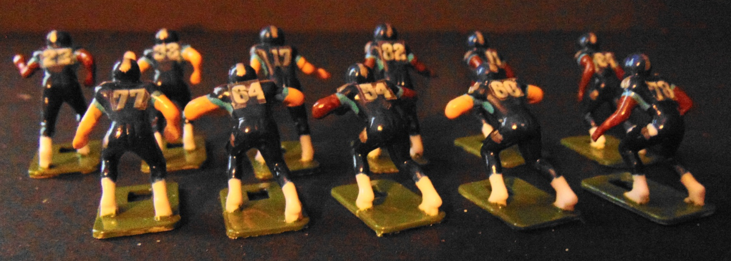
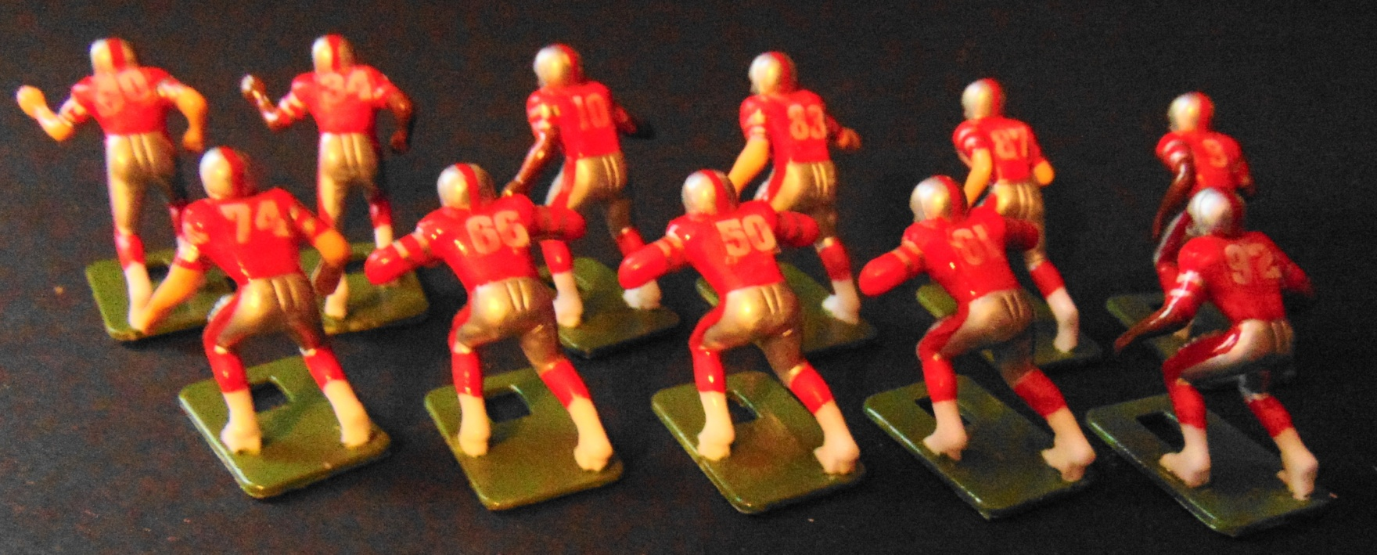
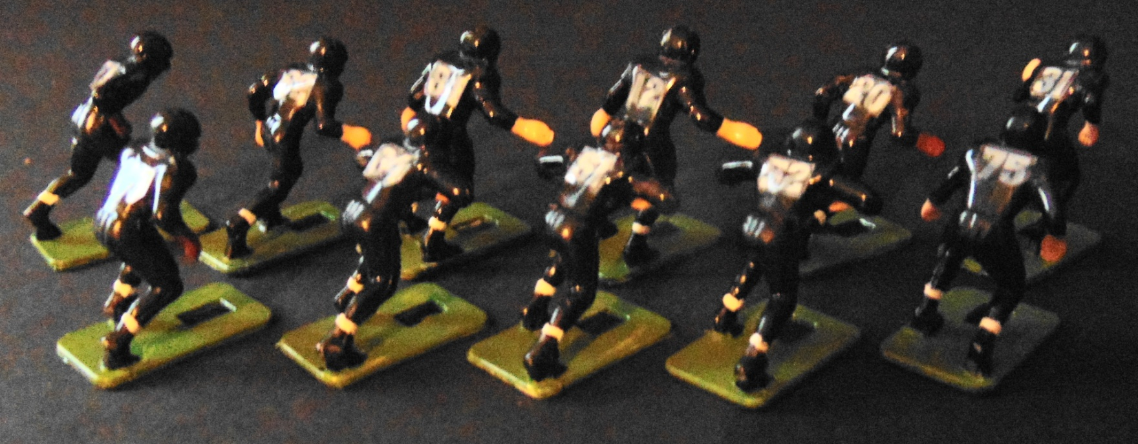

Team Photos
Blue Division
Tennessee Titans
Memphis Showboats
Knoxville Bears

Slide 6
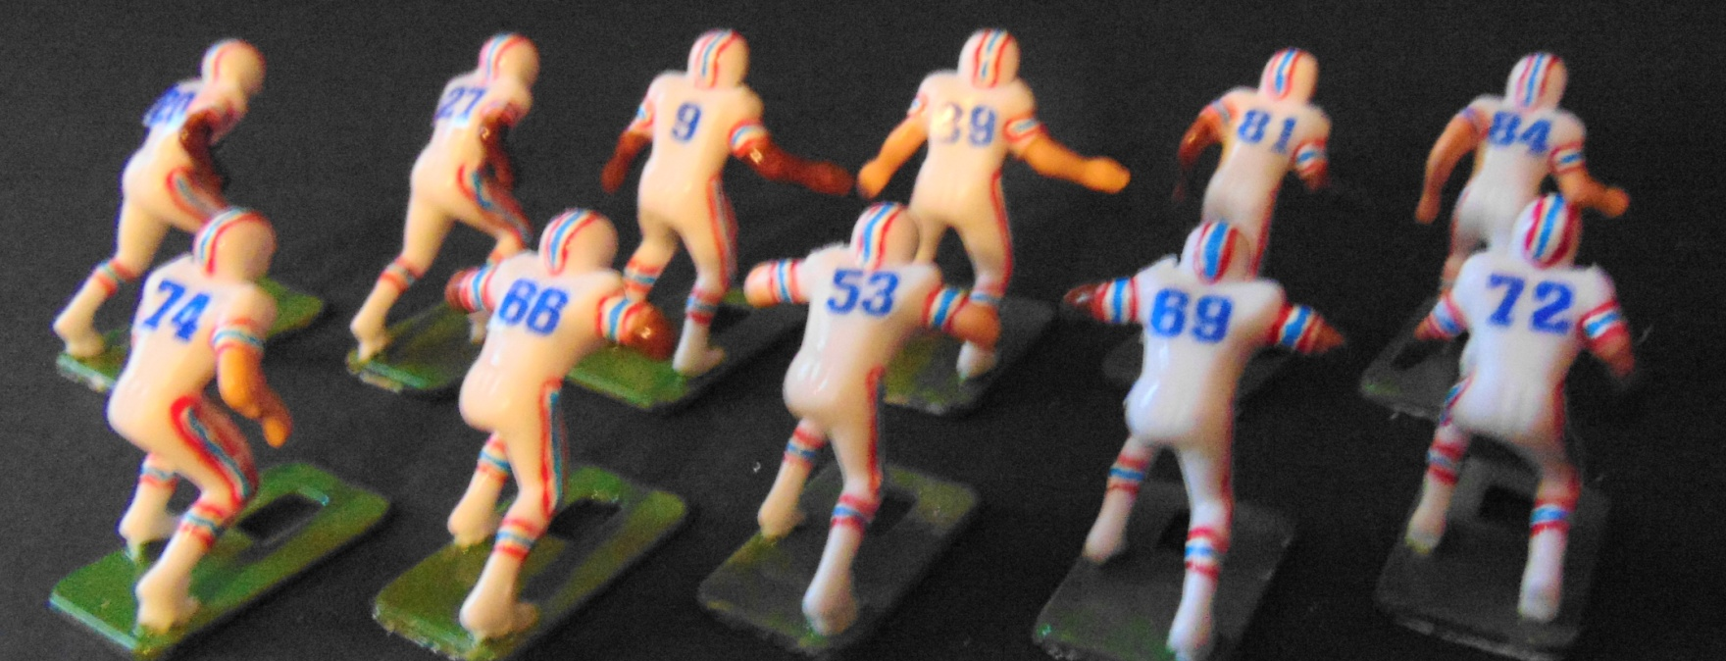
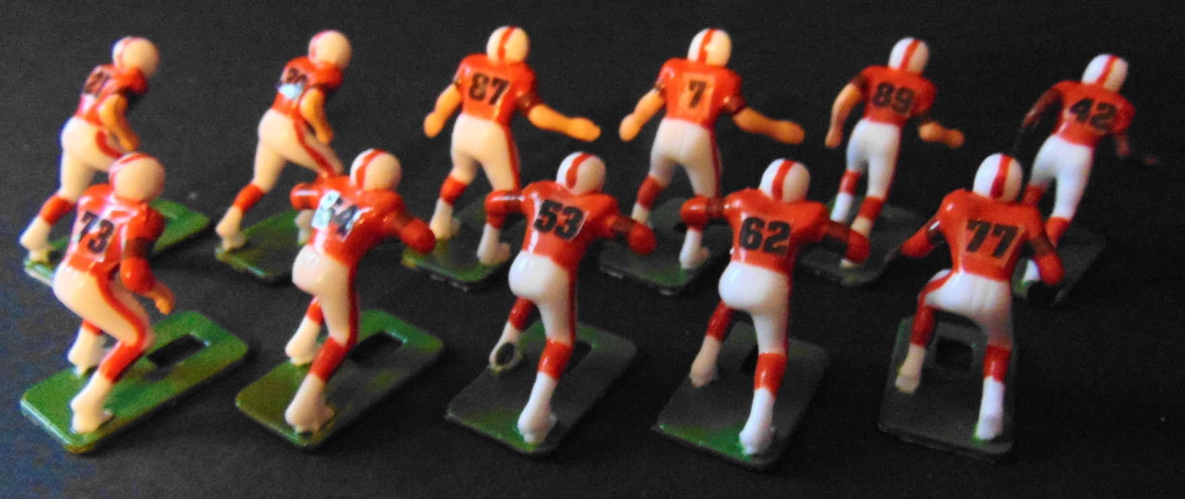
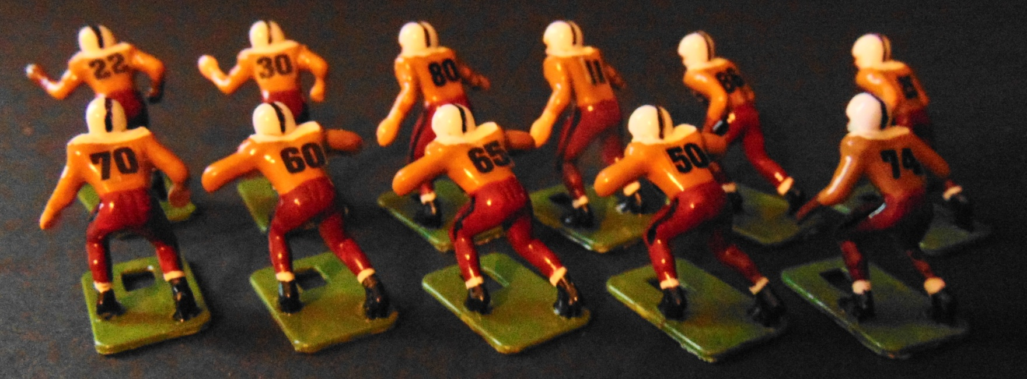
Team Photos
Grey Division
Tennessee Oilers
Memphis Southmen
Chattanooga Cherokees

Slide 7
TENNESSEE
Professional Electric Football League
Solitaire Electric Football Rules and Regulations
NFL Rules will be used to govern all games.
“The Kicking Game” kick placement cards will be used to determine the distance and field placement of all Kickoffs, Onside Kicks, Punts and Punts from Midfield.
“The Kicking Game” Kickoff cards will be used to determine the outcome of Field Goal Attempts by measuring the distance from the spot of the kick to the goal posts.
Tudor Games “Passing Sticks” will be used to determine the “catch” of a forward or backward pass of more than 2 base lengths from the “Passer” to The “Receiver”.
A running game clock will be used to time the game.
The Game Clock will start when the ball is fielded following a kickoff.
The Game Clock will stop following the conclusion of all plays.
The Game Clock will not run while players are separated in between plays.
Once the Line of Scrimmage has been established (by placing the offensive Center at the spot of the ball), the Game Clock will be restarted and allowed to run until the setup of the offense is complete.
The Game Clock will not run while the defense is being set up.
The Game Clock will start to begin a play and continue to run throughout the execution of a play.
On a play out of bounds or an incomplete pass, the Game Clock will not start again until the next play begins.
At the TWO MINUTE WARNING, the Game Clock will not start until the next play begins.
Teams are allowed 3 “Time Outs” per half. If a time out is called, the Game Clock will not start until the next play begins.
Regular Season Games will be allowed to end in a tie.
Post Season Games will be extended by overtime until a winner is determined.
For the last two weeks of the season used a “Quick Game” format.
One possession per team / per QTR.
4 scrimmage line plays from the 50 yard line to score by touchdown or field goal.
No punts on 4th down, must either attempt a field goal or run one more scrimmage line play.
Coin toss determines first possession
NO Over TIme. Games allowed to end in a tie.

Slide 8
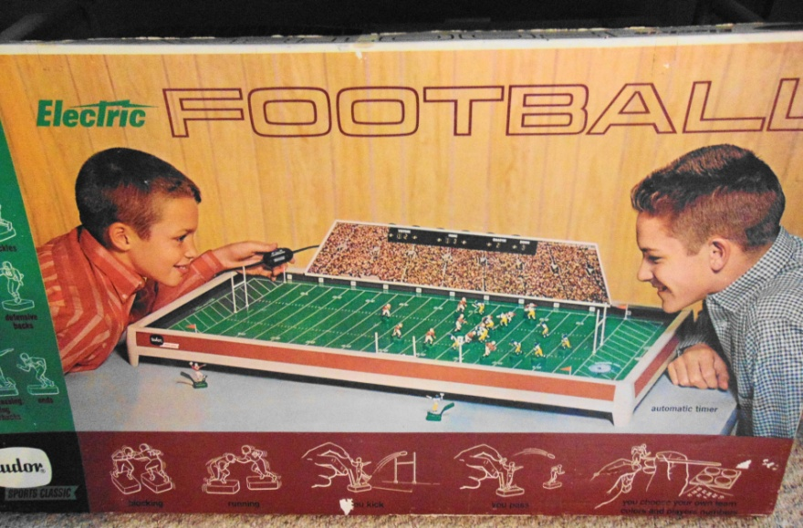
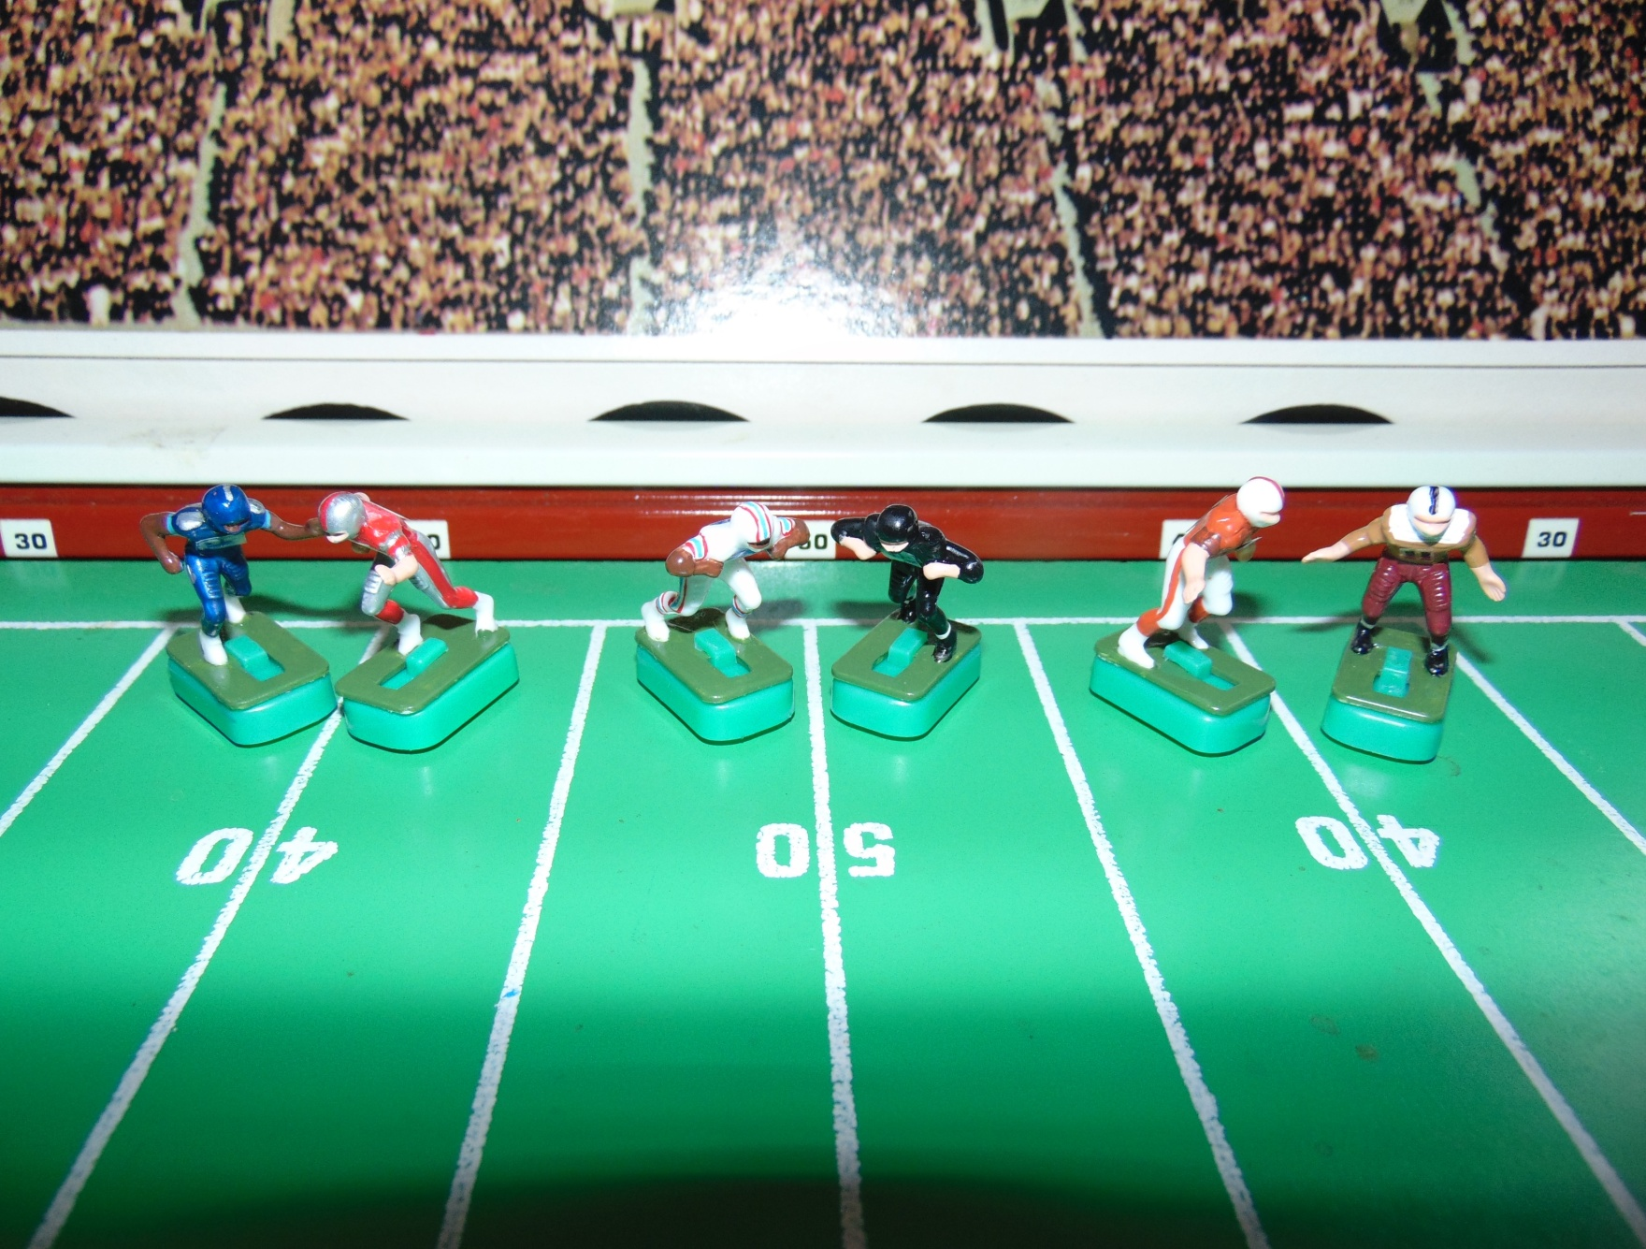


TENNESSEE
Professional Electric Football League
WK1 Games played on the
Tudor Sports Classic Model #600
Tennessee
Titans
Tennessee
Oilers
Memphis Southmen
@
@
@
Memphis Showboats
Knoxville Bears
Chattanooga
Cherokees

Slide 9
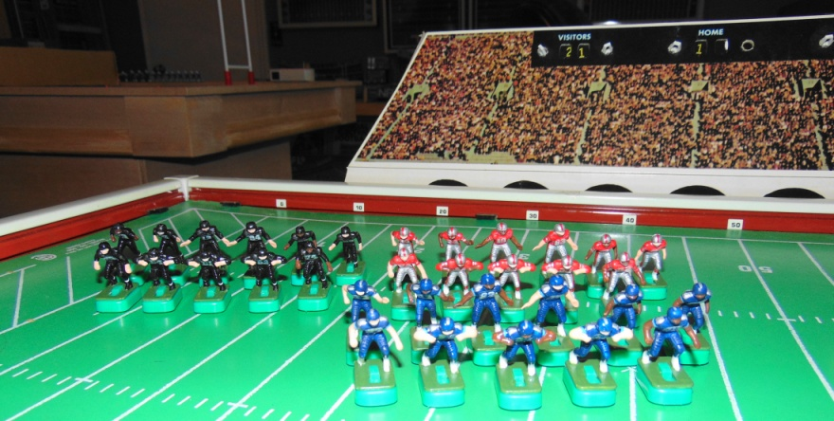
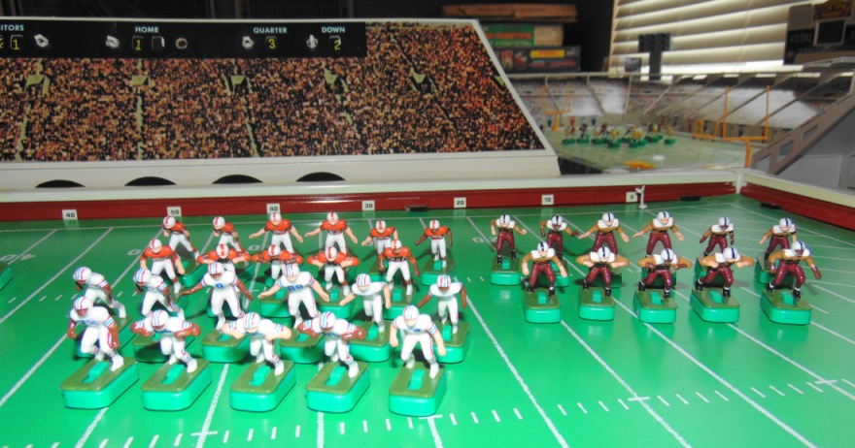
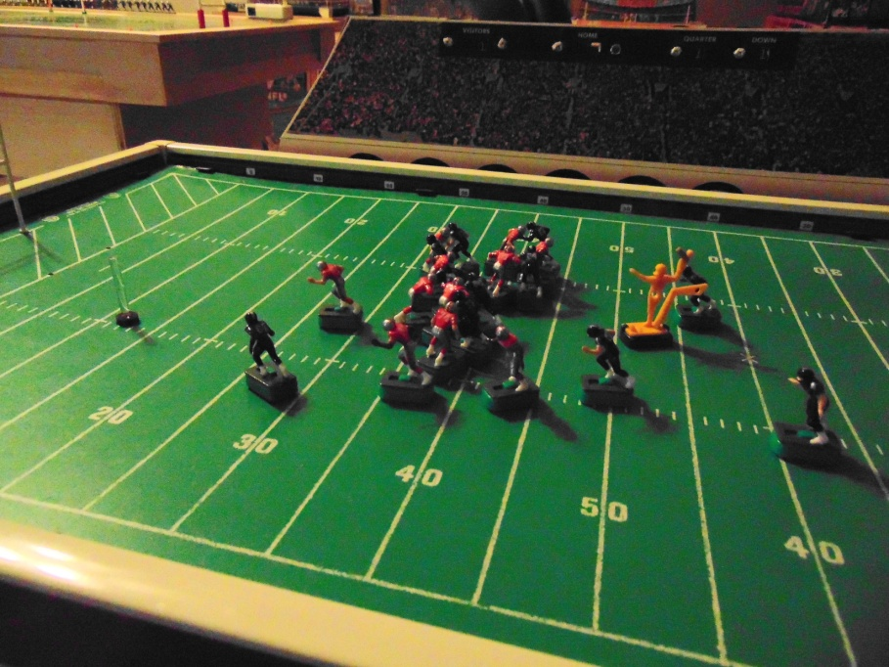
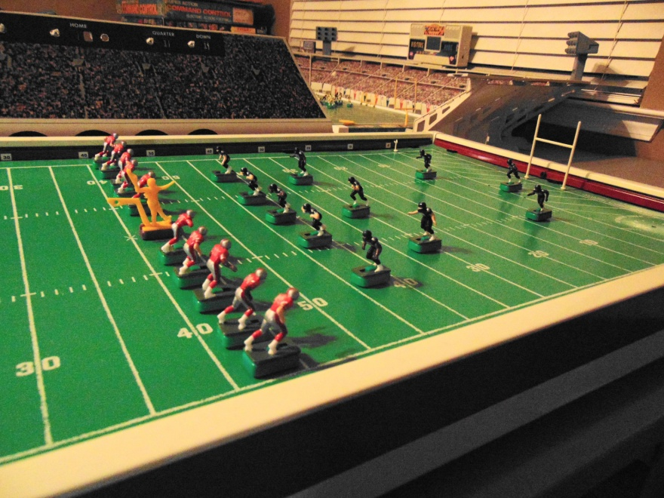
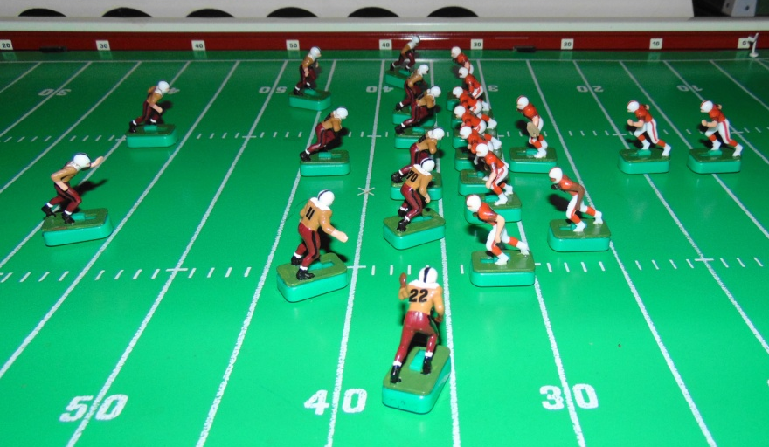
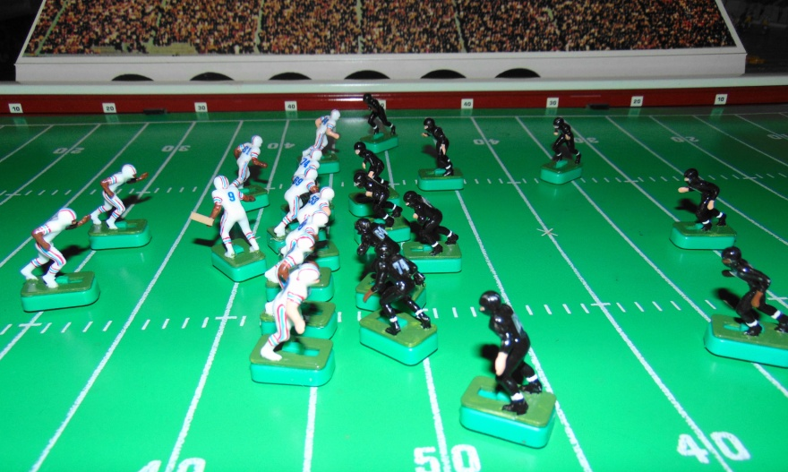
WK 1 Game Action Photos
WK1 Results
Titans 33 Showboats 35
Bears 37 Oilers 37
Southmen 49 Cherokees 20

Slide 10

Official Game Report 10/23/2020 WK1 Game 1
Tennessee Titans @ Memphis Showboats
Tennessee Titans
17 Tannehill
22 Henry
33 Lewis
11 Brown
84 Davis
82 Walker
60 Johns
64 N. Davis
54 Evans
77 Lewan
78 Conklin
QB / LB
FB / DB
HB / DB
FL / DB
WR / DB
TE / LB
C / MLB
G / DT
G / DT
T / DE
T / DE
Memphis Showboats
10 Lewis
40 Quarles
34 Reid
83 Carney
9 Crawford
87 Shirk
50 Kuehn
61 Smith
66 Gunn
92 White
74 Clark
 | 1 | 2 | 3 | 4 | F
Titans | 6 | 7 | 13 | 7 | 33
Showboats | 7 | 7 | 14 | 7 | 35
Scoring Summary
1st QTR TEN MEM
TEN - Davis 40yd PASS from Tannehill (Kick Blocked) 6 0
MEM - Shirk 35yd PASS from Lewis (Kick Good) 6 7
2nd QTR
MEM - Quarles 46yd RUN (Kick Good) 6 14
TEN - Davis 75yd PASS from Tannehill (Kick Failed) 13 14
3rd QTR
MEM - Quarles 36yd RUN (Kick Good) 13 21
TEN - Davis 73yd KR (Kick Failed) 19 21
MEM - Crawford 85yd KR (Kick Good) 19 28
TEN - Davis 82yd KR (Kick Good) 26 28
4th QTR
MEM - Crawford 21yd PASS from Lewis (Kick Good) 26 35
TEN - Brown 49yd PASS from Tannehill (Kick Good) 33 35
Coin Toss “Heads” - Titans to Receive
1st QTR
15:00 KO Showboats to Titans 71 yds to Henry @ 29yd KR (Quarles)
Titans @ their 23
14:24 1/10 @ 23 - Henry 38yd Run OB
13:28 1/10 @ D39 - Lewis -1yd Run (Reid)
13:01 2/11 @ D 40 - Pass COMP to Davis @ D9 / 40 yds TD
11:41 Conversion Kick - BLOCKED (White)
Titans 6 Showboats 0
11:41 KO Titans to Showboats 70 yds to Shirk in end zone / 50yd KR (Lewis)
Showboats @ their 45
10:28 1/10 @ 45 - Reid -3yd Run (Lewis)
10:03 2/13 @ 42 - Pass COMP to Shirk @ 44 / 23 yds (Brown)
8:17 1/10 @ D35 - Pass COMP to Shirk @ D22 / 35 yds TD
7:15 Conversion Kick - GOOD
Titans 6 Showboats 7
7:15 KO Showboats to Titans 62 yds to Henry @ 3 / 24yd KR (Carney)
Titans @ their 27
5:40 1/10 @ 27 - Henry -5yd Run (Clark)
5:16 2/15 @ 22 - Lewis -10yd Run (White)
4:30 3/25 @ 12 - Pass INC
2:56 4/25 @ 12 - Punt 46yds to D42 / Crawford @ 42 / 10yd PR (Evans)
Showboats @ Titans 47
0:30 1/10 @ D47 - Lewis 4yd run (Lewis) - End of QTR
Titans 6 Showboats 7
2nd Quarter
Showboats @ Titans 43
15:00 2/6 @ D43 - Reid -3yd Run (Tannehill)
13:40 2/9 @ D46 - Quarles 46 yd Run TD
11:57 Conversion Kick GOOD
Titans 6 Showboats 14
11:57 KO Showboats to Titans 73 yds to the end zone / Touchback
Titans @ their 25
11:57 1/10 @ 25 - Pass COMP to Davis @ 48 / 75 yds TD
9:11 Conversion Kick GOOD
Titans 13 Showboats 14
9:11 KO Titans to Showboats 65 yds to Crawford @ GL / 49yd KR (Evans)
Showboats @ their 49
7:23 1/10 @ 49 - Reid 7 yd Run (N. Davis)
6:08 2/3 @ D44 - Quarles -2yd Run (Davis)
4:57 3/5 @ D46 - Lewis 2 yd Run (Henry)
3:31 4/3 @ D44 Punt 43 yds OB @ D1
Titans @ their 1
3:14 1/10 @ 1 - Henry 7 yd Run OB
2:20 2/3 @ 8 - Henry 4 yd Run (Lewis)
TWO MINUTE WARNING
1:55 1/10 @ 12 - Tannehill 2 yd Run (Gunn)
1:12 1/10 @ 14 - Tannehill 22 yd Run (Shirk) / Titans call 1st Time Out
0:16 1/10 @ 36 - Pass INT Crawford @ D38 / 5 yd INT Return OB
Showboats @ their 43
0:06 1/10 @ 43 - Lewis -1 yd Run (Kneel Down) / Time Expires
End of QTR - Halftime
Titans 13 Showboats 14
Showboats to receive the 2nd half Kickoff
3rd Quarter
15:00 KO Titans to Showboats 44 yds to Reid @ 20 / 11yd KR (Davis)
Showboats @ their 31
14:04 1/10 @ 31 - Reid 2yd Run (Henry)
12:30 2/8 @ 33 - Quarles -8yd Run (Brown)
11:55 3/16 @ 25 - Pass COMP to Shirk @ 47 / 32yds OB
10:00 1/10 @ D44 - Reid 11yd Run (Walker)
8:12 1/10 @ D33 - Quarles 33yd Run TD
6:03 Conversion Kick GOOD
Titans 13 Showboats 21
6:03 KO Showboats to Titans 38 yds to Davis @ 27 / 73yd KR TD
3:54 Conversion Kick NO GOOD (short)
Titans 19 Showboats 21
3:54 KO Titans to Showboats 50 yds to Crawford @ 15 / 85yd KR TD
1:50 Conversion Kick GOOD
Titans 19 Showboats 28
1:50 KO Showboats to Titans 47 yds to Davis @ 18 / 82yd KR TD
0:00 Conversion Kick GOOD / End of QTR
Titans 26 Showboats 28
4th Quarter
15:00 KO Titans to Showboats 62 yds to Reid @ 3 / 51yd KR (Tannehill)
Showboats @ Titans 46
13:21 1/10 @ D46 - Quarles -3yd Run (Henry)
11:30 2/13 @ D49 - Quarles -1yd Run (Johns)
10:55 3/14 @ Midfield - Reid 29yd Run (Henry)
9:20 1/10 @ D21 - Pass COMP to Crawford in endzone / 21yds TD
8:17 Conversion kick GOOD
Titans 26 Showboats 35
8:17 KO Showboats to Titans 30 yds to Tannehill @ 35 / 12yd KR (Kuehn)
Titans @ their 47
7:05 1/10 @ 47 - Henry 4yd Run (Quarles)
6:01 2/6 @ D49 - Pass COMP to Brown @ D13 / 49yds TD
4:59 Conversion Kick GOOD
Titans 33 Showboats 35
4:59 KO Titans to Showboats 50 yds to Crawford @ 15 / 17yd KR (Henry)
Showboats @ their 32
4:06 1/10 @ 32 - Reid 4yd Run OB
3:21 2/6 @ 36 - Pass COMP to Reid @ 43 / 32yds (Walker)
2:45 1/10 @ D32 - Lewis -7yd Run (Evans)
2:10 2/17 @ D39 - Time allowed to run to TWO MINUTE WARNING
TWO MINUTE WARNING
2:00 2/17 @ D39 - Quarles -11yd Run (Evans) / Titans call 1st Time Out
Titans Time Out
1:16 3/28 @ Midfield - Pass INT Lewis @ D33 / 0yd INT Return (Crawford)
Titans @ their 33
1:06 1/10 @ 33 Pass INT Crawford @ 49 / 1 yd INT Return (Lewis)
Showboats possession @ Titans 48
0:41 1/10 @ D48 - Lewis -2yd Run (Kneel Down)
0:36 2/8 @ Midfield - Time allowed to expire
End of GAME
Titans 33 Showboats 35

Slide 11
Official Game Report 10/24/2020 WK1 Game 2
Knoxville Bears @ Tennessee Oilers
Knoxville Bears
12 Troutman
31 Nichols
23 Faircloth
20 Frazier
82 Baskette
84 McCauley
52 Shafer
64 Warwick
61 Cole
74 White
75 Daniels
QB / LB
FB / DB
HB / DB
FL / DB
WR / DB
TE / LB
C / MLB
G / DT
G / DT
T / DE
T / DE
Tennessee Oilers
9 McNair
27 George
20 Thomas
81 Sanders
84 Davis
89 Wycheck
53 Stepnoski
66 Layman
69 Runyon
74 Matthews
72 Hopkins
 | 1 | 2 | 3 | 4 | F
Bears | 23 | 0 | 0 | 14 | 37
Oilers | 7 | 21 | 7 | 2 | 37
Scoring Summary
1st QTR KNO TEN
TEN - Davis 105yd KR (Kick Good) 0 7
KNO - Baskette 74yd PASS from Troutman (Kick Good) 7 7 KNO - Baskette 57yd PASS from Troutman (Kick Good) 14 7
KNO - Warwick tackled NcNair in the end zone - SAFETY 16 7
KNO - Faircloth 50yd PASS from Troutman (Kick Good) 23 7 2nd QTR
TEN - Davis 41yd PASS from McNair (Kick Good) 23 14
TEN - George 50yd PASS from McNair (Kick Good) 23 21
TEN - Davis 14yd PASS from McNair (Kick Good) 23 28
3rd QTR
TEN - George 91yd RUN (Kick Good) 23 35
4th QTR
TEN - Hopkins tackled Troutman in the end zone -SAFETY 23 37
KNO - Baskette 52yd PASS from Troutman (Kick Good) 30 37
KNO - Faircloth 22yd RUN (Kick Good) 37 37
Coin Toss “Tails” - Oilers to Receive
1st Quarter
15:00 KO Bears to Oilers 70 yds Davis in the end zone 105yd KR TD
14:05 Kick Conversion Good
Bears 0 Oilers 7
14:05 KO Oilers to Bears 73 yds NO RETURN Touchback
Bears @ their 25
14:05 1/10 @ 25 - Nichols 1yd Run (Stepnoski)
13:31 2/9 @ 26 - Pass COMP to Baskette @ D45 / 74 yds TD
12:09 Conversion Kick GOOD
Bears 7 Oilers 7
12:09 KO Bears to Oilers 55 yds to Davis @ 10 / 36yd KR (Schafer)
Oilers @ their 46
11:42 1/10 @ 46 - McNair -8yd Run (Faircloth)
11:17 2/18 @ 38 - George -8yd Run (Frazier)
10:05 3/26 @ 30 - George 5yd Run (Daniels)
8:54 4/21 @ 35 - Punt 28 yds Nichols @ D42 / 1yd PR (Stepnoski)
Bears @ their 43
7:42 1/10 @ 43 - Faircloth 0yd Run (Matthews)
7:05 2/10 @ 43 - Pass COMP to Baskette @ D30 / 57 yds TD
6:18 Conversion Kick GOOD
Bears 14 Oilers 7
6:18 KO Bears to Oilers 73 yds NO RETURN TB
Oilers @ their 25
6:18 1/10 @ 25 - McNair -15yd Run (White)
5:17 2/25 @ 10 - McNair SACKED in the end zone SAFETY / -10 yd Run (Warwick)
Bears 16 Oilers 7
4:22 Safety Kick Oilers to Bears 44 yds to Baskette @ 36 / 14 yd SKR (Davis)
Bears @ Midfield
3:25 1/10 @ Midfield - Pass COMP to Faircloth @ 45 / 50 yds TD
2:32 Conversion Kick GOOD
Bears 23 Oilers 7
2:32 KO Bears to Oilers 73 yds to end zone Touchback
Oilers @ their 25
2:32 1/10 @ 25 - McNair 6yd Run (Frazier)
1:55 2/4 @ 31 - George -1yd Run (Nichols)
1:14 3/5 @ 30 - McNair 29 yd Run (Faircloth) Time Expires
End of QTR
Bears 23 Oilers 7
2nd Quarter
Oilers @ Bears 41
15:00 1/10 @ D41 - Pass COMP to Davis @ D10 / 41yds TD
14:08 Conversion Kick GOOD
Bears 23 Oilers 14
14:08 KO Oilers to Bears 65 yds to Baskette @ GL / 23yd KR (George)
Bears @ their 23
13:03 1/10 @ 23 - Troutman -8yd Run (Matthews)
12:14 2/18 @ 15 - Frazier 12yd Run OB
11:21 3/6 @ 27 - Frazier -2yd Run (Matthews)
10:51 4/8 @ 25 - Punt 28yds to George @ D47 / 3yd PR OB
Oilers @ Midfield
10:03 1/10 @ Midfield - George 0yd Run (Frazier)
9:18 2/10 @ Midfield - Pass INC to George
8:19 3/10 @ Midfield - Pass COMP to George @ D44 / 50yds TD
7:32 Conversion Kick GOOD
Bears 23 Oilers 21
7:32 KO Oilers to Bears 57yds to Baskette @ 12 / 18yd KR (George)
Bears @ their 30
6:23 1/10 @ 30 - Nichols 5yd FP
5:28 2/5 @ 35 - Faircloth 2yd Run (Stepnoski)
4:48 3/3 @ 37 - Troutman -2yd Run (Wycheck)
4:04 4/5 @ 35 - Punt 31 yds to Sanders @ D33 / - 5yd PR (Warwick)
Oilers @ their 26
2:56 1/10 @ 26 - Pass McNair SACKED / -4yd Run (Cole)
2:28 2/14 @ 22 - Time allowed to run to the TWO MINUTE WARNING
TWO MINUTE WARNING
2:00 2/14 @ 22 - Pass COMP to George @ D48 / 71 yds FP - Oilers call 1st Time Out
0:18 1/10 @ D14 - Pass COMP to Davis in end zone / 14 yds TD
0:08 Conversion Kick GOOD
Bears 23 Oilers 28
0:08 KO Oilers to Bears 67 yds to Nichols in the end zone / 29yd KR (Thomas) Time Expires
End of QTR - Half Time
Bears 23 Oilers 28
Bears to receive 2nd Half Kickoff3rd Quarter
15:00 KO Oilers to Bears 71 yds to Baskette in end zone / 19yd KR (George)
Bears @ their 13
14:02 1/10 @ 13 - Nichols 28yd Run (Wycheck)
12:42 1/10 @ 41 - Faircloth -5yd Run (Wycheck)
12:07 2/15 @ 36 - Faircloth 6yd Run (Thomas)
10:56 3/9 @ 42 - Pass INC to Baskette
9:37 4/9 @ 42 - Punt 33yds to Thomas @ D25 / 5 yd PR (Frazier)
Oilers @ their 30
7:40 1/10 @ 30 - George -1yd Run (Warwick)
7:12 2/11 @ 29 - George -12yd Run (Faircloth)
6:02 3/23 @ 17 - George -2yd Run (McCauley)
5:12 4/25 @ 15 - Punt 26yds to Faircloth @ 41 / 0yd PR (George)
Bears @ Oilers 41
5:03 1/10 @ D41 - Faircloth 0yd Run (George)
4:05 2/10 @ D41 - Pass INC
3:09 3/10 @ D41 - Pass to McCauley @ D4 / INT Thomas / 6yd INT Return (Frazier)
Oilers @ their 10
1:56 1/10 @ 10 - George -1yd Run (Warwick)
1:13 2/11 @ 9 - George 91 yd Run TD / Time Expires
0:00 Conversion Kick GOOD
Bears 23 Oilers 35
End Of QTR
4th Quarter
15:00 KO Oilers to Bears 70 yds to Baskette in end zone / 11yd KR (Davis)
Bears @ their 6
14:22 1/10 @ 6 - Pass INC to Frazier
13:41 2/10 @ 6 - Pass Troutman SACKED in endzone SAFETY (Hopkins) / - 6yd Run
Bears 23 Oilers 37
13:02 Safety Kick Bears to Oilers 64yds to Sanders @ 16 / 10yd KR (Warwick)
Oilers @ their 26
12:19 1/10 @ 26 - George 8yd Run (Warwick)
11:11 2/2 @ 34 - Thomas 1yd Run (Baskette)
10:04 3/1 @ 35 - George 0yd Run (Nichols)

Slide 12
8:55 4/1 @ 35 - Punt 28yds to Baskette @ D37 / 11yd PR (Geroge)
Bears @ their 48
7:16 1/10 @ 48 - Pass COMP to Baskette @ D38 / 52 yds TD
6:05 Conversion Kick GOOD
Bears 30 Oilers 37
6:05 KO Bears to Oilers 30yds to 35 / Bears Nichols recovers @ D35
Bears @ D35
6:05 1/10 @ D35 - Nichols 13yd Run (Davis)
4:30 1/10 @ D22 - Faircloth 22yd Run TD
3:00 Conversion Kick GOOD
Bears 37 Oilers 37
3:00 KO Bears to Oilers 54yds to Davis @ 11 / 28yd KR (Daniels)
Oilers @ their 39
2:15 1/10 @ 39 - Pass INC / TWO MINUTE WARNING
1:45 2/10 @ 39 - Pass INT Faircloth @ D40 / 8yd INT Return (Stepnoski)
Bears @ their 48
1:21 1/10 @ 48 - Pass Troutman SACKED (George) / -11 yd Run / Bears call 1st TO
0:43 2/21 @ 37 - Pass COMP to Faircloth @ Oilers 42 / 38yds (Thomas) / Bears Call 2nd TO
0:33 1/10 @ D25 - Pass INTERFERENCE Oilers Sanders @ D2
0:23 1/G @ D2 - Pass COMP to Frazier @ Oilers 14 / -12yds (Layman) Bears call 3rd TO
0:13 2/G @ D14 - 31yd FG - BLOCKED
Oilers @ their 21
0:03 1/10 @ 21 - Pass INT Nichols @ D42 / 2yd INT Return (George) / Time Expires
END of GAME
Bears 37 Oilers 37
Official Game Report 10/25/2020 WK1 Game 3
Memphis Southmen @ Chattanooga Cherokees
Memphis Southmen
7 Huarte
39 Csonka
21 Kiick
42 Warfield
89 Marshall
87 Shirk
53 Hill
64 Kruyer
62 Mikolajczyk
73 Canale
77 Cotton
Chattanooga Cherokees
11 Haushalter
30 Vandergriff
22 Henley
25 Hogan
86 Bradley
80 Brown
50 Kunka
60 Snyder
65 Fuller
70 Locke
74 Phillips
 | 1 | 2 | 3 | 4 | F
Southman | 7 | 14 | 7 | 21 | 49
Cherokees | 7 | 7 | 0 | 6 | 20
QB / LB
FB / DB
HB / DB
FL / DB
WR / DB
TE / LB
C / MLB
G / DT
G / DT
T / DE
T / DE
Scoring Summary
1st QTR MEM CHA
MEM - Kiick 89yd KR (Kick Good) 7 0
CHA - Hogan 70yd PASS from Haushalter (Kick Good) 7 7
2nd QTR
MEM - Csonka 6yd RUN (Kick Good) 14 7
MEM - Marshall 76yd PASS from Huarte (Kick Good) 21 7
CHA - Bradley 36yd Pass from Haushalter (Kick Good) 21 14
3rd QTR
MEM - Kiick 15yd PASS from Huarte (Kick Good) 28 14
4th QTR
MEM - Csonka 28yd RUN (Kick Good) 35 14
CHA - Henley 15yd RUN (Kick Failed) 35 20
MEM - Csonka 60yd RUN (Kick Good) 42 20
MEM - Csonka 43yd INT Return (Kick Good) 49 20
Coin Toss “Heads” - Southmen Receive
1st Quarter
15:00 KO Cherokees to Southmen 54yds Kiick @ 11 / 89yd KR TD
13:36 Conversion Kick GOOD
Southmen 7 Cherokees 0
13:36 KO Southmen to Cherokees 53yds Vandergriff @ 12 / 10yd KR (Warfield)
Cherokees @ their 22
13:07 1/10 @ 22 - Henley 8yd Run (Marshall)
11:47 2/2 @ 30 - Pass COMP Hogan @ Midfield / 70yds TD
10:31 Conversion Kick GOOD
Southmen 7 Cherokees 7
10:31 KO Cherokees to Southmen 65 yds Warfield @ GL / 28yd KR (Bradley)
Southmen @ their 28
9:37 1/10 @ 28 - Csonka 6yd Run (Kunka)
8:58 2/4 @ 34 - Csonka 0yd Run (Phillips)
8:13 3/4 @ 34 - Kiick -3yd Run (Fuller)
7:19 4/7 @ 31 - Punt 24yds / Downed by Csonka @ Cherokees 45
Cherokees @ their 45
6:46 1/10 @ 45 - Vandergriff 5yd Run (Huarte)
5:19 2/5 @ Midfield - Henley -4yd Run (Canale)
4:25 3/9 @ 46 - Henley 11yd (Fumble and Recovery) Run
2:15 1/10 @ D44 - Henley -3yd Run (Canale)
1:27 2/13 @ D47 - Pass to Vandergriff @ D41 / INT Csonka / 14yd INT Return (Haushalter)
Southmen @ D45
0:25 1/10 @ D45 - Kiick 39yd Run OB - Time Expires
End OF QTR
Southmen 7 Cherokkees 7
2nd Quarter
Southmen @ D6
15:00 1/10 @ D 6 - Csonka 6yd Run TD
14:29 Conversion Kick GOOD
Southmen 14 Cherokees 7
14:29 KO Southmen to Cherokees 53yds Hogan @ 12 / 24yd KR OB
Cherokees @ their 36
13:31 1/10 @ 36 - Henley 2yd Run OB
12:34 2/8 @ 38 - Vandergriff 12yd Run (Hill)
11:13 1/10 @ Midfield - Pass to Bradley @ D22 / INT Csonka / 0yd INT Return (Bradley)
Southmen @ their 23
9:45 1/10 @ 23 - Csonka 6yd Run (Locke)
8:26 2/4 @ 29 - Huarte -5yd Run (Brown)
6:33 3/9 @ 24 - Pass COMP Marshall @ Midfield / 76 yd TD
6:33 Conversion Kick GOOD
Southmen 21 Cherokees 7
6:33 KO Southmen to Cherokees 50yds Bradley @ 15 / 21yd KR (Shirk)
Cherokees @ their 36
5:41 1/10 @ 36 - Vandergriff 11yd Run (Csonka)
4:57 1/10 @ 47 - Pass COMP Vandergriff @ 43 / 25yds OB
3:32 1/10 @ D28 - Vandergriff 1yd Run (Warfield)
2:45 2/9 @ D27 - Haushalter -9yd Run (Kiick)
TWO MINUTE WARNING
1:45 3/18 @ D36 - Pass INC to Hogan @ D9
1:28 4/18 @ D36 - Pass COMP to Bradley @ D8 / 36 yd TD
0:47 Conversion kick GOOD
Southmen 21 Cherokees 14
0:47 KO Cherokees to Southmen 30yds Huarte @ 35 / 0yd KR (Henley)
Southmen @ their 35
0:47 1/10 @ 35 - Haurte -1yd Run (Kneel Down)
0:42 2/11 @ 34 - Haurte -1yd Run (Kneel Down)
0:37 3/12 @ 33 - Time Allowed to Expire
End of QTR - Halftime
Southmen 21 Cherokees 14
Cherokees to Receive 2nd Half Kickoff
3rd Quarter
15:00 KO Southmen to Cherokees 65yds to GL / Bradley 27yd KR (Csonka)
Cherokees @ their 27
14:40 1/10 @ 27 - Vandergriff 2yd Run (Marshall)
13:59 2/8 @ 29 - Vandergriff -6yd Run (Csonka)
12:35 3/14 @ 23 - Haushalter -3yd Run (Canale)
11:32 3/17 @ 20 - Punt 35yds to D45 / Warfield @ 45 / 17yd PR (Snyder)
Southmen @ D38
10:05 1/10 @ D38 - Csonka 4yd Run (Bradley)
9:31 2/6 @ D34 - Kiick 15yd Run OB
7:45 1/10 @ D19 - Kiick 4 yd Run (Henley)
6:46 2/6 @ D15 - Shirk 0yd Run (Bradley)
5:48 3/6 @ D15 - Pass COMP Kiick @ D10 / 15yds TD
4:34 Conversion Kick Good
Southmen 28 Cherokees 14
4:34 KO Southmen to Cherokees 54yds to Henley @ 11 / 30yd KR (Warfield)

Slide 13



Cherokees @ their 41
3:06 1/10 @ 41 - Vandergriff 0yd Run (Warfield)
2:33 2/10 @ 41 - Pass INC to Hogan @ D32
1:02 3/10 @ 41 - Vandergriff -9yd Run (Kiick)
0:36 4/19 @ 32 - Punt 40yds to Csonka @ D38 / 46yd PR (Hogan) - Time Expires
End of QTR
Southmen 28 Cherokees 14
4th Quarter
Southmen @ D26
15:00 1/10 @ D26 - Kiick -2yd Run (Hogan)
14:32 2/12 @ D28 - Csonka 28yd Run TD
13:06 Conversion Kick GOOD
Southmen 35 Cherokees 14
13:06 KO Southmen to Cherokees 54 yds to Henley @ 11 / 28yd KR (Canale)
Cherokees @ their 39
12:34 1/10 @ 39 - Henley -4yd Run (Csonka)
12:07 2/14 @ 35 - Henley 60 yd Run (Csonka)
10:31 1/G @ D5 - Vandergriff -4yd Run (Csonka)
9:16 2/G @ D9 - Henley -6yd Run (Canale)
8:29 3/G @ D15 - Henley 15yd Run TD
6:51 Conversion Kick NO GOOD (Short)
Southmen 35 Cherokees 20
6:51 KO Cherokees to Southmen 38yds to Huarte @ 27 / 13yd KR (Phillips)
Southmen @ their 40
6:34 1/10 @ 40 - Csonka 60yd Run TD
5:08 Conversion Kick GOOD
Southmen 42 Cherokees 20
5:08 KO Southmen to Cherokees 62yds to Bradley @ 3 / 25yd KR (Csonka)
Cherokees @ their 28
4:45 1/10 @ 28 - Haushalter SACKED / -9yd Run (Csonka)
4:14 2/19 @ 19 - Pass to Bradley @ 43 / INT Csonka / 43yd INT Return TD
2:40 Conversion Kick GOOD
Southmen 49 Cherokees 20
2:40 KO Southmen to Cherokees 57yds to Hogan @ 13 / 14yd KR (Csonka)
Cherokees @ their 27
2:04 1/10 @ 27 - Henley 23yd Run FP
TWO MINUTE WARNING
1:45 1/10 @ Midfield - Vandergriff 5yd Run (Haurte)
1:07 2/5 @ D45 - Vandergriff 11yd Run (Csonka)
0:06 1/10 @ D34 - Time Expires
END of GAME
Southmen 49 Cherokees 20
TENNESSEE
Professional Electric Football League
BLUE DIVISION
W L T
GREY DIVISION
W L T
Showboats 1 0 0
Southmen 1 0 0
Bears 0 0 1
Oilers 0 0 1
Titans 0 1 0
Cherokees 0 1 0
WK2 Schedule
Game 1 Knoxville Bears @ Tennessee Titans
Game 2 Tennessee Oilers @ Memphis Showboats
Game 3 Chattanooga Cherokees @ Memphis Southmen

Slide 14
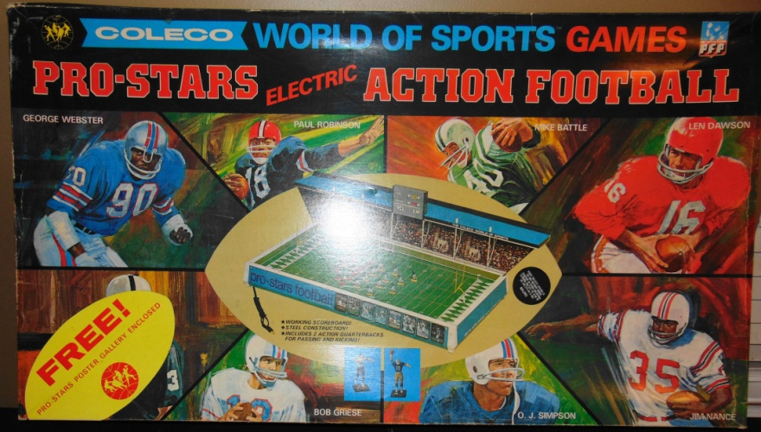
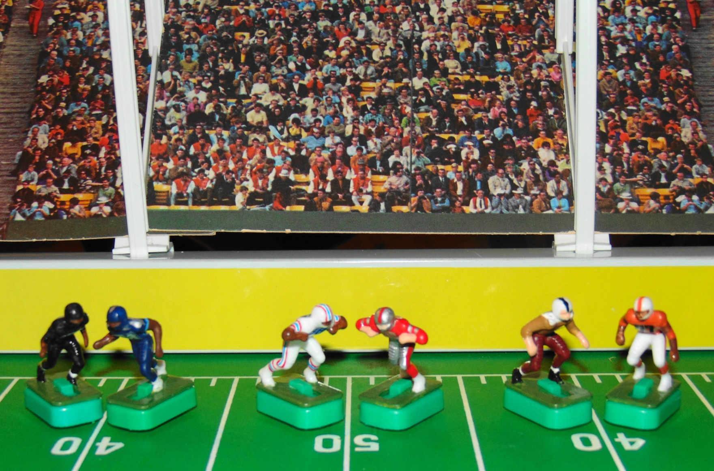



TENNESSEE
Professional Electric Football League
WK2 Games played on the
Coleco World of Sports
Pro Stars Electric Action Football 5785A
Knoxville Bears
Tennessee
Oilers
Chattanooga Cherokees
@
@
@
Tennessee Titans
Memphis Showboats
Memphis Southmen

Slide 15
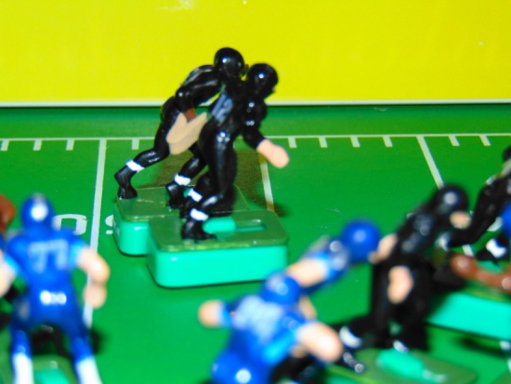
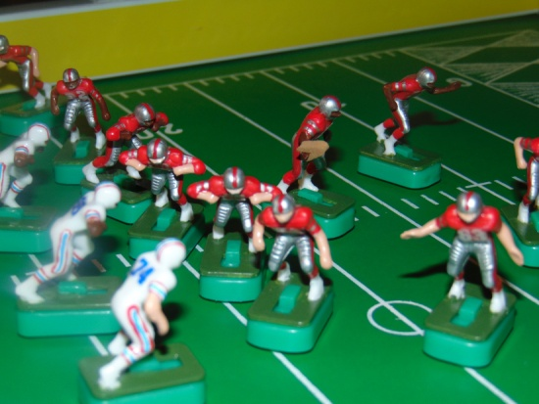
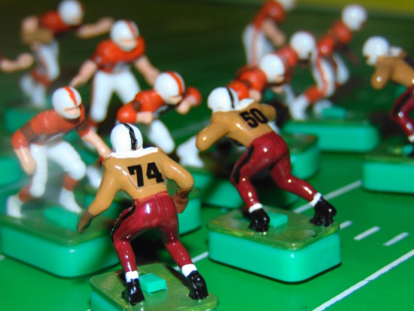



Week 2 Game Results
37
35
14
14
24
27
TENNESSEE
Professional Electric Football League
BLUE DIVISION
W L T
GREY DIVISION
W L T
Showboats 2 0 0
Southmen 2 0 0
Bears 1 0 1
Oilers 0 1 1
Titans 0 2 0
Cherokees 0 2 0
WK3 Schedule
Game 1 Tennessee Oilers @ Tennessee Titans
Game 2 Memphis Showboats @ Memphis Southmen
Game 3 Chattanooga Cherokees @ Knoxville Bears

Slide 16
Official Game Report 10/29/2020 WK2 Game 1
Knoxville Bears @ Tennessee Titans
Knoxville Bears
12 Troutman
31 Nichols
23 Faircloth
20 Frazier
82 Baskette
84 McCauley
52 Shafer
64 Warwick
61 Cole
74 White
75 Daniels
QB / LB
FB / DB
HB / DB
FL / DB
WR / DB
TE / LB
C / MLB
G / DT
G / DT
T / DE
T / DE
Tennessee Titans
17 Tannehill
22 Henry
33 Lewis
11 Brown
84 Davis
82 Walker
60 Johns
64 N. Davis
54 Evans
77 Lewan
78 Conklin
 | 1 | 2 | 3 | 4 | F
Bears | 14 | 0 | 0 | 23 | 37
Titans | 14 | 7 | 14 | 0 | 35
Scoring Summary
1st QTR KNO TEN
KNO - Nichols 77yd KR (Kick GOOD) 7 0
TEN - Henry 60yd Run (Kick GOOD) 7 7
TEN - Brown 36yd Pass from Tannehill (Kick GOOD) 7 14
KNO - Nichols 71yd Run (Kick GOOD) 14 14
2nd QTR
TEN - Davis 83yd Pass from Tannehill (Kick GOOD) 14 21
3rd QTR
TEN - Lewis 12yd Run (Kick GOOD) 14 28
TEN - Brown 42yd Pass from Tannehill (Kick GOOD) 14 35
4th QTR
KNO - Faircloth 22yd Run (Kick GOOD) 21 35
KNO - Baskette 88yd Pass from Troutman (Kick GOOD) 28 35
KNO - Daniels Tackled Henry in end zone - SAFETY 30 35
KNO - Frazier 54yd Pass from Troutman (Kick GOOD) 37 35
Coin Toss “Heads” - Bears Receive
1st Quarter
15:00 KO Titans to Bears - 43yds to 23 /Nichols 77yd KR TD
14:23 Conversion Kick GOOD
Bears 7 Titans 0
14:23 KO Bears to Titans - 53yds to 12 / Davis 18yd KR (Warwick)
Titans @ their 40
13:30 1/10 @ 40 - Henry 60yd run TD
12:27 Conversion Kick GOOD
Bears 7 Titans 7
12:27 KO Titans to Bears - 70 yds TOUCHBACK
Bears @ their 25
12:27 1/10 @ 25 - Nichols 7yd Run (Lewis)
11:18 2/3 @ 32 - Faircloth -5yd Run (Johns)
10:19 3/8 @ 27 - Nichols -12 yd Run (Conklin)
8:17 4/20 @ 15 - Punt 39yds to D46 - Tannehill FAIR CATCH
Titans @ their 46
7:20 1/10 @ 46 - Lewis 17yd Run (FP)
5:57 1/10 @ D37 - Henry 1yd Run (McCauley)
4:22 2/9 @ D36 - Pass to Brown @ D6 COMP / 36yds TD
2:38 Conversion Kick GOOD
Bears 7 Titans 14
2:38 KO Titans to Bears - 44yds to 21 / Baskette 14yd KR (Henry)
Bears @ their 40
2:08 1/10 @ 40 - Faircloth -11yd Run (John)
1:10 2/21 @ D29 - Nichols 71yd Run TD / Time Expires
0:00 Conversion Kick Good - End of QTR
Bears 14 Titans 14
2nd Quarter
15:00 KO Bears to Titans - 65yds to GL / Henry 14yd KR (Warwick)
Titans @ their 14
13:48 1/10 @ 14 - Lewis 1yd Run (Nichols)
12:36 2/11 @ 15 - Henry 2yd Run (McCauley
10:15 3/7 @ 17 - Pass to Davis @ 36 / COMP 83yd TD
8:08 Conversion Kick GOOD
Bears 14 Titans 21
8:08 KO Titans to Bears 38yds to 27 / Troutman 19yd KR (Evans)
Bears @ their 46
7:02 1/10 @ 46 - Faircloth 35yd Run FP
5:10 1/10 @D24 - Troutman -2yd Run (Henry)
3:40 2/12 @ D26 - Troutman -1yd Run (Walker)
2:01 3/13 @ D27 - Time allowed to run to TWO MINUTE WARNING
TWO MINUTE WARNING
2:00 3/13 @ D27 - Pass to Nichols in end zone INC
1:20 4/13 @ D27 - 45yd FG Att NO GOOD
Titans @ their 35
1:14 1/10 @ 35 - Pass to Henry @ 28 / COMP 7yds FP - Titans call 1st TO
0:15 2/3 @ 42 - Tannehill 11yd Run OB (Tannehill set to pass to Henry @ 32 - Fumbled and Recovered @ 34) - Time Expires
END of QTR - Halftime
Bears 14 Titians 21
Titans to receive the 2nd half KO
3rd Quarter
15:00 KO Bears to Titans 35yds to 30 / Lewis 2yd KR (Cole)
Titans @ their 32
14:32 1/10 @ 32 - Pass to Davis @ D49 INC
12:37 2/10 @ 32 - Pass to Lewis @ D46 / COMP 61yds OB
11:39 1/10 @ D7 - Henry -5yd Run (Faircloth)
10:40 2/15 @ D12 - Pass to Brown in the endzone INC
8:34 3/15 @ D12 - Lewis 12yd Run TD
7:59 Conversion Kick GOOD
Bears 14 Titans 28
7:59 KO Titans to Bears 30yds to 35 / Titans Conklin makes the recovery.
Titans @ D35
7:59 1/10 @ D35 - Lewis -3yd Run (Faircloth)
6:38 2/13 @ D38 - Henry -4yd Run (Baskette)
5:10 3/17 @ D42 - Pass to Brown @ D14 / COMP 42yds TD
3:45 Conversion Kick GOOD
Bears 14 Titans 35
3:45 KO Titans to Bears 63yds to 2 / Baskette 21yd KR OB
Bears @ their 23
3:31 1/10 @ 23 - Nichols 55yd Run FP
2:09 1/10 @ D22 - Nichols 15yd Run OB
0:05 1/G @ D7 - Nichols -9yd Run (Henry) Time Expires - End of QTR
Bears 14 Titans 35
4th Quarter
15:00 2/G @ D16 - Troutman SACKED -6yd Run (Lewan)
14:18 3/G @ D 22 - Faircloth 22yd Run TD
12:58 Conversion Kick GOOD
Bears 21 Titans 35
12:58 KO Bears to Titans ONSIDE KICK 17 yds OB
Titans @ their 48
12:58 1/10 @ 48 - Lewis 1yd Run (Warwick)
12:34 2/9 @ 49 - Lewis -1yd Run (Warwick)
11:47 3/10 @ 48 - Pass to Davis @ D24 INC
10:19 4/10 @ 48 - Punt 43yds to D7 / Nichols 5yd PR (Lewis)
Bears @ their 12
9:48 1/10 @ 12 - Pass to Baskette @ 35 / COMP 88yds TD
9:26 Conversion Kick GOOD
Bears 28 Titans 35
9:26 KO Bears to Titans 67yds to end zone / Brown 10yd KR (Frazier)
Titans @ their 8
8:38 1/10 @ 8 - Henry tackled in end zone SAFETY / -8yd Run (Daniels)
Bears 30 Titans 35
8:05 Safety Kick Titans to Bears 35yds to 45 / Nichols 6yd KR (Conklin)
Bears @ D49
7:23 1/10 @ D49 - Faircloth -5yd Run (Walker)
6:39 2/15 @ 46 - Pass to Frazier @ D27 / COMP 54yds TD
4:39 Conversion Kick GOOD
Bears 37 Titans 35
4:39 KO Bears to Titans 54yds to 11 / Henry 15yd KR (Faircloth)
Titans @ their 26
3:16 1/10 @ 26 - Pass to Brown @ 47 / INT by Bears Faircloth / 7yd INT Return (Brown)
Bears @ D40
2:12 1/10 @ D40 - Faircloth -10yd Run (Conklin) Titans Call
TWO MINUTE WARNING
1:29 2/10 @ Midfield - Nichols -6yd Run (Brown) Titans call 1st Time Out
1:06 3/26 @ 44 - Pass to Frazier @ 31 / COMP 28yds OB
0:43 1/10 @ D28 - Troutman -1yd Run (Kneel down)
0:39 2/11 @ D 29 - Time Allowed to Expire - End of Game
Bears 37 Titans 35

Slide 17
Official Game Report 10/30/2020 WK2 Game 2
Tennessee Oilers @ Memphis Showboats
Tennessee Oilers
9 McNair
27 George
20 Thomas
81 Sanders
84 Davis
89 Wycheck
53 Stepnoski
66 Layman
69 Runyon
74 Matthews
72 Hopkins
QB / LB
FB / DB
HB / DB
FL / DB
WR / DB
TE / LB
C / MLB
G / DT
G / DT
T / DE
T / DE
Memphis Showboats
10 Lewis
40 Quarles
34 Reid
83 Carney
9 Crawford
87 Shirk
50 Kuehn
61 Smith
66 Gunn
92 White
74 Clark
 | 1 | 2 | 3 | 4 | F
Oilers | 0 | 7 | 7 | 0 | 14
Showboats | 10 | 7 | 7 | 14 | 38
Scoring Summary
1st QTR TEN MEM
MEM - Crawford 62yd Pass from Lewis (Kick GOOD) 0 7
MEM - 9yd FG 0 10
2nd QTR
TEN - Davis 38yd Pass form McNair (Kick GOOD) 7 10
MEM - Reid 37yd Run (Kick GOOD) 7 17
3rd QTR
TEN - George 9yd Run (Kick GOOD) 14 17
MEM - Lewis 4yd Run (Kick GOOD) 14 24
4th QTR
MEM - Quarles 15yd Run (Kick GOOD) 14 31
MEM - Reid 18yd Run (Kick GOOD) 14 38
Coin Toss “Tails” - Showboats Receive
15:00 KO Oilers to Showboats 73yds Touchback
Showboats @ their 25
15:00 1/10 @ 25 - Crawford -3 yd Run (Thomas)
14:37 2/13 @ 22 - Reid 14 yd Run OB
13:11 1/10 @ 36 - Reid 1yd Run (Laymen)
12:09 2/9 @ 37 - Quarles 1yd Run (Stepnoski)
10:49 3/8 @ 38 - Pass to Crawford @ D23 COMP / 62 yds TD
9:03 Conversion Kick GOOD
Oilers 0 Showboats 7
9:03 KO Showboats to Oilers 50yds to 15 / Davis 6yd KR (Clark)
Oilers @ their 21
8:15 1/10 @ 21 - George -8yds Run (Carney)
7:17 2/8 @ 13 - McNair -8yd Run (Gunn)
6:31 3/16 @ 5 - Pass to Sanders @ 11 INC
5:08 4/16 @ 5 - Punt 35 yds to 40 / Shirk 27yd PR OB
Showboats @ D13
4:17 1/10 @ D13 - Reid 0yd Run (Matthews)
3:25 2/10 @ D13 - Quarles 7yd Run (Runyon)
2:28 3/3 @ D5 - Reid 4yd Run (Layman)
1:27 4/1 @ D1- 9yd FG Att GOOD
Oilers 0 Showboats 10
0:35 KO Showboats to Oilers 73yds Touchback
Oilers @ their 25
0:35 1/10 @ 25 - Thomas -9yd Run (Smith) - Time Expires
End of QTR
Oilers 0 Showboats 10
2nd Quarter
15:00 2/19 @ 16 - George -7yd Run (Shirk)
14:33 3/26 @ 9 - Pass to Davis @ 38 INC
13:33 4/26 @ 9 - Punt 40 yds to 49 / Downed by Davis
Showboats @ D 49
13:06 1/10 @ D49 - Lewis 12yd Run / Fumble @ D38 recovered by Oilers Runyon 5yd Fumble Return
Oilers @ 43
11:09 1/10 @ 43 - George -4yd Run (White)
9:47 2/14 @ 39 - Thomas 23yd Run OB
8:12 1/10 @ D38 - Pass to Davis in the end zone COMP 38yd TD
7:12 Conversion kick GOOD
Oilers 7 Showboats 10
7:12 KO Oilers to Showboats 53yds to 12 / Shirk 48yd KR (Runyon)
Showboats @ D40
6:01 1/10 @ D40 - Reid 3yd Run (Runyon)
5:21 2/7 @ D37 - Reid 37yd Run TD
3:11 Conversion Kick GOOD
Oilers 7 Showboats 17
3:11 KO Showboats to Oilers 71yds Touchback
Oilers @ their 25
3:11 1/10 @ 25 - Pass to Davis @ D35 INC
TWO MINUTE WARNING
2:00 2/10 @ 25 - Pass to Wycheck @ 49 / INT Shirk 11yd INT Return OB
Showboats @ D38
1:29 1/10 @ D38 - Lewis 28yds OB - Time expires
End of QTR - Halftime
Oilers 7 Showboats 17
Oilers to receive 2nd half kickoff
3rd Quarter
15:00 KO Showboats to Oilers 70yds Touchback
Oilers @ their 25
15:00 1/10 @ 25 - George 32 yd Run OB
13:52 1/10 @ D43 - George 2yd Run FP
12:51 2/8 @ D41 - Thomas 3yd Run (Kuehn)
12:05 3/5 @ D38 - Pass to Sanders @ 59 COMP 29yds (Reid)
11:01 1/10 @ D9 - George 9yd Run TD
9:28 Conversion Kick GOOD
Oilers 14 Showboats 17
9:28 KO Oilers to Showboats 57yds to 8 / 13yd KR (Hopkins)
Showboats @ their 21
8:00 1/10 @ 21 - Quarles -2yd Run (Davis)
6:30 2/12 @ 19 - Pass to Quarles @ 40 COMP 77yds OB
4:47 1/G @ D4 - Reid 0yd Run (Davis)
4:30 2/G @ D4 - Lewis 4yd Run TD
3:15 Conversion Kick GOOD
Oilers 14 Showboats 24
3:15 KO Showboats to Oilers 38yds to 27 / Matthews 6yd KR (Crawford)
Showboats @ their 33
3:08 1/10 @ 33 - George -3 yd Run (Reid)
2:04 2/13 @ 30 - George -11yd Run (Clark)
0:26 3/24 @ 19 - Time allowed to expire
End of QTR
Oilers 14 Showboats 24
4th Quarter
15:00 3/24 @ 19 - Thomas -6yd Run (Clark)
14:07 4/30 @ 13 - Punt 38yds to 38 / Carney 2yd PR OB
Showboats @ D36
13:05 1/10 @ D36 - Reid 21 yd Run OB
11:45 1/10 @ D15 - Reid 0yd Run (Davis)
11:17 2/10 @ D15 - Quarles 15 yd Run TD
10:13 Conversion Kick GOOD
Oilers 14 Showboats 31
10:13 KO Showboats to Oilers 50yds / Davis 11yd KR (Lewis)
Oilers @ their 26
8:37 1/10 @ 26 - George 7yd Run OB
8:10 1/10 @ 33 - Thomas -10yd Run (Gunn)
7:34 2/20 @ 23 - Pass to Sanders @ 38 INT Kuehn / 14yd INT Return OB
Showboats @ D24
5:39 1/10 @ D24 - Reid 1 yd Run (Davis)
5:08 2/19 @ D23 - Quarles 5yd Run (Stepnoski)
3:41 3/4 @ D18 - Reid 18 yd Run TD
2:23 Conversion Kick GOOD
Oilers 14 Showboats 38
2:23 KO Showboats to Oilers 53 yds to 12 / Sanders 15yd KR (Clark)
Oilers @ 27
2:14 1/10 @ 27 - Pass to Wycheck @ 41 INT Clark / 13yd INT Return (Wycheck)
TWO MINUTE WARNING
Showboats @ D27
1:18 1/10 @ D27 - Lewis -1yd Run (Kneel Down)
0:57 2/11 @ D28 - Lewis -1 yd Run (Kneel Down)
0:52 3/11 @ D29 - Lewis -1yd Run (Kneel Down)
0:21 4/11 @ D30 - Time allowed expire
END of GAME
Oilers 14 Showboats 38

Slide 18
Official Game Report 10/31/2020 WK2 Game 3
Chattanooga Cherokees @ Memphis Southmen
Chattanooga Cherokees
11 Haushalter QB / LB
30 Vandergriff FB / DB
22 Henley HB / DB
25 Hogan FL / DB
86 Bradley OE / DB
80 Brown OE / LB
50 Kunka C / DT
60 Snyder G/ DT
65 Fuller G / DE
70 Locke T / DE
74 Phillips T/ LB
QB / LB
FB / DB
HB / DB
FL / DB
WR / DB
TE / LB
C / MLB
G / DT
G / DT
T / DE
T / DE
Memphis Southmen
7 Haurte QB / LB
39 Csonka FB / DB
21 Kiick HB / DB
42 Warfield FL / DB
89 Marshall WR / DB
87 Shirk TE / LB
53 Hill C / DT
64 Kruyer G / DT
62 Mikolajczyk G / DT
73 Canale T / DE
77 Cotton T / LB
 | 1 | 2 | 3 | 4 | F
Cherokees | 0 | 7 | 7 | 10 | 24
Southmen | 7 | 14 | 6 | 0 | 27
Scoring Summary
1st QTR CHA MEM
MEM - Csonka 3yd Run (Kick GOOD) 0 7
2nd QTR
MEM - Kiick 1yd Run (Kick GOOD) 0 14
MEM - Kiick 16yd Run (Kick GOOD) 0 21
CHA - Vandergriff 8yd Pass from Haushalter (Kick GOOD) 7 21
3rd QTR
MEM - Marshall 29yd Pass from Huarte (Kick FAILED) 7 27
CHA - Brown 79yd Pass from Haushalter (Kick GOOD) 14 27
4th QTR
CHA - 28yd Field Goal 17 27
CHA - Bradley 21td Pass from Haushalter (Kick GOOD) 24 27
Coin Toss “Tails” - Southmen Receive
1st Quarter
15:00 KO Cherokees to Southmen 64yds Warfield @ Southmen 1 / 72yd KR OB
Southmen @ D27
12:03 1/0 @ D27 - Kiick 24yd Run OB
11:45 1/G @ D3 - Csonka 3yd Run TD
11:22 Conversion Kick GOOD
Cherokees 0 Southmen 7
11:22 KO Southmen to Cherokees 41 yds Bradley 13yd KR (Canale)
Cherokees @ their 34
10:55 1/10 @ 34 - Henley -9yd Run (Canale)
10:12 2/19 @ 25 - Henley -7yd Run (Canale)
8:57 3/16 @ 18 - Vandergriff -3 yd Run (Cotton)
8:02 4/19 @ 15 - Punt 38yds to D47 / Bradley Downs
Southmen @ their 47
6:16 1/10 @ 47 - Csonka 3yd Run (Phillips)
5:46 2/7 @ Midfield - Kiick 10yd Run (Locke)
4:49 1/10 @ D40 - Csonka 2yd Run (Locke)
3:26 2/8 @ D38 - Pass to Marshall in end zone INC
1:25 3/8 @ D38 - Csonka 7yd Run OB
0:25 4/1 @ D31 - Huarte 3yd Run (Synder)
0:15 1/10 @ D28 - Time allowed to expire
End of QTR
Cherokees 0 Southmen 7
2nd Quarter
15:00 1/10 @ D28 - Csonka 6yd Run (Snyder)
14:07 2/14 @ D23 - Kiick 13yd Run OB
12:37 1/G @ D9 - Csonka 8yd Run (Henley)
11:22 2/G @ D1 - Kiick 1yd Run TD
10:10 Conversion Kick GOOD
Cherokees 0 Southmen 14
10:10 KO Southmen to Cherokees 30yds to 35 Csonka recovers @ D35
Southmen @ D35
9:40 1/10 @ D35 - Kiick -7yd Run (Brown)
8:37 2/17 @ D42 - Csonka 26yd Run (Brown)
5:48 1/10 @ D 16 - Kiick 16 yd Run TD
4:18 Conversion Kick GOOD
Cherokees 0 Southmen 21
4:18 KO Southmen to Cherokees 40yds to 25 Vandergriff 30yd KR (Kruyer)
Cherokees @ D45
3:31 1/10 @ D45 - Vandergriff 1yd Run (Mikolajczyk)
2:19 2/19 @ D44 - Time allowed to advance to the Two Minute Warning
TWO MINUTE WARNING
2:00 2/19 @ D44 - Pass to Hogan @ D33 COMP / 35yds (Csonka) Cherokees call 1st TO
1:04 1/G @ D9 - Henley 1 yd Run (Kruyer) Cherokees call 2nd TO
0:41 2/G @ D8 - Pass to Vandergriff in end zone INC (Receiver OB)
0:17 3/G @ D8 - Pass to Vandergriff @ GL COMP / 8yds TD -Time expires
0:00 Conversion Kick GOOD
Cherokees 7 Southmen 21
End of QTR - Halftime
Cherokees to Receive 2nd half KO
3rd Quarter
15:00 KO Southmen to Cherokees 50yds to 15 / Bradley 10yd KR (Warfield)
Cherokees @ their 25
14:19 1/10 @ 25 - Henley 5yd Run (Kiick)
13:39 2/5 @ 30 - Henley -6yd Run (Mikolajczyk)
12:42 3/11 @ 24 - Haushalter 2yd Run (Shirk)
11:21 4/9 @ 26 - Punt 40yds to 34 / Kiick 37yd PR (Hogan)
Southmen @ D 29
9:07 1/10 @ D29 - Pass to Marshall @ D2 COMP / 29yd TD
8:23 Conversion Kick NO GOOD (Missed wide left)
Cherokees 7 Southmen 27
8:23 KO Southmen to Cherokees 57yds to 8 / Hogan 13yd KR (Kiick)
Cherokees @ their 21
7:34 1/10 @ 21 - Pass to Brown @ 40 COMP 79yds TD
6:19 Conversion Kick GOOD
Cherokees 14 Southmen 27
6:19 KO Cherokees to Southmen 67yds to endzone (-2) / Kiick 15yd KR OB
Southmen @ their 13
6:12 1/10 @ 13 - Pass to Csonka @ 5 COMP / 6yds (Vandergriff)
4:59 2/4 @ 19 - Warfield -7yd Run (Fuller)
3:56 3/11 @ 12 - Csonka 2yd Run (Bradley)
2:16 4/9 @ 14 - Punt 35yds to 49 / Brown 18yd PR (Marshall) Time expires
End of QTR
Cherokees 14 Southmen 27
4th Quarter
Cherokees @ D31
15:00 1/10 @ D31 - Vandergriff 7yd Run (Canale)
14:12 2/3 @ D24 - Henley 10 yd Run OB
12:40 1/10 @ D14 -Henley -7yds Run (Huarte)
12:08 2/17 @ D21 - Pass to Hogan @ D1 INC
10:43 3/17 @ D21 - Pass to Hogan in end zone INC
9:36 4/17 @ D21 - 28yd Field Goal GOOD
Cherokees 17 Southmen 27
9:27 KO Cherokees to Southmen 73 yards Touchback
Southmen @ their 25
9:27 1/10 @ 25 - Kiick -5yd Run (Haushalter)
8:13 2/15 @ 20 - Csonka 4yd Run (Phillips)
7:19 3/11 @ 24 - Pass to Kiick @ 13 COMP -6yds (Henley)
5:02 4/17 @ 18 - Punt 44yds to D42 / Henley 9yd PR OB
Cherokees @ D49
3:53 1/10 @ D49 - Pass to Bradley @ D10 INC
3:16 2/10 @ D49 - Pass to Hogan @ 42 COMP 4yds OB
2:03 3/6 @ D45 - Pass to Vandergriff @D26 COMP 24yds OB
TWO MINUTE WARNING
1:37 1/10 @ D21 - Pass to Brown @ D11 INC
1:18 2/10 @ D21 - Pass to Bradley @ D3 COMP 21yds TD
0:53 Conversion Kick GOOD
Cherokees 24 Southmen 27
0:53 KO Cherokees to Southmen -ONSIDE KICK- 12yds to 47 / Shirk recovers / 0yd KR (Hogan)
Southmen @ D47
0:41 1/10 @ D47 - Huarte -1yd Run (Kneel Down)
0:37 211 @ D48 - Time allowed to expire
End of Game
Cherokees 24 Southmen 27

Slide 19

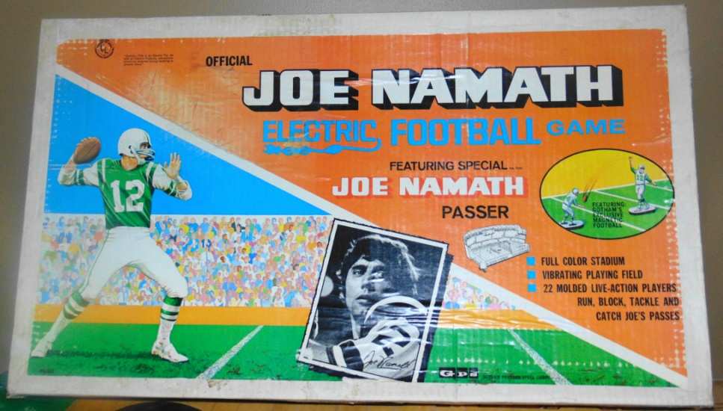
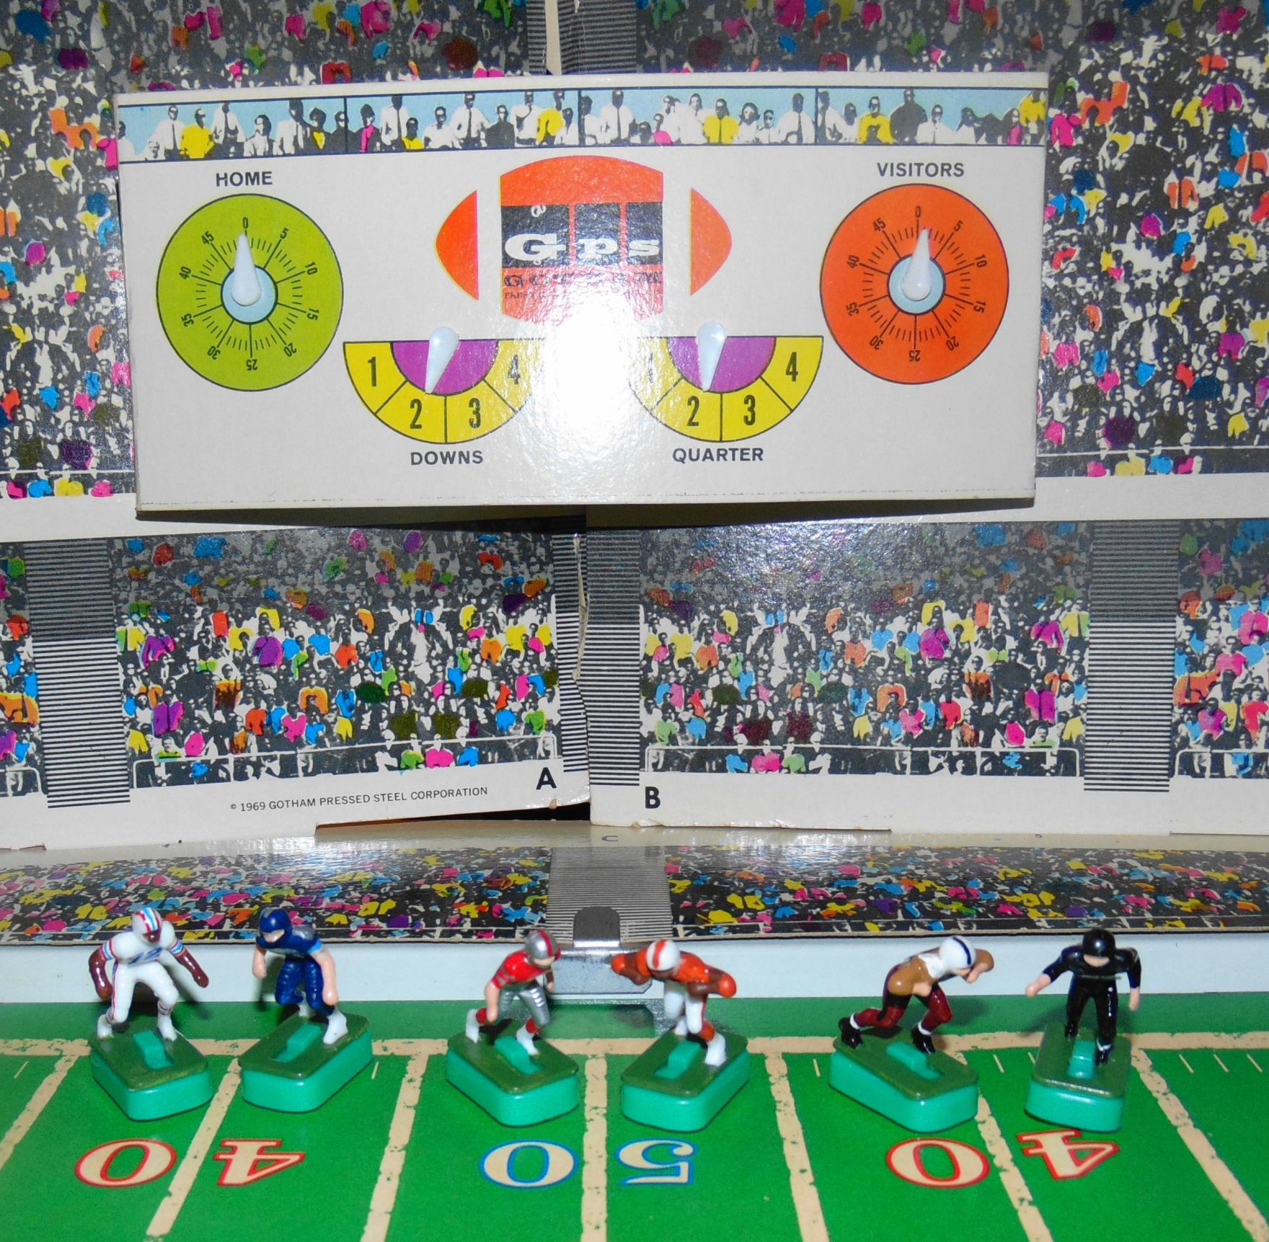
WK3 Games to played on this Classic Gotham Gameboard
Oilers @ Titans
0-1-1 0-2
Showboats @ Southmen
2-0 2-0
Cherokees @ Bears
0-2 1-0-1

Slide 20
Official Game Report 11/04/2020 WK2 Game 1
Tennessee Oilers @ Tennessee Titans
Tennessee Oilers
9 McNair QB / LB
27 George FB / DB
20 Thomas HB / DB
81 Sanders FL / DB
84 Davis SE / DB
89 Wycheck TE / LB
53 Stepnoski C / DT
66 Layman G / DT
69 Runyon G /DE
74 Matthews T / DE
72 Hopkins T / LB
QB / LB
FB / DB
HB / DB
FL / DB
WR / DB
TE / LB
C / MLB
G / DT
G / DT
T / DE
T / DE
Tennessee Titans
17 Tannehill QB / LB
22 Henry FB / DB
33 Lewis HB / DB
11 Brown FL / DB
84 Davis WR / DB
82 Walker TE / LB
60 Johns C / MLB
64 N. Davis G / DT
54 Evans G / DT
77 Lewan T / DE
78 Conklin T / DE
 | 1 | 2 | 3 | 4 | F
Oilers | 0 | 0 | 0 | 14 | 14
Titans | 0 | 13 | 14 | 7 | 34
Scoring Summary
2Nd QTR OIL TIT
TIT - 50yd FG 0 3
TIT - Lewis 70yd Pass from Tannehill (Kick GOOD) 0 10
TIT - 38yd FG 0 13
3rd QTR
TIT - Lewis 30yd Run (Kick GOOD) 0 20
TIT - Lewis 51yd Run (Kick GOOD) 0 27
4th QTR
OIL - McNair 10yd Run (Kick GOOD) 7 27
TIT - Walker 25yd Pass from Tannehill 7 34
OIL - Wycheck 55yd Pass from McNair (Kick GOOD) 14 34
Coin Toss “Tails” - Titans Receive
15:00 KO Oilers to Titans 73yds Touchback
Titans @ their 25
15:00 1/10 @25 - Henry -11yd Run (Sanders)
14:41 2/21 @ 14 - Henry 16 yd Run (Davis)
12:53 3/5 @ 30 - Lewis 2yd Run (Runyon)
12:02 4/7 @ 32 - Punt 30 yds to D38 / #84 44yd PR OB
Oilers @ Titans 18
9:58 1/10 @ D18 - George -14yd Run (Lewis)
9:12 2/24 @ D32 - McNair 21 yd Run FUMBLE / Titans Evans recovers @ D11 / 0yd Fumble Return (Davis)
Titans @ their 11
7:15 1/10 @ 11 - Henry -6 yd Run (Stepnoski)
6:54 2/16 @ 5 - Pass to Davis @ 10 COMP 11yds OB
5:48 1/10 @ 16 - Lewis -1yd Run (Hopkins)
5:25 2/11 @ 15 - Tannehill SACKED / -3yd Run (McNair)
4:22 3/14 @ 12 - Pass to Davis @ 35 COMP / 49yds (George)
2:17 1/10 @ D37 - Henry 4yd Run (George)
1:12 2/6 @ D33 - Henry -2yd Run FP - Time expires
End of QTR
Oilers 0 Titans 3
2nd Quarter
15:00 3/8 @ D35 - Henry -8yd Run (Sanders)
14:06 4/16 @ D43 - 50yd FG GOOD Oilers 0 Titans 3
13:09 KO Titans to Oilers 50yds to 15 / Sanders 20yd KR (Walker)
Oilers @ their 35
12:41 1/10 @ 35 - Thomas 6yd Run (Conklin)
11:54 2/4 @ 41 - George -4yd Run (Lewis)
10:59 3/8 @ 37 - Pass to Thomas @ 41 / McNair FUMBLE @ 19 recovers / 0yd Run OB
9:58 4/8 @ 37 - Punt 25yds to D37 / Walker 3yd PR (George)
Titans @ their 40
9:10 1/10 @ 40 - Lewis -10yd Run (Davis)
8:44 2/20 @ 30 - Pass to Davis @ D37 INC
7:27 3/20 @ 30 - Pass to Lewis @ D32 COMP 70yd TD
6:15 Conversion kick GOOD
Oilers 0 Titans 10
6:15 KO Titans to Oilers 62yds to 8 / Davis 20yd KR (N. Davis)
Oilers @ their 28
5:35 1/10 @ 28 - George 4yd Run FP
5:05 2/6 @ 32 - McNair 3yd Run (Henry)
3:13 3/3 @ 35 - Pass to Thomas @ D47 INT by Evans @ D47 / 26yd INT Return OB
TWO MINUTE WARNING
Titans @ D32
1:56 1/10 @ D32 - Henry -3yd Run (Stepnoski)
1:14 2/13 @ D35 - Henry 5yd Run (Thomas) Titans call their 1st Time Out
0:17 3/8 @ D30 - 38yd FG GOOD
Oilers 0 Titans 13
0:11 KO Titans to Oilers 57yds to 7 / Sanders 28yd KR (Lewan) Time Expires
End of QTR - Halftime
Oilers 0 Titans 13
Oilers receive 2nd half KO
15:00 KO Titans to Oilers 38yds to 27 / Davis 7yd KR (Davis)
Oilers @ their 34
14:11 1/10 @ 34 - George -9yd Run (Henry)
13:56 2/19 @ 25 - Thomas -5yd Run (Davis)
12:37 3/24 @ 20 - Pass to Wycheck @ 48 INT Davis @ midfield / 20yd INT Return (Runyon)
Titans @ D30
10:58 1/10 @ D30 - Henry 0yd Run (Hopkins)
10:11 2/10 @ D30 - Lewis 30yd Run TD
8:33 Conversion Kick GOOD
Oilers 0 Titans 20
8:33 KO Titans to Oilers 35yds to 30 / Sanders 26yd KR OB
Oilers @ D44
7:51 1/10 @ D44 - George 4yd Run FUMBLE / Lewis recovers 0yd Fumble Return (McNair)
Titans @ their 44
6:59 1/10 @ 44 - Henry 11yd Run OB
6:24 1/10 @ D49 - Henry -2yd Run (Stepnoski)
6:03 2/12 @ 49 - Lewis 51yd run TD
4:01 Conversion Kick GOOD
Oilers 0 Titans 27
4:01 KO Titans to Oilers 54yds to 11 / Thomas 64yd KR OB
Oilers @ D25
3:04 1/10 @ D25 - McNair 15yd Run (FP)
1:54 1/G @ D10 - Thomas -5yd Run (Davis)
1:45 2/G @ D15 - George 10yd Run (Lewis)
0:28 3/G @ D5 - George -5yd Run (Johns) Time expires
End of QTR
Oilers 0 Titans 27
4th Quarter
15:00 4/G @ D10 - McNair 10yd Run TD
14:16 Conversion Kick GOOD
Oilers 7 Titans 27
14:16 KO Oilers to Titans 47yds to 18 / Henry 72yd KR (FP)
Titans @ D10
12:57 1/G @ D10 - Henry -5yd Run OB
12:20 2/G @ D15 - Pass to Walker in end zone SACK / Tannehill -10yd Run(Stepnoski)
12:12 3/G @ D25 - Pass to Walker @ D11 COMP 25yds TD
11:07 Conversion Kick GOOD
Oilers 7 Titans 34
11:07 KO Titans to Oilers 44yds to 21 / Sanders -1yd KR (Walker)
Oilers @ their 20
10:47 1/10 @ 20 - McNair 5 yd Run (Brown)
10:16 2/5 @ 25 - Pass to Wycheck INC
9:07 3/5 @ 25 - Pass to Davis @ D32 - COMP 33yds (Lewis)
6:06 1/10 @ D42 - McNair SACK / -13yd Run (Conklin)
4:51 2/23 @ 45 - Pass to Wycheck @ D21 COMP 55yds TD
2:27 Conversion Kick GOOD
Oilers 14 Titans 34
2:27 KO Oilers to Titans 65yds TO GL / Henry 50yd KR (FP)
TWO MINUTE WARNING
Titans @ Midfield
1:34 1/10 @ Midfield - Lewis -5yd Run (Wycheck)
1:15 2/15 @ 45 - Tannehill 0yd Run (Stepnoski)
0:36 3/15 @ 45 Time allowed to expire
End of Game
Oilers 14 Titans 34

Slide 21
Official Game Report 11/08/2020 WK3 Game 2
Memphis Showboats @ Memphis Southmen
Memphis Showboats
10 Lewis
40 Quarles
34 Reid
83 Carney
9 Crawford
87 Shirk
50 Kuehn
61 Smith
66 Gunn
92 White
74 Clark
QB / LB
FB / DB
HB / DB
FL / DB
WR / DB
TE / LB
C / MLB
G / DT
G / DT
T / DE
T / DE
Memphis Southmen
7 Huarte
39 Csonka
21 Kiick
42 Warfield
89 Marshall
87 Shirk
53 Hill
64 Kruyer
62 Mikolajczyk
73 Canale
77 Cotton
 | 1 | 2 | 3 | 4 | F
Showboats | 7 | 7 | 6 | 13 | 33
Southmen | 0 | 7 | 13 | 14 | 34
Scoring Summary
1st QTR SHW SOU
SHW - Shirk 42yd Pass from Lewis (Kick GOOD) 7 0
2nd QTR
SHW - Quarles 17yd Run (Kick GOOD) 14 0
SOU - Marshall 30 yd Pass from Huarte (Kick GOOD) 14 7
SHW - Reid 57yd Run (Kick FAILED) 20 7
3rd QTR
SOU - Kiick 20yd Run (Kick FAILED) 20 13
SOU - Warfield 32yd Pass from Huarte (Kick GOOD) 20 20
4th QTR
SHW - Crawford 39yd Pass from Lewis (Kick GOOD) 27 20
SOU - Shirk 44yd Pass from Huarte (Kick GOOD) 27 27
SHW - Reid 75yd Pass form Lewis (Kick FAILED) 33 27
SOU - Csonka 31 yd Pass from Huarte (Kick GOOD) 33 34
Coin Toss “Tails” - Southmen Receive
15:00 KO Southmen to Showboats 57yds to 8 / Shirk 14yd KR (Csonka)
Showboats @ their 22
14:55 1/10 @ 22 - Lewis 12yd Run (FP)
14:44 1/10 @ 34 - Quarles -3yd Run (Kruyer)
13:32 2/13 @ 31 - Reid 28yd Run OB
11:53 1/10 @ D41 - Reid -1 yd Run (Canale)
11:16 2/11 @ D42 - Pass to Shirk @ D 13 COMP 42yds TD
9:32 Conversion Kick GOOD
Showboats 7 Southmen 0
9:32 KO Showboats to Southmen 43yds to 22 / Huarte 11yd KR (Carney)
Southmen @ their 33
9:24 1/10 @ 33 - Kiick -5yd Run (Reid)
8:57 2/15 @ 28 - Csonka 6yd Run (Shirk)
7:18 3/9 @ 34 - Kiick 2yd Run OB
5:58 4/7 @ 36 - Punt 30yds to D34 / Crawford 22yd PR (Kiick)
Showboats @ D44
4:50 1/10 @ D44 - Reid 32yd Run (Marshall)
3:42 1/10 @ 12 - Pass to Shirk in end zone / Lewis SACKED / -14yd Run (Kruyer)
2:23 2/24 @ D26 - Quarles 9yd Run (Csonka)
0:39 3/15 @ D17 - Time allowed to expire
End of QTR
Showboats 7 Southmen 0
2nd Quarter
15:00 3/15 @ D17 - Quarles 17yd Run TD
14:09 Conversion Kick GOOD
Showboats 14 Southmen 0
14:09 KO Showboats to Southmen 44yds to 21 / Kiick 13yd KR (White)
Showboats @ their 34
14:03 1/10 @ 34 - Csonka -3yd Run (Gunn)
13:50 2/13 @ 31 - Csonka 21yd Run (Clark)
11:55 1/10 @ D48 - Kiick 1yd Run OB
10:28 2/9 @ D47 - Pass to Warfield @ D26 COMP 34yds OB
9:39 1/10 @ D13 - Kiick -4yd Run OB
8:29 2/14 @ D17 - Pass to Csonka @ in end zone / Huarte SACKED - 13yd Run (Shirk)
8:17 3/26 @ D30 - Pass to Marshall @ D5 COMP 30yds TD
7:11 Conversion Kick GOOD
Showboats 14 Southmen 7
7:11 KO Southmen to Showboats 73yds TOUCHBACK
Showboats @ their 25
7:11 1/10 @ 25 - Lewis 7yd Run (Csonka)
6:10 2/3 @ 32 - Quarles 7yd Run (Kiick)
4:59 1/10 @ 39 - Reid 4yd Run (Marshall)
3:49 2/6 @ 43 - Reid 57yd Run TD
1:52 Conversion Kick NO GOOD (missed left)
Showboats 20 Southmen 7
TWO MINUTE WARNING
1:52 KO Showboats to Southmen 38yds to 27 / Shirk 8yd KR (Carney)
Southmen @ their 35
1:29 1/10 @ 35 - Kiick 7yd Run (Reid) Southmen call 1st TO
0:29 2/3 @ 42 - Pass to Kiick @ 33 / Huarte SACKED -14yd Run (White) Southmen Call 2nd TO
0:17 3/17 @ 28 - Pass to Kiick @ 47 INT Crawford 0yd INT Return (Kiick)
Showboats @ D47
0:05 1/10 @ D47 - Lewis -1yd Run (Kneel Down)
0:03 2/11 @ D48 - Time allowed to expire
End of QTR - Halftime
Showboats 20 Southmen 7
Southmen to Receive 2nd half KO
3rd Quarter
15:00 KO Showboats to Southmen 64yds to 1 / Marshall 29yd KR (Clark)
Southmen @ their 30
14:34 1/10 @ 30 - Pass to #21 @ 23 INC
14:17 2/10 @ 30 - Huarte Fumble and Recovery / Fumble Warfield recovers @ 20 /Huarte -10yd Run (Shirk)
13:19 3/20 @ 20 - Csonka 72yd Run OB
12:26 1/G @ D8 - Kiick -9yd Run OB
11:49 1/G @ D17 - Csonka -3yd Run (Crawford)
11:10 1/G @ D20 - Kiick 20yd Run TD
9:32 Conversion Kick NO GOOD (short)
Showboats 20 Southmen 13
9:32 KO Southmen to Showboats 38yds to 22 / Quarles 15yd KR (Warfield)
Showboats @ their 37
9:28 1/10 @ 37 - Reid -2yd Run (Canale)
8:37 2/12 @ 35 - Quarles 16yd Run OB
7:47 1/10 @ D49 - Quarles 2yd Run (Marshall)
7:14 2/8 @ D47 - Quarles -10yd Run (Marshall)
6:14 3/18 @ 43 - Pass to Shirk @ D40 / Huarte SACKED -13yd Run (Cotton)
5:33 4/31 @ 30 - Punt 41yds to 29 / Warfield 48yd PR OB
Southmen @ D23
3:48 1/10 @ D23 - Csonka 12yd Run OB
2:41 1/10 @ D11 - Csonka -4yd Run (Carney)
1:56 2/14 @ D15 - Pass to Csonka @ D35 (Lateral) -17yd Run (Carney)
0:44 3/31 @ D32 - Pass to Warfield @ D6 COMP 32yds TD - Time Expires
End of QTR
0:00 Conversion Kick GOOD
Showboats 20 Southmen 20
4th Quarter
15:00 KO Southmen to Showboats 55yds to 10 / Reid 34 yd KR (Huarte)
Showboats @ their 44
14:45 1/10 @ 44 - Quarles -4yd Run (Kruyer)
14:30 2/14 @ 40 - Reid 9yd Run (Csonka)
13:16 3/5 @ 49 - Reid 2yd Run (Kiick
11:57 4/3 @ D49 - 56yd FG attempt NO GOOD (Short)
Southmen @ D 44
11:12 1/10 @ D44 - Kiick Fumble @ D46 / Showboats Quarles recovers 20yd Fumble Return (Huarte)
Showboats @ D34
10:14 1/10 @ D34 - Shirk -5yd Run (Warfield)
8:42 2/15 @ D39 - Pass to Crawford @ D10 COMP 39yds TD
6:56 Conversion Kick GOOD
Showboats 27 Southmen 20
6:56 KO Showboats to Southmen 73 yds TOUCHBACK
Southmen @ their 25
6:56 1/10 @ 25 - Pass to Warfield @ D48 INT / Crawford 23yd INT Return (Marshall)
Showboats @ D29
5:45 1/10 @ D29 - Reid -6yd Run (Csonka)
5:15 2/16 @ D35 - Reid Fumble /Crawford recovers @ D43 / -8 yd run w/ 5yd

Slide 22
Fumble Return (Cotton)
3:37 3/19 @ D38 - Reid Fumble and Recovery -11 yd Run (Shirk) - Southmen call 1st Time Out
2:45 4/30 @ D49 - 54yd FG Attempt NO GOOD (Short)
Southmen @ D44
2:36 1/10 @ D44 - Pass to Shirk @ D17 COMP 44yd TD
2:17 Conversion Kick GOOD
Showboats 27 Southmen 27
2:17 KO Southmen to Showboats 71yds TOUCHBACK
Showboats @ their 25
2:17 1/10 @ 25 - Pass to Reid @ D29 COMP 75yds TD
1:55 Conversion Kick NO GOOD (Short)
Showboats 33 Southmen 27
TWO MINUTE WARNING
1:55 KO Showboats to Southmen 47yds to 18 / Kiick 33yd KR OB
1:28 1/10 @ D49 - Huarte SACKED -9yds (Gunn) Southmen Call 2nd Time Out
1:14 2/19 @ 42 - Pass to Csonka @ D22 COMP 49yds (Quarles) Southmen Call 3rd Time Out
1:00 1/G @ 9 - Pass to Marshall in end zone / Huarte SACKED -11yd Run (Clark)
0:52 2/G @ 20 - Pass to Csonka @ D4 / Huarte SACKED -11yds (Clark)
0:19 3/G @ 31 - Pass to Csonka @ D5 COMP 31 yds TD -Time expires
0:00 Conversion Kick GOOD
Showboats 33 Southmen 34
END of GAME
Official Game Report 11/09/2020 WK3 Game 3
Chattanooga Cherokees @ Knoxville Bears
Chattanooga Cherokees
12 Troutman
31 Nichols
23 Faircloth
20 Frazier
82 Baskette
84 McCauley
52 Shafer
64 Warwick
61 Cole
74 White
75 Daniels
Knoxville Bears
11 Haushalter
30 Vandergriff
22 Henley
25 Hogan
86 Bradley
80 Brown
50 Kunka
60 Snyder
65 Fuller
70 Locke
74 Phillips
 | 1 | 2 | 3 | 4 | F
Cherokees | 0 | 14 | 0 | 0 | 14
Bears | 7 | 13 | 7 | 13 | 40
QB / LB
FB / DB
HB / DB
FL / DB
WR / DB
TE / LB
C / MLB
G / DT
G / DT
T / DE
T / DE
Scoring Summary
1st QTR CHA KNX
KNX - Henley 39yd PR (Kick GOOD) 0 7
2nd QTR
CHA - Faircloth 12yd Run (Kick GOOD) 7 7
KNX - Hogan 102yd KR (Kick FAILED) 7 13
CHA - Frazier 67yd Pass from Troutman (Kick Good) 14 13
KNX - Henley 88yd KR (Kick GOOD) 14 20
3rd QTR
KNX - Henley 7yd Run (Kick Good) 14 27
4th QTR
KNX - Hogan 31yd Pass from Haushalter (Kick Good) 14 34
KNX - Vandergriff 13yd Run (Kick Failed) 14 40
Coin Toss “Heads” - Cherokees Receive
15:00 KO Bears to Cherokees 38yds to 27 / McCauley 21yd KR (Brown)
Cherokees @ their 48
14:24 1/10 @ 48 - Nichols -9yd Run (Fuller)
14:03 2/19 @ 39 - Faircloth FUMBLE / Bears Snyder recovers @ 41 / 2yd Run w/ 0yd Fumble Return
Bears @ D41
12:59 1/10 @ D41 - Henley FUMBLE (Locke Recovers @ D24) 18yd Run w/ 0yd Fumble Return
12:12 1/10 @ D23 - Vandergriff -9yd Run (FP)
10:49 2/19 @ D32 - Vandergriff -4yd Run (Troutman)
9:30 3/23 @ D36 - Hauhalter -4yd Run (Nichols)
8:24 4/27 @ D 40 - 47yd FG Attempt NO GOOD (short)
Cherokees @ their 47
7:28 1/10 @ 47 - Nichols -6yd Run (Fuller)
7:11 2/16 @ 41 - Pass to Frazier @ D32 / Troutman SACKED -22 yd Run (Phillips)
6:21 3/38@ 19 - Troutman SACKED -8yd Run (Kunka)
5:34 4/46 @ 11 - Punt 28yds to 39 / Henley 39yd PR TD
3:54 Conversion Kick GOOD
Cherokees 0 Bears 7
3:54 KO Bears to Cherokees 44yds to 21 / Faircloth 35yd KR (Bradley)
Cherokees @ D44
3:17 1/10 @ D44 - Faircloth -7yd Run (Bradley)
2:55 2/17 @ 49 - Faircloth FUMBLE (Bears Fuller recovers @ 34) -15yd Run w/ 0yd Fumble Return (Cole)
Bears @ D34 -
1:09 1/10 @ D34 - Henley -3yd Run (Daniels)
0:23 2/13 @ D37 - Time allowed to exprire
End OF QTR
Cherokees 0 Bears 7
2nd Quarter
15:00 2/12 @ D37 - Pass to Vandergriff @ D15 COMP 24yds OB
14:22 1/10 @ D13 - Henley 3yd Run (McCauley)
13:21 2/7 @ D10 - Henley -3yd Run (Baskette)
12:00 3/10 @ D13 - Vandergriff -2yd Run (Faircloth)
10:38 4/12 @ D15 - 22yd FG attempt BLOCKED (Baskette)
Cherokees @ their 20
9:48 1/10 @ 20 - Faircloth 4yd Run OB
9:26 2/6 @ 24 - Nichols 4yd Run (Henley)
8:09 3/2 @ 28 - Faircloth 8yd Run (Bradley)
6:47 1/10 @ 36 - Pass to Baskette @ D40 COMP 52yds (Hogan)
5:12 1/10 @ D12 - Faircloth 12yd Run TD
3:58 Conversion Kick GOOD
Cherokees 7 Bears 7
3:58 KO Cherokees to Bears 67 yds to -2 in end zone / Hogan 102yd KR TD
3:14 Conversion Kick NO GOOD (short)
Cherokees 7 Bears 13
3:14 KO Bears to Cherokees 70yds to -5 in end zone / Warwick downs in end zone TOUCHBACK
Cherokees @ their 25
3:14 1/10 @ 25 - Nichols 7yd Run (Baskette)
2:32 2/9 @ 32 - Nichols 1yd Run (Baskette)
TWO MINUTE WARNING
1:34 3/8 @ 33 - Pass to Frazier @ 41 COMP / 67yds TD
0:40 Conversion Kick GOOD
Cherokees 14 Bears 13
0:40 KO Cherokees to Bears 53 yards to 12 / Henley 88yd KR TD - Time expires
0:00 Conversion Kick Good
Cherokees 14 Bears 20
End of QTR - Halftime
Cherokees to Receive 2nd Half KO
3rd Quarter
15:00 KO Bears to Cherokees 47yds to 18 / Faircloth 9yd KR (Brown)
Cherokees @ their 27
14:55 1/10 @ 27 - Faircloth 23yd Run (Fuller)
14:37 1/10 @ Midfield - Nichols -7yd Run (Haushalter)
13:33 2/17 @ 43 - Pass to Baskette @ D25 INT Bears Vandergriff / 55yd INT Return OB
Bears @ D20
11:52 1/10 @ D20 - Henley 0yd Run (FP)
11:07 2/10 @ D20 - Henley 13yd Run (FP)
9:17 1/10 @ D7 - Henley 7yd Run TD
7:51 Conversion Kick Good
Cherokees 14 Bears 27
7:51 KO Bears to Cherokees 70yds to -5 in end zone Faircloth downed in the end zone TOUCHBACK
Cherokees @ their 25
7:51 1/10 @ 25 - Troutman 33yd Run (FP)
7:14 1/10 @ D42 - Pass to Baskette @ D10 INC
5:41 2/10 @ D42 - Faircloth -3yd Run (Bradley)
5:22 3/13 @ D45 - Troutman -6yd Run (Locke)
4:29 4/19 @ 49 - Punt 27yds to D24 / Hogan 23yd PR (White)
Bears @ their 47
3:10 1/10 @ 47 - Henley -12yd Run (Cole)
2:32 2/22 @ 35 - Henley 22yd Run (FP)

Slide 23

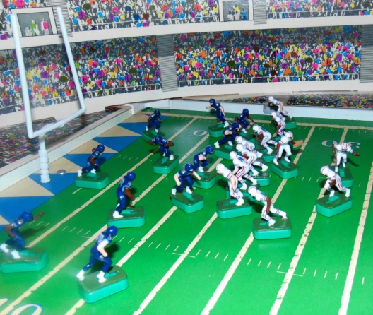
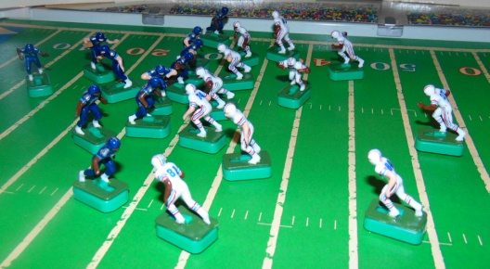
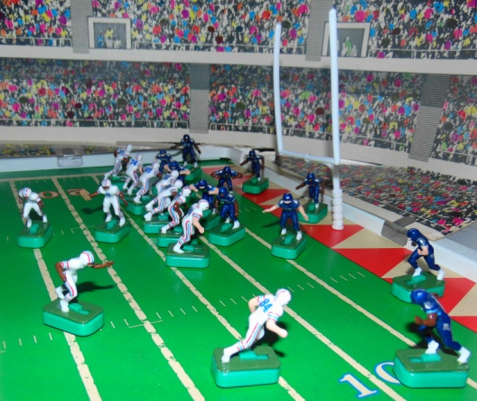

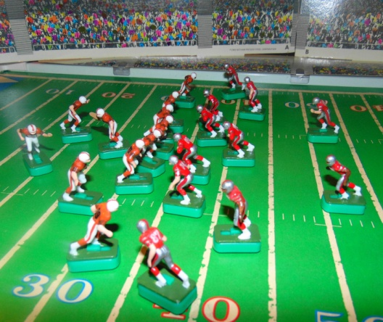
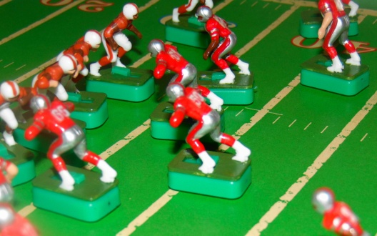
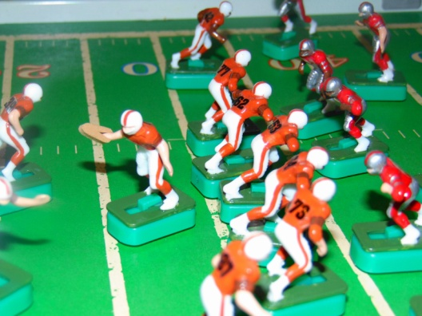
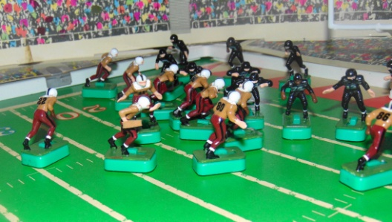
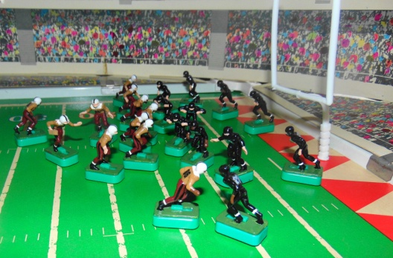
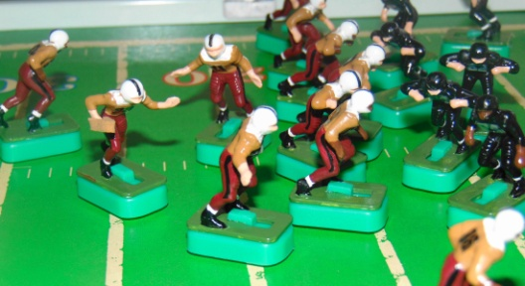
0:40 1/10 @ D43 - Vandergriff 6yd Run (Warwick) - Time expired
End of QTR
Cherokees 14 Bears 27
4th Quarter
15:00 2/4 @ D37 - Vandergriff 14yd Run (Shafer)
14:07 1/10 @ D23 - Henley -8yd Run (Warwick)
13:07 2/18@ D31 - Pass to Brown @ D3 INC
11:45 3/18 @ D31 - Pass to Hogan @ D6 COMP 31yd TD
10:56 Conversion Kick GOOD
Cherokee 14 Bears 34
10:56 KO Bears to Cherokees 35yds to 30 / Nichols 4yd KR (Brown)
Cherokees @ their 34
10:52 1/10 @ 34 - Faircloth FUMBLE / Frazier recovers @ 23 (Phillips) - Faircloth -12yd Run
8:36 3/21 @ 23 - Faircloth -3yd Run (Snyder)TWO MINUTE WARNING
1:55 KO Showboats to Southmen 47yds to 18 / Kiick 33yd KR OB
1:28 1/10 @ D49 - Huarte SACKED -9yds (Gunn) Southmen Call 2nd Time Out
1:14 2/19 @ 42 - Pass to Csonka @ D22 COMP 49yds (Quarles) Southmen Call 3rd Time Out
1:00 1/G @ 9 - Pass to Marshall in end zone / Huarte SACKED -11yd Run (Clark)
0:52 2/G @ 20 - Pass to Csonka @ D4 / Huarte SACKED -11yds (Clark)
0:19 3/G @ 31 - Pass to Csonka @ D5 COMP 31 yds TD -Time expires
0:00 Conversion Kick GOOD
Showboats 33 Southmen 34
END of GAME
LEAGUE STANDINGS after 3 WEEKS
BLUE DIVISION
W L T
GREY DIVISION
W L T
Bears 2 0 1
Southmen 3 0 0
Showboats 2 1 0
Oilers 0 2 1
Titans 1 2 0
Cherokees 0 3 0
14
34
Week 3 Game Results
33
34
14
40

Slide 24
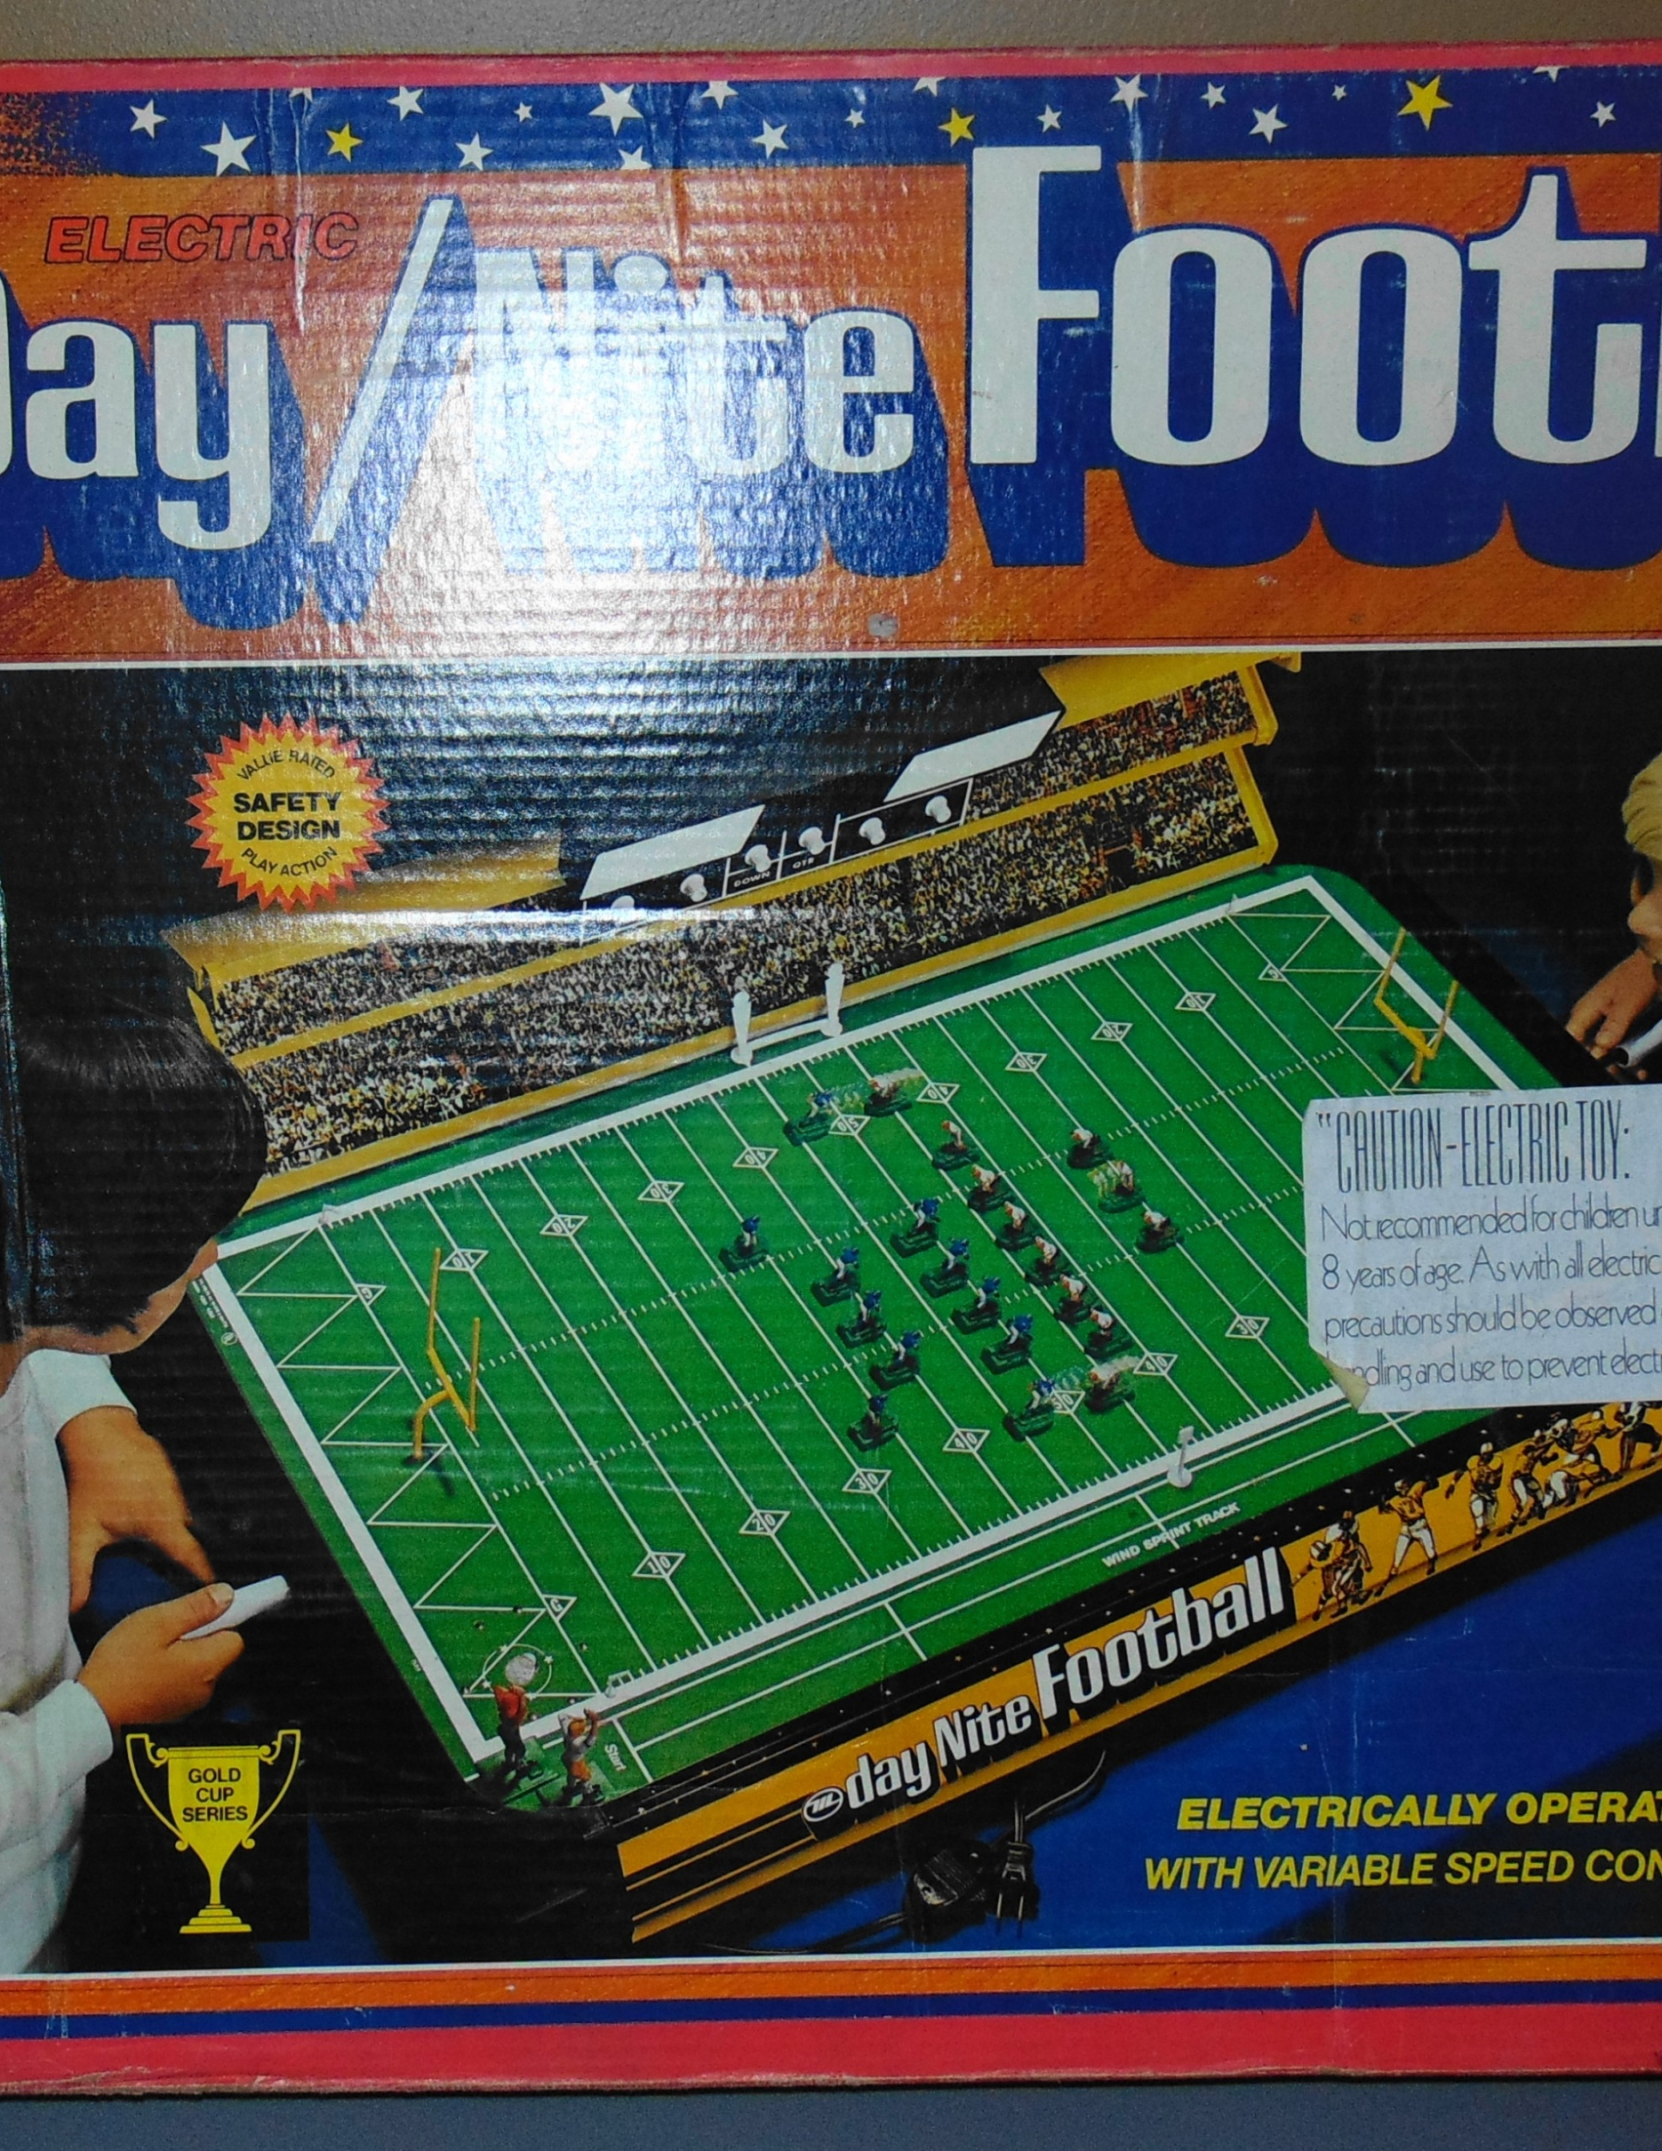
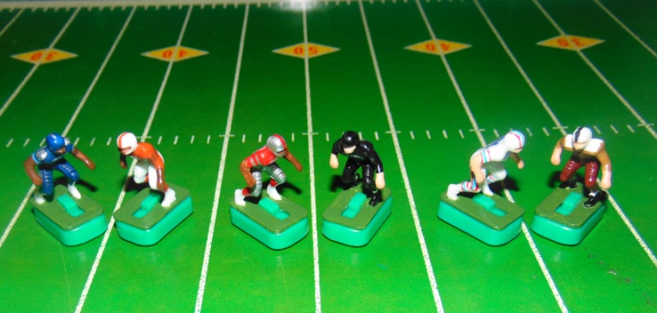



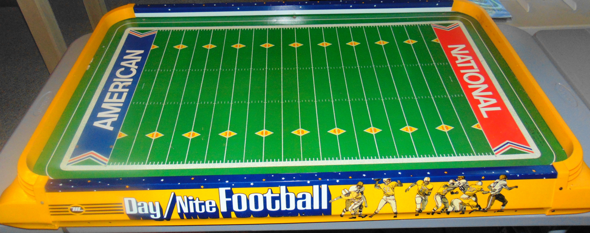

Wk 4 Games
Game 1
Titans (1-2) @
Southmen (3-0)
Game 2
Showboats (2-1) @
Bears (2-0-1)
Game 3
Oilers (0-2-1) @
Cherokees (0-3)
Joe Namath day/Nite Football by Munro

Slide 25
Official Game Report 11/14/2020 WK4 Game 1
Tennessee Titans @ Memphis Southmen
Tennessee Titans
17 Tannehill
22 Henry
33 Lewis
11 Brown
84 Davis
82 Walker
60 Johns
64 N. Davis
54 Evans
77 Lewan
78 Conklin
QB / LB
FB / DB
HB / DB
FL / DB
WR / DB
TE / LB
C / MLB
G / DT
G / DT
T / DE
T / DE
Memphis Southmen
7 Haurte
39 Csonka
21 Kiick
42 Warfield
89 Marshall
87 Shirk
53 Hill
64 Kruyer
62 Mikolajczyk
73 Canale
77 Cotton
 | 1 | 2 | 3 | 4 | F
Titans | 7 | 3 | 0 | 21 | 31
Southmen | 7 | 7 | 7 | 20 | 14
Scoring Summary
1st QTR TEN MEM
TEN - Henry 32yd Run (Kick GOOD) 7 0
MEM - Marshall 19yd Pass from Huarte (Kick GOOD) 7 7
2nd QTR
TEN - 50yd FG 10 7
MEM Warfied 14yd Pass from Huarte (Kick GOOD) 10 14
3rd QTR
MEM - Warfield 8yd Pass from Huarte (Kick GOOD) 10 21
4th QTR
TEN - Henry 31yd Pass from Tannehill (Kick GOOD) 17 21
MEM - Csonka 37yd Run (Kick FAILED) 17 27
MEM - Warfield 18yd Pass from Huarte (Kick GOOD) 17 34
TEN - Tannehill 6 yd Run (Kick GOOD) 24 34
MEM - Csonka 40yd Run (Kick GOOD) 24 41
TEN - Henry 9yd Run (Kick GOOD) 31 41
Coin Toss “Heads” - Titans Receive
1st Quarter
15:00 KO Southmen to Titans 38yds to 27 / Walker 8yd KR (Marshall)
Titans 1/10 @ their 35
14:52 1/10 @ 35 - Henry 3yd Run (Csonka)
14:19 2/7 @ 38 - Henry 62yd Run TD
12:30 Conversion Kick GOOD
Titans 7 Southmen 0
12:30 KO Titans to Southmen 53yds to 12 / Marshall 11yd KR (Davis)
Southmen @ their 24
12:23 1/10 @ 24 - Huarte -5yd Run (Henry)
11:53 2/15 @ 19 - Csonka 39yd Run OB
9:51 1/10 @ D42 - Pass to Csonka @ D32 COMP 37yds (FP)
8:49 1/G @ D5 - Csonka -6yd Run OB
7:34 2/G @ D11 - Csonka -8yd Run (Kruyer)
6:01 3/G @ D19 - Pass to Marshall in end zone COMP 19yds TD
5:04 Conversion Kick GOOD
Titans 7 Southmen 7
5:04 KO Southmen to Titans 64yds to 1 / Henry 20yd KR (Csonka)
Titans @ their 21
4:59 1/10 @ 21 - Henry -6yd Run (Kiick)
4:29 2/16 @ 15 - Lewis 29yd Run OB
1:51 1/10 @ 44 - Henry 4yd Run (Canale)
1:05 2/6 @ 48 - Henry 10yd Run (Kiick) - Time Expires
End of QTR
Titans 7 Southmen 7
2nd Quarter
15:00 1/10 @ D42 - Lewis 13yd Run (Marshall)
13:47 1/10 @ D29 - Henry 18yd Run OB
11:49 1/10 @ D11 - Henry 6yd Run (Marshall)
10:42 2/4 @ D5 - Lewis -10yd Run (Kruyer)
9:00 3/14 @ D15 - Tannehill -18yd run (Canale)
7:24 4/32 @ D33 - 50yd FG Att. GOOD
Titans 10 Southmen 7
6:33 KO Titans to Southmen 54yds to 11 / Warfield 28yd KR (Tannehill)
Southmen @ their 39
6:15 1/10 @ 39 - Kiick -3yd Run OB
5:45 2/13 @ 36 - Csonka 10 yd Run (Davis)
5:11 3/3 @ 46 - Pass to Csonka @ D9 INC
3:43 4/3 @ 46 - Pass to Csonka @ D26 COMP 40yds (Davis)
3:01 1/10 @ D14 - Kiick 0yd Run OB - Time Out
TWO MINUTE WARNING
2:00 2/10 @ D14 - Pass to Warfield @ D4 COMP 14yds TD
1:29 Conversion Kick GOOD
Titans 10 Southmen 14
1:29 KO Southmen to Titans - 53yds to 12 / Henry 12yd KR (Hill)
Titans @ their 24
1:04 1/10 @ 24 - Lewis 38yd Run OB
0:08 1/10 @ D38 - Henry 2yd Run FP - Time expires
End of QTR - Halftime
Titans 10 Southmen 14
3rd Quarter
15:00 KO Titans to Southmen - 47yds to 18 / Warfield 19yd KR (Tannehill)
Southmen 1/10 @ their 37
14:54 1/10 @ 37 - Csonka 21yd Run (Davis)
14:20 1/10 @ D42 - Kiick 1yd Run (Evans)
13:32 2/9 @ D41 - Kiick 40yd run OB
12:28 1/G @ D1 - Kiick -7yd Run (Walker)
12:07 2/G @ D8 - Pass to Warfield in end zone COMP 8yds TD
11:01 Conversion Kick GOOD
Titans 10 Southmen 21
11:01 KO Southmen to Titans 53yds to 12 / Davis 16yd KR (Marshall)
Titans @ their 28
10:24 1/10 @ 28 - Lewis -2yd Run (Kruyer)
10:19 2/12 @ 26 - Pass to Henry @ 26 COMP 13yds (Marshall)
9:05 1/10 @ 39 - Lewis 13yd Run (Marshall)
7:43 1/10 @ D48 - Henry -8yd Run (Kruyer)
6:43 2/18 @ 43 - Henry 20yd Run OB
5:07 1/10 @ D37 - Henry -4yd Run (Mikolajczyk)
4/30 2/14 @ D41 - Pass to Walker @ D30 Defensive Pass Interference (Huarte) 5yds Auto 1st Down
3:36 1/10 @ D36 - Henry -2yd Run (Hill )
2:49 2/12 @ D38 - Lewis 13yd run (Shirk)
1:17 1/10 @ D25 - Tannehill -6yd Run (Kiick) Time allowed to expire
End of QTR
Titans 10 Southmen 21
4th Quarter
15:00 2/16 @ D31 - Pass to Henry @ D21 COMP 31 yds TD
14:14 Conversion Kick GOOD
Titans 17 Southmen 21
14:14 KO Titans to Southmen 44yds to 21 / Csonka 16yd KR (Davis)
Southmen @ their 37
14:09 1/10 @ 37 - Csonka 26yd Run OB
13:37 1/10 @ D37 - Csonka 37 yd Run TD
12:47 Conversion Kick Failed (wide left)
Titans 17 Southmen 27
12:47 KO Southmen to Titans 64 yds to 1 / Recovered by Kicking Team (Csonka)
Southmen @ D1
12:47 1/G @ D1 - Csonka FUMBLE and Recovery @ D20 / -17yd Run (Lewis)
12:24 2/G @ D18 - Pass to Warfield in end zone COMP 18yds TD
11:25 Conversion Kick GOOD
Titans 17 Southmen 34
11:25 KO Southmen to Titans 55yds to 10 / Henry 35yd KR (FP)
Titans @ their 45
10:40 1/10 @ 45 - Pass to Lewis @ D22 COMP 49yds OB
9:30 1/G @ D6 - Pass to Davis in end zone INC
9:18 2/G @ D6 - Pass to Henry @ D3 INC
8:48 3/3G @ D6 - Tannehill 6yd run TD
8:25 Conversion Kick GOOD
Titans 24 Southmen 34
8:21 KO Titans to Southmen 65yds to GL / Warfield 30yd KR (Tannehill)
Southmen @their 30
8:21 1/10 @ 30 - Csonka 33yd Run (Evans)
7:34 1/10 @ D37 - Kiick -3yd Run (Walker)
6:29 2/13 @ D40 - Csonka 40yd Run TD
5:04 Conversion Kick GOOD
Titans 24 Southmen 41
5:04 KO Southmen to Titans 54yds to 11 / Evans 87yd KR OB
Titans @ D 2
4:08 1/10 @ D2 - Tannehill -7yd Run (FP)
4:02 2/17 @ D9 - Henry 9yd Run TD
3:04 Conversion Kick GOOD
Titans 31 Southmen 41

Slide 26
3:04 KO Titans to Southmen “Onside Kick” 10yds to D45 / Titans Brown recovers - Down @ the Spot
Titans @ their 45
3:04 1/10 @ 45 - Pass to Henry @ 46 COMP 16 yds OB
2:38 1/10 @ D39 - Pass to Brown @ D15 INC
2:29 2/10 @ D39 - Tannehill 12yd Run (Huarte)
TWO MINUTE WARNING
1:38 1/10 @ D27 - Pass to Lewis INC
1:24 2/10 @ D27 - Pass to Brown @ D7 INC
1:12 3/10 @ D27 - Pass to Brown @ D15 Tannehill SACKED / -12yd Run (Canale)
1:06 4/22 @ D40 - 57yd FG Att NO GOOD
Southmen @ their 47
0:58 1/10 @ 47 - Huarte -2 yd Run - Tians Call 1st Time Out
0:55 2/12 @ 45 - Huarte 4 yd Run (Brown)
0:28 3/8 @ 49 - Time allowed to expire
END of Game
Titans 31 Southmen 41
Official Game Report 11/16/2020 WK4 Game 2
Memphis Showboats @ Knoxville Bears
Memphis Showboats
10 Lewis
40 Quarles
34 Reid
83 Carney
9 Crawford
87 Shirk
50 Kuehn
61 Smith
66 Gunn
92 White
74 Clark
Knoxville Bears
12 Troutman
31 Nichols
23 Faircloth
20 Frazier
82 Baskette
84 McCauley
52 Shafer
64 Warwick
61 Cole
74 White
75 Daniels
 | 1 | 2 | 3 | 4 | F
Showboats | 3 | 10 | 7 | 20 | 40
Bears | 0 | 0 | 14 | 14 | 28
QB / LB
FB / DB
HB / DB
FL / DB
WR / DB
TE / LB
C / MLB
G / DT
G / DT
T / DE
T / DE
Scoring Summary
1st QTR TEN MEM
MEM - 36yd FG 3 0
2nd Quarter
MEM - Crawford 72yd Pass from Lewis (Kick GOOD) 10 0
MEM - 37yd FG 13 0
3rd QTR
KNX - Frazier 2yd Pass from Troutman (Kick GOOD) 13 7
MEM - Quarles 75yd Run (Kick GOOD) 20 7
KNX - Baskette 52yd Pass from Troutman (kick GOOD) 20 14
4th QTR
MEM - Quarles 14yd Run (Kick GOOD) 27 14
MEM - Quarles 65yd Run (Kick FAILED) 33 14
KNX - McCauley 18yd Pass from Troutman (Kick GOOD) 33 21
MEM - Reid 16yd Run (Kick GOOD) 40 21
KNX - Faircloth 82 yd KR TD (Kick GOOD) 40 28
Coin Toss “Heads” - Showboats Receive
1st Quarter
15:00 KO Bears to Showboats 38yds to 27 / Shirk 32 yd KR (Nichols)
Showboats @ D41
14:25 1/10 @ D41 - Reid 7yd Run (Daniels)
13:45 2/3 @ D34 - Reid 16yd Run (Faircloth)
11:56 1/10 @ D18 - Quarles 4yd Run (Troutman)
10:49 2/6 @ D14 - Quarles -1yd Run (Cole)
9:58 3/7 @ D15 - Quarles -4yd Run (Nichols)
8:53 4/11 D19 - 36yd FG Att. GOOD
Showboats 3 Bears 0
7:25 KO Showboats to Bears 35yds to 30 / Nichols 4yd KR (Clark)
Bears @ their 34
7:20 1/10 @ 34 - Nichols -2yd Run (Shirk)
6:48 1/10 @ 32 - Faircloth 22yd Run OB
5:28 1/10 @ D46 - Faircloth to D9 FUMBLE / Showboats Quarles recovers @ D12 / 34yd Run w/Fumble / Quarles 4yd Fumble Return (Faircloth)
Showboats @ their 16
3:37 1/10 @ 16 - Quarles 8yd Run (White)
2:57 2/2 @ 24 - Reid 22yd Run (Frazier)
1:36 1/10 @ 46 - Quarles to 45 FUMBLE / Recovered by Kuehn / Quarles 9yd Run / Kuehn 0yd Fumble Return (Troutman)
0:27 2/1 @ D45 - Time allowed to expire
End of QTR
Showboats 3 Bears 0
2nd Quarter
15:00 2/1 @ D45 - Lewis SACK(White)/FUMBLE @ 28 / Recovered by Smith / Down @ 32 / -22yd Run w/ Fumble and Recovery by the Offense.
13:55 3/23 @ 28 - Pass to Crawford @ D43 COMP 72yds TD
11:59 Conversion Kick GOOD
Showboats 10 Bears 0
11:59 KO Showboats to Bears 57yds to 8 / Baskette 25yd KR (Kuehn)
Bears @ their 33
11:39 1/10 @ 33 - Nichols -4yd Run (Shirk)
11:17 2/14 @ 29 - Nichols 32yd Run (Kuehn)
9:53 1/10 @ D39 - Pass to Baskette @ D20 COMP 19yds (Reid)
9:08 1/10 @ D20 - Faircloth -8yd Run (Shirk)
8:30 2/8 @ D28 - Nichols 0yd Run (Quarles)
7:28 3/18 @ D28 - Pass to Nichols @ D30 COMP to D18 / FUMBLE / Showboats Smith recovers @ D16 / 10yds w/Fumble recovered by the defense /15yd Fumble Return (McCauley)
Showboats @ their 31
5:49 1/10 @ 31 - Quarles 9yd Run (Baskette)
5:14 2/1 @ 40 - Reid 5yd Run (FP)
4:03 1/10 @ 45 - Reid -2yd Run (Daniels)
3:05 2/12 @ 43 - Crawford 20yd Run (Faircloth)
TWO MINUTE WARNING
1:20 1/10 @ D37 - Quarles 0yd Run (Nichols) - Showboats call 1st TO
1:02 2/10 @ D37 - Pass to Carney @ D15 COMP 27yds (Nichols) - Showboats call 2nd TO
0:44 1/G @ D10 - Reid -10yd Run (Daniels) - Showboats call 3rd TO
0:26 2/G @ D20 - Pass to Quarles in end zone INC
0:11 3/G @ D20 - 37yd FG Att. GOOD
Showboats 13 Bears 0
0:05 KO Showboats to Bears 35 yds to 30 / Faircloth 7yd KR (Kuehn) - Time Expires
END of Qtr- Halftime
Showboats 13 Bears 0
Bears to receive 2nd Half Kickoff
3rd Quarter
15:00 KO Showboats to Bears 57 yds to 8 / Baskette 32yd KR (Kuehn)
Bears @ their 40
14:30 1/10 @ 40 - Faircloth 3yd Run (Kuehn)
14:08 2/7 @ 43 - Nichols 38yd Run (Crawford)
12:43 1/10 @ D19 - Faircloth -5yd Run (White)
11:26 2/15 @ D24 - Nichols 22yd Run (Reid)
10:14 1/G @ D2 - Pass to Frazier @ GL COMP 2yds TD
9:28 Conversion Kick GOOD
Showboats 13 Bears 7
9:28 KO Bears to Showboats 73yds to end zone (-8) / TOUCHBACK
Showboats @ their 25
9:28 1/10 @ 25 - Quarles 75yd Run TD
8:08 Conversion Kick GOOD
Showboats 20 Bears 7
Bears @ their 14
7:58 1/10 @ 14 - Pass to Baskette @ 33 INC
7:27 2/10 @ 14 - Pass to Frazier @ 33 COMP 24yds (Quarles)
6:56 1/10 @ 38 - Faircloth 0yd Run (Quarles)
5:54 2/10 @ 38 - Troutman FUMBLE and Recovery @ 27 / 10yd Run (FP)
4:37 1/10 @ 48 - Pass to Baskette @ D23 COMP 52yds TD
3:36 Conversion Kick GOOD
Showboats 20 Bears 14
3:36 KO Bears to Showboats 54yds to 11 / Reid 16yd KR (Baskette)
Showboats @ their 27
3:18 1/10 @ 27 - Quarles 40yd Run OB
2:43 1/10 @ D33 - Reid -3yd Run (Baskette)
1:51 2/13 @ D36 - Quarles 27yd Run OB
0:23 1/G @ D6 - Pass to Crawford in end zone SACK / Lewis -19yd Run (Shafer) - Time expires
End of QTR

Slide 27
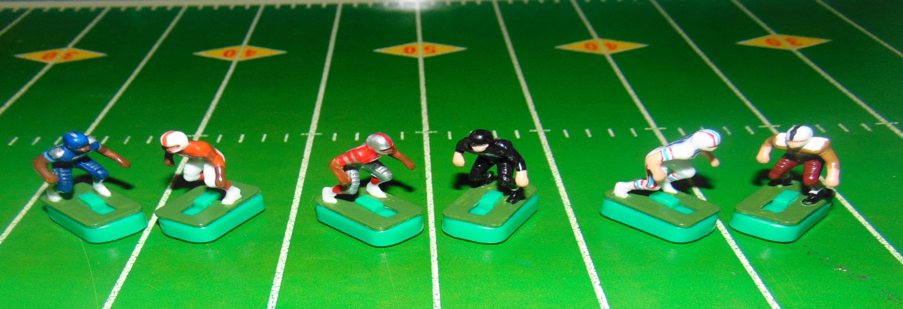
Showboats 20 Bears 14
4th Quarter
15:00 2/G @ D25 - Quarles 11yd Run OB
14:02 3/G @ D14 - Quarles 14yd Run TD
13:26 Conversion Kick GOOD
Showboats 27 Bears 14
13:26 KO Showboats to Bears 64 yds to 1 / Faircloth 28yd KR OB
Bears @ their 34
12:33 1/10 @ 34 - Faircloth 49yd Run (FP)
11:56 1/10 @ D17 - Faircloth -6yd Run (Carney)
10:47 2/16 @ D23 - Pass to Baskette in end zone INC
9:37 3/16 @ D23 - Faircloth -4yd Run (Quarles)
9:17 4/20 @ D27 - 45yd FG Att. NO GOOD (Short)
Showboats @ 35
8:30 1/10 @ 35 - Quarles 65yd Run TD
7:13 Conversion Kick NO GOOD
Showboats 33 Bears 14
7:13 KO Showboats to Bears 67yds to end zone (-2) / Baskette 26yd KR (Kuehn)
Bears @ their 24
6:17 1/10 @ 24 - Pass to Frazier @ 46 COMP 58yds (FP)
5:24 1/10 @ D18 - Pass to McCauley in end Zone COMP 18yds TD
4:18 Conversion KICK GOOD
Showboats 33 Bears 21
4:18 KO Bears to Showboats “Onside Kick” 17yds OB
Showboats @ their 48
4:18 1/10 @ 48 - Reid 32yd Run (FP)
2:59 1/10 @ D20 - Reid 1yd Run (FP) - Time allowed to advance - Time Out
TWO MINUTE WARNING
2:00 2/9 @ D19 - Lewis 18yd Run OB
1:33 1/G @ D1 - Quarles -12yd Run (McCauley) Bears call 1st TO
1:22 2/G @ D13 - Reid -3yd Run (Warwick) Bears call 2nd TO
0:44 3/G @ D16 - Reid 16yd Run TD
0:19 Conversion Kick GOOD
Showboats 40 Bears 21
0:19 KO Showboats to Bears 47 yds to 18 / Faircloth 82yd KR TD - Time Expires
0:00 Conversion Kick GOOD
Showboats 40 Bears 28
END OF GAME
LEAGUE STANDINGS after 4 WEEKS
BLUE DIVISION
W L T
GREY DIVISION
W L T
Showboats 3 1 0
Southmen 4 0 0
Bears 2 1 1
Cherokees 1 3 0
Titans 1 3 0
Oilers 0 3 1
Week 4 Game Results: Titans 31 - Showboats 40, Oilers 28 - Southmen 41, Bears 28 - Cherokees 38. Both Memphis teams lead their Divisions and both Nashville teams are in the cellars of their divisions with the Oilers remaining winless. So much for NFL dominance.

Slide 28

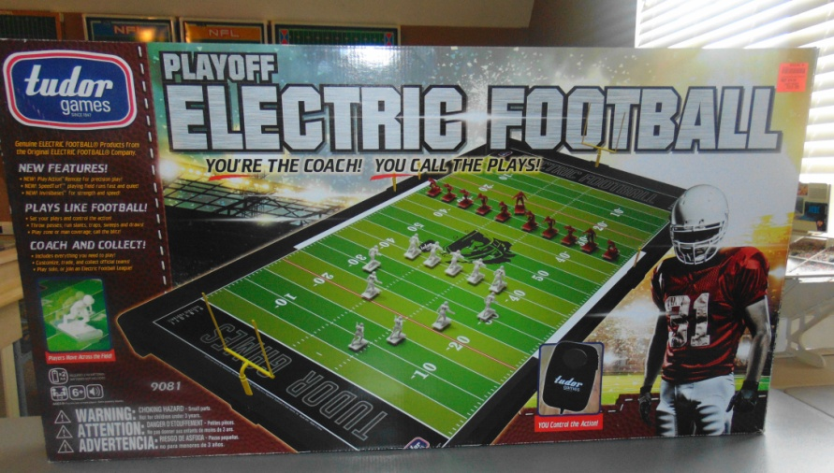
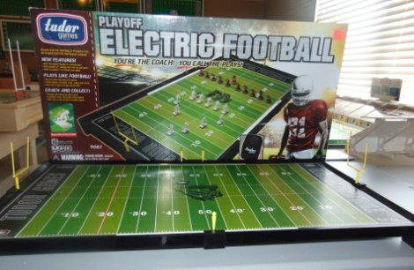
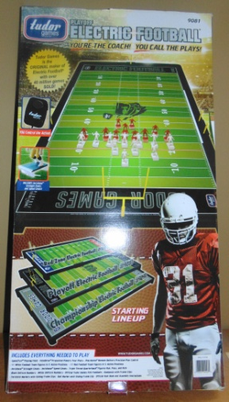
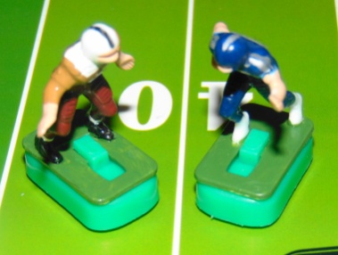
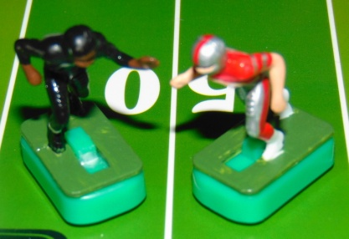
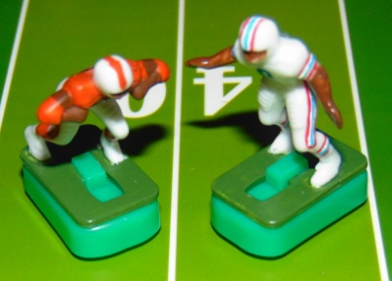
Modern Tudor Games #9081 PVC Game Board
Week 5 Game Previews
Cherokees (1-3) vs. Titans (1-3) Bears (2-1-1) vs. Showboats (3-1) Southmen (4-0) vs. Oilers (0-3-1)
The game that will have the most impact this week is the Bears and Showboats. The Bears can take a 1/2 game lead in their division with a win. The undefeated Southmen look to maintain their dominance while the Oilers are seeking a win over their division leader. The Cherokees and Titans are just looking to keep things respectable and hope for a good playoff seeding. Haven’t decided on a playoff format yet. Probably a cross division 3 round playoff with the division leaders receiving a bye and 2nd in each division playing the last in the opposite division. Blue vs. Grey.

Slide 29
Official Game Report 11/25/2020 WK5 Game 1
Chattanooga Cherokees @ Tennessee Titians
Chattanooga Cherokees
11 Haushalter
30 Vandergriff
22 Henley
25 Hogan
86 Bradley
80 Brown
50 Kunka
60 Snyder
65 Fuller
70 Locke
74 Phillips
Tennessee Titans
17 Tannehill
22 Henry
33 Lewis
11 Brown
84 Davis
82 Walker
60 Johns
64 Davis
54 Evans
77 Lewan
78 Conklin
 | 1 | 2 | 3 | 4 | F
Cherokees | 0 | 3 | 7 | 3 | 13
Titans | 0 | 7 | 0 | 0 | 7
QB / LB
FB / DB
HB / DB
FL / DB
WR / DB
TE / LB
C / MLB
G / DT
G / DT
T / DE
T / DE
Scoring Summary
TEN CHA
1st QTR 0 0
2nd QTR
CHA - 53yd FG 0 3
TEN - Lewis 28yd Pass from Tannehill (Kick GOOD) 7 3
3rd QTR
CHA - Vandergriff 47yd Run (Kick GOOD) 7 10
4th QTR
CHA - 41 yd FG 7 13
Coin Toss “Heads” - Titans Receive
1st Quarter
15:00 KO Cherokees to Titans 38yds to 27 / Walker 7yd KR (Haushalter)
Titans @ their 34
14:35 1/10 @ 34 - Henry 37yd Run (FP)
13:42 1/10 @ D29 - Lewis 8yd Run OB
12:52 2/2 @ D21 - Henry -10yd Run (Snyder)
12:03 3/12 @ D31 - Pass to Lewis @ D29 / INT by Cherokees Bradley / 0yd INT Return (Lewis)
Cherokees @ their 29
10:48 1/10 @ 29 - Henley -10yd Run (Lewan)
8:55 2/20 @ 19 - Haushalter 11yd Run OB
7:54 3/9 @ 30 - Pass to Hogan @ D29 SACK / Haushalter -14yd Run (Lewan)
6:50 4/23 @ 16 - Punt 28yds to 44 / Henry 0yd PR (Henley)
Titans @ D44
6:16 1/10 @ D44 - Lewis 18yd Run OB
5:16 1/10 @ D26 - Henry -7yd Run (Brown)
3:51 2/17 @ D33 - Pass to Davis @ D3 INC
2:41 3/17 @ D33 - Lewis 12yd Run OB
1:03 4/5 @ D21 - Titans Call TO (1st)
0:32 4/5 @ D21 - 38yd FG Att. NO GOOD (short)
Cherokees @ their 28
0:28 1/10 @ 28 - Henley 4yd Run (Lewis) Time expires
End of QTR
2nd Quarter
15:00 2/6 @ 32 - Vandergriff 5yd Run (Walker)
14:42 3/1 @ 37 - Vandergriff 8yd Run (Walker)
13:38 1/10 @ 45 - Henley 15 yd Run OB
12:15 1/10 @ D40 - Henley -8yd Run (DT Davis)
11:09 2/18 @ D48 - Henley -5yd Run (Conklin)
9:59 3/23 @ 47 - Henley 17yd Run (Haushalter)
9:02 4/6 @ D36 - 53yd FG Att. GOOD
Titans 0 Cherokees 3
8:00 KO Cherokees to Titans 73 yds to -8 yds in end zone / TOUCHBACK
Titans @ their 25
8:00 1/10 @ 25 - Pass to Davis @ midfield INC
7:36 2/10 @ 25 - Tannehill -1yd Run (Brown)
6:28 3/11 @ 24 - Tannehill 18yd Run (Kunka)
4:58 1/10 @ 42 - Tannehill -11yd Run (Vandergriff)
3:19 2/21 @ 31 - Pass to Henry @ D42 COMP 37yds (FP)
2:15 1/10 @ D28 - Time allowed to run to the 2 minute warning - Time Out
TWO MINUTE WARNING
2:00 1/10 @ D28 - Pass to Lewis @ D5 COMP 28yds TD
1:23 Conversion Kick GOOD
Titans 7 Cherokees 3
1:23 KO Titans to Cherokees 54yds to 11 / Henley 19yd KR (FP)
Cherokees @ their 30
0:56 1/10 @ 30 - Henley 21 yd Run (FP) Cherokees call TO (2nd)
0:32 1/10 @ D49 - Haushalter 0yd Run (Johns) Cherokees call TO (3rd)
0:24 2/10 @ D49 - Haushalter FUMBLE @ D48 / Recovered by Locke / Down @ D48 / Haushalter 1yd Run w/Fumble / Locke 0yd Fumble recovery and 0yd FR (Locke)
0:03 3/9 @ D48 - Time expires
End of QTR - Halftime
Titans 7 Cherokees 3
Cherokees to Receive 2nd Half KO
3rd Quarter
15:00 KO Titans to Cherokees 54yds to 11 / Henley 20yd KR (FP)
Cherokees @ their 31
14:44 1/10 @ 31 - Henley 0yd Run (DT Davis)
14:06 2/10 @ 31 - Vandergriff 0yd Run (Evans)
12:40 3/10 @ 31 - Pass to Brown @ 48 INC
11:38 4/10 @ 31 - Punt 33yds to D37 / Fair Catch
Titans @ their 37
10:46 1/10 @ 37 - Henry 10yd Run (FP)
9:59 1/10 @ 47 - Henry -2yd Run (Kunka)
8:52 2/12 @ 45 - Tannehill -8yd Run (Fuller)
7:26 3/20 @ 37 - Pass to Walker @ D49 INC
5:14 4/20 @ 37 - Punt 30yds to D33 / Bradley 20yd PR (Walker)
Cherokees @ D47
4:42 1/10 @ D47 - Vandergriff 47yd Run TD
3:57 Conversion Kick GOOD
Titans 7 Cherokees 10
3:57 KO Cherokees to Titans 70yds to -5 yd in end zone / Henry 36yds KR (FP)
Titans @ their 31
3:30 1/10 @ 31 - Henry -2yd Run (FP)
2:24 2/12 @ 29 - Lewis 2yd Run (Brown)
1:25 3/10 @ 31 - Lewis 33yd Run (FP) Time expires
End of QTR
4th Quarter
15:00 1/10 @ D39 - Henry FUMBLE @ D49 / Cherokees Phillips recovers / 0 yd FR (FP) / Henry -10 yd Run (Fumble)
Cherokees @ their 49
14:32 1/10 @ 49 - Vandergriff 1yd Run (Brown)
13:23 2/9 @ midfield - Vandergriff 8yd Run OB
12:11 3/1 @ D42 - Henley -1yd Run (Johns)
10:27 4/2 @ D43 - Punt 38yds to D9 / Brown 13yd PR (Haushalter)
Titans @ their 22
9:38 1/10 @ 22 - Brown 0yd Run (Henley)
9:10 2/10 @ 22 - Henry 6yd Run (Bradley)
7:47 3/4 @ 28 - Pass to Henry @ 25 / Cherokees Phillips INT / 0yd INT Return (Henry)
Cherokees @ D25
6:25 1/10 @ D25 - Vandergriff -4yd Run (Johns)
6:12 2/14 @ D29 - Henley 5yd Run OB
5:04 3/9 @ D24 - Pass to Bradley in end zone INC
3:38 4/19 @ D24 - 41 yd FG Att. GOOD
Titans 7 Cherokees 13
3:34 KO Cherokees to Titans 70yds to -5 in end zone / Henry 15yd KR (FP)
Titans @ their 10
2:46 1/10 @ 10 - Tannehill 7yd Run (Haushalter)
1:58 2/3 @ 17 - Pass to Henry @ 13 INC
1:24 3/3 @ 17 - Pass to Henry @ 30 INC
1:07 4/3 @ 17 - Pass to Walker @ D40 INC - Turnover on Downs
Cherokees @ D17
0:41 1/10 @ D17 - Troutman -2yd Run (FP Kneel Down)
0:36 2/12 2 D19 - Time allowed to run to expiration
End of QTR - Game Over
Titans 7 Cherokees 13

Slide 30
Official Game Report 11/26/2020 WK5 Game 2
Knoxville Bears @ Memphis Showboats
Knoxville Bears
12 Troutman
31 Nichols
23 Faircloth
20 Frazier
82 Baskette
84 McCauley
52 Shafer
64 Warwick
61 Cole
74 White
75 Daniels
Memphis Showboats
10 Lewis
40 Quarles
34 Reid
83 Carney
9 Crawford
87 Shirk
50 Kuehn
61 Smith
66 Gunn
92 White
74 Clark
 | 1 | 2 | 3 | 4 | F
Bears | 7 | 14 | 3 | 7 | 31
Showboats | 0 | 21 | 7 | 14 | 42
QB / LB
FB / DB
HB / DB
FL / DB
WR / DB
TE / LB
C / MLB
G / DT
G / DT
T / DE
T / DE
Scoring Summary
1st QTR KNX TEN
KNX - Faircloth 23 yd Pass from Troutman (Kick GOOD) 7 0
2nd QTR
MEM - Reid 4 yd Run (Kick GOOD) 7 7
MEM - Crawford 9yd Pass from Lewis (Kick GOOD) 7 14
KNX - Faircloth 85yd KR (Kick Good) 14 14
MEM - Quarles 11yd Run (Kick GOOD) 14 21
KNX - Nichols 49yd Run (Kick GOOD) 21 21
3rd QTR
KNX - 26 yd FG 24 21
MEM - Quarles 20 yd Run (Kick GOOD) 24 28
4th QTR
MEM- Crawford 36yd Pass from Lewis (Kick GOOD) 24 35
KNX - Baskette 55yd Pass from Troutman (Kick GOOD) 31 35
MEM - Reid 17yd Run (Kick GOOD) 31 42
Coin Toss “Heads” - Bears Receive
1st Quarter
15:00 KO Showboats to Bears 35yds to 30 / Nichols 28yd KR (FP)
Bears @ D42
14:31 1/0 @ D42 - Faircloth 7yd Run (Crawford)
14:18 2/3 @ D35 - Troutman -1 yd Run (Clark)
13:07 3/4 @ D36 - Faircloth 5yd Run (Carney)
12:01 1/10 @ D31 - Nichols 2yd Run (Quarles)
10:49 2/8 @ D29 - Pass to Baskette @ D5 INC
9:40 3/8 @ D29 - Faircloth 8yd Run (Smith)
8:55 1/10 @ D21 - Troutman -2yd Run (FP)
7:19 2/12 @ D23 - Pass to Faircloth @ D7 COMP 23yds TD
5:52 Conversion Kick GOOD
Bears 7 Showboats 0
5:52 KO Bears to Showboats 40yds to 25 / Carney 17yd KR (Frazier)
Showboats @ their 42
5:24 1/10 @ 42 - Reid 17yd Run (Cole)
3:48 1/10 @ D41 - Quarles 11yd Run (FP)
2:16 1/10 @ D30 - Reid 12yd Run (Warwick)
1:01 1/10 @ D18 - Quarles -5yd Run (Cole)
0:13 2/15 @ D23 - Time Expires
End Of QTR
Bears 7 Showboats 0
15:00 2/15 @ D23 - Quarles -4yd Run (Faircloth)
14:18 3/19 @ D27 - Reid 23yd Run (FP)
13:26 1/G @ D4 - Reid 4yd Run TD
11:53 Conversion Kick GOOD
Bears 7 Showboats 7
11:53 KO Showboats to Bears 43yds to 22 / Frazier 6yd KR (Crawford)
Bears @ their 28
11:47 1/10 @ 28 - Faircloth -10 yd Run (Reid)
11:15 2/20 @ 18 - Lateral to Faircloth @ 6 - INC FUMBLE recovered by Showboats Crawford @ D9 / Troutman -10 yd run w/Fumble - Crawford 0yd FR (McCauley)
9:56 1/10 @ D9 - Quarles -1yd Run (Nichols)
9:25 2/11 @ D10 - Pass to Carney in end zone INC - Pass Interference in end zone Bears McCauley - 10 yd Pass Interference Penalty
8:22 1/G @ D1 - Quarles -8yd Run (Warwick)
7:35 2/G @ D9 - Pass to Crawford in end zone COMP 9yd TD
6:43 Conversion Kick (Good)
Bears 7 Showboats 14
6:43 KO Showboats to Bears 55 yds to 15 / Faircloth 85yd KR TD
5:02 Conversion Kick GOOD
Bears 14 Showboats 14
5:02 KO Bears to Showboats 30yds to 35 / Clark 19yd KR OB
Showboats @ their 49
4:53 1/10 @ 49 - Quarles -3yd Run (McCauley)
4:19 2/13 @ 46 - Reid 4yd Run (Clark)
3:00 3/9 @ midfield - Pass to Crawford @ D24 COMP 29yds (Baskette)
2:14 1/10 @ D21 - Time allowed to advance - Time Out
TWO MINUTE WARNING
2:00 1/10 @ D21 - Reid 10yd Run (FP) Showboats call Time Out (1st)
1:19 1/10 @ D11 - Quarles 11 yd Run TD
0:52 Conversion Kick GOOD
Bears 14 Showboats 21
0:52 KO Showboats to Bears 30yds to 35 / McCauley 14yd KR (White)
Bears @ their 49
0:38 1/10 @ 49 - Nichols 49yd Run TD - Time expires
0:00 Conversion Kick GOOD
End of QTR - Halftime
Bears 21 Showboats 21
Bears to Receive 2nd Half Kickoff
3rd Quarter
15:00 KO Showboats to Bears 30yds to 35 / Frazier 16yd KR (Quarles)
Showboats @ D49
14:39 1/10 @ D49 - Nichols 33yd Run (FP)
14:16 1/10 @ D16 - Faircloth -3yd Run (Smith)
13:18 2/13 @ D19 - Faircloth 15yd Run OB
12:03 1/G @ D4 - Faircloth -1yd Run (Smith)
10:52 2/G @ D5 - Nichols 1yd Run (Smith)
9:53 3/G @ D4 - Troutman -4yd Run (FP)
8:26 4/G @ D8 - 26yd FG ATT GOOD
Bears 24 Showboats 21
7:36 KO Bears to Showboats 47yds to 18 / Shirk 14yd KR (Cole)
Showboats @ their 32
7:30 1/10 @ 32 - Pass to Crawford @ D49 COMP 35yds (Frazier)
7:01 1/10 @ D33 - Quarles 13yd Run (Nichols)
5:38 1/10 @ D20 - Quarles 20yd Run TD
4:24 Conversion Kick GOOD
Bears 24 Showboats 28
4:24 KO Showboats to Bears 50yds to 15 / Frazier 22 yd PR (White)
Bears @ their 37
3:43 1/10 @ 37 - Faircloth 5yd Run (Smith)
3:18 2/5 @ 42 - Nichols -10 yd Run (Reid)
2:07 3/15 @ 32 - Pass to Faircloth @ D40 INC
0:44 4/15 @ 32 - Punt 20yds to 48 / Lewis 16yd PR (Nichols)Time Expires
End of QTR
Bears 24 Showboats 28
4th Quarter
15:00 1/10 @ 36 - Pass to Crawford @ D2 COMP 36 yds TD
14:34 Conversion Kick GOOD
Bears 24 Showboats 35
14:34 KO Showboats to Bears 47yds to 18 / Faircloth 9yd KR (Gunn)
Bears @ their 27
14:24 1/10 @ 27 - Pass to Nichols @ 36 COMP 18yds (Quarles)
13:44 1/10 @ 45 - Pass to Baskette @ D37 COMP 55 yds TD
12:40 Conversion Kick GOOD
Bears 31 Showboats 35
12:40 KO Bears to Showboats 67yds to -2 in End Zone / 31yd KR (Warwick)
Showboats @ Their 29
11:57 1/10 @ 29 - Reid 2yd Run (Faircloth)
11:21 2/8 @ 31 - Quarles 5yd Run (Daniels)
9:37 3/3 @ 36 - Reid 41yd Run (Cole)
8:06 1/10 @ D23 - Quarles 6yd Run (Nichols)
6:38 2/4 @ D17 - Reid 17yd Run TD
5:12 Conversion Kick GOOD
Bears 31 Showboats 42
5:12 KO Showboats to Bears 70yds to -5yds in the End Zone / Faircloth 41yd KR (FP)
Bears @ their 36
4:31 1/10 @ Troutman -19yd Run (White)
3:44 2/29 @ 17 - Pass to Nichols @ 35 COMP 27yds (Quarles)
2:29 1/10 @ 44 - Bears call Time Out (1st) @ 2:14 remaining

Slide 31
2:14 1/10 @ 44 - Pass INC (ball thrown away) Time Out @ 1:59
TWO MINUTE WARNING
1:59 2/10 @ 44 - Pass to Faircloth @ D32 INC
1:44 3/10 @ 44 - Pass to Baskette @ D28 INC
1:27 4/10 @ 44 - Pass to Baskette @ D26 COMP 35yds (Quarles) / Bears Call Timeout (2nd)
1:09 1/10 @ D21 - Pass to Frazier @ D6 INC
0:54 2/10 @ D21 - Pass to Baskette @ D3 INC
0:36 3/10 @ D21 - Pass to Nichols in End Zone INC
0:23 4/10 @ D21 - Pass to Nichols in End Zone INC / Turnover on Downs
Showboats @ D21
0:07 1/10 @ D21 - Lewis -1 yd Run (Kneel Down) Time Expires
End of QTR /End of Game
Bears 31 Showboats 42
Official Game Report 11/29/2020 WK5 Game 3
Memphis Southmen @ Tennessee Oilers
Memphis Southmen
7 Haurte
39 Csonka
21 Kiick
42 Warfield
89 Marshall
87 Shirk
53 Hill
64 Kruyer
62 Mikolajczyk
73 Canale
77 Cotton
QB / LB
FB / DB
HB / DB
FL / DB
WR / DB
TE / LB
C / MLB
G / DT
G / DT
T / DE
T / DE
Tennessee Oilers
9 McNair
27 George
20 Thomas
81 Sanders
84 Davis
89 Wycheck
53 Stepnoski
66 Layman
69 Runyon
74 Matthews
72 Hopkins
 | 1 | 2 | 3 | 4 | F
Southmen | 21 | 14 | 0 | 14 | 49
Oilers | 0 | 3 | 0 | 0 | 3
Scoring Summary
1st QTR MEM TEN
MEM - Kiick 31 yd Run (Kick GOOD) 7 0
MEM - Csonka 56 yd Run (Kick GOOD) 14 0
MEM - Csonka 38yd Run (Kick GOOD) 21 0
2nd QTR
MEM - Csonka 14yd Run (Kick GOOD) 28 0
TEN - 29yd FG 28 3
MEM - Csonka 70yd KR (Kick GOOD) 35 3
3rd QTR 35 3
4th QTR
MEM - Kiick 40yd Run (Kick GOOD) 42 3
MEM - Csonka 80yd Run (Kick GOOD) 49 3
Coin Toss “Heads” - Southmen Receive
1st Quarter
15:00 KO Oilers to Southmen 55yds / Kiick 17yd KR (Matthews)
Southmen @ their 27
14:32 1/10 @ 27 - Csonka 11yd Run (Runyon)
13:36 2/10 @ 38 - Kiick 32yd Run TD
12:02 Conversion Kick GOOD
Southmen 7 Oilers 0
12:02 KO Southmen to Oilers 40yds to 30 / Davis 37yd KR (Huarte)
Oilers @ D33
11:04 1/10 @ D33 - Thomas 0yd Run (Kruyer)
10:48 2/10 @ D33 - George -5yd Run (Hill)
9:38 3/15 @ D38 - Pass to Daivs @ D17 INC
7:59 4/15 @ D38 - 55 yd Field Goal Att. NO GOOD (Short)
Southmen @ their 45
7:11 1/10 @ 45 - Csonka -1yd Run (Matthews)
6:50 2/11 @ 44 - Csonka 56 yd Run TD
5:25 Conversion Kick GOOD
Southmen 14 Oilers 0
5:25 KO Southmen to Oilers 32yds TO 3 / Sanders 66yd KR (FP)
Oilers @ D31
4:30 1/10 @ 31 - McNair -18yd Run SACK (Canale)
4:10 2/28 @ D49 - Pass to Davis @ D29 INT Southmen Csonka / Oyd INT Return (Davis)
Southmen @ their 29
3:02 1/10 @ 29 - Kiick 3yd Run (FP)
2:06 2/7 @ 32 - Csonka 68yd Run TD
0:46 Conversion Kick GOOD
Southmen 21 Oilers 0
0:46 KO Southmen to Oilers 43yds to 22 / Davis 19yd KR (FP)
Oilers @ their 41
0:32 1/10 @ 41 - George -5yd Run (Huarte)
0:04 2/15 @ 36 - Time allowed to expire
End of QTR
Southmen 21 Oilers 0
2nd Quarter
15:00 2/15 @ 36 - Pass to Davis @ D44 INC
14:04 3/15 @ 36 - Pass to Sanders @ D47 INC
13:12 4/15 @ 36 - Punt 25yds to D39 / Kiick 7yd PR (Thomas)
Southmen @ their 46
12:32 1/10 @ 46 - Kiick 45yd Run (FP)
11:38 1/10 @ D14 - Csonka 14 yd Run TD
9:41 Conversion Kick GOOD
Southmen 28 Oilers 0
9:41 KO Southmen to Oilers 35yds to 30 / George 6yd Run (Marshall)
Oilers @ their 36
9:34 1/10 @ 36 - Pass to Sanders @ 44 INC
9:24 2/10 @ 36 - Pass to Thomas @ D46 INC
8:28 3/10 @ 36 - Pass to Davis @ D33 INC
7:39 4/10 @ 36 - Pass to Thomas @ D39 COMP 33yds (FP)
6:39 1/10 @ D31 - Thomas 17yd Run OB
5:38 1/10 @ D14 - Pass to George @ D20 COMP 4yds (Warfield)
4:20 2/6 @ D10 - George -9 yd Run (Shirk)
3:13 3/19 @ D19 - Pass to Wycheck in the end zone / Pass Interference (Marshall) Ball paced at the D1
2:20 1/G @ D1 - Time allowed to advance to 2:00 - Time Out
TWO MINUTE WARNING
2:00 1/G @ D1 - George -7yd Run (FP) Oilers call Time Out (1st)
1:24 2/G @ D 8 - Pass to Wycheck in the end zone INC
1:03 3/G @ D8 - McNair -4yd Run (Huarte)
0:32 4/G @ D12 - 29 yd Field Goal Att. GOOD
Southmen 28 Oilers 3
0:25 KO Oilers to Southmen 35yds to 30 / Csonka 70yd KR TD - Time Expires
0:00 Conversion Kick GOOD
Southmen 35 Oilers 3
End of QTR - Halftime
Oilers to receive 2nd Half Kickoff
3rd Quarter
15:00 KO Southmen to Oilers 57yds to 8 / Davis 33yd KR (FP)
Oilers @ their 41
14:32 1/10 @ 41 - George -7yd Run (Cotton)
13:57 2/17 @ 34 - Pass to Thomas @ D43 INC
12:42 3/17 @ 34 - Pass to Sanders @ D46 INC
11:35 4/17 @ 34 - Punt 40yds to D26 / Warfield 23yd PR (FP)
Southmen @ their 49
10:15 1/10 @ 49 - Csonka 12yd Run (George)
9:45 1/10 @ D39 - Kiick 0yd Run (FP)
8:18 2/10 @ D39 - Csonka 3yd Run (McNair)
7:15 3/7 @ D36 - Huarte -4yd Run (Matthews)
6:15 4/11 @ D 40 - Punt 39yds to D9 / Sanders 18yd PR (Cotton)
Oilers @ their 27
5:20 1/10 @ 27 - Pass to Davis @ D28 INC
4:32 2/10 @ 27 - Pass to Sanders @ 40 INT Southmen Marshall FUMBLE @ 28 / Kruyer recovers / 2yd Fumble Recovery Run (McNair) - Marshall 12yd INT Return (Fumble)
Southmen @ D26
3:27 1/10 @ D26 - Csonka -2yd Run (Hopkins)
2:40 2/12 @ D28 - Csonka 14yd Run OB
1:19 1/10 @ D14 - Kiick -4yd Run OB
0:19 2/14 @ D18 - Time allowed to expire
End of QTR
Southmen 35 Oilers 3
4th Quarter
15:00 2/14 @ D18 - Csonka 3yd Run (Layman)
14:34 3/12 @ D15 - Kiick -1yd Run (Stepnoski)
13:20 4/13 @ D16 - 33yd Field Goal Att. NO GOOD (short)
Oilers @ their 23
12:27 1/10 @ 23 - McNair 2yd Run (Csonka)
11:54 2/8 @ 25 - Pass to Davis @ D42 INC
10:43 3/8 @ 25 - Pass to Wycheck @ 46 COMP 36yds (Marshall)
9:41 1/10 @ D39 - Pass to Thomas @ D26 INC

Slide 32



8:31 2/10 @ D39 - Pass to George @ D34 COMP 54yds (Mikolajczyk)
7:30 3/5 @ D34 - McNair -6yd Run (Kruyer)
6:31 4/11 @ D40 - McNair Fumble @ 42 recovers -20yd Run (Kruyer) - Turnover on Downs
Southmen @ D40
4:58 1/10 @ D40 - Kiick 40 yd Run TD
3:54 Conversion Kick GOOD
Southmen 42 Oilers 3
3:54 KO Southmen to Oilers 50yds to 15 / Sanders 65yd KR (FP)
2:59 1/10 @ D20 - Pass to Sanders @ D5 INC
2:41 2/10 @ D20 - George 0yd Run (FP) - Time out
TWO MINUTE WARNING
1:48 3/10 @ D20 Pass to Davis @ GL INT Southmen Warfield in end zone TOUCHBACK
1:19 1/10 @ 20 - Csonka 80yd Run TD
1:07 KO Southmen to Oilers 73yds TOUCHBACK
Oilers @ their 25
1:07 1/10 @ 25 - George -10yd Run (Marshall)
0:40 2/10 @ 25 - NO PLAY - Time allowed to expire
End of Game
Southmen 49 Oilers 3
WEEK 5 Standings and Game Results
BLUE DIVISION
W L T
GREY DIVISION
W L T
Showboats 4 1 0
Southmen 5 0 0
Bears 2 2 1
Cherokees 2 3 0
Titans 1 4 0
Oilers 0 4 1
13
7
31
42
49
3
Southmen clinch the Division. Showboats Maintain Division lead. Cherokees win. Bears Lose. Titans and Oilers Lose AGAIN!!!

Slide 33
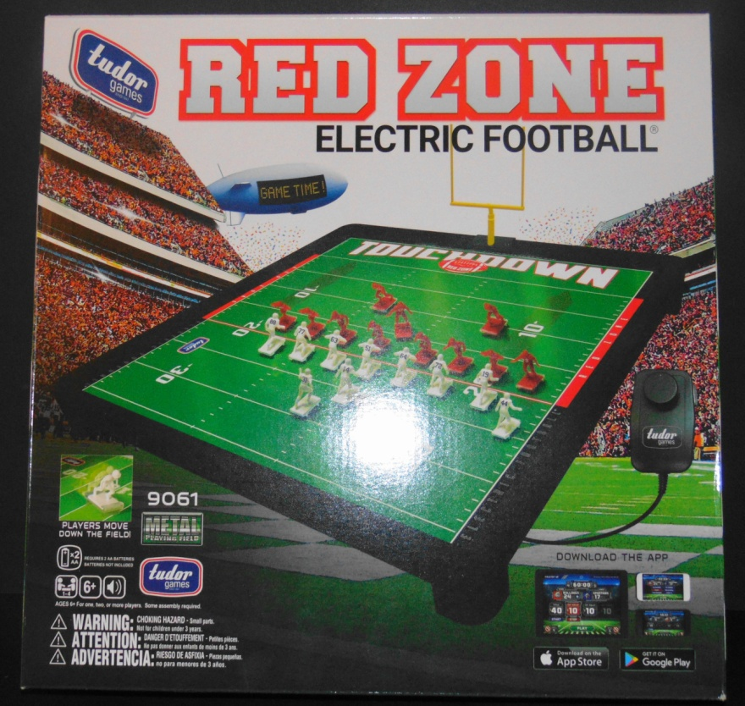
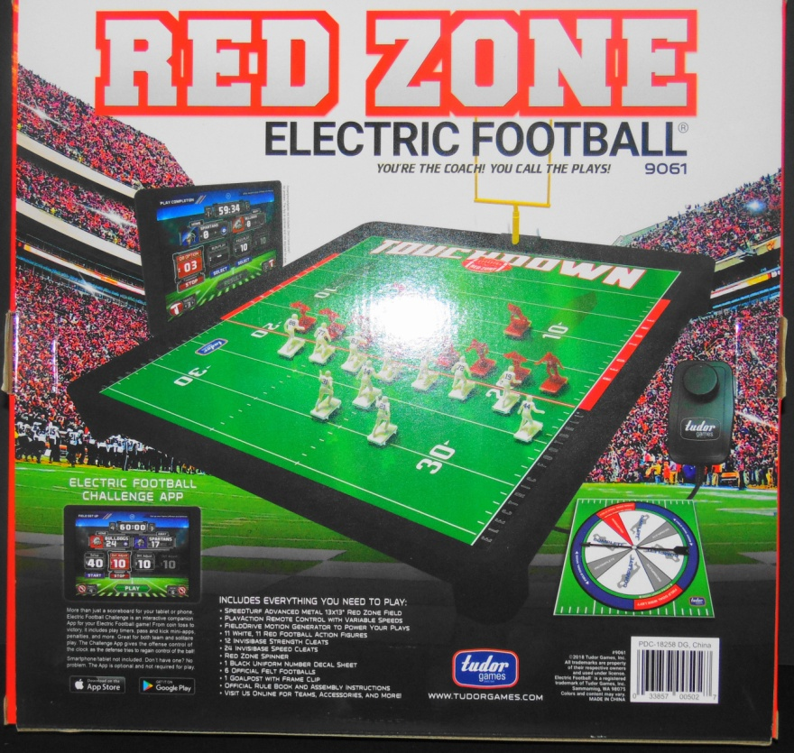
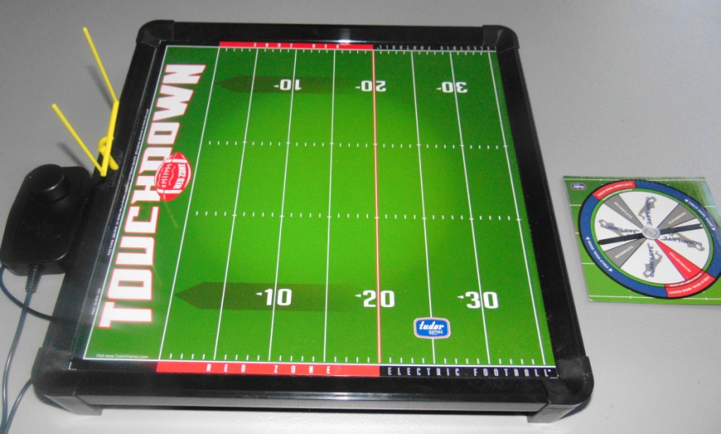
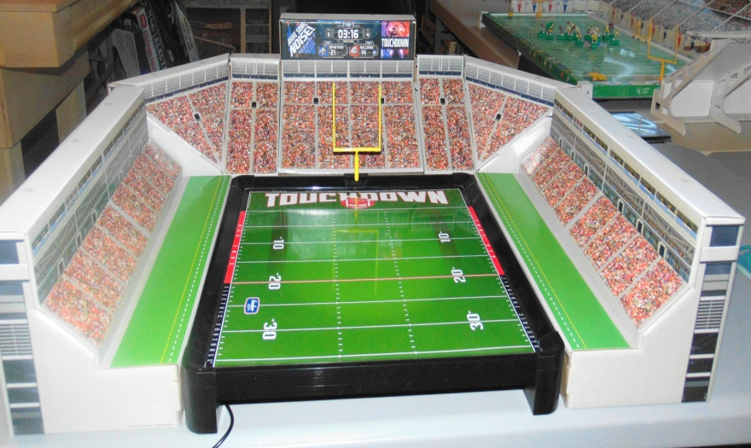

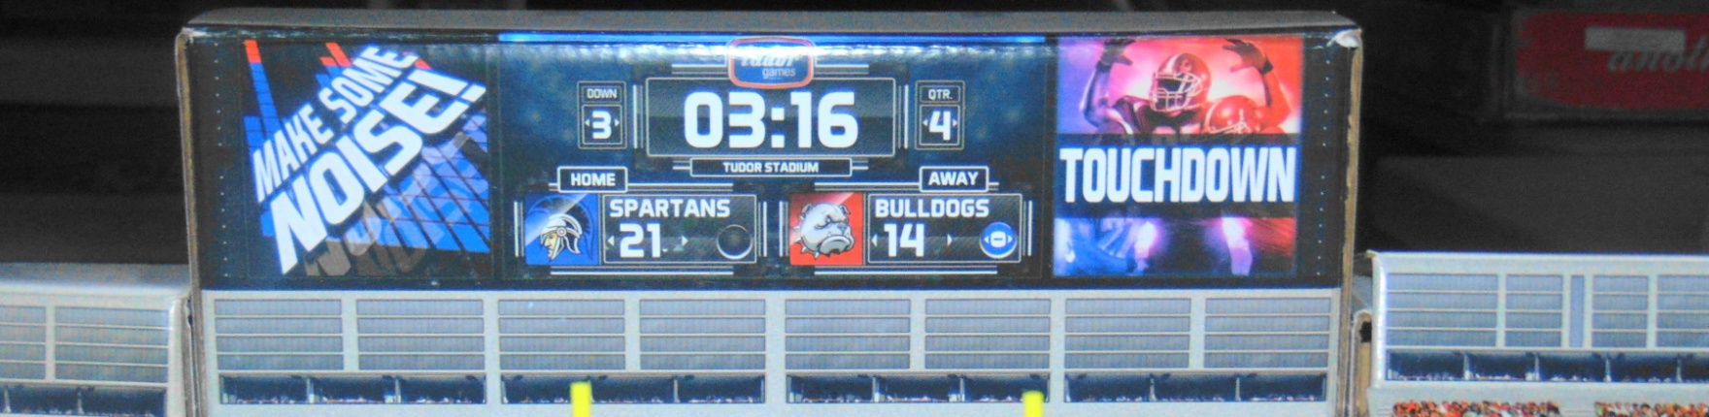


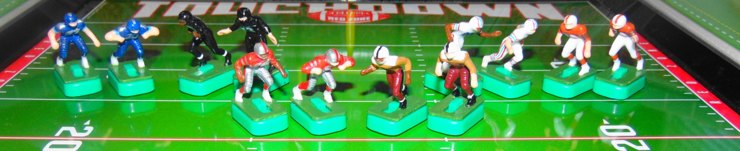
Tudor #9061 RED ZONE Electric Football
WEEK 6 GAME SCHEDULE
TENNESSEE TITANS VS. KNOXVILLE BEARS
TENNESSEE OILERS VS. MEMPHIS SOUTHMEN
MEMPHIS SHOWBOATS VS. CHATTANOOGA CHEROKEES

Slide 34
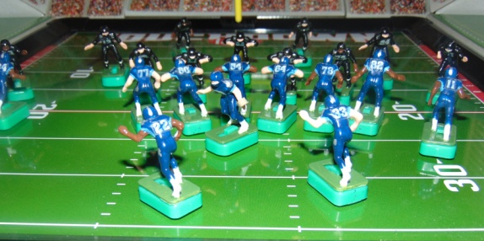







Official Game Report 12/03/2020 WK6 Game 1
Tennessee Titans @ Knoxville Bears
Tennessee Titans
17 Tannehill
22 Henry
33 Lewis
11 Brown
84 Davis
82 Walker
60 Johns
64 Davis
54 Evans
77 Lewan
78 Conklin
QB / LB
FB / DB
HB / DB
FL / DB
WR / DB
TE / LB
C / MLB
G / DT
G / DT
T / DE
T / DE
Knoxville Bears
12 Troutman
31 Nichols
23 Faircloth
20 Frazier
82 Baskette
84 McCauley
52 Shafer
64 Warwick
61 Cole
74 White
75 Daniels
 | 1 | 2 | 3 | 4 | F
Titans | 7 | 7 | 7 | 6 | 27
Bears | 3 | 0 | 6 | 14 | 23
Scoring TEN KNX
1st QTR
TEN - Lewis 8 yd Run (Kick GOOD) 7 0
KNX - 37 yd FG 7 3
2nd QTR
TEN - Tannehill 1 yd Run (Kick GOOD) 14 3
3rd QTR
KNX - Baskette 5yd Pass from Troutman (Kick FAILED) 14 9
TEN - Henry 10 yd Run (Kick GOOD) 21 9
4th QTR
KNX - Nichols 20yd Pass from Troutman (Kick GOOD) 21 16
KNX - Faircloth 20yd Run (Kick GOOD) 21 23
TEN - Henry 20yd Run 27 23
Coin Toss “Heads” - Titans 1st Possession
1st Quarter
Possession: Titans
1. 1/G @ 20 - Tannehill 12yd Run OB
2. 2/G @ 8 - Lewis 8yd Run TD
Conversion Kick GOOD
Titans 7 Bears 0
Possession: Bears
1. 1/G @ 20 - Faircloth 15yd Run (FP) Fell Down @ 5
2. 2/G @ 5 - Nichols -5yd Run (N. Evans)
3. 3/G @ 10 - Troutman Scramble SACK (Lewis) -10yd Run
4. 4/G @ 20 - 37 yd Field Goal Att. GOOD
Titans 7 Bears 3
End of QTR
2nd QTR
Possession: Titans
1. 1/G @ 20 - Pass to Brown @ 15 COMP 19yds (Baskette)
2. 2/G @ 1 - Tannehill 1 yd Run TD
Conversion Kick GOOD
Titans 14 Bears 3
Possession: Bears
1. 1/G @ 20 - Nichols -5yd Run (FP)
2. 2/G @ 25 - Nichols -5yd Run (FP) Fell Down
* NOTE * This resulted in the ball being placed at the 30 yd Line. With the scrimmage line being only 6 yards from the end of the game board, this does not leave enough room for the offense to be able to set up in a legal offensive formation. (At least 7 men on the line of scrimmage and at least one player behind the line of scrimmage to receive a center snap.)Therefore a special ruling made to require that the line of scrimmage must be at least the 29 yard line or closer to the goal line or the offense is forced to give up possession of the ball (when using the 13” x 13” Tudor Red Zone Game Board) . This results in a “A forced turnover by the defense resulting in a loss of possession by the offense thereby ending their possession”.
End of QTR - Halftime
Titans 14 Bears 3
Bears get 1st possession to begin the 2nd half
3rd Quarter
Possession: Bears
1. 1/G @ 20 - Pass to Frazier @ 17 COMP 13 yds (Tannehill)
2. 2/G @ 7 - Pass to Frazier in End Zone INC
3. 3/G @ 7 - Pass to Nichols @ 12 COMP 2 yds (Henry)
4. 4/G @ 5 - Pass to Baskette @ 1 COMP / 5yds TD
Conversion Kick NO GOOD
Titans 14 Bear 9
Possession: Titans
1. 1/G @ 20 - Pass to Henry @ 25 COMP 10yds (Frazier)
2. 2/G @ 10 - Henry 10 yd Run TD
Conversion Kick GOOD
Titans 21 Bears 9
End of QTR
4th Quarter
Possession: Bears
1. 1/G @ 20 - Pass to Nichols @ 13 INC
2. 2/G @ 20 - Pass to Nichols @ 6 COMP 20 yds TD
Conversion Kick GOOD
Titans 21 Bears 16
* NOTE * Special 4th Quarter Rule: If the team with first possession going into the fourth quarter is behind in score , that team must score to pull within one more score to tie the game or take the lead. If they are able to do this, they will retain possession and have the opportunity to score again to tie the game or take the lead. If they fail to score the game is over.
Possession: Bears
1. 1/G @ 20 - Faircloth 0yd Run (FP) Fell down
2. 2/G @ 20 - Faircloth 20yd Run TD
Conversion Kick (GOOD)
Titans 21 Bears 23

Slide 35


Official Game Report 12/03/2020 WK6 Game 2
Memphis Showboats @ Chattanooga Cherokees
Memphis Showboats
10 Lewis
40 Quarles
34 Reid
83 Carney
9 Crawford
87 Shirk
50 Kuehn
61 Smith
66 Gunn
92 White
74 Clark
QB / LB
FB / DB
HB / DB
FL / DB
WR / DB
TE / LB
C / MLB
G / DT
G / DT
T / DE
T / DE
Chattanooga Cherokees
11 Haushalter
30 Vandergriff
22 Henley
25 Hogan
86 Bradley
80 Brown
50 Kunka
60 Snyder
65 Fuller
70 Locke
74 Phillips
 | 1 | 2 | 3 | 4 | F
Showboats | 0 | 7 | 7 | 7 | 21
Cherokees | 7 | 7 | 7 | 7 | 28
Scoring MEM CHA
1st QTR
CHA - Henley 22 yd Pass from Haushalter (Kick GOOD) 0 7
2nd QTR
CHA - Henley 20 Run (Kick GOOD) 0 14
MEM - Carney 20 yd pass from Haushalter (Kick GOOD) 7 14
3rd QTR
MEM - Shirk 20yd Pass from Lewis (Kick GOOD) 14 14
CHA - Hogan 22yd Pass from Haushalter (Kick GOOD) 14 21
4th QTR
MEM - Quarles 20yd Run (Kick GOOD) 21 21
CHA - Brown 15 yd Pass from Haushalter (Kick GOOD) 21 28
Coin Toss “Tails” - Cherokees 1st Possession
1st Quarter
Possession: Cherokees
1. 1/G @ 20 - Henley -2yd Run (Kuehn)
2. 2/G @ 22 - Pass to Henley @ 24 COMP 22yds TD
Conversion Kick (GOOD)
Showboats 0 Cherokees 7
Possession: Showboats
1. 1/G @ 20 - Quarles 4yd Run OB
2. 2/G @ 16 - Quarles 6yd Run (Phillips)
3. 3/G @ 10 - Reid -8 yd Run (Henley)
4. 4/G @ 18 - 25 yd FG Att. NO GOOD (Wide Right)
End of QTR
Showboats 0 Cherokees 7
2nd Quarter
Possession: Cherokees
1. 1/G @ 20 - Henley 20yd Run TD
Conversion Kick GOOD
Showboats 0 Cherokees 14
Possession: Showboats
1. 1/G @ 20 - Pass to Carney @ 15 COMP 20yds TD
Conversion Kick GOOD
Showboats 7 Cherokees 14
End of QTR - Haltime
Showboats 7 Cherokees 14
Showboats 1st possession to begin 2nd half.
3rd Quarter
Possession: Showboats
1. 1/G @ 20 - Pass to Shirk @ 17 COMP 20yds TD
Conversion Kick GOOD
Showboats 14 Cherokees 14
Possession: Cherokees
1. 1/G @ 20 - Henley 5yd Run (Lewis)
2. 2/G @ 15 - Hwnley -7yd Run (Phillips)
3. 3/G @ 22 - Pass to Hogan @ 11 COMP 22yds TD
Conversion Kick GOOD
Showboats 14 Cherokees 21
End of QTR
4th Quarter
* NOTE * Showboats must score to tie or take lead.
Possession: Showboats
1. 1/G @ 20 - Quarles 20yd Run TD
Conversion Kick GOOD
Showboats 21 Cherokees 21
Possession: Cherokees
* NOTE * Cherokees only need a Field Goal to win.
1. 1/G @ 20 - Pass to Bradley @ 11 COMP 5yds (Shirk)
2. 2/G @ 15 - Pass to Brown @ 8 COMP 15 yds TD
Conversion Kick GOOD
Showboats 21 Cherokees 28
End of Qtr - END of GAME
Showboats 21 Cherokees 28

Slide 36












Official Game Report 12/04/2020 WK6 Game 3
Tennessee Oilers @ Memphis Southmen
Tennessee Oilers
9 McNair
27 George
20 Thomas
81 Sanders
84 Davis
89 Wycheck
53 Stepnoski
66 Layman
69 Runyon
74 Matthews
72 Hopkins
QB / LB
FB / DB
HB / DB
FL / DB
WR / DB
TE / LB
C / MLB
G / DT
G / DT
T / DE
T / DE
Memphis Southmen
7 Haurte
39 Csonka
21 Kiick
42 Warfield
89 Marshall
87 Shirk
53 Hill
64 Kruyer
62 Mikolajczyk
73 Canale
77 Cotton
 | 1 | 2 | 3 | 4 | F
Oilers | 3 | 7 | 6 | 7 | 23
Southmen | 7 | 7 | 7 | 6 | 27
Scoring TEN MEM
1st QTR
TEN - 33yd FG 3 0
MEM - Warfield 23yd Pass from Huarte (Kick GOOD) 3 7
2nd QTR
TEN - George 20yd Run (Kick GOOD) 10 7
MEM - Huarte 5yd Run (Kick GOOD) 10 14
3rd QTR
MEM - Huarte 16yd Run (Kick GOOD) 10 21
TEN - Wycheck 1 yd Fumble Recovery in End Zone (Kick FAILED) 16 21
4th QTR
TEN - George 10yd Pass from McNair (Kick GOOD) 23 21
MEM - Csonka 20yd Run (No Kick Necessary) 23 27
Coin Toss “Heads” Oilers 1st possession
1st QTR
Possession: Oilers
1. 1/G @ 20 - Thomas -9yd Run (Hill)
2. 2/G @ 29 - Pass to Sanders @ 26 COMP 7yds (Kiick)
3. 3/G @ 22 - Pass to George @ 30 COMP 8yds (Marshall)
4. 4/G @ 16 - 33 yd Field Goal Att. GOOD
Possession: Southmen
1. 1/G @ 20 - Kiick 0yd Run (McNair)
2. 2/G @ 20 - Pass to Kiick @ 30 COMP -3yds (Sanders)
3. 3/G @ 23 - Pass to Warfield @ 13 COMP 23yds TD
Conversion Kick GOOD
Oilers 3 Southmen 7
End of QTR
2nd Quarter
Possession: Oilers
1. 1/G @ 20 - George 20yd Run (McNair)
Conversion Kick GOOD
Oilers 10 Southmen 7
Possession: Southmen
1. 1/G @ 20 - Pass to Marshall @ 15 COMP 15yds OB
2. 2/G @ 5 - Huarte 5yd Run TD
Conversion Kick GOOD
Oilers 10 Southmen 14
End of QTR - Halftime - Southmen 1st Possession to begin 2nd Half
3rd Quarter
Possession: Southmen
1. 1/G @ 20 - Csonka 3yd Run (George)
2. 2/G @ 17 - Kiick 1yd Run OB
3. 3/G @ 16 - Huarte 16yd Run TD
Conversion Kick GOOD
Oilers 10 Southmen 21
Possession: Oilers
1. 1/G @ 20 - Wycheck -1yd Run (Warfield)
2. 2/G @ 21 - Pass to George @ 26 COMP 3 yds (Huarte)
3. 3/G @ 18 - Pass to Sanders @ 16 COMP 13yds (Csonka)
4. 4/G @ 5 - McNair Scramble Run 4yds FUMBLE @ 1/ ball goes into end zone / Wycheck recovers /Wycheck 1 yd Fumble Recovery in the End Zone TD
Conversion Kick (NO GOOD)
Oilers 16 Southmen 21
End of QTR
4th Quarter
* NOTE * Oilers get 1st possession to begin the 4th quarter. Must score to win or tie. Only option is to score a TD and take the lead.
Possession: Oilers
1. 1/G @ 20 - Thomas 0yd Run (Csonka)
2. 2/G @ 20 - Pass to George @ 21 COMP 4yd Run (Hill)
3. 3/G @ 16 - Thomas 6yd Run OB
4. 4/G @ 10 - Pass to George @ 8 COMP 10 yds TD
Conversion Kick GOOD
Oilers 23 Southmen 21
Possession: Southmen
1. 1/G @ 20 - Csonka 20yd Run TD
NO Conversion Kick Necessary
End of QTR - END of GAME
Oilers 23 Southmen 27

Slide 37






WEEK 6 Standings and Game Results
BLUE DIVISION
W L T
GREY DIVISION
W L T
Showboats 4 2 0
Southmen 6 0 0
Bears 2 3 1
Cherokees 3 3 0
Titans 2 4 0
Oilers 0 5 1
27
23
21
28
23
27
With the Bears losing to the Titans, the Showboats clinch the Blue Division despite losing to the Cherokees. The Southmen remain undefeated, denying the Oilers a win and leaving them only one more chance to get into the win column next week against their division rival the Cherokees. Next week’s games will conclude the regular season with the Bears, Titans and Cherokees vying to secure the # 3 seed in the playoffs.

Slide 38






2007 Model No. NF-07
Vibrating Football
WEEK 7 GAME
SCHEDULE
Season Finales
SHOWBOATS VS. TITANS - BEARS VS. SOUTHMEN - CHEROKEES VS. OILERS
4 - 2 - 0 @ 2 - 4 - 0 2 - 3 - 1 @ 6 - 0 - 0 3 - 3 -0 @ 0 - 5 - 1
Current Playoff Seedings
#1 Southmen - #2 Showboats - #3 Cherokees - #4 Bears - #5 Titans - #6 Oilers

Slide 39


Official Game Report 12/04/2020 WK7 Game 1
Memphis Showboats @ Tennessee Titans
Memphis Showboats
10 Lewis
40 Quarles
34 Reid
83 Carney
9 Crawford
87 Shirk
50 Kuehn
61 Smith
66 Gunn
92 White
74 Clark
Tennessee Titans
17 Tannehill
22 Henry
33 Lewis
11 Brown
84 Davis
82 Walker
60 Johns
64 Davis
54 Evans
77 Lewan
78 Conklin
 | 1 | 2 | 3 | 4 | F
Showboats | 7 | 0 | 0 | 7 | 14
Titans | 7 | 3 | 3 | 0 | 13
QB / LB
FB / DB
HB / DB
FL / DB
WR / DB
TE / LB
C / MLB
G / DT
G / DT
T / DE
T / DE
Scoring MEM TEN
1st QTR
MEM - Reid 1yd Run (Kick GOOD) 7 0
TEN - Henry 37 yd Run (Kick GOOD) 7 7
2nd QTR
TEN - 63 yd Field Goal 7 10
3rd QTR
TEN - 36 yd Field Goal 7 13
4th QTR
MEM - Crawford 50yd Pass from Lewis (Kick Good) 14 13
Coin Toss “Heads” Showboats 1st possession
1st QTR
Possession: Showboats (2 plays / 50 yds / TD)
1. 1st Down @ 50 - Lewis 49yd Run (Lewan)
2. 2nd Down @ 1 - Reid 1yd Run TD
Conversion Kick GOOD
Showboats 7 Titans 0
Possession: Titans (2 plays / 50 yds / TD)
1. 1st Down @ 50 - Lewis 13yd Run (Quarles)
2. 2nd Down @ 37 - Henry 37yd Run TD
Conversion Kick GOOD
Showboats 7 Titans 7
End of QTR
2nd Quarter
Possession: Showboats (2 plays / 10yds / INT)
1. 1st Down @ 50 - Quarles 10yd Run (N. Davis)
2. 2nd Down @ 40 -Pass to Quarles @ 42 / INT
Possession: Titans (3 plays / 4yds / 63yd FG)
1. 1st Down @ 50 - Henry 0yd Run (FP)
2. 2nd Down @ 50 - Pass to Brown @ 42 INC
3. 3rd Down @ 50 - Henry 4yd Run (Carney)
4. 4th Down @ 46 - 63 yd FG Att GOOD
Showboats 7 Titans 10
End of QTR - Halftime
Titans 1st possession to begin 2nd Half
3rd Quarter
Possession: Titans (3 plays / 31yds / 36 yd FG)
1. 1st Down @ 50 - Henry FUMBLE @ 48 / Recovers @ 45 / 10 yd Run (FP)
2. 2nd Down @ 40 - Pass to Davis @ 25 COMP 24yds (Lewis)
3. 3rd Down @ 16 - Lewis -3yd Run (Gunn)
4. 4th Down @ 19 - 36yd FG Att. GOOD
Showboats 7 Titans 13
Possession: Showboats (4 plays / 38 yds / NO SCORING)
1. 1st Down @ 50 - Pass to Quarles @ 32 COMP 42 yds OB
2. 2nd Down @ 8 - Quarles 0yd Run (Johns)
3. 3rd Down @ 8 - Reid 1yd Run (Tannehill)
4. 4th Down @ 7 - Reid -5yd Run (Walker)
Showboats 7 Titans 13
End of QTR
4th Quarter
Possession: Showboats (1 play / 50 yards / TD)
* NOTE * Must score at least 6 points to tie or 7 to take the lead.
1. 1st Down - Pass to Crawford @ 41 Comp 50yds TD
Conversion Kick GOOD
Showboats 14 Titans 13
Possession: Titans (1 play / 39 yards / Missed FG)
* NOTE * Must run at least one play from scrimmage, must score, either a FG or a TD, to win.
1. 1st Down @ 50 - Henry 39yd Run OB
2. 2nd Down @ 11 - 28yd FG Att. NO GOOD (Wide right)
Showboats 14 Titans 13
End of QTR - END of GAME
* NOTE * Titans chose to go for the quick win on 2nd down and kick a field goal but failed losing the game. Played the following alternate ending in which the Titans won on a 3rd down run for a TD.
ALTERNATE ENDING:
2. 2nd Down @ 11 - Henry 5yd Run OB
3. 3rd Down @ 6 - Tannehill 6 yd Run TD
Conversion Kick - Not needed
Showboats 14 Titans 19

Slide 40






Official Game Report 12/05/2020 WK7 Game 2
Knoxville Bears @ Memphis Southmen
Knoxville Bears
12 Troutman
31 Nichols
23 Faircloth
20 Frazier
82 Baskette
84 McCauley
52 Shafer
64 Warwick
61 Cole
74 White
75 Daniels
Memphis Southmen
7 Haurte
39 Csonka
21 Kiick
42 Warfield
89 Marshall
87 Shirk
53 Hill
64 Kruyer
62 Mikolajczyk
73 Canale
77 Cotton
 | 1 | 2 | 3 | 4 | F
Bears | 3 | 7 | 7 | 0 | 17
Southmen | 7 | 7 | 7 | - | 21
QB / LB
FB / DB
HB / DB
FL / DB
WR / DB
TE / LB
C / MLB
G / DT
G / DT
T / DE
T / DE
Scoring KNX MEM
1st QTR
KNX - 28 yd Field Goal 3 0
MEM - Csonka 29yd Pass from Huarte (Kick GOOD) 3 7
2nd QTR
KNX - Nichols 20 yd Run (Kick GOOD) 10 7
MEM - Csonka 6yd Pass from Huarte (Kick GOOD) 10 14
3rd QTR
MEM - Warfield 28yd Pass from Huarte (Kick GOOD) 10 21
KNX - Baskette 50yd Pass from Troutman 17 21
4th QTR
KNX - Fail to score to take lead 17 21
Coin Toss “Heads” Bears 1st possession
1st QTR
Possession: Bears (3 plays / 39 yds / 28 yd FG)
1. 1st Down @ 50 - Nichols -7yd Run OB
2. 2nd Down @ -43 - Faircloth 41yd Run OB
3. 3rd Down @ 16 - Pass to Baskette @ 20 COMP 5yds (Csonka)
4. 4th Down @ 11 - 28 yd FG Att. GOOD
Conversion Kick GOOD
Bears 3 Southmen 0
Possession: Southmen (2 plays / 50 yds / TD)
1. 1st Down @ 50 - Kiick 21yd Run (Mikolajczyk)
2. 2nd Down @ 29 - Pass to Csonka @ 11 COMP 29 yds TD
Conversion Kick GOOD
Bears 3 Southmen 7
End of QTR
2nd Quarter
Possession: Bears (2 plays / 50 yds / TD)
1. 1st Down @ 50 - Pass to Frazier @ 40 COMP 30yds OB
2. 2nd Down @ 20 - Nichols 20yd Run TD
Conversion Kick GOOD
Bears 10 Showboats 7
Possession: Southmen (3 plays / 50 yds / TD)
1. 1st Down @ 50 - Kiick 0yd Run (Baskette)
2. 2nd Down @ 50 - Csonka 44 yd Run OB
3. 3rd Down @ 6 - Pass to Csonka @ 12 COMP 6yds TD
Conversion Kick GOOD
Bears 10 Southmen 14
End of QTR - Halftime
Southmen 1st possession to begin 2nd Half
3rd Quarter
Possession: Southmen (2 plays / 50 yds / TD)
1. 1st Down @ 50 - Csonka 22yds (Schafer)
2. 2nd Down @ 28 - Pass to Warfield @ 14 COMP 28yds TD
Conversion Kick GOOD
Bears 10 Southmen 21
Possession: Bears (1 play / 50 yds / TD)
1. 1st Down @ 50 - Pass to Baskette @ 36 COMP 50yds TD
Conversion Kick GOOD
Bears 17 Southmen 21
End of QTR
4th Quarter
* NOTE * Bears to get first possession. Must score a touchdown to take the lead.
Possession: Bears (4 Plays / 46yds / NO SCORE)
1. 1st Down @ 50 - Nichols 3yd Run (Warfield)
2. 2nd Down @ 47 - Pass to Baskette @ 27 COMP 30yds (Csonka)
3. 3rd Down @ 17 - Pass to Nichols @ 33 COMP 0yds (Shirk)
4. 4th Down @ 17 - Pass to Baskette @ 8 COMP 13yds (FP) - NO SCORE
END OF GAME
Bears 17 Southmen 21

Slide 41




















Official Game Report 12/07/2020 WK7 Game 3
Chattanooga Cherokees @ Tennessee Oilers
Chattanooga Cherokees
11 Haushalter
30 Vandergriff
22 Henley
25 Hogan
86 Bradley
80 Brown
50 Kunka
60 Snyder
65 Fuller
70 Locke
74 Phillips
Tennessee Oilers
9 McNair
27 George
20 Thomas
81 Sanders
84 Davis
89 Wycheck
53 Stepnoski
66 Layman
69 Runyon
74 Matthews
72 Hopkins
 | 1 | 2 | 3 | 4 | F
Cherokees | 3 | 7 | 0 | 7 | 17
Oilers | 7 | 0 | 3 | 7 | 17
QB / LB
FB / DB
HB / DB
FL / DB
WR / DB
TE / LB
C / MLB
G / DT
G / DT
T / DE
T / DE
Scoring CHA TEN
1st QTR
TEN - Thomas 50yd Pass from McNair (Kick GOOD) 0 7
CHA - 49yd FG 3 7
2nd QTR
TEN - 47yd FG 7 10
CHA - Vandergriff 50 yd Run (Kick GOOD) 10 10
4th QTR
CHA - Vandergriff 25yd Run (Kick GOOD) 17 10
TEN - Thomas 18yd Pass From McNair (Kick GOOD) 17 17
Coin Toss “Tails” Oilers 1st possession
1st QTR
Possession: Oilers (1 play / 50 yds / TD)
1st Down @ 50 - Pass to Thomas @ 31 COMP 50yds TD
Conversion Kick (GOOD)
Cherokees 0 Oilers 7
Possession: Cherokees (3 plays / 18 yds / FG)
1st Down @ 50 - Vandergriff -7yd Run (Wycheck)
2nd Down @ -43 - Haushalter SACKED / -17yd Run (McNair)
3rd Down @ -26 - Pass to Hogan @ 50 COMP 42 yds OB
4th Down @ 32 - 49yd FG Att. GOOD
Cherokees 3 Oilers 7
2nd QTR
Possession: Oilers (3 plays / 20 yds / FG)
1st Down @ 50 - George 15yd Run (Brown)
2nd Down @ 36 - Thomas 5yd Run (Henley)
3rd Down @ 30 - Pass to Sanders @ 30 INC
4th Down @ 30 - 47 yd FG Att. GOOD
Cherokees 3 Titans 10
Possession: Cherokees
1st Down @ 50 - Vandergriff 50yd Run TD
Conversion Kick GOOD
Cherokees 10 Titans 10
End Of QTR - Halftime - Cherokees 1st Possession to begin 2nd Half.
3rd QTR
Possession: Cherokees (2 plays / 24 yds / INT)
1st Down @ 50 - Haushalter 24yd Run OB
2nd Down @ 26 - Pass to Henley @ 20 INT - NO SCORING
Possession: Oilers (4 plays / 39 yds / No Score)
1st Down @ 50 - George 0yd Run (Snyder)
2nd Down @ 50 - Thomas 28yd Run OB
3rd Down @ 22 - Pass to Davis @ 27 COMP 21yds (Hogan)
4th Down @ 1 - George -10yd Run (Snyder) NO SCORING
4th QTR
Possession: Cherokees (2 plays / 50yds / TD)
1st Down @ 50 - Pass to Bradley @ 41 COMP 25yds OB
2nd Down @ 25 - Vandergriff 25yd Run TD
Conversion Kick GOOD
Cherokees 17 Oilers 17
Possession: Oilers
1st Down @ 50 - Pass to Sanders @ 30 COMP 33yds OB
2nd Down @ 17 - George 7 yd Run (Vandergriff)
3rd Down @ 10 - Thomas -8yd Run (Phillips)
4th Down @ 18 - Pass to Thomas @ 18 COMP 18yds TD
Conversion Kick GOOD
Cherokees 17 Oilers 17
END OF GAME

Slide 42
WEEK 7 Final Game and Season Standing Results
BLUE DIVISION
W L T
GREY DIVISION
W L T
Showboats 5 2 0
Southmen 7 0 0
Bears 2 4 1
Cherokees 3 3 1
Titans 2 5 0
Oilers 0 5 2
Game 1 Game 2 Game 3
14
13
17
21
17
17
Cross Divisional - Blue vs. Grey - Playoff Bracket
6. Tennessee Oilers
1st round of the Playoffs will be played by a Cross-Divisional format matching up “Blue vs. Grey” . Depending on who wins , will determine the opponents for the next round.
4. Knoxville Bears
5. Tennessee Titans
3. Chattanooga Cherokees

Slide 43






TUDOR GAMES Model # 9092
NFL PRO BOWL GAMEBOARD
High Impact Polystyrene (HIPS) Plastic Playing Field= 36"x18"
CROSS DIVISIONAL
PLAYOFFS ROUND ONE

Slide 44




NFL PRO BOWL GAMEBOARD
High Impact Polystyrene (HIPS) Plastic Playing Field= 36"x18"
CROSS DIVISIONAL PLAYOFFS
ROUND 1 GAME 1

Slide 45
Cross Divisional Playoffs Round Game 1 12/14/2020
Tennessee OIlers vs Knoxville Bears
Tennessee Oilers
9 McNair
27 George
20 Thomas
81 Sanders
84 Davis
89 Wycheck
53 Stepnoski
66 Layman
69 Runyon
74 Matthews
72 Hopkins
QB / LB
FB / DB
HB / DB
FL / DB
WR / DB
TE / LB
C / MLB
G / DT
G / DT
T / DE
T / DE
Knoxville Bears
12 Troutman
31 Nichols
23 Faircloth
20 Frazier
82 Baskette
84 McCauley
52 Shafer
64 Warwick
61 Cole
74 White
75 Daniels
 | 1 | 2 | 3 | 4 | F
Oilers | 3 | 7 | 3 | 0 | 13
Bears | 0 | 0 | 7 | 14 | 21
Scoring Summary TEN KNX
1st QTR
CHA - Brown 41 yd Pass from Haushalter (Kick GOOD) 0 7
2nd QTR
TEN - Lewis 48yd PR (Kick GOOD) 7 7
CHA - Brown 59yd Pass from Haushalter (Kick FAILED) 7 13
3rd QTR
CHA - Bradley 32yd Pass from Haushalter (Kick GOOD) 7 20
4th QTR
TEN - Lewis 70 yd Pass from Tannehill (Kick GOOD) 14 20
CHA - 57yd Field Goal 14 23
Coin Toss “Heads” - Oilers defer to the second Half - Bears will receive.
1st Quarter
15:00 KO Oilers to Bears - 55yds to 10 / Faircloth 31yd KR (Stepnoski)
Bears @ their 41
14:19 1/10 @ 41 - Faircloth -3yd Run (Wycheck)
13:45 2/13 @ 38 - Nichols 35yd Run OB
12:21 1/10 @ 27 - Troutman pass SCRAMBLE / FUMBLE recovered by Oilers Thomas @ D 43 / -2 yd FR Return (Cole) - Troutman 15yds FUMBLE
Oilers @ their 45
11:08 1/10 @ 45 - George -5yds (Troutman)
10:32 2/15 @ 50 - McNair pass to Thomas @ 36 / McNair FUMBLE - Recovers @ D26 / pass to Thomas @ 18 COMP 40yds OB
8:58 1/G @ D10 - Thomas -7yd run (Daniels)
8:02 2/G @ D17 - McNair handoff to George -6yd Run OB
6:54 3/G @ D23 - Thomas FUMBLE / George recovers @ D31 0yd FR Return (Baskette) - Thomas -8yd Run (Fumble)
5:48 4/G @ 31 - Oilers Call Time Out @ 5:15 (1st)
5:15 - 4/G @ 31 - 48yd Field Goal Att GOOD Oilers 3 Bears 0
5:06 KO Oilers to Bears 71yds to (-6) endzone TOUCHBACK
Bears @ their 25
5:06 1/10 @ 25 - Troutman handoff to Nichols 22yd Run (McNair)
4:27 1/10 @ 47 - Faircloth 5yd Run (Layman)
2:57 2/5 @ D48 - Nichols -2 yd Run (Wycheck)
1:56 3/7 @ 50 - Faircloth FUMBLE @ 39 / Oilers Thomas recovers @ 39 0yd FR Return (Troutman) - Farircloth 11yd Run (Lost Fumble)
Oilers @ D39
0:42 1/10 @ D39 - McNair handoff to George -2 yd Run (Nichols)
0:14 2/13 @ D41 - Time allowed to expire
End Of QTR Oilers 3 Bears 0
2nd Quarter
15:00 2/13 @ D41 - McNair to Thomas 40yd Run (FP)
14:21 1/G @ D1 - Thomas 1 yard run TD
13:08 Conversion Kick GOOD Oilers 10 Bears 0
13:08 KO Oilers to Bears 71yds to (-6) end zone TOUCHBACK
13:08 1/10 @ 25 - Nichols 2yd Run (Wycheck)
12:43 2/8 @ 27 - Troutman 27 yd Run (FP)
11:44 1/G @ D44 - Troutman falls down @ 44 pass to Faircloth @ D39 COMP 15yds (Thomas)
10:23 1/10 @ D29 - Troutman pass to Baskette in end zone INC
9:25 2/10 @ D29 - Troutman to Nichols -9yd run OB
8:34 3/19 @ D38 - Faircloth FUMBLE @ D26 / Oilers George recovers / 2 yd FR Return (FP) - Faircloth 8yd Run (Fumble)
Oilers @ their 28
7:30 1/10 @ 28 - McNair to Thomas -2yd Run (Cole)
7:13 2/12 @ 26 - George 20yd Run (FP)
6:13 1/10 @ 46 - George 4yd Run (Frazier)
5:23 2/6 @ 50 - McNair pass to George @ D26 INC
4:14 3/6 @ 50 - George Fumble @ 45 recovers / 15yd Run (White)
2:53 1/10 @ D35 - McNair to Thomas -4yd Run (Baskette) - Time Out
TWO MINUTE WARNING
1:59 2/14 @ D39 - McNair pass to George @ D31 INC
1:32 3/14 @ D39 - McNair pass to Thomas @ D36 / QB FUMBLE @ 45 recovers / pass to George INC
1:17 4/14 @ D39 - After Setup - Oilers call Time Out (1st)
1:17 4/14 @ D39 - 56yd FG Att. / FUMBLED SNAP / recovered by George @ D46 /FUMBLE @ D33 / Matthews OB @ D15 - George 6yd Run (Fumble) / Matthews 18yd FR Return OB.
0:19 1/10 @ D15 - 32yd Field Goal Att (30) NO GOOD (Short)
Bears @ their 22
0:09 1/10 @ 22 - Troutman -2yd Run (Kneel Down)
0:07 2/12 @ 20 - Time allowed to run to Expiration.
End of QTR - Halftime Oilers 10 Bears 0
Oilers to receive the 2nd half kickoff
3rd Quarter
15:00 KO Bears to Oilers 70yds to (-5) the end zone / George 47yd KR (FP)
Oilers @ their 42
14:10 1/10 @ 42 - George -4yd Run (Nichols)
14:02 2/14 @ 38 - George -1yd Run (Daniels)
13:19 3/15 @ 37 - McNair pass scramble FUMBLE @ 37 / Layman recovers / 0yd FR Return (Warwick)
11:41 4/15 @ 37 - Punt 28yds to D36 / Faircloth 6yd PR (McNair)
Bears @ their 42
10:16 1/10 @ 42 - Troutman pass to Nichols @ D41 INC
9:54 2/10 @ 42 - Nichols 58 yd Run TD
8:50 Conversion Kick GOOD Oilers 10 Bears 7
8:50 KO Bears to Oilers 47 yds to 18 / Davis 23yd KR (Warwick)
Oilers @ their 41
8:42 1/10 @ 41 - George 0yd Run (FP)
8:13 2/10 @ 41 - George 18yd Run (FP)
6:26 1/10 @ D41 - Thomas 0yd Run (Baskette)
5:33 2/10 @ D41 - McNair 6yd Run (Warwick)
4:28 3/4 @ D35 - Thomas 5yd Run (Shafer)
3:38 1/10 @ D30 - McNair pass to Davis @ D5 INC
2:39 2/20 @ D30 - McNair 9yd Run (Baskette)
1:27 3/1 @ D21 - George -2yd Run (Daniels)
0:39 4/3 @ D23 - 40yd Field Goal Att. (57) GOOD - Time Expires
End of QTR Oilers 13 Bears 7
15:00 KO Oilers to Bears - 44yds to 21 / Nichols 54yd KR OB
Bears @ D25
14:11 1/10 @ D25 - Troutman to Faircloth -5yd Run (Thomas)
13:23 2/15 @ D30 - Nichols -5 yd Run (Thomas)
12:27 3/20 @ D 35 - Troutman Shotgun Scramble -4yd Run (Runyon)
11:14 4/24 @ D39 - 56yd FG Att. (47) NO GOOD (Short) TOUCHBACK
Oilers @ 46
10:19 1/10 @ 46 - McNair to George 4yd Run (McCauley)
9:23 2/6 @ 50 - Thomas -6yd Run (Nichols)
8:21 3/13 @ 44 - McNair to George FUMBLE @ D34 / Bears Baskett recovers / 0yd FR Return (George) / George 22yd Run (Fumble)
Bears @ their 34
7:02 1/10 @ 34 - Faircloth pass to Nichols @ D44 COMP 41yds OB
6:06 1/10 @ D25 - Faircloth 1yd Run (Wycheck)
4:58 2/9 @ D24 - Faircloth 1 yd Run OB
3:41 3/8 @ D23 - Troutman Shotgun pass to McCauley in end zone COMP 23yds TD
2:33 Conversion Kick GOOD Oilers 13 Bears 14
2:33 KO Bears to Oilers 65yds to GL / Sanders FUMBLE @ 20 / Bears Nichols recovers / 20yd FR Return TD - Sanders 20yd KR (FUMBLE)
2:26 Conversion Kick GOOD Oilers 13 Bears 21
2:26 KO Bears to Oilers 44yds to 21 / Thomas 27yd KR (Faircloth)
Oilers @ their 48
2:02 1/10 @ 48 - McNair 5yd Run (Faircloth) Time Out
TWO MINUTE WARNING
1:50 2/5 @ D43 - McNair pass to George @ 42 COMP 2yd Run OB
1:17 3/3 @ D41 - McNair Shotgun pass to Wycheck @ D24 / INT Bears Nichols 48yd INT Return (McNair)
0:42 1/10 @ D28 - “Victory” Formation - Troutman Kneels Down / -2yd Run (FP)
0:38 2/12 @ D30 - Game Clock allowed to run until Time Expires
End of QTR - GAME OVER Oilers 13 Bears 21

Slide 46

NFL PRO BOWL GAMEBOARD
High Impact Polystyrene (HIPS) Plastic Playing Field= 36"x18"
6. Tennessee Oilers
4. Knoxville Bears
CROSS DIVISIONAL PLAYOFFS
ROUND 1 GAME 2

Slide 47
Cross Divisional Playoffs Round Game 1 12/12/2020
Tennessee Titans vs Chattanooga Cherokees
Tennessee Titans
17 Tannehill
22 Henry
33 Lewis
11 Brown
84 Davis
82 Walker
60 Johns
64 N. Davis
54 Evans
77 Lewan
78 Conklin
QB / LB
FB / DB
HB / DB
FL / DB
WR / DB
TE / LB
C / MLB
G / DT
G / DT
T / DE
T / DE
Chattanooga Cherokees
11 Haushalter
30 Vandergriff
22 Henley
25 Hogan
86 Bradley
80 Brown
50 Kunka
60 Snyder
65 Fuller
70 Locke
74 Phillips
 | 1 | 2 | 3 | 4 | F
Titans | 7 | 0 | 7 | 0 | 14
Cherokees | 7 | 6 | 7 | 3 | 23
Scoring Summary TEN CHA
1st QTR
TEN - 48yd FG 3 0
2nd QTR
TEN - Thomas 1yd Run (Kick GOOD) 10 0
3rd QTR
KNX - Nichols 58yd Run (Kick GOOD) 10 7
TEN - 40yd FG 13 7
4th QTR
KNX - McCauley 23yd Pass from Troutman (Kick GOOD) 13 14
KNX - Nichols 20yd Fumble Recovery Return (Kick GOOD) 13 21
Coin Toss “Heads” - Titans defer to the second Half -Cherokees will receive.
1st Quarter
15:00 KO Titans to Cherokees - 73 yds to Hogan in the end zone / No Return / TOUCHBACK
Cherokees @ their 25
15:00 1/10 @ 25 - Haushalter handoff to Henley / Henley -2yd Run (Davis)
14:46 2/12 @ 23 - Henley -3yd Run (Johns)
13:19 3/15 @ 20 - Vandergriff 47yd Run (FP)
11:03 1/10 @ D33 - Henley -8yd Run (FP)
10:25 2/18 @ D41 - Haushalter pass to Brown @ D25 COMP 41 yds TOUCHDOWN
9:04 Conversion Kick GOOD Titans 0 Cherokees 7
9:04 KO Cherokees to Titans - 47 yds to Lewis @ 33 / 18yd KR (Kunka)
Titans @ their 36
8:46 1/10 @ 36 - Henry 13 yd Run (Snyder)
7:49 1/10 @ 49 - Tannehill handoff to Lewis / Lewis 9yd Run (FP)
6:24 2/9 @ D42 - Lewis -2yd Run (Locke)
5:32 3/7 @ D44 - Tannehill pass to Lewis @ D24 COMP 20 yds (Bradley)
4:13 1/10 @ D24 - Henry 7yd Run (Henley)
2:36 2/3 @ D17 - Tannehill handoff to Henry / Henry 9yd Run OB
1:02 1/G @ D8 - Tannehill pass to Davis in the end zone INC - Time expires
End of QTR Titans 0 Cherokees 7
2nd Quarter
15:00 2/G @ D8 - Henry -6yd Run (Synder)
14:19 3/G @ D14 - Henry -4yd Run (Fuller)
12:47 4/G @ D18 - 35 yd Field Goal Att. BLOCKED (defensive line pushes the offensive line back until an offensive blocker falls over into the kicker.
Cherokees @ their 25
11:57 1/10 @ 25 - Haushalter handoff to Henley / Henley 5yd run (Evans)
11:03 2/5 @ 30 - Haushalter handoff to Brown / 17yd Run (Lewan)
9:15 1/10 @ 47 - Haushalter to Vandergriff - fell down after receiving the handoff / Vandergriff -10 yd Run (Conklin)
7:53 2/20 @ 37 - Vandergriff -7yd Run (Lewis)
7:04 3/27 @ 30 - Troutman pass to Brown @ 40 / Troutman SACKED - 5yd Run (Walker)
5:48 4/32 @ 25 - Punt 27 yds to D48 / Lewis 48yd PR - TOUCHDOWN
3:44 Conversion Kick GOOD Titans 7 Cherokees 7
3:44 KO Titans to Cherokees 40yds to 25 / Hogan 16yd KR (Conklin)
Cherokees @ their 41
3:33 1/10 @ 41 - Haushalter pass to Brown @ D20 COMP 59yds - TOUCHDOWN
2:25 Conversion Kick NO GOOD - Wide left Titans 7 Cherokees 13
2:25 KO Cherokees to Titans 54yds to 11 / Henry 29yd KR (Henley)
TWO MINUTE WARNING
Titans @ their 40
1:44 1/10 @ 40 - Lewis 0yd Run (Snyder) - Titans call TO (1st)
1:27 2/10 @ 40 - Tannehill pass to Brown @ D43 COMP/ Fumble @ D21 Recovered by the Cherokees Fuller / Fuller 16yd FR (Walker) - Brown 19yd pass reception.
Cherokkes @ their 37
0:24 1/10 @ 37 - Haushalter takes a knee - Time Expires
End of QTR - Halftime - Titans 7 Cherokees 13
Titans to Receive 2nd Half Kickoff
3rd Quarter
15:00 KO Cherokees to Titans 57yds to 8 / Davis 31yd KR (Kunka)
Titans @ their 39
14:45 1/10 @ 39 - Tannehill handoff to Lewis 4yd Run OB
13:47 2/6 @ 43 - Henry -7yd Run (Kunka)
12:36 3/13 @ 36 - Tannehill Pass to Brown @ 50 INC
10:57 4/13 @ 36 - Punt 53yds to D11 /Hogan 29yd PR OB
Cherokees @ their 40
9:26 1/10 @ 40 - Haushalter handoff to Henley 22yd Run OB
8:32 1/10 @ D38 - Henley 4yd Run (Lewan)
7:15 2/6 @ D34 - Vandergriff 10yd Run (Walker)
6:04 1/10 @ D 24 - Haushalter -8yd Run Tannehill)
5:01 2/18 @ D 32 - Haushalter pass to Bradley @ D6 INC
3:20 3/18 @ D32 - Haushalter pass to Bradley @ D10 COMP 32yds -TOUCHDOWN
2:12 Conversion Kick GOOD Titans 7 Cherokee 20
2:12 KO Cherokee to Titans 53yds to 12 / Brown 22yd Run (Hogan)
Titans @ their 34
1:56 1/10 @ 34 -Tannehill pass to Henry @ 45 SACKED / Tannehill -10yd run (Locke)
1:39 2/20 @ 24 - Lewis 5yd Run (Vandergriff)
0:35 3/15 @ 29 - Tannehill SACK -4yd Run (Phillips) - Time expires
End of QTR Titans 7 Cherokee 20
4th Quarter
15:00 4/19 @ 25 - Punt 40yds to D35 / Bradley 12yd PR (Evans)
Cherokees @ their 47
14:43 1/10 @ 47 - Haushalter handoff to Henley / 19yd Run (Brown)
13:31 1/10 @ D34 - Vandergriff 13yd Run (Johns)
12:00 1/10 @ D21 - Haushalter Pass to Brown @ D7 COMP 20yds (Tannehill)
11:09 1/10 @ D1 - Henley FUMBLE @ D2 / Titans Lewis recovers @ D5 / 0yd FRR (Henley) - Henley -4yd Run FUMBLE
9:19 1/G @ 5 - Tannehill pass to Henry @ GL INC
9:04 1/G @ 5 - Tannehill (falls down) FUMBLE @ 2 - Brown recovers @ 2 -Fumbles @ 15 - Tannehill recovers Down @ 21 / Tannehill -3yd Run / Brown 13 yd Run / Tannehill 6yd Run (Henley)
6:34 1/10 @ 21 - Tannehill 9yd Run OB
5:08 2/1 @ 30 - Tannehill Pass to Lewis @ 40 COMP 70yds TD
3:30 Conversion Kick (GOOD) Titans 14 Cherokees 20
3:30 KO Titans to Cherokees “Onside Kick” 8yds to 43 / Vandergriff @ 43 1yd KR OB
Cherokees @ D43
3:29 1/10 @ D43 - Haushalter handoff Vandergriff / -2yd Run (Brown)
3:04 2/12 @ D45 - Vandergriff 3yd Run OB
2:05 3/9 @ D42 - Allow clock to advance to 2:00 - Time Out
TWO MINUTE WARNING
2:00 3/9 @ D42 - Vandergriff 2yd Run (Brown) Titans Time Out (1st)
1:40 4/7 @ D40 - 57 yd FG Att. (70yds) GOOD Titans 14 Cherokees 23
1:31 KO Cherokees to Titans 73yds / No Return / TOUCHBACK
Titans @ their 25
1:31 1/10 @ 25 - Tannehill Pass to Lewis @ D44 COMP 37yds (Hogan) Titans Time Out (2nd)
1:16 1/10 @ D38 - Tannehill Pass to @ D17 INT Cherokees Bradley / 6yd INT Return (Philips)
0:37 1/10 @ 23 - Haushalter -2yd Run (FP) - Victory Formation Kneel Down
0:32 2/12 @ 21 - NO PLAY - Time allowed to expire
End of QTR - Game Over Titans 14 Cherokees 23

Slide 48

CROSS DIVISIONAL PLAYOFFS
ROUND 1 Game Results
14
23
14
21
SEMI-FINAL RD2 MATCHUPS
Game 1 Game 2
3.Chattanooga Cherokees
4. Knoxville Bears
2. Memphis Showboats
1. Memphis Southmen

Slide 49






NFL Electric Football
Vintage “CLASSIC” Tudor Model # 618
3.Chattanooga Cherokees
4. Knoxville Bears
2. Memphis Showboats
1. Memphis Southmen
SEMI-FINAL GAME 1
SEMI-FINAL GAME 2

Slide 50
SEMI-FINAL GAME 1
3.Chattanooga Cherokees
2. Memphis Showboats
In this, the first game of the TnPEFL Cross Divisional Semi-Finals, the #2 Showboats, with a season record of 5-2, are hosting the #3 Cherokees, who finished the season with a 3-3-1 record and are coming off a first- round playoff victory over the Tennessee Titans 23-14. In the only season matchup of these two teams, the Cherokees handed the Showboats their second loss by a score of 28 - 21. So, the Showboats came into this game looking to avenge that WK 6 loss. Despite that loss, the Showboats clinched the Blue Division Championship by virtue of a loss by the Knoxville Bears to the Titans, that same week.
The first half of this game was a hard-fought struggle by both teams, with only one touchdown apiece scored to lead to a 7-7 tie at the end of the first quarter.
The 2nd quarter saw both teams add a field goal and touchdown each to their scores taking the game to a 20-20 tie at the half.
The Showboats were finally able to gain the edge, scoring 2 touchdowns before the Cherokees scored again to end the 3rd quarter with a 34 - 27 lead.
Then in the 4th, the dam burst with a total of 33 points being scored by both teams in the period. The Showboats scored first increasing their lead to 40 - 27, the Cherokees came back with a touchdown to make it 40 - 34 and then Memphis scored to increase the lead to 46 - 34. The Chattanooga team then came to within 5 points, 41 - 46, but failed to recover the ensuing onside kick, which the Showboats took down the field and scored again giving them the deciding lead of 53 - 41.
The Cherokees were unable to score on their final possession of the game, handing the ball back over to the Showboats with just 1:48 left in the game. Memphis QB Lewis then took a knee for the final three plays giving he ‘Boats the win. FINAL SCORE Showboats 53 - Cherokees 41.

Slide 51
Cross Divisional Semi - Final Game 1 12/22/2020
Chattanooga Cherokees @ Memphis Showboats
Chattanooga Cherokees
11 Haushalter
30 Vandergriff
22 Henley
25 Hogan
86 Bradley
80 Brown
50 Kunka
60 Snyder
65 Fuller
70 Locke
74 Phillips
QB / LB
FB / DB
HB / DB
FL / DB
WR / DB
TE / LB
C / MLB
G / DT
G / DT
T / DE
T / DE
Memphis Showboats
10 Lewis
40 Quarles
34 Reid
87 Carney
9 Crawford
83 Shirk
50 Kuehn
61 Smith
66 Gunn
92 White
74 Clark
 | 1 | 2 | 3 | 4 | F
Cherokees | 7 | 13 | 7 | 14 | 41
Showboats | 7 | 13 | 14 | 19 | 53
Scoring Summary CHA MEM
1st QTR
CHA - Vandergriff 70yd pass from Haushalter (Kick GOOD) 7 7
MEN - Reid 35yd TD RUN (Kick GOOD) 7 7
2nd QTR
MEM - 43yd FG 7 10
CHA - Vandergriff 74yd Run (Kick GOOD) 14 10
MEM - Crawford 7yd Pass from Lewis (Kick GOOD) 14 17
CHA - Vandergriff 8yd Run (Kick FAILED) 20 17
MEM - 24yd FG GOOD 20 20
3rd QTR
MEM - Quarles 18yd Pass from Lewis (Kick GOOD) 20 27
MEM - Reid 23yd Run (Kick GOOD) 20 34
CHA - Vandergriff 65yd Run (Kick GOOD) 27 34
4th QTR
MEM - Quarles 50yd Pass from Lewis (Kick FAILED) 27 40
CHA - Henley 85yd KR (Kick GOOD) 34 40
MEM - Reid 80yd Run (Kick FAILED) 34 46
CHA - Vandergriff 20yd Pass from Haushalter (Kick GOOD) 41 46
MEM - Quarles 20yd Run (Kick GOOD) 41 53
Coin Toss “Tails” - Showboats defer to the second Half - Cherokees will Receive.
1st Quarter
15:00 KO Showboats to Cherokees 53yds to 12 / Haushalter 19yd KR (Crawford)
Cherokees @ their 31
14:45 1/10 @ 31 - Henley -1yd Run (Shirk)
14:08 2/11 @ 30 - Vandergriff 0yd Run (Brown)
13:06 3/11 @ 30 - Haushalter pass to Vandergriff @ 19 COMP 70yds TD
11:14 Conversion Kick GOOD
Cherokees 7 Showboats 0
11:14 KO Cherokees to Showboats 43yds to 22 / Crawford 21yd KR OB
Cherokees @ their 43
11:09 1/10 @ 43 - Quarles 11yd Run (Vandergriff)
10:12 1/10 @ D46 - Lewis to Quarles 11yd Run OB
8:53 1/10 @ D35 - Reid 35yd run TD
7:46 Conversion Kick GOOD
Cherokees 7 Showboats 7
7:46 KO Showboats to Cherokees 65yds to GL / Crawford - No return - TOUCHBACK
Cherokees @ their 25
7:46 1/10 @ 25 - Vandergriff 20yd Run (Crawford)
6:54 1/10 @ 45 - Haushalter to Henley 3yd Run (Kuehn)
5:16 2/7 @ 48 - Henley 22yd Run OB
3:30 1/10 @ D30 - Haushalter pass to Bradley / INT Showboats Kuehn @ D39 / 35yd INT Return OB
Showboats @ D26
2:28 1/10 @ D26 - Lewis pass to Carney @ D4 INC
1:31 2/10 @ D26 - Lewis pass to Shirk @ D16 INC
0:47 3/10 @ D26 - Lewis pass to Reid @ D26 INC - Time Expires
End of QTR Cherokees 7 Showboats 7
2nd Quarter
15:00 4/10 @ D26 - 43yd FG Att. GOOD
Cherokees 7 Showboats 10
14:47 KO Showboats to Cherokees 73 yds to -8yds in end zone / TOUCHBACK
Cherokees @ their 25
14:47 1/10 @ 25 - Haushalter to Henley 1yd Run (Carney)
14:17 2/9 @ 26 - Vandergriff 74yd Run TD
13:35 Conversion Kick GOOD
Cherokees 14 Showboats 10
13:35 KO Cherokees to Showboats 57 yds to 8 / Crawford 35yd KR OB
Showboats @ their 43
13:03 1/10 @ 43 - Quarles -3yd Run (Snyder)
12:41 2/13 @ 40 - Lewis 58yd Run OB
10:54 1/G @ 2 - Quarles -5yd Run (Kunka)
10:02 2/G @ 7 - Lewis pass to Crawford @ 14 / COMP 7yds TD
9:08 Conversion Kick GOOD
Cherokees 14 Showboats 17
9:08 KO Showboats to Cherokees 47yds to 18 / Bradley 23yd KR (Reid)
Cherokees @ their 41
8:52 1/10 @ 41 - Vandergriff 24yd Run (Reid)
8:03 1/10 @ D35 - Henley 27yd Run (Smith)
6:58 1/G @ D8 - Haushalter to Vandergriff 8yd Run TD
5:57 Conversion Kick NO GOOD (Short)
Cherokees 20 Showboats 17
5:57 KO Cherokees to Showboats 62yds to 3 / Shirk 32yd KR (Fuller)
Showboats @ their 35
5:19 1/10 @ 35 - Lewis 24yd Run (Snyder)
3:36 1/10 @ D41 - Reid 36yd Run (Kunka)
2:27 1/G @ D5 - No Play - Time allowed to run to 2:00 -Time Out
TWO MINUTE WARNING
2:00 1/G @ D5 - Lewis pass to Crawford in end zone INC
1:44 2/G @ D5 - Lewis pass to Carney in end zone INC
1:32 3/G @ D5 - Lewis “Shotgun” scramble -2yd Run (FP)
1:11 4/G @ D7 - 24yd FG Att. - Time allowed to run to 0:32 Showboats call Time Out (1st)
0:32 4/G @ D7 - 24 yd FG Att. Good
Cherokees 20 Showboats 20
0:23 KO Showboats to Cherokees 43 yds to 22 / Haushalter 18yd KR (Shirk)
0:05 1/10 @ 40 - Haushalter -2 yard Run (Kneel down) - Time Expires
End of QTR - Halftime Cherokees 20 Showboats 20
3rd Quarter
Showboats to receive 2nd Half Kickoff
15:00 KO Cherokees to Showboats 62yds to 3 / Crawford 25yd KR (Snyder)
Showboats @ their 27
14:44 1/10 @ 27 - Quarles 15yd Run (Brown)
14:02 1/10 @ 42 - Lewis pass to Carney @ D42 INC
13:23 2/10 @ 42 - Reid 9yd Run (Brown)
12:22 3/1 @ D49 - Reid 31yd Run OB
11:02 1/10 @ D 18 - Lewis to Quarles 18yds TD
9:58 Conversion Kick GOOD
Cherokees 20 Showboats 27
9:58 KO Showboats to Cherokees 43yds to 22 / Hogan 15yd KR (Kuehn)
Cherokees @ their 37
9:41 1/10 @ 37 - Henley 6yd Run (Kuehn)
8:56 2/4 @ 43 - Lewis FUMBLE @ 32 recovered by Showboats Shirk / 2yd FR Return - Lewis -11yd Run (Fumble)
Showboats @ D30
7:33 1/10 @ D30 - Lewis to Quarles 7yd Run (Bradley)
7:02 2/3 @ D23 - Reid 23 yd Run TD
5:33 Conversion Kick GOOD
Cherokees 20 Showboats 34
5:33 KO Showboats to Cherokees 53yds to 12 / Bradley 26yd KR (Quarles)
Cherokees @ their 38
5:19 1/10 @ 38 - Haushalter to Brown -3yd Run (Smith)
4:18 2/13 @ 35 - Vandergriff 65yd run TD
3:05 Conversion Kick GOOD
Cherokees 27 Showboats 34
3:05 KO Cherokees to Showboats 38yds to 27 / Shirk 15yd KR (FP)
Showboats @ their 42
2:50 1/10 @ 42 - Lewis to Reid -4yd Run (Vandergriff)
2:14 2/14 @ 38 - Quarles 14yd Run OB
0:57 1/10 @ D48 - Lewis pass to Reid @ 40 COMP 3yds (Haushalter) - Time Expires
End of QTR Cherokees 27 Showboats 34

Slide 52









4th Quarter
15:00 2/7 @ D45 - Lewis to Reid -5yd Run (FP)
14:35 3/12 @ 50 - Lewis pass to Quarles @ D46 50yds TD
13:40 Conversion Kick FAILED (Blocked)
Cherokees 27 Showboats 40
13:40 KO Showboats to Cherokees 55yds to 15 / Henley 85yd KR TD
13:00 Conversion Kick GOOD
Cherokees 34 Showboats 40
13:00 KO Cherokees to Showboats 54yds to 11 / Reid 9yd KR (FP)
Showboats @ their 20
12:34 1/10 @ 20 - Reid 80yd Run TD
11:11 Conversion Kick GOOD
Cherokees 34 Showboats 46
11:11 KO Showboats to Cherokees 57yds to 8 / Hogan 19yd KR (Clark)
10:43 1/10 @ 27 - Haushalter pass to Hogan @ 36 INC
10:34 - 2/10 @ 27 - Haushalter “Shotgun” pass to Brown @ 30 INC
9:53 - 3/10 @ 27 - Haushalter “Shotgun” pass to Brown @ 28 COMP
8yds (Gunn)
8:56 - 4/2 @ 35 - Haushalter “Shotgun” 4yd Run (Smith)
8:15 - 1/10 @ 39 - Haushalter pass to Vandergriff @ 48 COMP 41yds OB
7:19 - 1/10 @ D20 - Haushalter pass to Vandergriff @ 24 COMP 20yd TD
5:58 - Conversion Kick GOOD
Cherokees 41 Showboats 46
5:58 KO Cherokees to Showboats “Onside Kick” 8yds to 43 / Cherokees Bradley - “first to touch” @ the 43 - Ruling “Short kick - illegally touched” / Ball to Showboats at the point of illegal touch.Showboats @ D43
5:58 1/10 @ D43 - Reid 2yd Run (Vandergriff)
5:41 2/8 @ D41 - Quarles 21 yd Run OB
4:43 1/10 @ 20 - Lewis 0yd Run (Kunka)
4:07 2/10 @ 20 - Lewis to Quarles 20yd Run TD
3:11 Conversion Kick GOOD
Cherokees 41 Showboats 53
3:11 KO Showboats to Cherokees 62yds to 3 / Bradley 28yd KR (Clark)
Cherokees @ 31
2:59 1/10 @ 31 - Haushalter -7yd Run OB
2:47 2/17 @ 24 - Haushalter “Shotgun” pass to Bradley @ 42 INC -Time allowed to run to 2:00 -Time Out
TWO MINUTE WARNING
2:00 3/17 @ 24 - Haushelter “Shotgun” pass to Hogan @ 47 INC
1:53 4/17 @ 24 - Haushalter “Shotgun” pass SACKED (Smith) / -2yd Run - Ball goes over downs.
Showboats @ D24
1:48 1/10 @ D24 - Lewis KNEEL DOWN / -2yd Run (FP)
1:45 2/12 @ D26 - Lewis KNEEL DOWN / -2yd Run (FP)
1:03 3/14 @ D28 - Lewis KNEEL DOWN / -2yd Run (FP)
0:22 4/14 @ D30 - NO PLAY - Time allowed to expire
End of Game - Game Over Cherokees 41 Showboats 53
Showboats 53 Cherokees 41

Slide 53
SEMI-FINAL GAME 2
4. Knoxville Bears
1. Memphis Southmen
The second game of the SEMI-FINAL Cross Divisional Playoffs has the #1 undefeated Memphis Southmen (7-0) hosting the #4 Knoxville Bears (2-4-1). In their only meeting during the regular season (WK 7 Game 2) the Southmen narrowly defeated the Bears 21 - 17. That game was a short format game with the Southmen leading the Bears by the final score after the 3rd quarter and then the Bears failed to score on their possession in the 4th period giving the Southmen the win without having to possess the ball in the last period.
This game started with the Southmen winning the coin toss and choosing to defer, giving the Bears the first possession of the game. The Bears were able to score twice and hold the Southmen scoreless on two possessions to take the early 14 - 0 1st QTR lead. The period ended with the Bears in possession of the ball deep in their own territory.
After a Bears punt from their 6 yard-line, the Southmen took possession inside Bears territory, completing a 4 play, 44-yard drive to get their first TD. Bears 14 Southmen 7. Three and outs by both teams led to a Bears possession beginning at the Southmen’s 36 with 3:26 remaining in the half. The Bears scored with 0:36 seconds remaining to take the 21 - 7 lead. However, the Southmen came right back with a 65yd KR and then kicked a 39yd FG to end the half down by 11 21 - 10.
The third quarter saw only one score by the Bears that did not occur until there was only 0:15 left in the quarter. Going into the fourth, with the Bears leading 28 - 10, things were not looking good for the Souhmen.
The Southmen scored on the first play of the 4th QTR to pull within 11, 28 - 17, but that is as close as it ever got. The Bears scored 3 more TDs and the Southmen scored twice more. This ended the season for the Southmen and any chance of meeting that other team from Memphis, the Showboats, in the Championship Game.

Slide 54
Cross Divisional Semi - Final Game 2 12/26/2020
Knoxville Bears @ Memphis Southmen
Knoxville Bears
12 Troutman
31 Nichols
23 Faircloth
20 Frazier
82 Baskette
84 McCauley
52 Shafer
64 Warwick
61 Cole
74 White
75 Daniels
QB / LB
FB / DB
HB / DB
FL / DB
WR / DB
TE / LB
C / MLB
G / DT
G / DT
T / DE
T / DE
Memphis Southmen
7 Huarte QB / LB
39 Csonka FB / DB
21 Kiick HB / DB
42 Warfield FL / DB
89 Marshall WR / DB
87 Shirk TE / LB
53 Hill C / DT
64 Kruyer G / DT
62 Mikolajczyk G / DT
73 Canale T / DE
77 Cotton T / LB
 | 1 | 2 | 3 | 4 | F
Bears | 14 | 7 | 7 | 21 | 49
Southmen | 0 | 10 | 0 | 21 | 31
Scoring Summary KNX MEM
1st QTR
KNX - Nichols 27 yd Run (Kick GOOD) 7 0
KNX - Frazier 20yd Pass from Troutman (Kick GOOD) 14 0
2nd QTR
MEM - 2yd Run (Kick GOOD) 14 7
KNX - Nichols 5yd Pass form Troutman (Kick GOOD) 21 7
MEM - 39yd FG 21 10
3rd QTR
KNX - Faircloth 4yd Run (Kick GOOD) 28 10
4th QTR
MEM - Csonka 66yd Run (Kick GOOD) 28 17
KNX - McCauley 24yd Pass from Troutman (Kick GOOD) 35 17
MEM - Csonka 75yd Pass from Huarte (Kick GOOD) 35 24
KNX - Nichols 24yd Run (Kick GOOD) 42 24
KNX - Troutman 21yd Run (Kick GOOD) 49 24
MEM - Kiick 41yd Run (Kick GOOD) 49 31
Coin Toss “Tails” - Southmen choose to defer to the 2nd Half - Bears will “Receive”
15:00 KO Southmen to Bears 53yds to 12 / Baskette 43yd KR (Hill)
Bears @ D45
14:40 1/10 @ D45 - Faircloth 18 yd Run (Mikolajczyk)
13:45 1/10 @ D27 - Nichols 27yd Run TD
12:42 Conversion Kick GOOD
Bears 7 Southmen 0
12:42 KO Bears to Southmen 64 yds to 1 / Warfield 35yd KR OB
Southmen @ their 36
11:47 1/10 @ 36 - Csonka -1yd Run (White)
11:20 2/11 @ 35 - Kiick -3yd Run (Cole)
10:27 2/14 @ 32 - Haurte pass to Kiick @ 27 INC
9:42 3/14 @ 32 - Punt 38 yds to 29 / Baskette 19td PR (Kiick)
Bears @ their 48
8:42 1/10 @ 48 - Nichols 0yd Run OB
8:18 2/10 @ 48 - Faircloth 23yd Run OB
7:04 1/10 @ D29 - Nichols -10yd Run (FP)
5:56 2/20 @ D39 - Troutman pass to Baskette @ D26 INC
4:50 3/20 @ D39 - Troutman pass to Frazier @ D3 COMP 39yds TD
4:02 Conversion Kick GOOD
Bears 14 Southmen 0
4:02 KO Bears to Southmen 38yds to 27 / Shirk 20yd KR (Nichols)
Southmen @ their 47
3:50 1/10 @ 47 - Huarte pass to Csonka @ D33 INC
3:39 2/10 @ 47 - Huarte pass SCRAMBLE -16yd Run (Shafer)
2:53 3/26 @ 31 - Huarte “Shotgun” FUMBLE / 21yd Run OB
1:44 4/6 @ D48 - Punt to D1 OB / 47 yds - NO Return
Bears @ their 1
0:55 1/10 @ 1 - Troutman 5yd Run (Canale)
0:47 2/5 @ 6 - Troutman pass to Faircloth @ 14 INC
0:07 3/5 @ 6 - NO PLAY - Time allowed to Expire
End of QTR Bears 14 Southmen 0
2nd Quarter
15:00 3/5 @ 6 - Troutman pass to Faircloth @ 20 INC
14:47 4/5 @ 6 - Punt 41yds to 47 / Csonka 3yd PR (Nichols)
Southmen @ D44
13:35 1/10 @ D44 - Kiick 5yd Run OB
13:02 2/5 @ D39 - Csonka 0yd Run (Faircloth)
12:07 3/5 @ D39 - Huarte pass to Shirk @ D23 COMP 37yds OB
11:10 1/G @ D2 - Csonka 2yd Run TD
10:24 Conversion Kick GOOD
Bears 14 Southmen 7
10:24 KO Southmen to Bears 38yds to 27 / McCauley 28yd KR (FP)
Bears @ D45
9:58 1/10 @ D45 - Troutman to pass FUMBLE & RECOVERY pass to Faircloth @ D25 INC
9:41 2/10 @ D45 - Troutman to Nichols 0yd Run (Shirk)
8:20 3/10 @ D45 - Troutman to Faircloth 5yd Run (Kiick)
7:33 4/5 @ D40 - Punt 37yds to D3 / Marshall 17yd PR (Baskette)
Southmen @ their 20
6:40 1/10 @ 20 - Huarte to Kiick 7yd Run (White)
6:22 2/3 @ 27 - Csonka -4yd Run (Daniels)
5:31 3/7 @ 23 - Huarte pass to Shirk @ 34 INC
4:39 4/7 @ 23 - NO PLAY - Clock allowed to run to 3:59 / Southmen Call 1st Time Out
3:59 4/7 @ 23 - Punt 35yds to D38 / Frazier 26yd PR (FP)
Bears @ D36
3:29 1/10 @ D36 - Faircloth 12 yd Run (FP)
3:15 1/10 @ D24 - Troutman to pass / SCRAMBLE -4yd Run (Kiick)
2:10 2/14 @ D28 - NO PLAY - Clock allowed to run to 2:00 - Time Out
TWO MINUTE WARNING
2:00 2/14 @ D28 - Troutman to Nichols 2yd Run (Marshall)
1:39 3/12 @ D26 - NO PLAY - Southmen call Time Out @ 1:23
1:23 3/12 @ D26 - Troutman to pass SCRAMBLE 21yd Run OB
0:56 1/G @ D5 - Troutman pass to Nichols @ D7 COMP 5yds TD
0:36 Conversion Kick GOOD
Bears 21 Southmen 7
0:36 KO Bears to Southmen 50yds to 15 / Warfield 65yd KR OB
0:09 1/10 @ D22 - 39yd FG Att. GOOD - Time Expires
End of QTR - Halftime Bears 21 Southmen 10
Southmen to receive 2nd half Kickoff
3rd Quarter
15:00 KO Bears to Southmen 54yds to 11 / Csonka 19yd KR (Frazier)
Southmen @ their 30
14:50 1/10 @ 30 - Kiick 13yd Run (Warwick)
14:26 1/10 @ 43 - Kiick -18yd Run (Nichols)
13:20 2/28 @ 25 - Huarte pass to Marshall @ 50 INC
12:29 3/28 @ 25 - Huarte pass to Shirk @ 27 COMP 13yds OB
11:23 4/15@ 38 - Punt 28yds to 34 / Baskette -1yd PR OB
Bears @ their 33
10:32 1/10 @ 33 - Faircloth -3yd Run (Kiick)
9:46 2/13 @ 30 - Nichols -3yd Run (Cotton)
9:05 3/16 @ 27 - Troutman pass to Faircloth @ 29 COMP 5yds (Csonka)
8:17 4/11 @ 32 - Troutman rollout to pass / open Field punt 41 yds to 27 / Csonka -1yd PR OB
Southmen @ their 26
7:16 1/10 @ 26 - Huarte pass to Shirk @ 30 INC
6:58 2/10 @ 26 - Huarte Shotgun pass to Csonka @ 26 COMP 4yds (Troutman)
6:26 3/6 @ 30 - Huarte Shotgun pass to Csonka @ 25 INC
5:46 4/6 @ 30 - Punt 25yds to D45 / Nichols 27yd PR OB
Bears @ D28
4:43 1/10 @ D28 - Troutman -7yd Run (Mikolajczyk)
4:21 2/17 @ D 35 - Troutman pass to McCauley @ 15 COMP 31yds (Kruyer)
2:50 1/G @ D4 - Nichols -2yd Run (Cotton)
2:16 2/G @ D6 - Faircloth 2yd Run OB
1:02 3/G @ D4 - Faircloth 4yd Run TD
0:15 Conversion Kick GOOD
Bears 28 Southmen 10
0:15 KO Bears to Southmen 30yds to 35 / Southmen Huarte and Bears White - simultaneous possession - ball to Huarte @ 37 / 2yd KR (White)
Southmen @ their 37
0:09 1/10 @ 37 - Csonka -3yd Run (White) - Time Expires
End of QTR Bears 28 Southmen 10
4th Quarter
15:00 2/10 @ 34 - Csonka 66yd Run TD
14:40 Conversion Kick GOOD
Bears 28 Southmen 17
14:40 KO Bears to Southmen 50yds to 15 / Frazier 71ydKR OB
Bears @ D19
13:57 1/10 @ D19 - Faircloth -5yd Run (Cotton)

Slide 55









13:35 2/15 @ D24 - Troutman pass to McCauley @ D18 COMP 24yds TD
12:35 Conversion Kick GOOD
Bears 35 Southmen 17
12:35 KO Bears to Southmen 71yds to -6yds in the end zone TOUCHBACK
Southmen @ their 25
12:35 1/10 @ 25 - Huarte Shotgun pass to Marshall @ 50 INC
12:25 2/10 @ 25 - Huarte Shotgun pass to Csonka @ 32 COMP 75yds TD
11:16 Conversion Kick GOOD
Bears 35 Southmen 24
11:16 KO Southmen to Bears 65yds to the GL / Baskette 76yd KR OB
Bears @ D24
10:40 1/10 @ D24 - Nichols 24yd Run TD
10:14 Conversion Kick GOOD
Bears 42 Southmen 24
10:14 KO Bears to Southmen 50yds to 15 / Warfield 16yd KR OB
Southmen @ their 31
10:03 1/10 @ 31 - Huarte Shotgun pass to Kiick @ 35 INC
9:55 2/10 @ 31 - Huarte Shotgun pass to Marshall @ 45 INC
8:45 3/10 @ 31 - Huarte Shotgun pass to Marshall @ 46 INC
8:14 4/10 @ 31- Huarte Shotgun pass to Kiick @ 41 INC - Turnover on Downs
Bears @ D31
7:32 1/10 @ D31 - Troutman Pass to Frazier @ 39 INC
7:18 2/10 @ D31 - Troutman 9yd Run (Canale)
5:45 3/1 @ D22 - Troutman 5yd Run OB
4:52 1/10 @ D17 - Faircloth -4yd Run (Hill)
4:30 2/14 @ D21 - Troutman 21yd Run TD
3:16 Conversion Kick GOOD
Bears 49 Southmen 24
3:16 KO Bears to Southmen 65yds to GL / Warfied 29yd KR (Troutman)
Southmen @ their 21
2:57 1/10 @ 29 - Kiick -5yd Run (Warwick)
2:45 2/15 @ 24 - Csonka 6yd Run OB - Time Out @ 1:45 Remaining
TWO MINUTE WARNING
1:45 3/9 @ 30 Huarte pass to Csonka @ 19 COMP 21yds OB
1:20 1/10 @ D49 - Huarte pass to Warfield @ 37 INC
1:13 2/10 @ D49 - Huarte 8yd Run (Warwick) Southmen call Time Out (1st)
0:54 3/2 @ D41 - Huarte to Kiick 41yd TD
0:41 Conversion Kick GOOD
Bears 49 Southmen 31
0:41 KO Southmen to Bears “Onside kick” 12yds to 47 / White recovers / 0yd KR OB
Bears @ D47
0:37 1/10 @ D47 - Troutman “Kneel Down”/ -2yd Run (FP)
0:33 2/12 @ D49 - NO PLAY - Time allowed to Expire
End of Game Bears 49 Southmen 31
BEARS 49 SOUTHMEN 31

Slide 56





2021
KNOXVILLE BEARS
MEMPHIS SHOWBOATS
Begins Sunday, January 3, 2021
Official NFL ELECTRIC FOOTBALL Super Bowl
Miggle Toys / Tudor Games model # 6072

Slide 57
Musio City Championship Game 01/03/2020
Knoxville Bears @ Memphis Showboats
Knoxville Bears
12 Troutman
31 Nichols
23 Faircloth
20 Frazier
82 Baskette
84 McCauley
52 Shafer
64 Warwick
61 Cole
74 White
75 Daniels
QB / LB
FB / DB
HB / DB
FL / DB
WR / DB
TE / LB
C / MLB
G / DT
G / DT
T / DE
T / DE
Memphis Showboats
10 Lewis
40 Quarles
34 Reid
87 Carney
9 Crawford
83 Shirk
50 Kuehn
61 Smith
66 Gunn
92 White
74 Clark
 | 1 | 2 | 3 | 4 | F
Bears | 3 | 17 | 7 | 0 | 27
Showboats | 13 | 21 | 14 | 19 | 67
Scoring Summary KNX MEM
1st QTR
MEM - Lewis 6 yd Run (Kick FAILED - Blocked) 0 6
KNX - 45 yd FG 3 6
MEM - Reid 3yd Run (Kick GOOD) 3 13
2nd QTR
KNX - Nichols 6yd Run (Kick GOOD) 10 13
MEM - Carney 92 yd KR (Kick GOOD) 10 20
KNX - 51yd FG 13 20
KNX - Daniels 41 yd INT Return (Kick GOOD) 20 20
MEM - Carney 85yd KR (Kick GOOD 20 27
MEM - Reid 54yd TD Run (Kick GOOD) 20 34
3rd QTR
MEM - Reid 72yd TD Run (Kick GOOD) 20 41
KNX - Nichols 55yd Pass from Troutman (Kick GOOD) 27 41
MEM - Quarles 14yd Run (Kick GOOD) 27 48
4th QTR
MEM - Reid 5yd Run (Kick FAILED) 27 54
MEM - Quarles 24yd Pass from Lewis (Kick GOOD) 27 61
MEM - Carney 72yd FR Return (Kick FAILED) 27 67
Coin Toss “Heads” - Bears choose to Receive Opening Kickoff.
1st Quarter
15:00 KO Showboats to Bears 54 yds to 11/ Baskette 24yd KR (White)
Bears @ their 35
14:48 1/10 @ 35 - Faircloth -5yd Run (Carney)
14:30 2/15 @ 30 - Troutman -12yd run (Smith)
13:38 3/27 @ 18 - Troutman pass to Baskette @ 30 INC
12:47 4/27 @ 18 - Punt Blocked @ 6 (White) / -12 yds / 0yd PR (Punt Blocked)
Showboats @ D6
12:42 1/10 @ D6 - Lewis 6yd Run TD
12:07 Conversion Kick NO GOOD - Blocked
Bears 0 Showboats 6
12:07 KO Showboats to Bears 44yds to 21 / Nichols 36yds OB
Bears @ D43
11:49 1/10 @ D43 - Nichols 5yd Run OB
11:25 2/5 @ D38 - Faircloth 8yd Run (Carney)
10:01 1/10 @ D30 - Troutman 5yd Run OB
8:56 2/5 @ D25 - Troutman to Nichols -4yd Run (FP)
8:00 3/9 @ D29 - Nichols 1 yd Run (Quarles)
6:47 4/8 @ D28 - 45yd FG Att. GOOD
Bears 3 Showboats 6
5:55 KO Bears to Showboats 55yds to 10 / Lewis @ 5 / 5yd KR (White)
Showboats @ their 10
5:43 1/10 @ 10 - Quarles 7yd Run (Cole)
5:26 2/3 @ 17 - Reid 80 yd Run OB
3:57 1/G @ D3 - Reid 3yd Run TD
2:34 Conversion Kick GOOD
Bears 3 Showboats 13
2:34 KO Showboats to Bears 54yds to 11 Faircloth 14yd KR (Gunn)
Bears @ their 25
2:24 1/10 @ 25 - Faircloth 3yd Run (Smith)
2:02 2/7 @ 28 - Faircloth FUMBLE @ D18 / Daniels recovers @ D6 / Faircloth 66 yd Run (Fumble) Daniels 0yd FR Return (OB)
0:42 1/G @ 6 - Troutman pass to Frazier @ GL INC - Time Expires
End Of QTR Bears 3 Showboats 13
2nd Quarter
15:00 2/G @ D6 - Troutman to Nichols 6yd Run TD
14:26 Conversion Kick GOOD
Bears 10 Showboats 13
14:26 KO Bears to Showboats 57yds to 8 / Carney 92yd KR TD
13:57 Conversion Kick GOOD
Bears 10 Showboats 20
13:57 KO Showboats to Bears 57yds to 8 /Faircloth 32yd KR (Schafer)
Bears @ their 40
13:16 1/10 @ 40 -Troutman to Faircloth 25yd Run OB
12:54 1/10 @ D35 - Troutman to Faircloth 0yd Run (FP)
11:48 2/10 @ D35 - Troutman to Faircloth 4yd Run (Reid)
10:45 3/6 @ D31 - Nichols -3 yd Run (Gunn)
9:53 4/9 @ D34 - 51yd FG Att. GOOD
Bears 13 Showboats 20
9:12 KO Bears to Showboats 67yds to -2 in end zone / Crawford 56yd KR (FP)
8:47 1/10 @ D46 - Lewis to Reid -10yd Run (White)
8:31 2/20 @ 44 - Lewis to Reid Fumble @ 48 / Gunn recovers @ 50 (FP) / Reid 6yd Run (Fumble and Recovery)
7:02 3/14 @ Midfield - Lewis pass to Quarles @ D47 / INT Bears Daniels @ 41 / 41yd INT Return TD
5:58 Conversion Kick GOOD
Bears 20 Showboats 20
5:58 KO Bears to Showboats 50yds to 15 / Carney 85yd KR TD
5:26 Conversion Kick GOOD
Bears 20 Showboats 27
5:26 KO Showboats to Bears 50yds to 15 / Baskette 29yd KR (Gunn)
Bears @ their 44
5:08 1/10 @ 44 - Troutman pass to Baskette @ D43 COMP 21yds (Crawford)
4:47 1/10 @ D35 - Troutman pass to Nichols @ D33 INC
3:57 2/10 @ D35 - Troutman pass to Frazier @ D28 INC
3:12 3/10 @ D35 - Faircloth -5yd Run (Smith)
2:22 4/5 @ D40 - NO PLAY - Time allowed to run to 2:00
TWO MINUTE WARNING
2:00 4/5 D40 - 47yd FG Att. BLOCKED Showboats Carney @ D47.
Showboats @ D47
1:56 1/10 @ D47 - Quarles 1yd Run (White)
1:31 2/9 @ D46 - Reid 54yd Run TD
0:06 Conversion Kick GOOD
Bears 20 Showboats 34
0:06 KO Showboats to Bears 38yds to 27 / McCauley 11yd KR (Smith) - Time Expires
End of QTR - Halftime Bears 20 Showboats 34
Showboats to Receive the 2nd Half Kickoff
3rd Quarter
15:00 KO Bears to Showboats 65yds to GL Reid 28yd KR (Warwick)
Showboats @ their 28
14:15 1/10 @ 28 - Reid 72yd Run TD
13:56 Conversion Kick GOOD
Bears 20 Showboats 41
13:56 KO Showboats to Bears 67yds to -2yds in the end zone / Baskette 47yds OB
Bears @ their 45
13:23 1/10 @ 45 - Troutman pass to Frazier @ D46 INC
13:07 2/10 @ 45 - Troutman pass to Baskette @ D40 INC
12:11 3/10 @ 45 - Troutman pass to Nichols @ 48 COMP 55yds TD
10:54 Conversion Kick GOOD
Bears 27 Showboats 41
10:54 KO Bears to Showboats 57yds to 8 / Reid 44yd KR (FP)
Showboats @ D48
10:38 1/10 @ D48 - Reid FUMBLE @ 30 - Crawford recovers @ 30 / Reid -22yd Run / Crawford 0yd FR Return (Nichols)
10:00 2/32 @ 30 - Lewis pass to Quarles @ 20 COMP 0yds (McCauley)
8:52 3/32 @ 30 - Lewis to Quarles 41yd Run (Schafer)
7:53 1/10 @ D29 - Reid 15yd Run OB
6:56 1/10 @ D14 - Quarles 14yd Run TD
6:10 Conversion Kick GOOD
Bears 27 Showboats 48
6:10 KO Showboats to Bears 65yds to GL Frazier 22yd KR (Clark)
Bears @ their 22
5:52 1/10 @ 22 - Troutman pass to Frazier @ 20 COMP 0yds (White

Slide 58
5:31 2/10 @ 22 - Troutman pass to Frazier @ 31 COMP 32yds (Quarles)
4:36 1/10 @ D45 - Troutman pass to Baskette @ D40 / INT Showboats Quarles @ D44 / 35yd INT Return OB
3:18 1/10 @ D21 - Quarles 0yd Run (Faircloth)
2:58 2/10 @ D21 - Reid -4yd Run (Warwick)
2:13 3/14 @ D25 - Reid 13yd Run OB
1:11 4/1 @ D12 - Lewis 7yd Run (Warwick)
0:22 1/G @ D5 - NO PLAY -Time allowed to expire
END of QTR Bears 27 Showboats 48
4th Quarter
15:00 1/G @ D5 - Lewis pass to Reid @ 11 INC
14:39 2/G @ D - Reid 5yd Run TD
13:12 Conversion Kick NO GOOD (38 - Wide Left)
Bears 27 Showboats 54
13:12 KO Showboats to Bears 38yds to 27 / Faircloth 23yd KR OB
Bears @ D47
13:01 1/10 @ D47 - Faircloth 12yd Run (FP)
12:06 1/10 @ D35 - Troutman pass to Nichols @ D32 /INT Showboats Quarles @ D37 / 13yd INT Return OB
Showboats @ Midfield
10:46 1/10 @ Midfield - Reid -9yd Run (Baskette)
10:13 2/19 @ 41 - Reid -5yd Run (Nichols)
9:05 3/24 @ 36 - Quarles 47 yd Run OB
7:39 1/10 @ D17 - Reid -7yd Run OB
5:13 2/17 @ D24 - Lewis pass to Quarles @ 22 COMP 24yds TD
3:52 Conversion Kick GOOD
Bears 27 Showboats 61
3:52 KO Showboats to Bears 47yds to 18 / Baskette 14yd KR (FP)
Bears @ their 32
3:34 1/10 @ 32 - Troutman “Shotgun” pass to Baskette @ 46 INC (Hit OL)
3:24 2/10 @ 32 - Troutman “Shotgun” pass to Faircloth @ 45 INC
2:26 3/10 @ 32 - NO PLAY - Time allowed to run to 2:00
TWO MINUTE WARNING
2:00 3/10 @ 32 - Troutman pass to Faircloth @ D47 COMP / FUMBLE @ D28 - recovered by Showboats Carney / 72yd FR Return TD - Faircloth 40yds (Fumble)
0:36 Conversion Kick NO GOOD (38 - Wide left)
Bears 27 Showboats 67
0:36 KO Showboats to Bears 35 yds to 30 / Nichols 52yd KR OB
Bears @ D18
0:02 1/10 @ D18 - Troutman -2yds (Kneel Down) - Time Expires
END of Game Bears 27 Showboats 67
2021
KNOXVILLE BEARS
MEMPHIS SHOWBOATS
27
67

